Slide 1
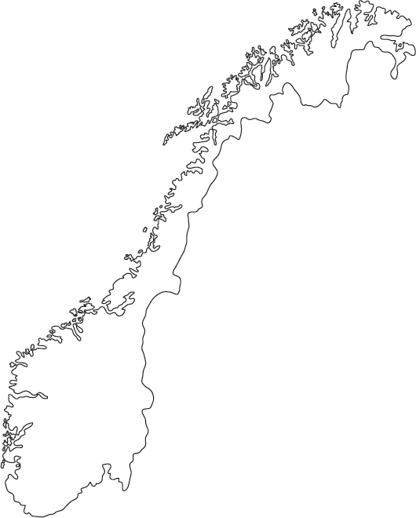
Norwegian Internet Use
97%
Use Internet
92%
Google
81%
Online Shop
Per quarter

Slide 2

Search Engine Optimization
Increased Web Traffic
Low Cost Option
NOK 126/Month

Slide 3



Targeting through Social Media
Focused Marketing
Retargeting
Targeting

Slide 4
Targeting through Social Media
Focused Marketing

Slide 5
Appendix: Current Given Financials
 | Total Revs | Total Costs | Total Profit
2015 | NOK 1,190,000,000 | - | -
2016 | NOK 1,380,000,000 | NOK 1,352,750,000 | NOK 27,250,000
Net Increase | NOK 190,000,000 | n/a | n/a
Total Clients | 2,000
Total Temps Employed | 8,000
Total Rev from Temp | NOK 1,242,000,000
# Temps | 8,000
Rev/Temp | NOK 155,250

Slide 6
Appendix: Total Financial Impact
 | 2017 Expected | 2018 Expected | 2019 Expected | 2020 Expected | 2021 Expected | 2022 Expected
Total Increase in # Temps Placed | 400 | 580 | 800 | 1,000 | 1,200 | 1,600
Rev/ Temp From Assumption | NOK 155,250 | NOK 155,250 | NOK 155,250 | NOK 155,250 | NOK 155,250 | NOK 155,250
Total Added Revenue | NOK 62,100,000 | NOK 90,045,000 | NOK 124,200,000 | NOK 155,250,000 | NOK 186,300,000 | NOK 248,400,000
Annual SEO Cost | NOK (1,512) | NOK (1,512) | NOK (1,512) | NOK (1,512) | NOK (1,512) | NOK (1,512)
Annual Targeting | NOK (919) | NOK (1,034) | NOK (1,149) | NOK (1,378) | NOK (1,838) | NOK (2,297)
Cost of CATS System | NOK (70,728) | NOK (66,528) | NOK (66,528) | NOK (66,528) | NOK (66,528) | NOK (66,528)
New Project Profits Before Taxes and Other Ops Costs | NOK 62,026,841 | NOK 89,975,926 | NOK 124,130,811 | NOK 155,180,582 | NOK 186,230,122 | NOK 248,329,663
Total Operational Cost Savings through ATS | NOK 13,527,500 | NOK 20,291,250 | NOK 23,673,125 | NOK 27,055,000 | NOK 33,818,750 | NOK 33,818,750
Total Income Increase (or Loss) | NOK 75,554,341 | NOK 110,267,176 | NOK 147,803,936 | NOK 182,235,582 | NOK 220,048,872 | NOK 282,148,413
Expected Addition to JobZone Bottom line | NOK 1,491,924 | NOK 2,177,377 | NOK 2,918,592 | NOK 3,598,492 | NOK 4,345,168 | NOK 5,571,409
NPV of Project | NOK 7,904,895
Profit CAGR | 3.79%
 | 2017 | 2018 | 2019 | 2020 | 2021 | 2022
Total Annual Profit | NOK 28,741,924 | NOK 29,427,377 | NOK 30,168,592 | NOK 30,848,492 | NOK 31,595,168 | NOK 32,821,409
Profit Growth | - | 2.38% | 2.52% | 2.25% | 2.42% | 3.88%

Slide 7
Appendix: SEO Provider Website Traffic Growth
 | Jan-17 | Feb-17 | Mar-17 | Apr-17 | May-17 | Jun-17 | Jul-17 | Aug-17 | Sep-17 | Oct-17 | Nov-17 | Dec-17
2017 User Growth if Implemented March | 0% | 0% | 0% | 1% | 1% | 2% | 5% | 5% | 5% | 5% | 5% | 5%
 | 2017 | 2018 | 2019 | 2020 | 2021 | 2022
Annual Expected Growth in Website Traffic | 2.83% | 5.12% | 6.17% | 6.70% | 7.23% | 7.50%

Slide 8
Appendix: SEO Provider Costs
Cost/Month | NOK 126
Number Months/ Year | 12
Annual Cost | (NOK 1,512)
 | 2017 | 2018 | 2019 | 2020 | 2021 | 2022
Total SEO Costs/Year | (NOK 1,512) | (NOK 1,512) | (NOK 1,512) | (NOK 1,512) | (NOK 1,512) | (NOK 1,512)

Slide 9
Appendix: SEO Providers Breakdown

Slide 10
Appendix: Targeting Costs
 | 2017 | 2018 | 2019 | 2020 | 2021 | 2022
Expected Number of Clicks | 400 | 450 | 500 | 600 | 800 | 1000
Cost Per Click | NOK 2.30 | NOK 2.30 | NOK 2.30 | NOK 2.30 | NOK 2.30 | NOK 2.30
Total Cost | (NOK 919) | (NOK 1,034) | (NOK 1,149) | (NOK 1,378) | (NOK 1,838) | (NOK 2,297)

Slide 11
Appendix: CATS System Costs
Total Number of Employees | 150
# Employees Using System | 100
Expected Price/Employee/Month | NOK 832
Expected Discount | 20%
New Price/Employee/Month | NOK 665
Cost of CATS System | (NOK 66,528)
Implemenation Cost | (NOK 4,200)
Total Cost | (NOK 70,728)
 | 2017 | 2018 | 2019 | 2020 | 2021 | 2022
Total Cost/Year | (NOK 70,728) | (NOK 66,528) | (NOK 66,528) | (NOK 66,528) | (NOK 66,528) | (NOK 66,528)

