Slide 1
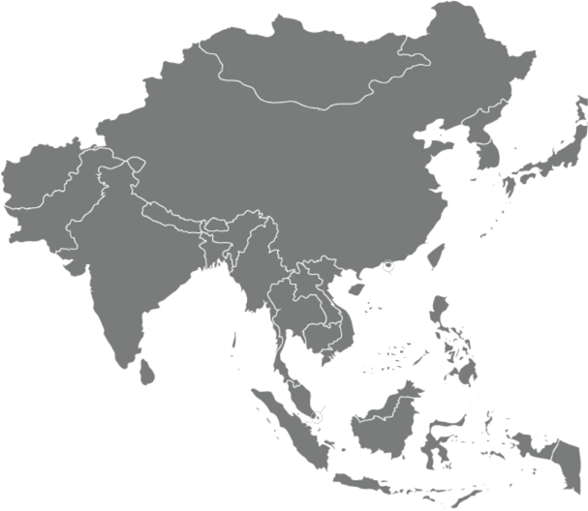
Targeting the Asian Paint Market
Significant Growth in Coatings Market
Extremely Fragmented Market
$52.9bn
$84.4bn
50%
Top 20 Market Share in Asia. Remaining are local manufacturers.
(2015)
(2018)
Asian Paint sales are expected to grow 1.9 times in terms of volume by 2018.
Current Market Share in Asia
Potential Increase in Market Share by 2018
2.4%
Corresponding to $1.3 billion in sales in the entire region.
2.1^{X}
Increase, attributing to $2.1 billion in revenues from increased presence

Slide 2
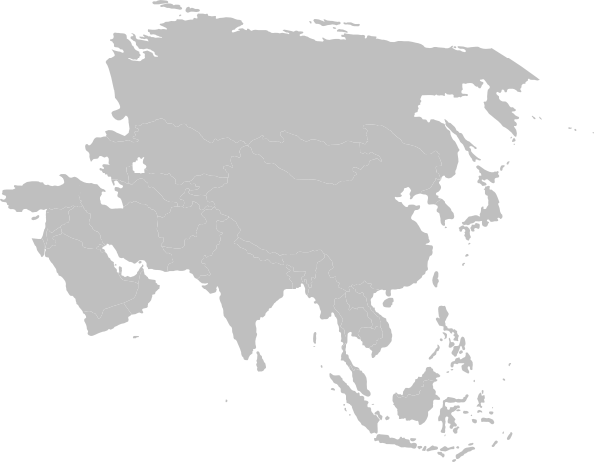
Successful Growth Through Product Segments
Powders
Market: 4.7 bn
Automotive
Market: 3.0 bn

Slide 3
Successful Growth Through Product Segments
Powders
Capture: $1.4 bn
Automotives

Slide 4
Successful Growth Through Product Segments
Powders
Automotives
Capture: $.692 bn

Slide 5
Successful Growth Through Product Segments
Powders
Capture: $1.4 bn
Automotives
Capture: $.692 bn

Slide 6
Appendix: Current Market Assumptions
 | Total Paint & Coating Market | Asian Market | Jotun Targeted Market | Total Jotun Sales | Total Jotun Market Share Asia | Percentage of Asian Market
 | $126,000,000,000 | $52,920,000,000 | $75,000,000,000 | $3,000,000,000 | $1,260,000,000 | 2.38%
Powder (8%) | $10,080,000,000 | $4,233,600,000 | $4,233,600,000 | $302,400,000 | $37,800,000 | 0.89%
Automotive (7%) | $8,820,000,000 | $3,704,400,000 | $- | $- | $- | 0%

Slide 7
Appendix: Asian Market Share Captured
Projected Asian Market 2020 | Top 20 Market Share | Total Market Opportunity | Total Projected Sales Captured | Jotun Captured Share
$84,465,000,000 | $42,232,500,000 | $42,232,500,000 | $2,111,625,000 | 5%
 | Powders (8%)+40% growth in segment | $4,730,040,000 | $1,419,012,000 | 30%
 | Auto (7%) | $2,956,275,000 | $692,613,000 | 23%

Slide 8
Appendix: Market Share and Multiples
Total World Market 2020 | Asian Market | Jotun Targeted Market (including Auto) | Total Projected Sales Captured | New Market Share
$141,000,000,000 | $84,465,000,000 | $93,798,571,429 | $4,001,625,000 | 4.27%
 |  |  | Total Jotun Increase in Market share | 1.07
 |  |  | Total Jotun Increase in Market Share-Asia | 2.10
Assumptions | 50% market share because top 10 hold 25%
 | Will Capture 4 % of market through push in powders
 | Powders Expected Growth of 40%
 | Large Expected Capture of Auto segment due to lots of technological advantages that Jotun's decorative tech can bring to auto and because auto paint segment is heavily fragmented in Asia
 | Total Global Paint market to hit 141 billion in 2018
 | Total Asian Paint Market will be 84 billion in 2018
 | Expected 5% growth in overall world wide sales
 | *All projections are based on 2018 projections to be conservative

Slide 9
Appendix: New Factories Needed
 | Total Revenues Jotun | Total # Factories | Avg. Rev/Factory
2015 | $3,000,000,000 | 32 | $93,750,000
2020 | $4,001,625,000 | 43 | $93,750,000
Total Increase | $1,001,625,000 | 11 | -

Slide 10
Appendix: Added Profit
 | Cost | Added # Factories | Total
Average Cost of Factories in Asia | $50,000,000 | 11 | $(534,200,000)
Operating Cost Margin (30%)* |  |  | $(300,487,500)
Net Increase In Revenues |  |  | $1,001,625,000
Net Profit |  |  | $233,712,500
Net Added Profit |  |  | $233,712,500
Current Profit |  |  | $233,000,000
New Expected Profit |  |  | $466,712,500
Assumptions | Cost of building factory in Asia based on old factory costs for Jotun
 | Operating Costs in Asia are lower than rest of world

