Slide 1
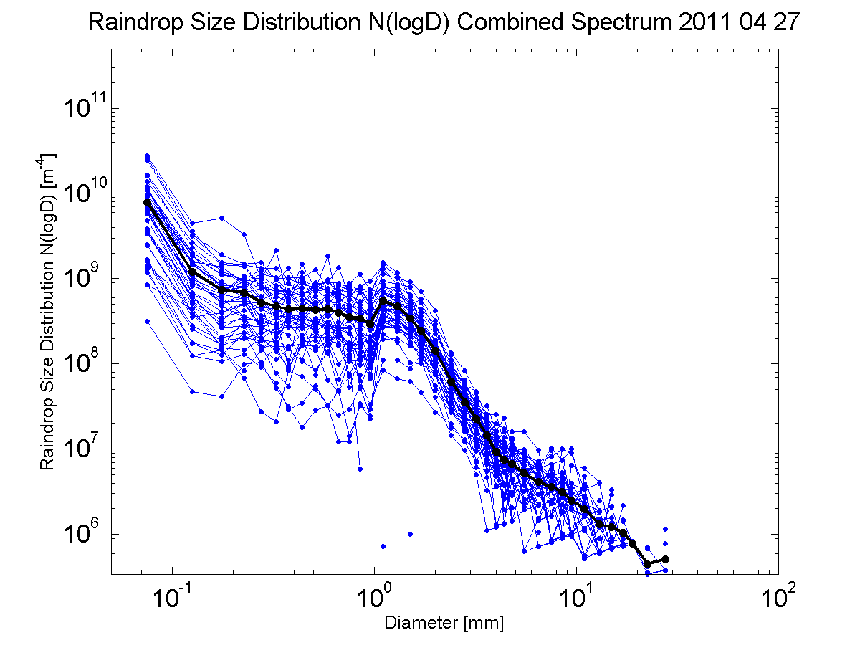
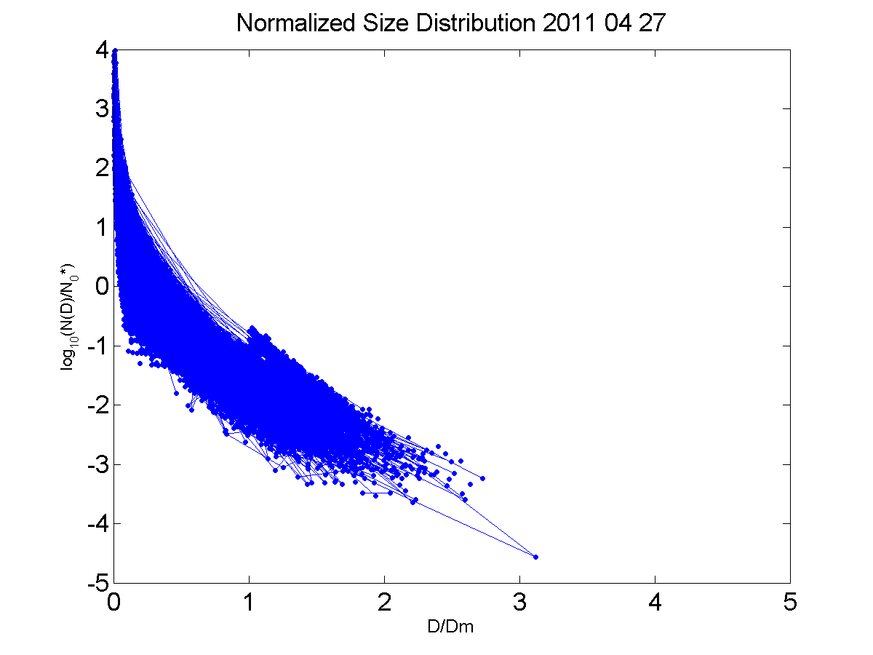

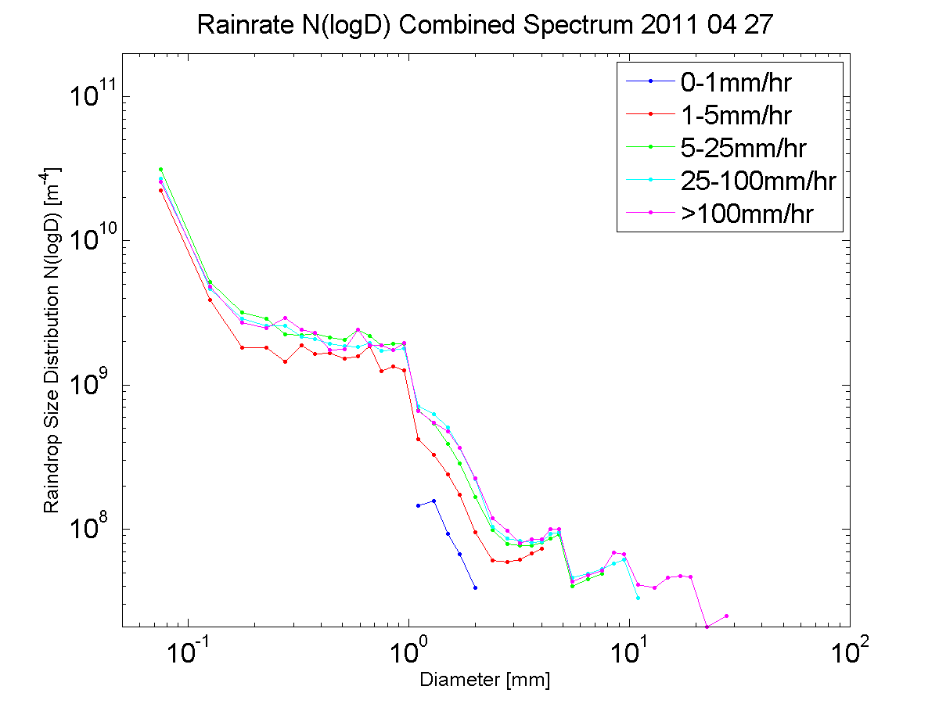
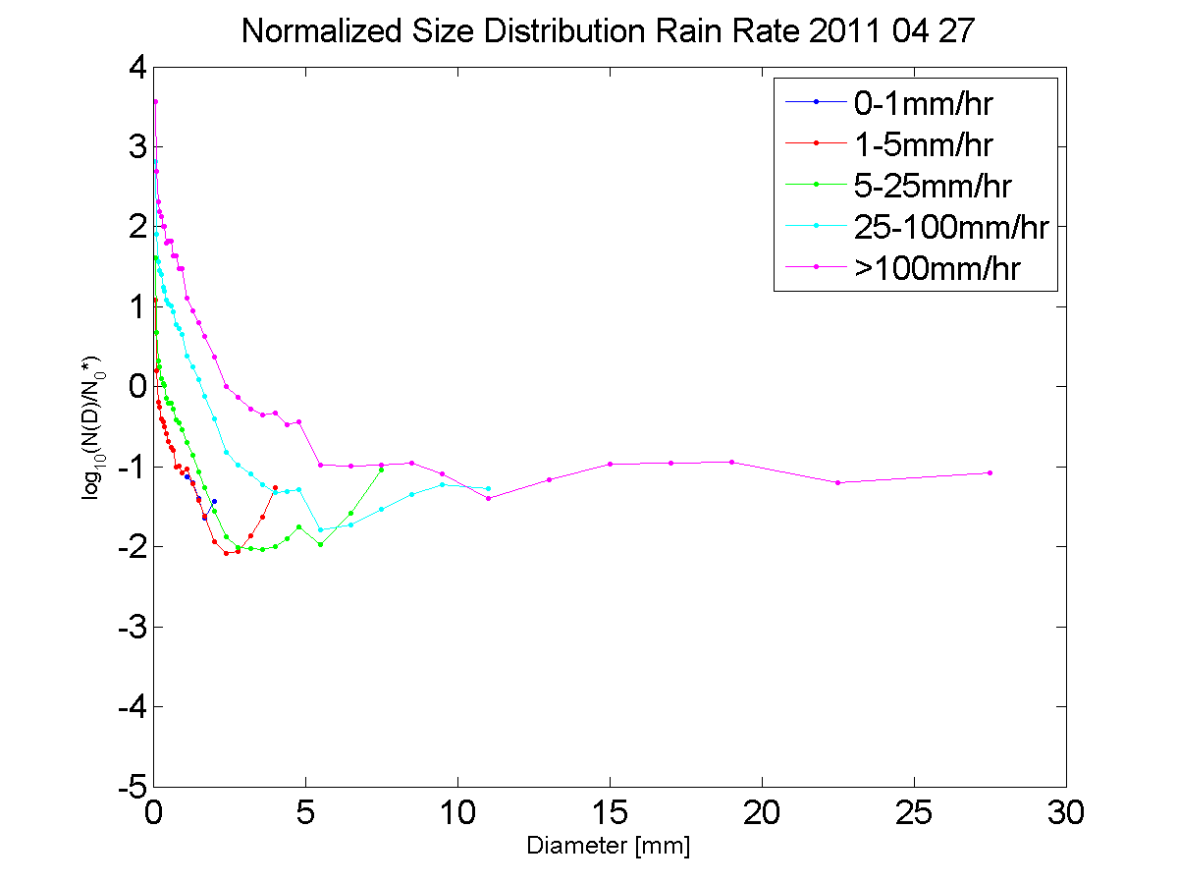
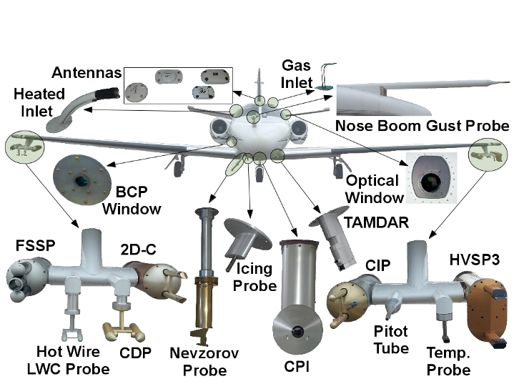
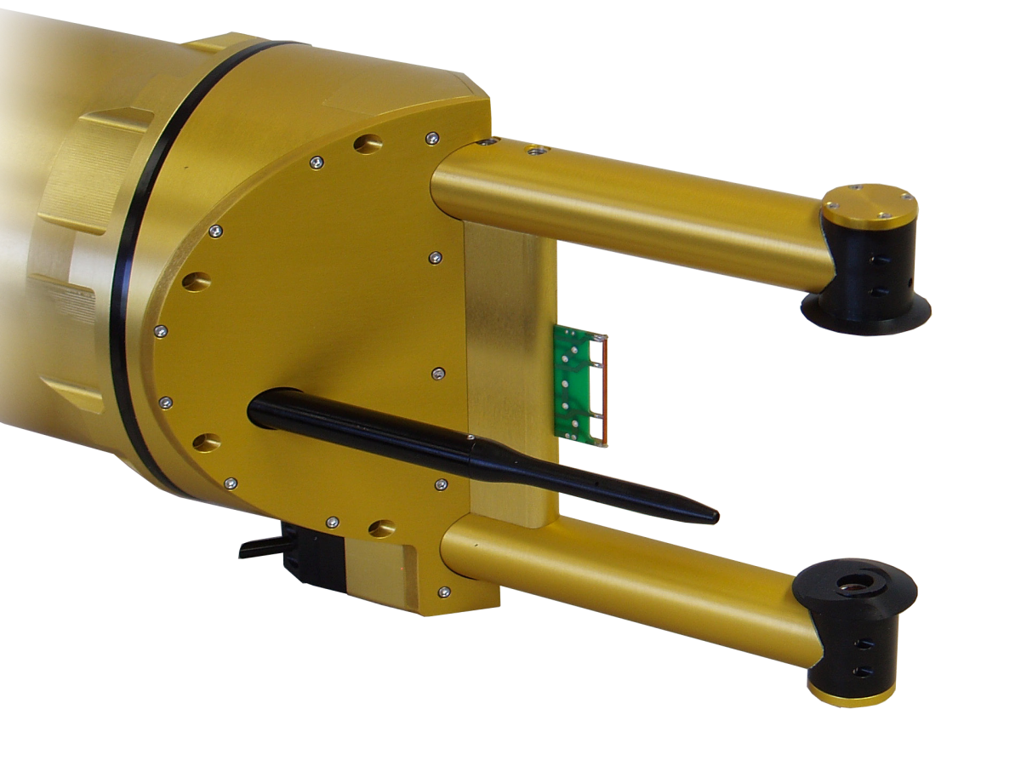




Analysis of Raindrop Size Distributions Measured During the Mid-latitude Continental Convective Clouds Experiment
Casey Pham, Greg M. McFarquhar, Aaron Barnsermer, Andrew Heymsfield
Motivation
Explore the shapes of raindrop size distributions in mid-latitude convective clouds
Data from the Mid-latitude Continental Convective Clouds Experiment (MC3E), processed by the National Center for Atmospheric Research (NCAR)
How do raindrop size distributions vary with rain rate?
Can raindrop size distributions be normalized?
Data
Cloud Imaging Probe (CIP)
30-920 μm
Two-Dimensional Optical Array Cloud Imaging Probe (2DC)
25 μm-1.6mm
High Volume Precipitation Spectrometer (HVPS)
150 μm-1.9cm
Probe measurements processed by the National Center for Atmospheric Research to generate composite number distribution functions
Combined Spectrum: merges data from the 2DC, or CIP when 2DC measurements are not present, with the HVPS
Range: 50μm to 3mm
Resolution: 1s
Plots
MC3E
UND Citation
Photo Credit : Mike Jensen
Methods
MATLAB Programming Language
Restrict data to greater than 0° Celsius to capture only raindrops
Calculate rain rate based of size distributions
Terminal Velocity
Rain Rate
Normalization using methods from Testud et al. (2000)
Liquid Water Content
Mean Volume Diameter
Scaling Parameter
CIP
May 20, 2011
Conclusions
Raindrop size distributions do appear to vary with rain rate.
High rain rates have not only higher concentrations, but also larger drop sizes
Normalization of raindrop size distributions can be applied to data from MC3E
Future Work
Acknowledgements

