Slide 1
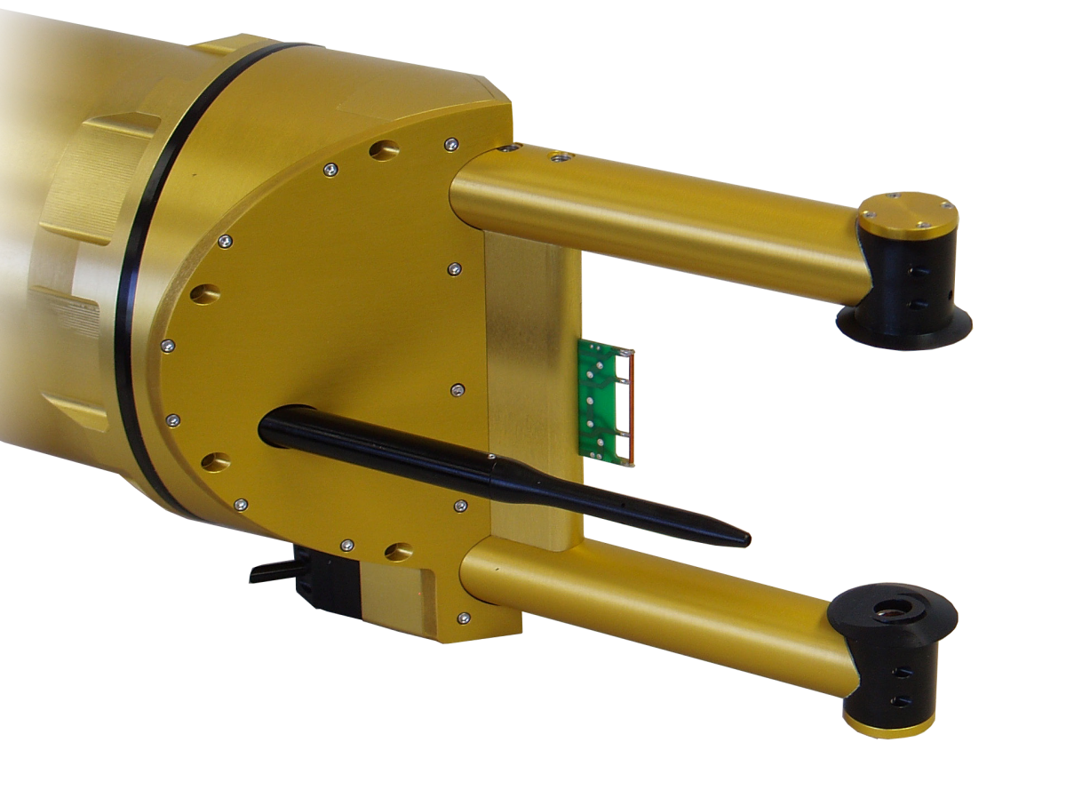
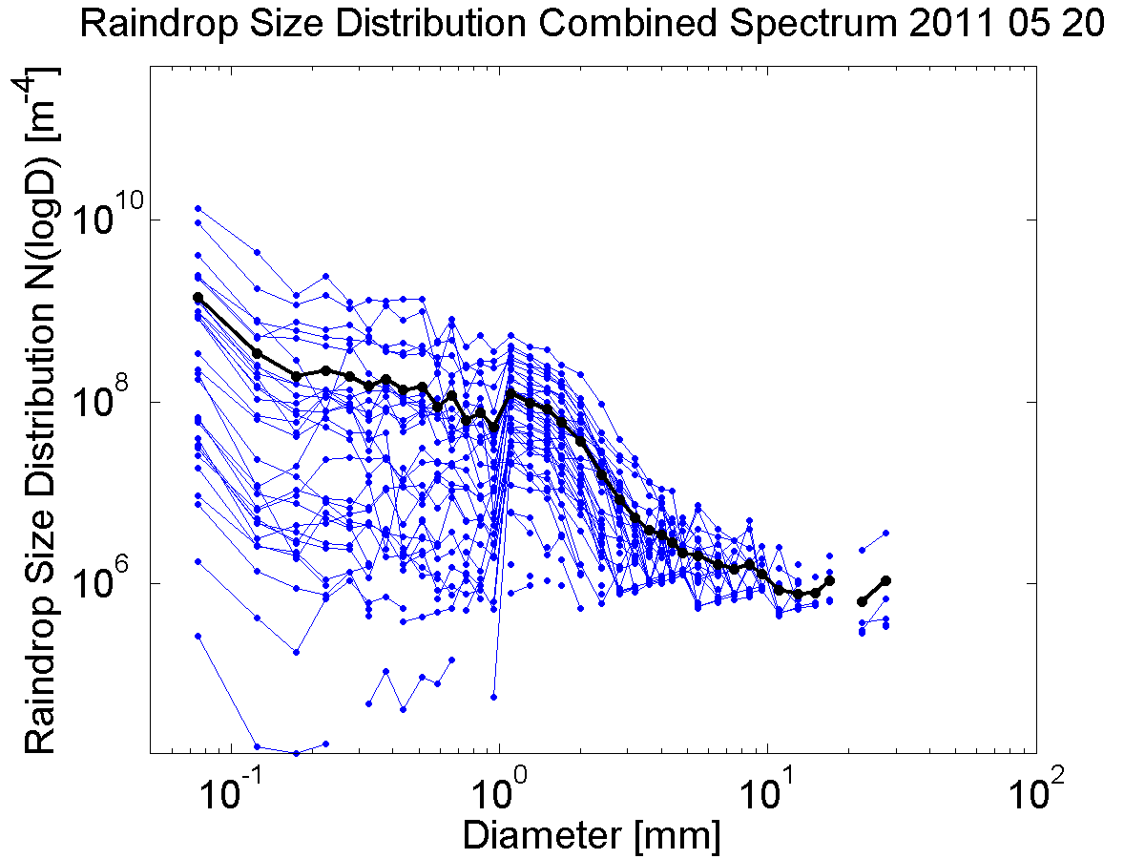
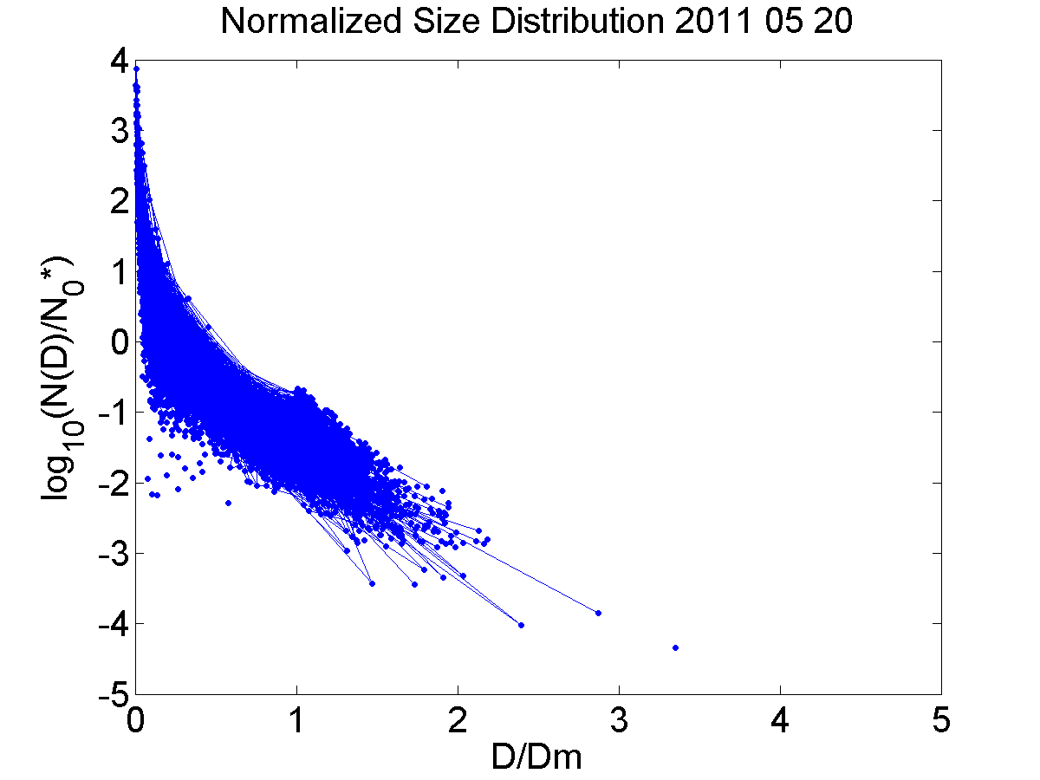
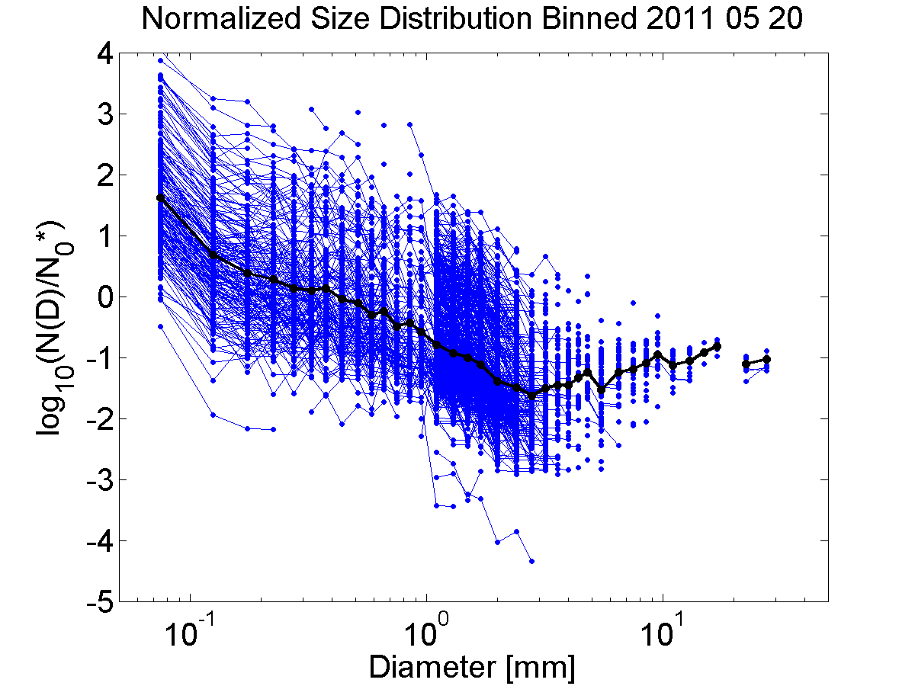

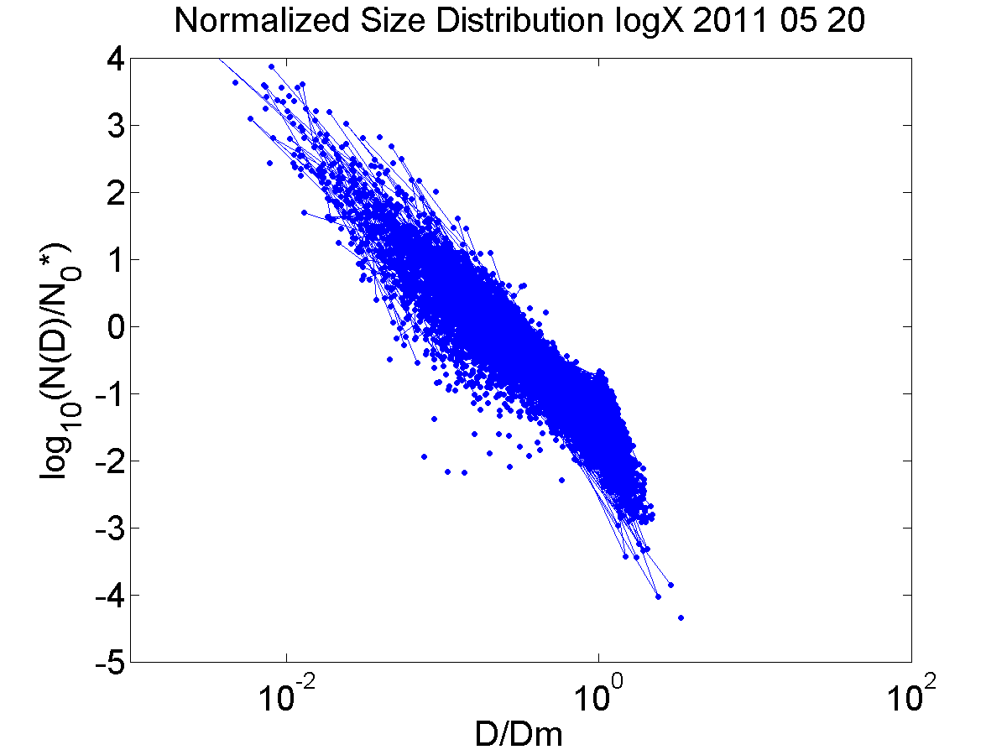


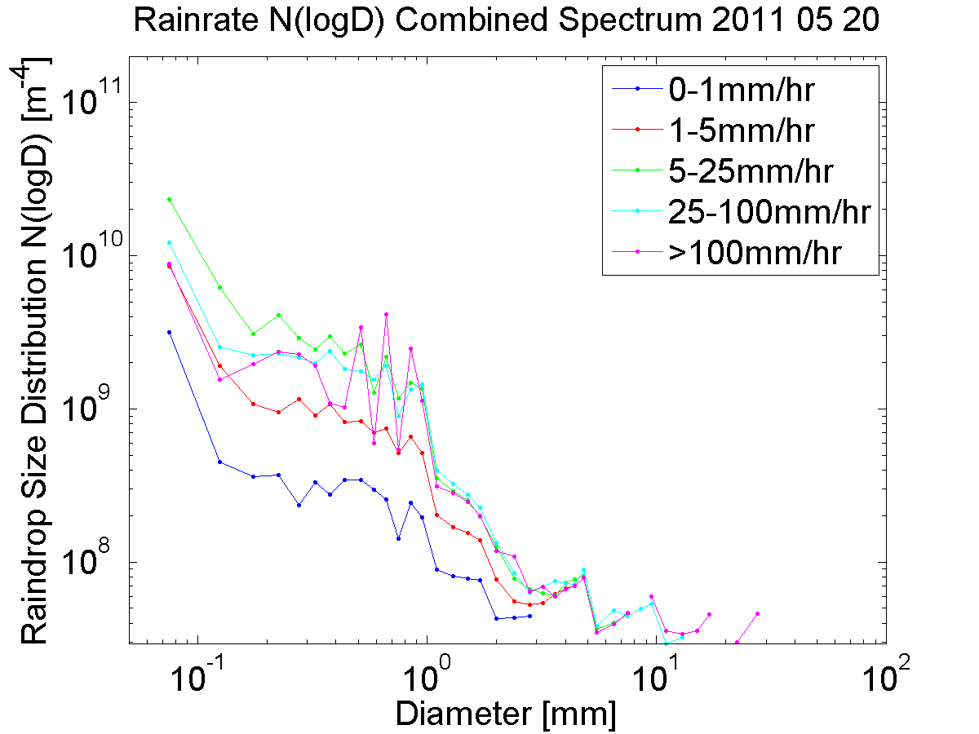
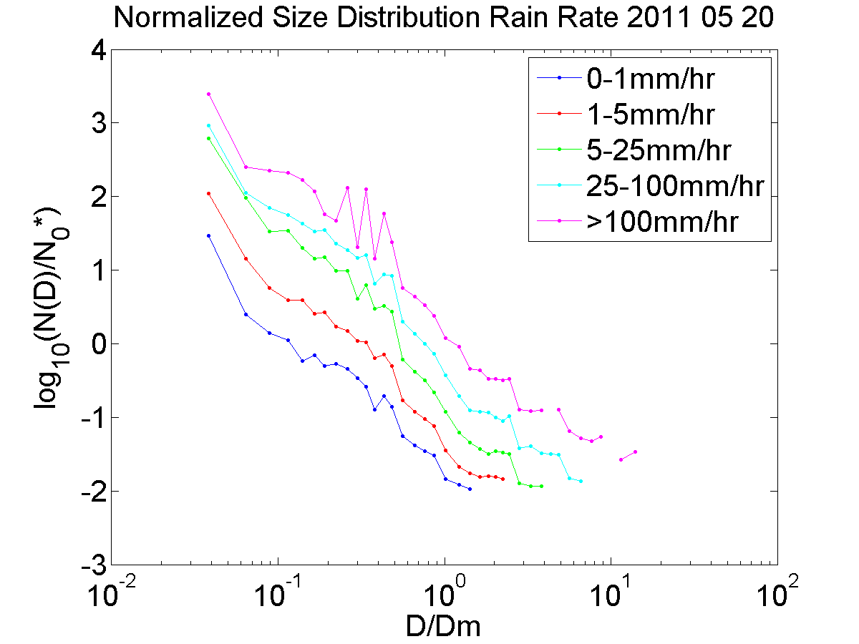
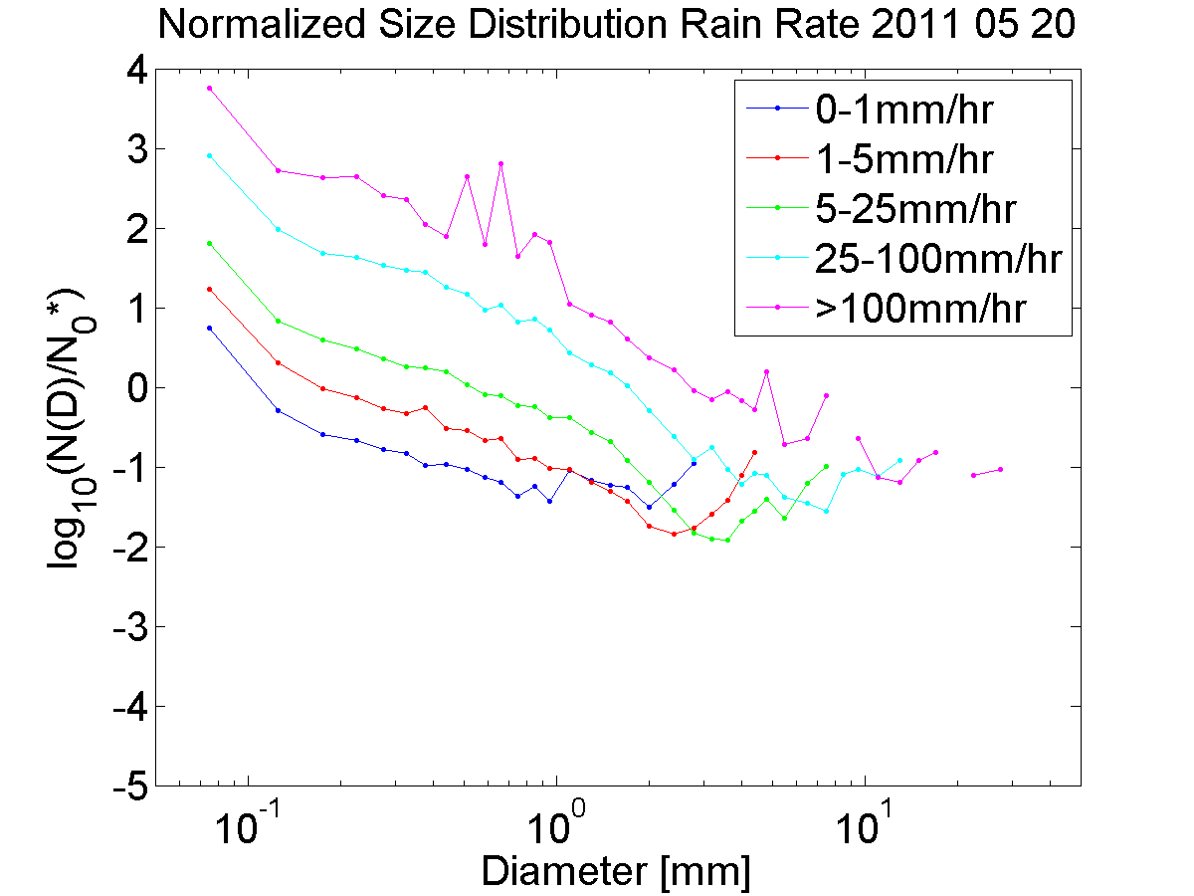




Analysis of Raindrop Size Distributions Measured During the Mid-latitude Continental Convective Clouds Experiment
Casey Pham¹ and Greg M. McFarquhar^{1,2}, Aaron Barnsemer², Andrew Heymsfield²,
¹University of Illinois, Urbana, IL ²National Center for Atmospheric Research, Boulder, CO
Motivation
Explore shapes of raindrop size distributions in mid-latitude convective clouds
Use data collected by cloud probes during Mid-latitude Continental Convective Clouds Experiment (MC3E)
How do raindrop size distributions vary with rain rate?
Is shape of raindrop size distributions invariant when normalized?
Data
Cloud Imaging Probe (CIP)
Measures particles with maximum dimension (D) between 30 and 920 μm
Two-Dimensional Cloud Imaging Probe (2DC)
25 μm-1.6mm
High Volume Precipitation Spectrometer (HVPS)
150 μm-1.9cm
Probe data processed at National Center for Atmospheric Research to generate size distributions covering all particle sizes, merging data from the 2DC (or CIP when 2DC measurements are not available) and HVPS using 1 mm dimension to transition between probes
Range: 50μm to 3mm
Resolution: 1s
Analysis
MC3E
Size distributions plotted using N(logD) to better see any peaks in size distribution
Peak at D=1 mm may be associated with transition between probes; no other prominent peaks
Normalized distributions obtained by as N(D)/N0*
Working to determine if normalized size distributions have invariant shape
Photo Credit : Mike Jensen
Methods
Analyze data with temperatures greater than 5° C to include only raindrops
Calculate rain rate of size distributions
Terminal Velocity
Normalization scaling parameter as outlined by Testud et al. (2000)
Liquid Water Content
Mean Volume Diameter
Plot normalized size distributions by dividing size distribution N(D) by N0*, against normalized diameter D/Dm.
Fig. 1: University of North Dakota Cessna Citation II Research Aircraft used for flights
20 May 2011
Some variation in size distribution with rain rate, but less so at higher rain rates.
Can see much clearer variation in size distributions, with higher rain rates having higher concentrations and larger drops.
Conclusions
Normalized raindrop size distributions do appear to vary with rain rate.
High rain rates have not only higher concentrations, but also larger drop sizes
Normalization of raindrop size distributions can be applied to data from MC3E
Future Work
Examine contribution of other environmental factors to size distributions.
Investigate variation in normalized size distributions between flights.
Determine if normalized size distributions have invariant shape and can be characterized.
Acknowledgements
Fig.2: Flight track from 20 May, 2011

