Slide 1
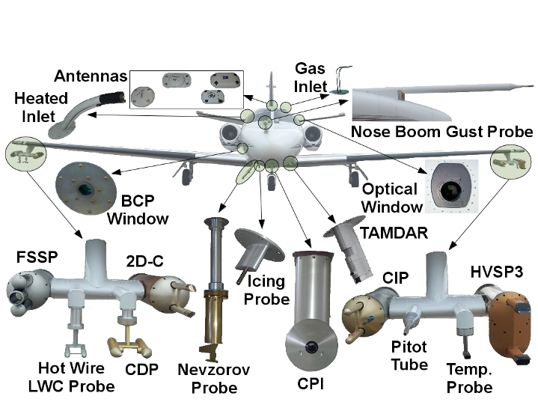
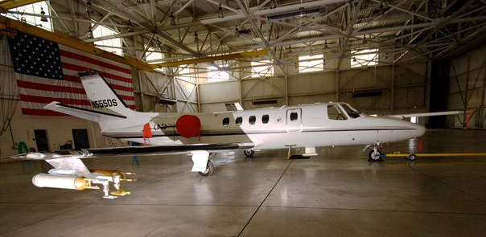
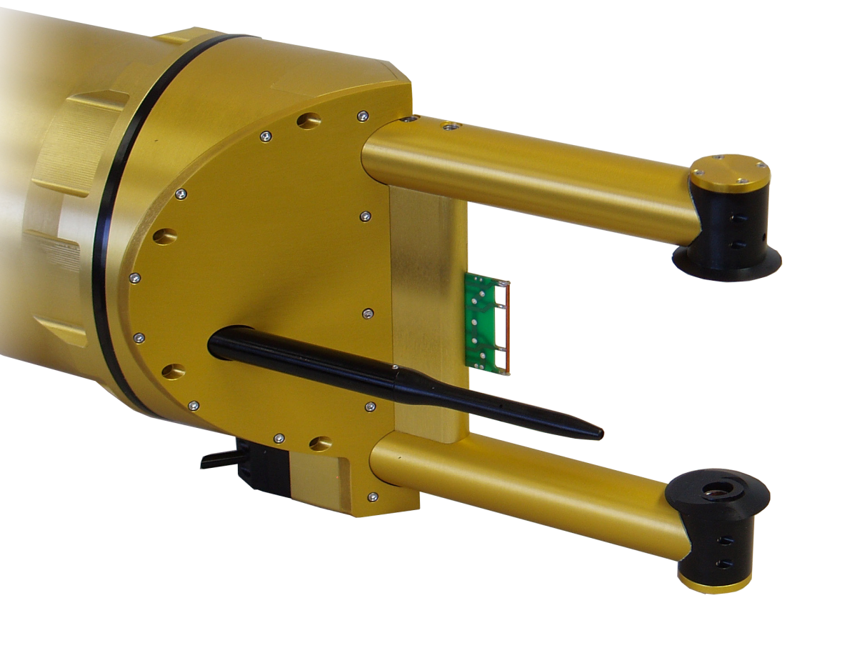
Cloud Probes for MC3E
UND Citation
Sampled 12 convective storms, include fronts, squall lines and Mesoscale Convective Systems (MCS)
CIP
I
Photo Credit : Mike Jensen
Probes | Resolution | Diode Number | Measuring Ranges | Anti-shattering Tips
2D-C | 30 μm | 32 | 30– 920 μm | Yes
CIP | 25 μm | 64 | 25– 1600 μm | No
HVPS3 | 150 μm | 128 | 150 – 19,200 μm | Yes
CPI (Last 7 flights only ) | 2.3 μm | - | - | -

