Slide 1
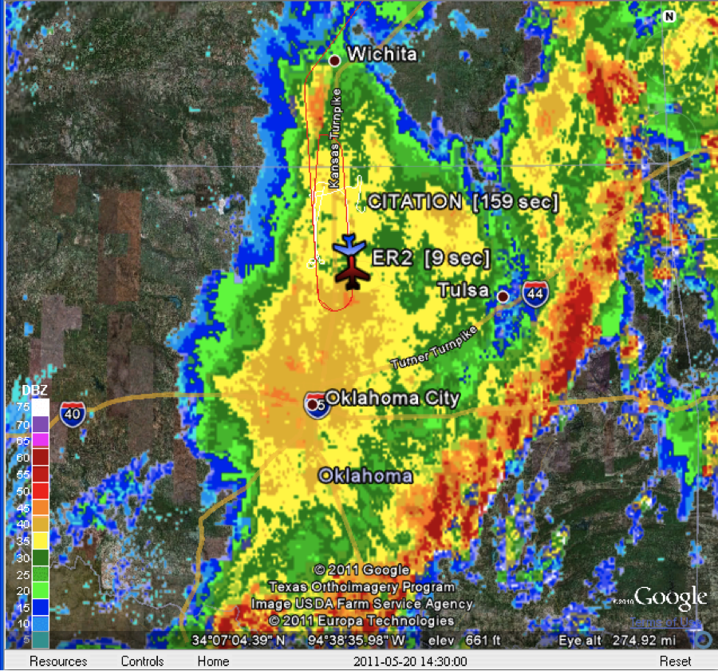
May 20 Case MC3E case

