Slide 1
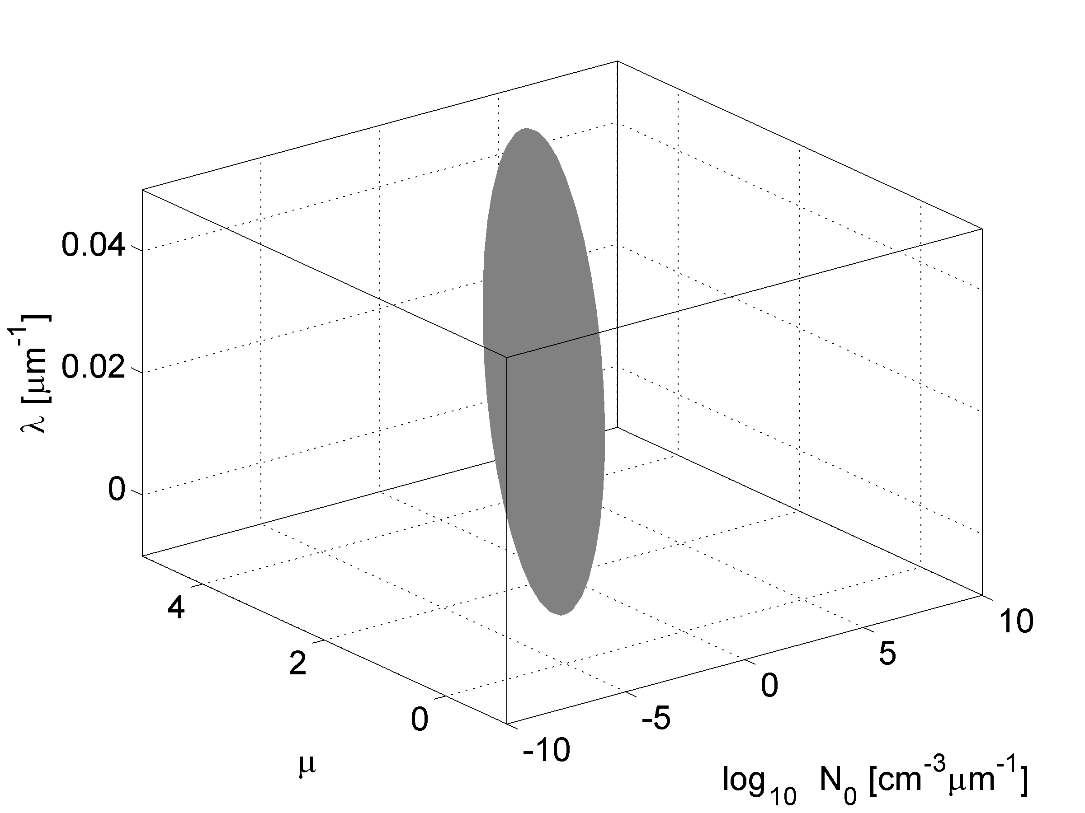
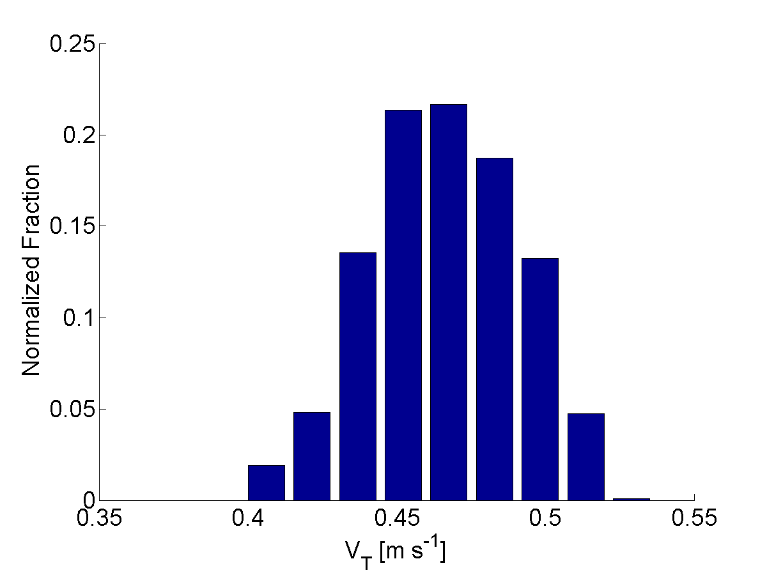
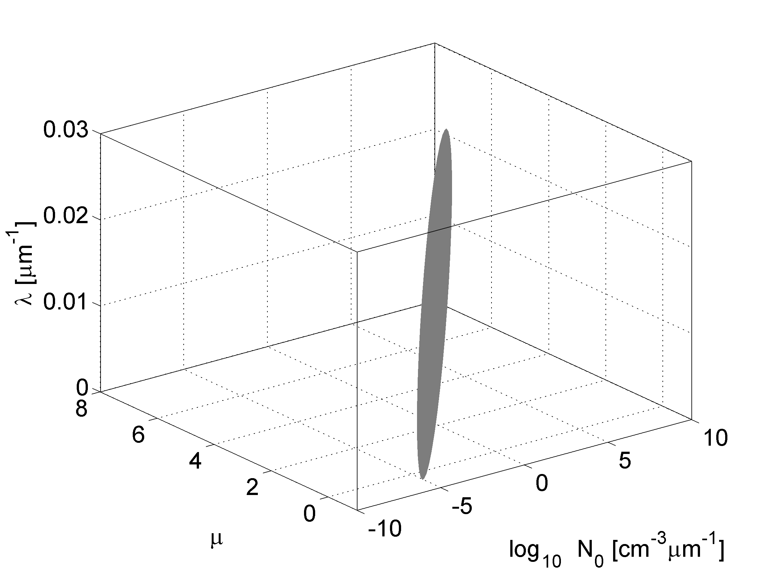
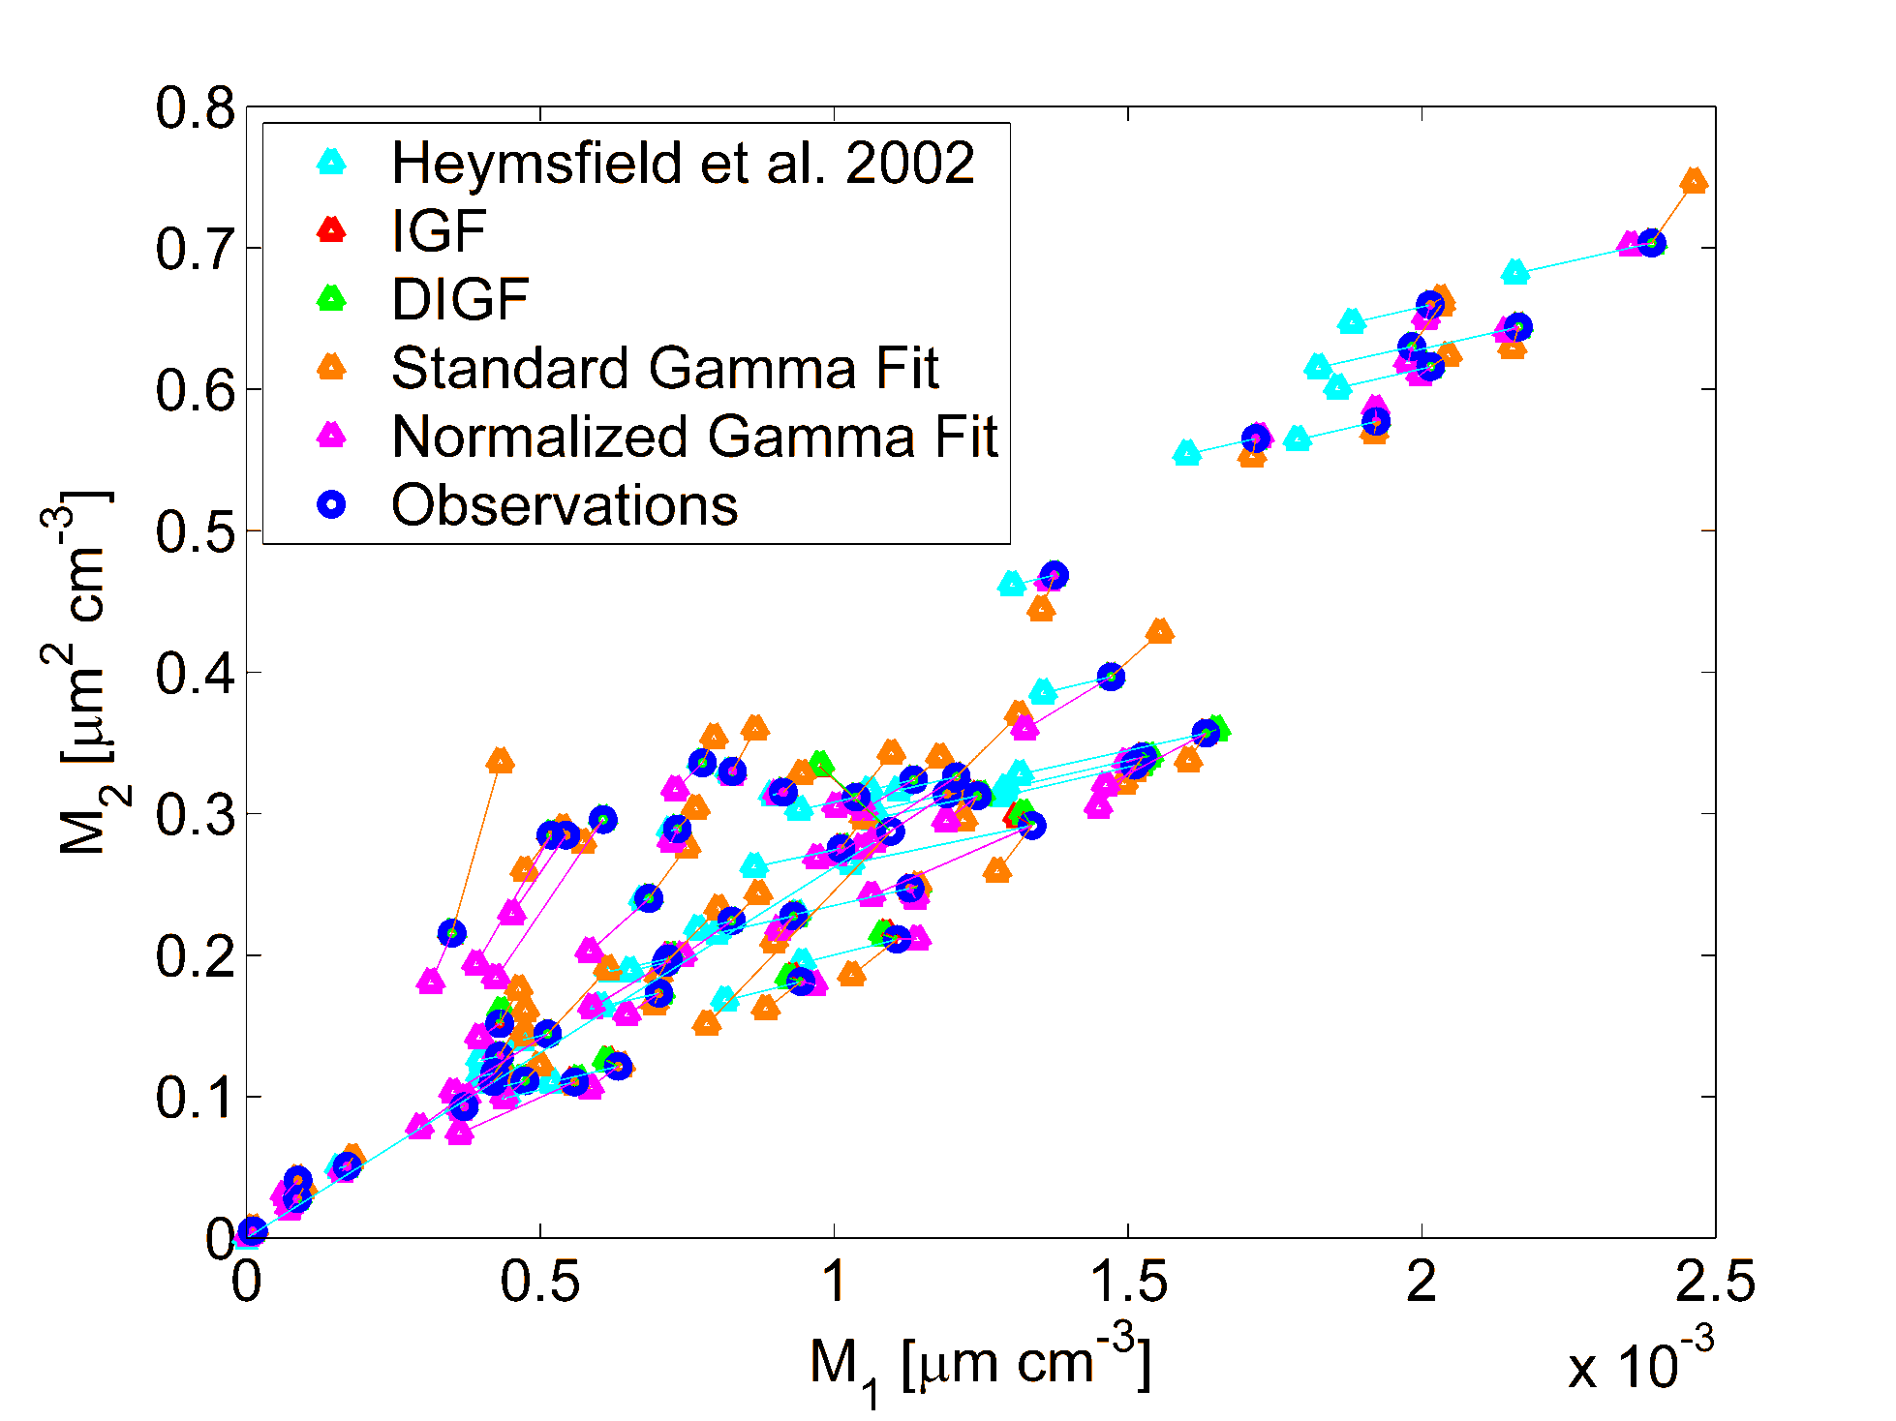
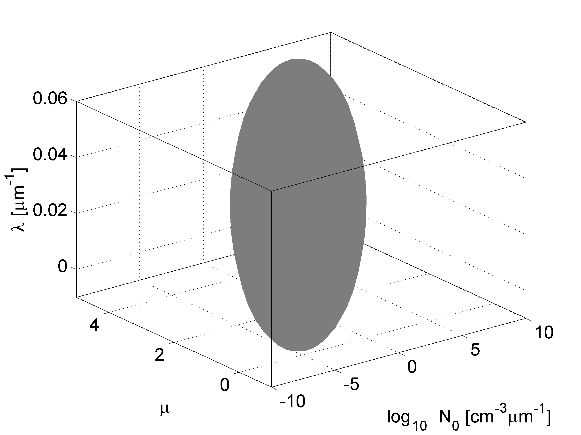
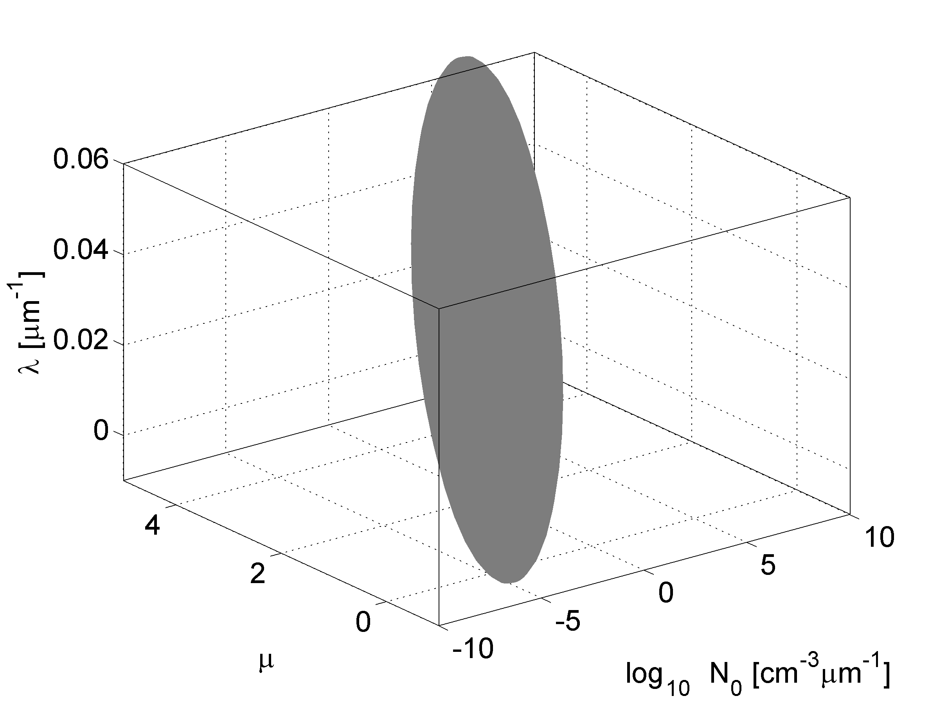
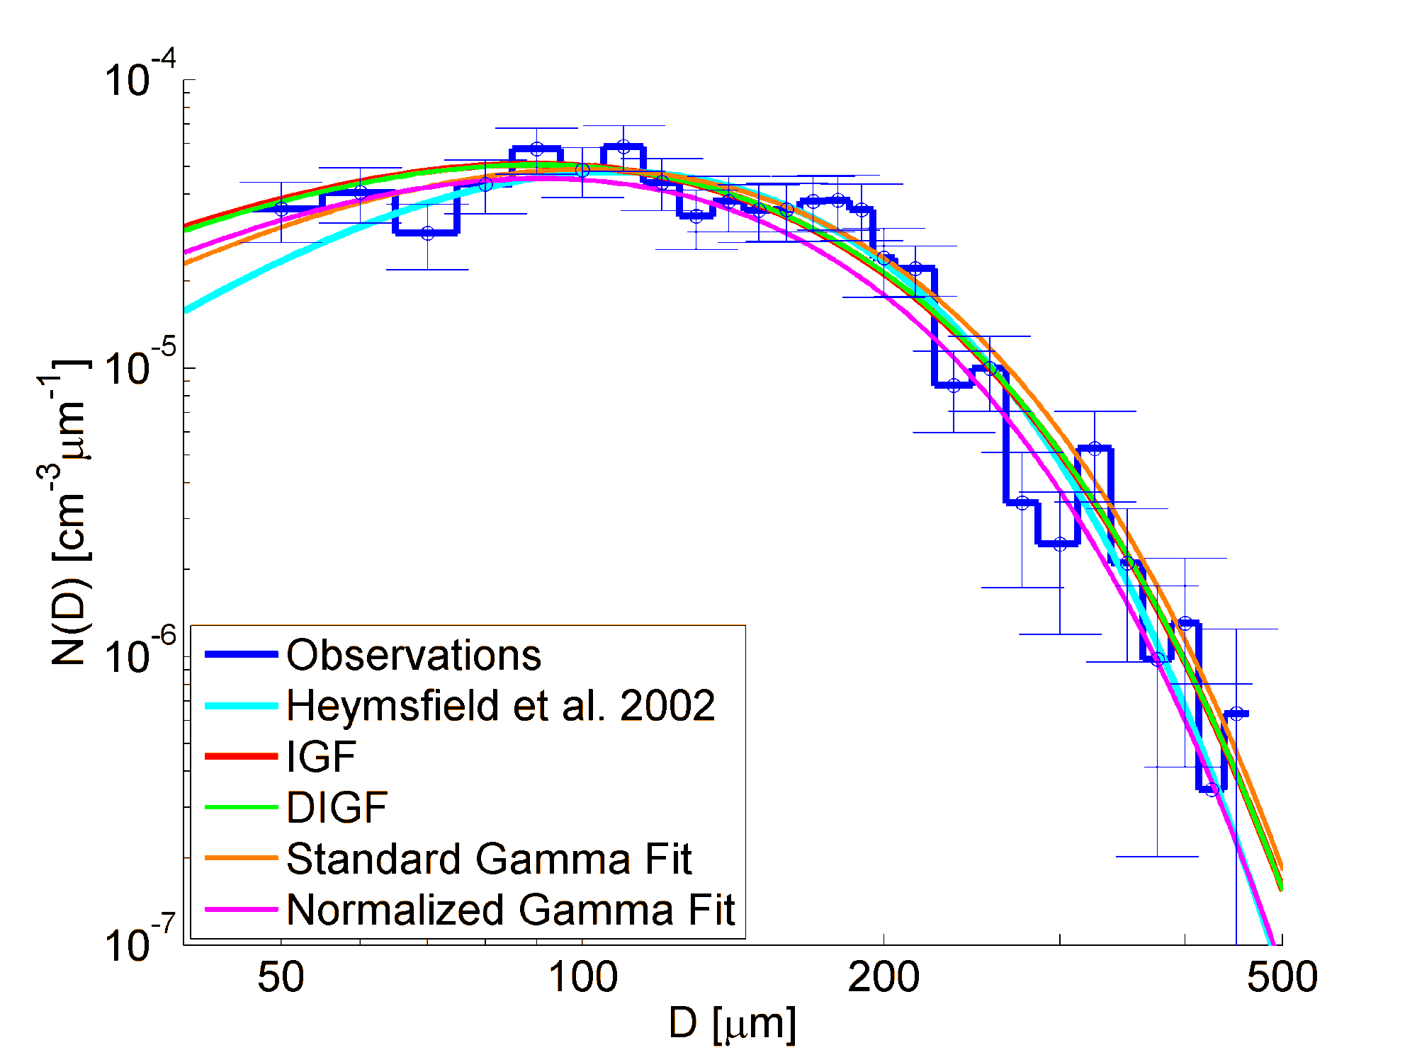
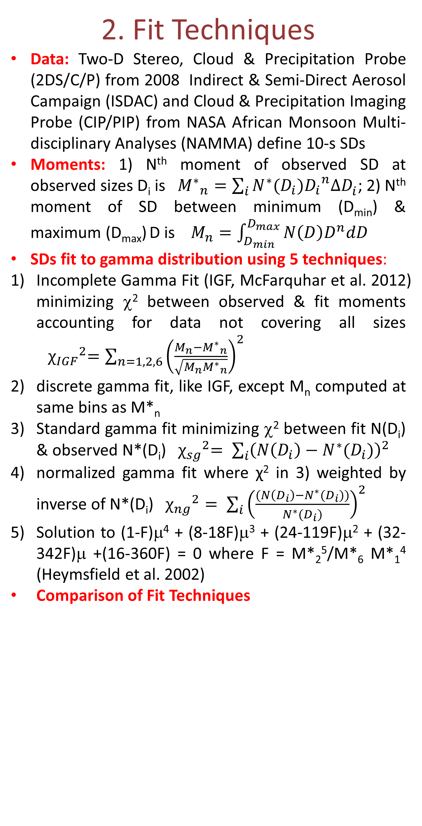
The Characterization of Hydrometeor Gamma Size Distributions as Volumes in N₀/μ/λ Phase Space: Implications for Microphysical Process Modeling
Greg M. McFarquhar¹, Tsung-Lin Hsieh¹, Matt Freer^{1,2}, Jeana Mascio^{1,3}, and Brian F. Jewett¹
¹University of Illinois ²Now at DMT, ³Now at University of Utah
1. Motivation
Size distributions (SDs) parameterized in model schemes as gamma functions N(D) = N₀ (D/D₀)^{μ} e^{-λD} where D₀ is a constant, assumed to be 1 cm
N(D) # distribution; D dimension; N₀ μ λ fit parameters
N₀/λ/μ determined from model-predicted moments or assumptions based on SDs measured in-situ
In order to ultimately determine how in-situ N₀/λ/μ vary with meteorology, we need to investigate:
How accurately N₀/λ/μ can be determined from in-situ data?
How uncertainties in N₀/λ/μ affect model process rates?
3. Volumes in N₀/μ/λ Phase Space
2. Fit Techniques
Data: Two-D Stereo, Cloud & Precipitation Probe (2DS/C/P) from 2008 Indirect & Semi-Direct Aerosol Campaign (ISDAC) and Cloud & Precipitation Imaging Probe (CIP/PIP) from NASA African Monsoon Multi-disciplinary Analyses (NAMMA) define 10-s SDs
Moments: 1) N^{th} moment of observed SD at observed sizes D_{i} is ${M^{∗}}_{n}=\sum_{i}{N^{∗}(D_{i}){D_{i}}^{n}∆D_{i}^{}}$; 2) N^{th} moment of SD between minimum (D_{min}) & maximum (D_{max}) D is $M_{n}=\int_{D_{min}}^{D_{max}}{N\left(D\right)D^{n}dD}$
SDs fit to gamma distribution using 5 techniques:
Incomplete Gamma Fit (IGF, McFarquhar et al. 2012) minimizing χ² between observed & fit moments accounting for data not covering all sizes ${ χ_{IGF}}^{2}=\sum_{n=1,2,6}{{\left(\frac{M_{n}−{M^{∗}}_{n}}{\sqrt{M_{n}{M^{∗}}_{n}}}\right)}^{2}}$
discrete gamma fit, like IGF, except M_{n} computed at same bins as M*_{n}
Standard gamma fit minimizing χ² between fit N(D_{i}) & observed N*(D_{i}) ${ χ_{sg}}^{2}= \sum_{i}{{\left(N\left(D_{i}\right)−N^{∗}(D_{i})\right)}^{2}}$
normalized gamma fit where χ² in 3) weighted by inverse of N*(D_{i}) ${χ_{ng}}^{2}= \sum_{i}{{\left(\frac{(N\left(D_{i}\right)−N^{∗}(D_{i}))}{N^{∗}(D_{i})}\right)}^{2}}$
Solution to (1-F)μ⁴ + (8-18F)μ³ + (24-119F)μ² + (32-342F)μ +(16-360F) = 0 where F = M*₂⁵/M*₆ M*₁⁴ (Heymsfield et al. 2002)
Comparison of Fit Techniques
Fig. 2: Volume of equally realizable solutions in (N₀, μ, λ) phase space text for SD depicted in Fig. 1.
Fig. 4: Normalized frequency distribution of mass-weighted fall speed, V_{q}, using N₀/λ/μ randomly selected from surface in Fig. 2; there is ~10% variation in V_{q} depending on N₀/λ/μ selected
Fig. 3: As in Fig. 2; except for SD measured during NAMMA
Fig. 5: Comparison of observed & simulated moments for NAMMA SDs; IGF best matches observed moments
4. Characterizing Families of SDs
Fig. 6
Fig. 7
Fig. 8
Fig. 6 (left) and 7 (right): Ellipsoids characterizing ISDAC (left) and NAMMA (right) SDs include all points included within 1% of individual SD ellipses: eigenvectors & eigenvalues of Hessian matrix allow use of these volumes in numerical models. Need to determine how ellipsoids vary with cloud and environmental parameters. Reasons for differences between ISDAC and NAMMA volumes currently being investigated.
5. Conclusions
IGF technique accounting for fact in-situ data does not cover all particle sizes gives better estimate of bulk observed moments than other techniques.
Volume of N₀/λ/μ values, determined from uncertainty of observed SDs, characterizes fit to each SD and gives mutual dependence of fit parameters.
Uncertainty of about 10% in V_{q} seen from uncertainty in of N₀/λ/μ.
Currently using these techniques to investigate how SD parameters vary with cloud and environmental parameters.
Fig. 1: SD derived from 2DS, 2DC & 2DP data for 10-s period during ISDAC with best fit for all 5 techniques.
Visually 5 fits appear similar
But, there is huge range in N₀/λ/μ
IGF: N₀=4.9x10⁰ cm⁻³ μm⁻¹, μ = 2.0; λ = 2.2x10⁻¹ μm⁻¹
H02: N₀=1.1x10⁻³ cm⁻³ μm⁻¹, μ = 3.1;λ = 2.8x10⁻² μm⁻¹
Can’t represent SD by single N₀/λ/μ; need ranges
Develop volumes which give all N₀/λ/μ with χ² < χ_{min}² + Δχ², which are equally realizable solutions
Δχ² determined from uncertainties in SDs & Jakobian of χ² derived from fit
Acknowledgements: This work was supported by grant DE-SC0001279 through the Department of Energy (DOE) Atmospheric Systems Research Program and by grant NNX09AB82G from the NASA Hurricane Science Research Program. Data were obtained by the DOE Atmospheric Radiation Measurement Program (ARM) archive.

