Slide 1



Unraveling the Web of Deception
Fake News Detection Using ML & DL

Slide 2
Fake News?
Fake news refers to intentionally fabricated or misleading information presented as genuine news.
It often includes false statements, misleading headlines or altered images and videos designed to deceive readers or viewers.

Slide 3

The Importance of Detecting Fake News
1
Seperating fact from fiction🗳️
2
Manipulation of public opinion🚫
Helps to make informed decisions by distinguishing between trustworthy and unreliable content.
Preventing the spread of misinformation that can lead to harm and injustice.
3
Protect Credibility⚖️
Maintaining the credibility of reliable news sources and preventing the spread of fake ones.

Slide 4
Fake news detector
Why we chose this?
A fake news detection model is a system designed to identify and classify misinformation, hoaxes or fabricated information within news articles, social media posts, or other forms of online content.
It employs various techniques from natural language processing, machine learning, and data analysis to assess the credibility and accuracy of the information presented.
Real World Application
Technological Interest
Addressing Misinformation
Enhancing Media Literacy

Slide 5
Features for Detection
Social Network Analysis
Examining the patterns of information spread on social networks can reveal the origins of fake news and its spread.
1
2
3
Natural Language Processing
Source Credibility
Using machine learning algorithms to analyze the language and writing style of articles can help identify patterns indicative of fake news.
Measuring the used sources credibility through reputation analysis and fact-checking can provide a means for flagging potential fake news articles.

Slide 6
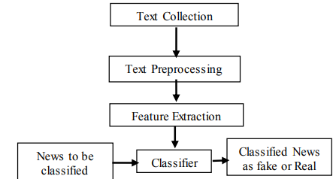
An Insight into the Methodology

Slide 7
Techniques Used for Detecting Fake News
Machine Learning:
Naïve Bayes
Logistic Regression
Decision Tree
Random Forest
SVM
Deep Learning:
CNN
LSTM

Slide 8
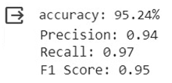
Naive Bayes (Multinomial)
A popular supervised machine learning algorithm used for classification tasks
Easy to build and particularly useful for very large data sets
Primarily based on the assumption that each feature makes an independent
and equal contribution to the outcome.
Useful in fake news detection as it perform well in case of categorical
input variables.
Benefits of using Naive Bayes in our project :
Less Complex
Fast and efficient
Handles high-dimensional data

Slide 9
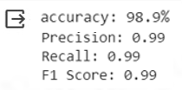
Logistic Regression
Commonly used algorithm for binary classification tasks.
Classification technique in ML which models the relationship between independent (features)
and binary dependent (target) variable by estimating the probability that dependent variable
is a certain class.
Benefits of using Logistic Regression in our project :
Efficient with Linearly Separable Data
Parameter Estimation
Regularization to prevent overfitting
Interpretability
Handling Feature Importance
Scalability
Probabilistic model

Slide 10

Decision Tree
A popular supervised machine learning algorithm used for both classification and regression
Effectively partitions the data such that each internal node of the tree represents a decision
based on a specific feature.
Final output is determined by navigating the tree from the root to one of the leaf nodes on
the basis of input features.
Splitting of the tree is made as pure as possible by using measures like entropy, information
gain and gini index.
Benefits of using Decision Tree in our project :
Highly interpretable
Easy Implementation
Determine importance of different features
Handle categorical data efficiently
Building block for ensemble learning

Slide 11

Random Forest
Powerful ensemble learning method used for classification & regression tasks. For the
classification problem, we have used the entropy as a cost function to estimate a split
Consists of large number of decision trees working individually to predict an outcome of a
class where the final prediction is based on a class that received majority votes.
Benefits of using Random Forest in our project :
Effective Ensemble Learning
Decision Making
Feature Importance
Robust to Overfitting
Outlier Robustness
Handles High-Dimensional Data
Ease of use
Balancing Bias and Variance

Slide 12

Support Vector Machine
A supervised machine learning algorithm that works well for classification
Tries to find a hyperplane that best separates the classes based on statistical approaches
Benefits of using SVM in our project :
Binary classification
Feature selection
Handling imbalanced data
Robustness to overfitting
Incorporates textual data
Ensemble learning

Slide 13
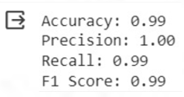
Convolutional Neural Network
Primarily used in image recognition and computer vision tasks
A type of ANN architecture often applied to the analysis of textual data
through methods like text classification
Benefits of using CNN in our project :
Feature Extraction from Text
Convolutional Layers
Pooling Layers
Transfer Learning
Handling Sequence Information
Visual Representation Learning
Model Performance

Slide 14

Long Short Term Memory
A deep neural network technique.
LSTM is a type of RNN architecture, well suited for processing and analysing
sequential data. It can effectively capture patterns and dependencies within the text.
Benefits of using LSTM in our project :
Sequential Data Processing
Memory Retention
Word Embedding
Variable length input sequences
Attention Mechanisms
Handling imbalanced data
Transfer Learning
Ensemble Learning

Slide 15
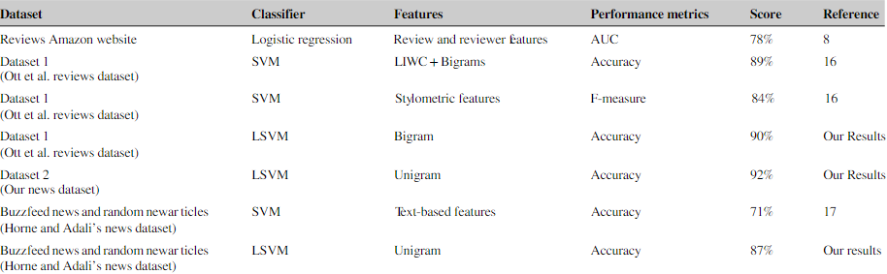
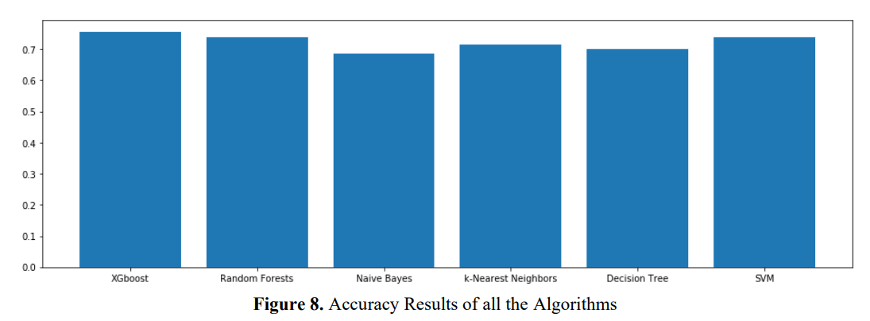
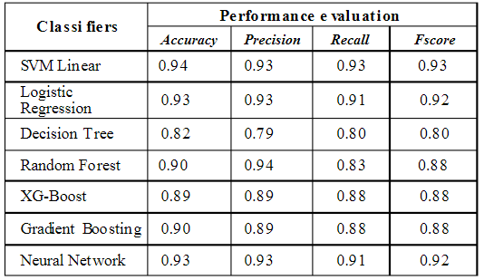
Comparison
Research Papers:

Slide 16
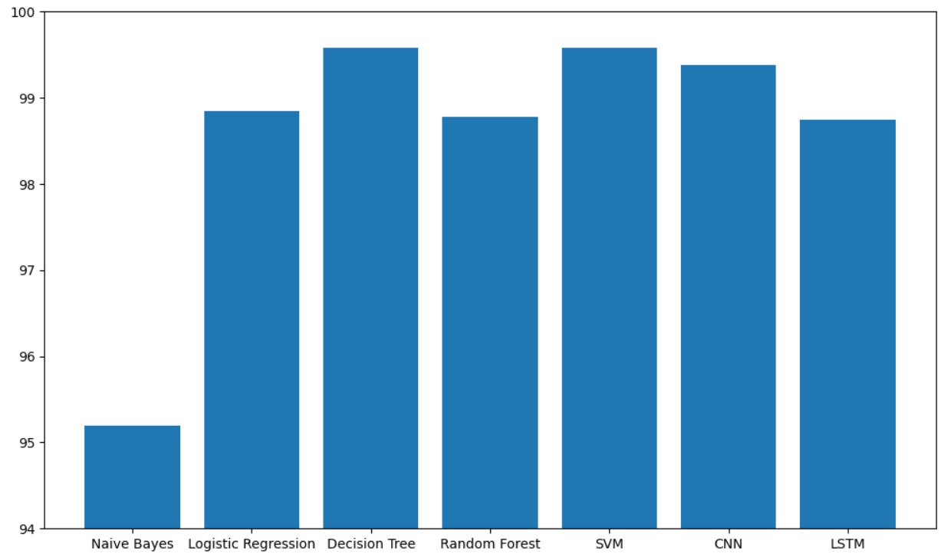
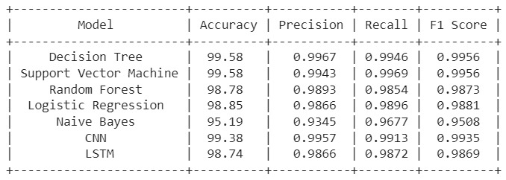
Comparison
Our Project:

Slide 17
Parameters Added:
Multimodal content analysis:
Image to text
Audio to text
Web Scraping
Data cleaning parameters:
Feature selection
Conversion to lower case, punctuation
Stopword word removal
Lemmatization
Label encoding
Handling of missing & duplicate data

Slide 18
Future Scope
Deepfake detection
Accessing the credibility of different sources, authors & content types
Addressing ethical implications & legal frameworks
Integrating using web development to enhance user experience
Real time fact checking

Slide 19
References
https://iopscience.iop.org/article/10.1088/1757-899X/1099/1/012040/pdf
Z Khanam, B. N. (2021). Fake News Detection Using Machine Learning. Fake News Detection Using
Machine Learning, 14.
https://www.hindawi.com/journals/complexity/2020/8885861/#conclusion
Ahmad, I. (2020). Fake News Detection Using Machine Learning Ensemble Methods. Fake News
Detection Using Machine Learning Ensemble Methods, 11.
N. Smitha and R. Bharath, "Performance Comparison of Machine Learning Classifiers for Fake News Detection," 2020 Second International Conference on Inventive Research in Computing Applications (ICIRCA), 2020, pp. 696-700.
https://medium.com/swlh/fake-news-detection-using-machine-learning-69ff9050351f
https://www.researchgate.net/publication/322128415_Detecting_opinion_spams_and_fake_news_using_text_classification
https://arxiv.org/pdf/1811.00770v2.pdf
https://techieloops.com/top-image-to-text-converters/

Slide 20
Thank You

