Slide 1
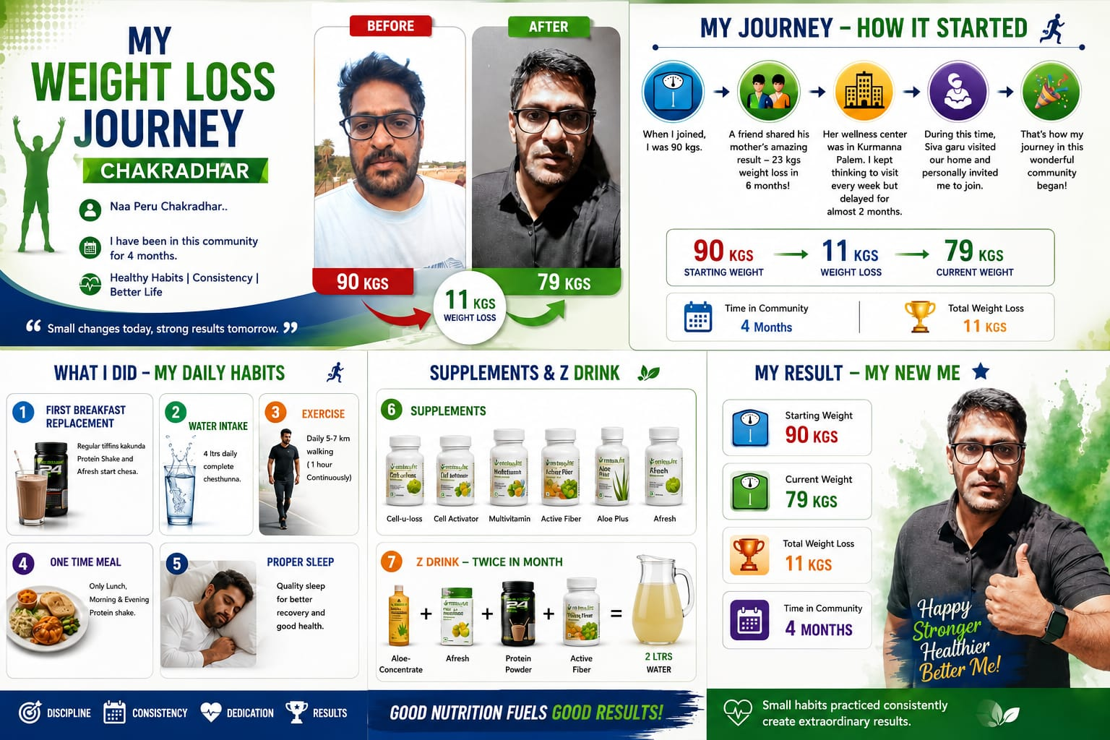
My Transformation Story
A five-month Herbalife journey of healthy habits, consistency, better energy, and a stronger, happier life.

Slide 2
How It Started
When I began this journey, I weighed 90 kg. A friend shared his mother's transformation — she lost 23 kg in six months. Her center is in Kurmannapalem. Siva Garu personally invited me to join, and that became my turning point.

Slide 3
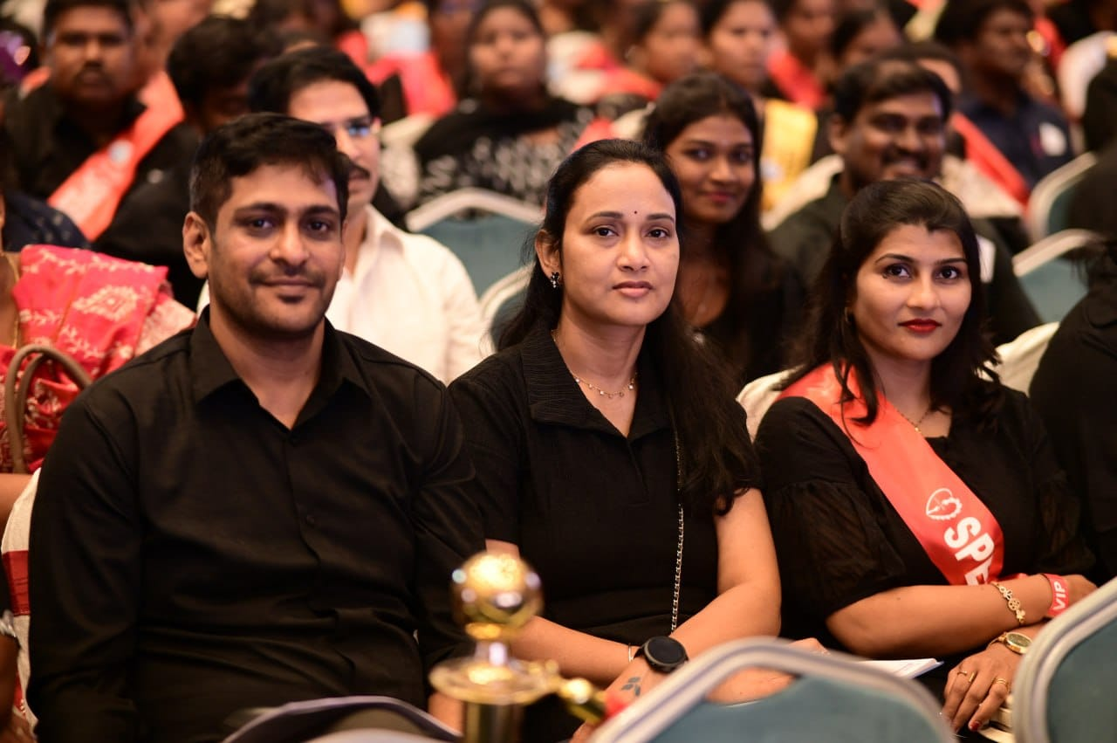
Daily Habits
• Walked 5–7 km every day • Replaced breakfast with Afresh + Protein Shake • Drank about 4 liters of water daily • One balanced lunch with less rice and more vegetables • Proper sleep and active recovery • Followed supplements and the Z Drink routine twice a month

Slide 4
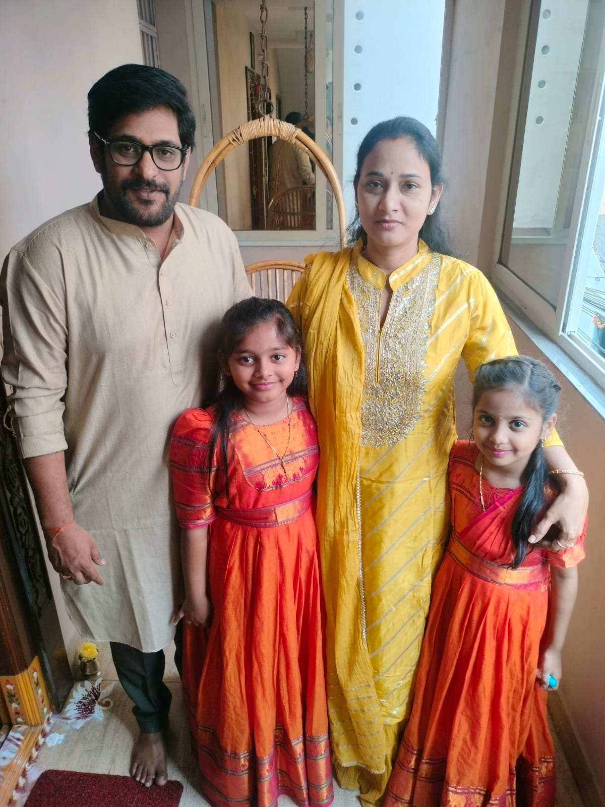
Results
In the last 3–4 months, I lost 11 kg — from 90 kg to 79 kg. This is more than weight loss. It is better flexibility, more energy, and a stronger sense of well-being. My body feels happy, light, and full of life again.

Slide 5
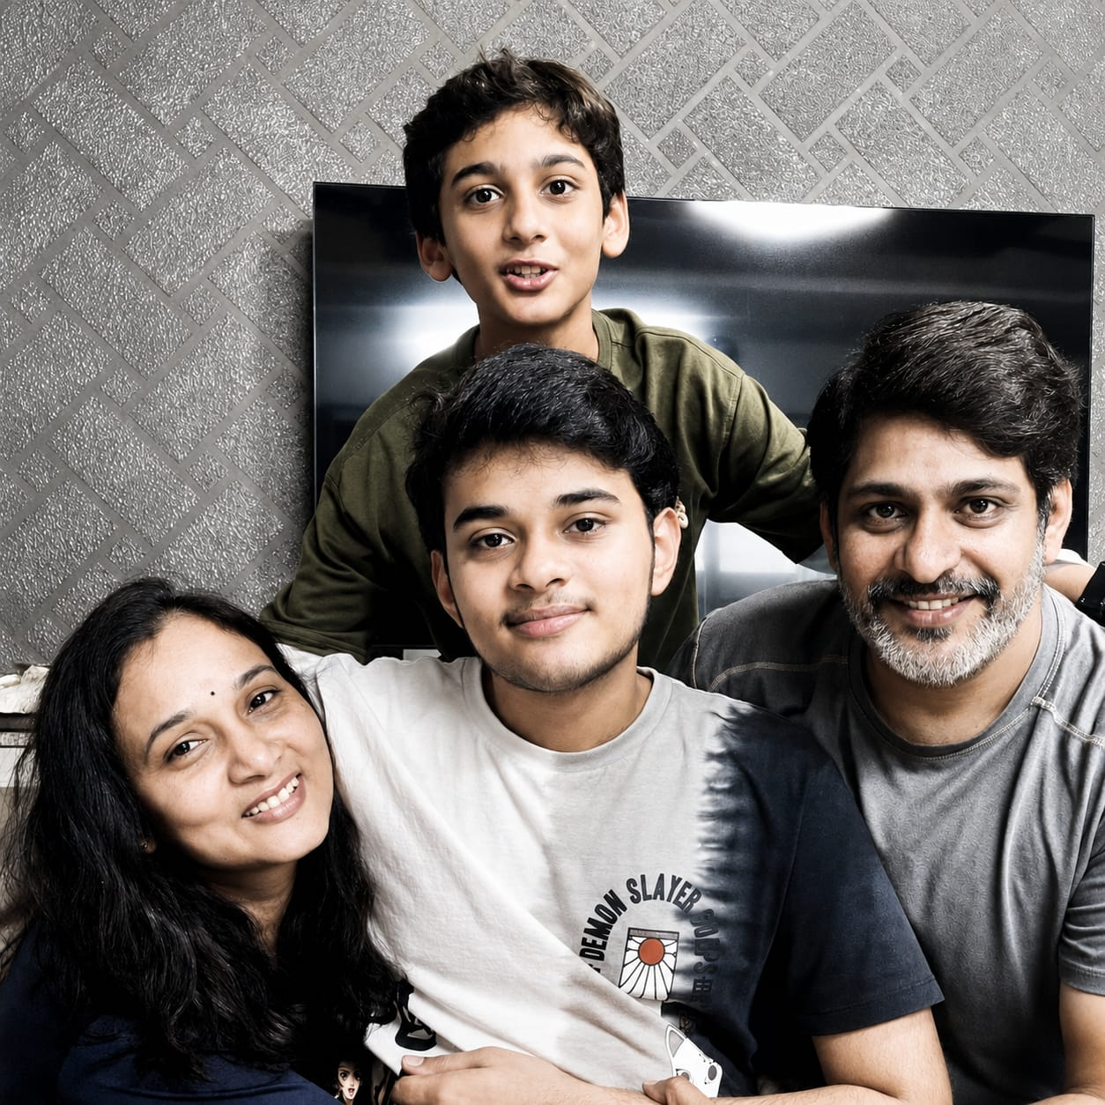
Feeling Young Again
It honestly feels like I've gone back 15 years. I can run without getting tired, play cricket, bend with ease, jump confidently, and climb stairs effortlessly. This isn't just about losing weight — it's about getting my life back.

Slide 6
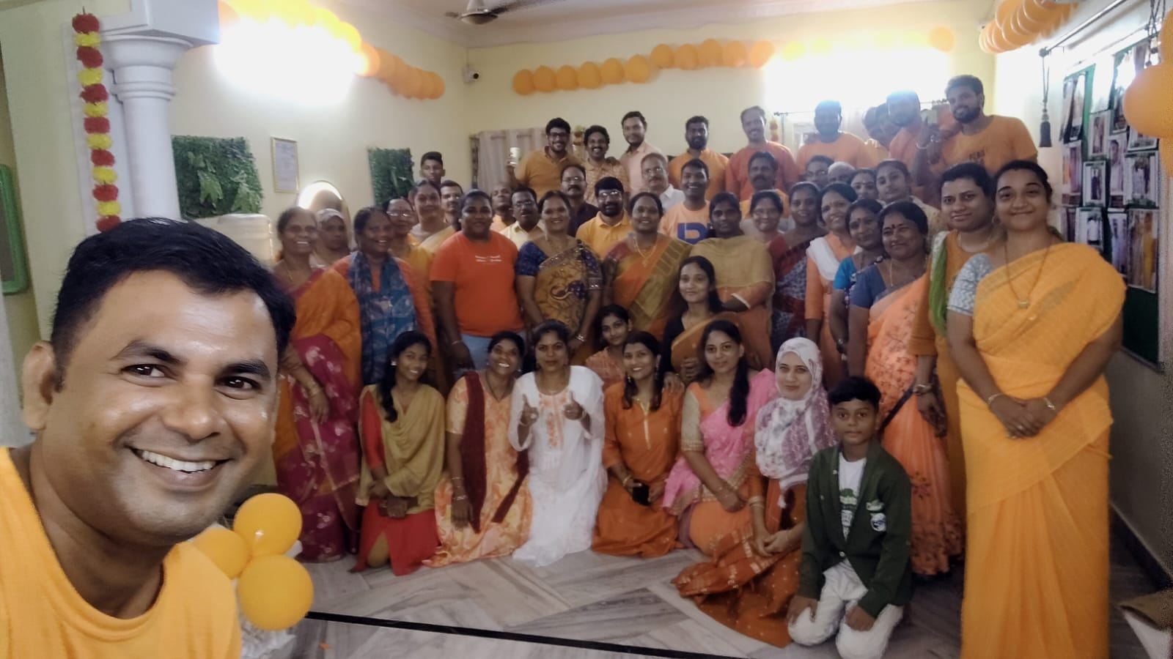
Community Moments
Speedup Event • STS Gallery • Picnic & Color Day

