Slide 1
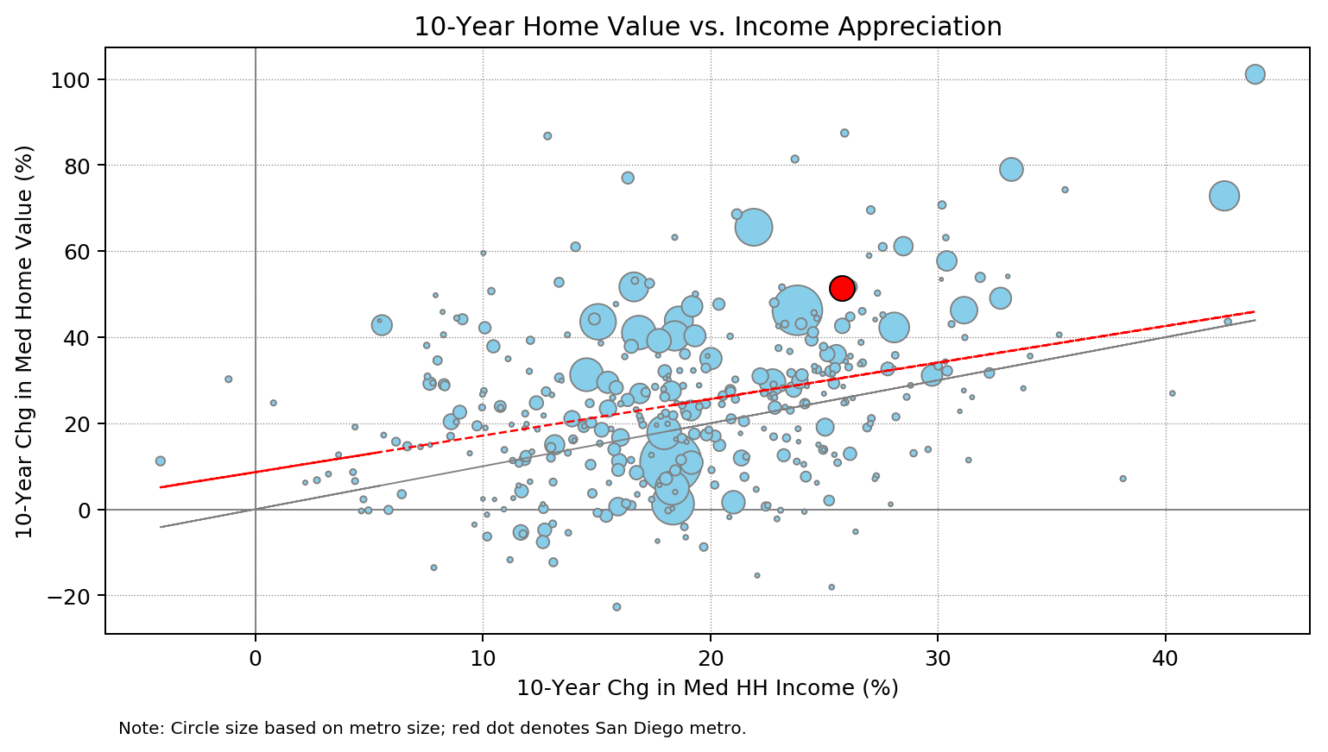
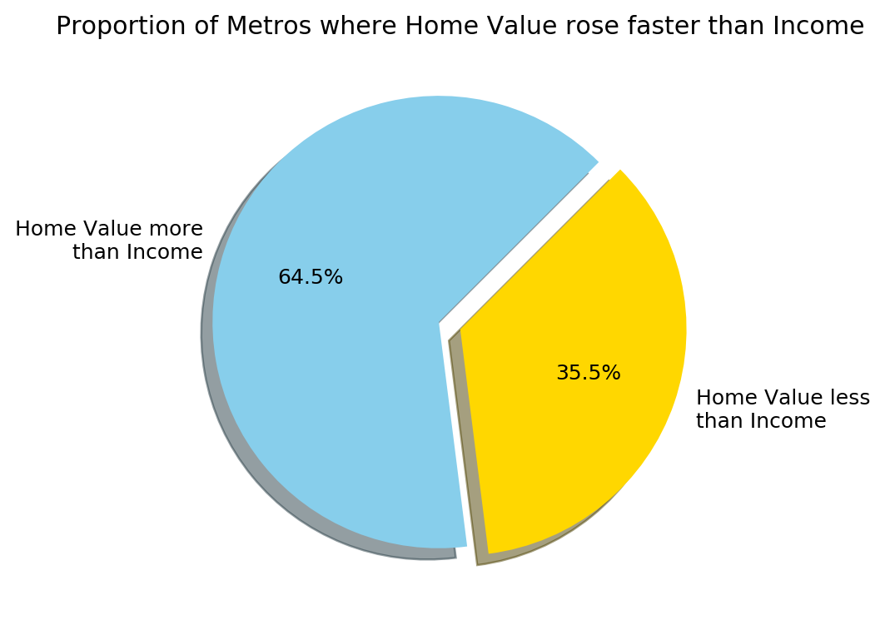
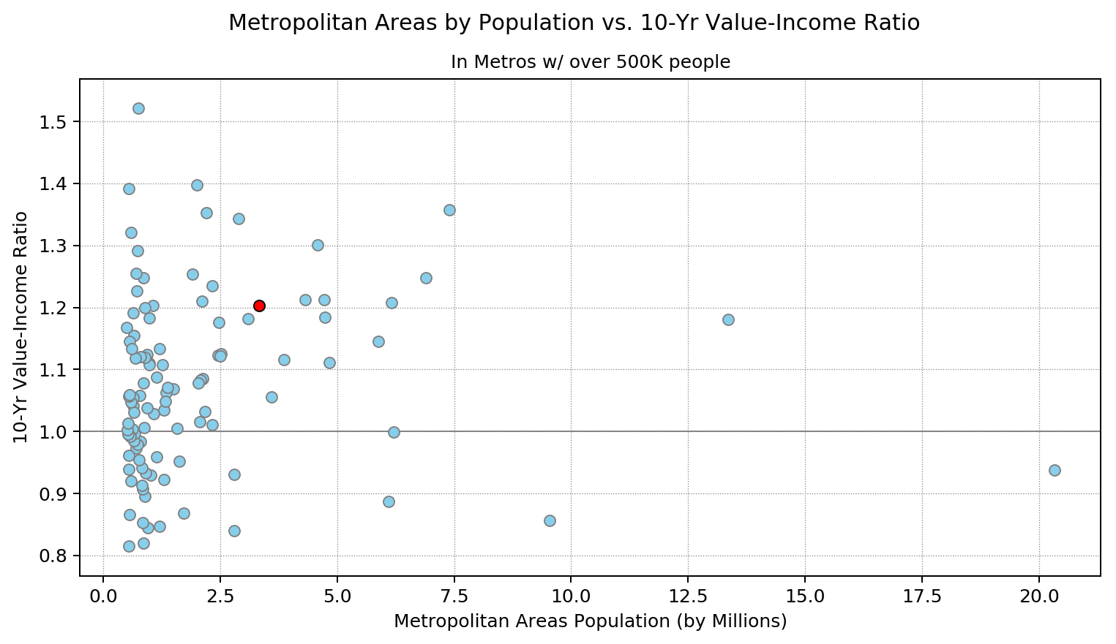
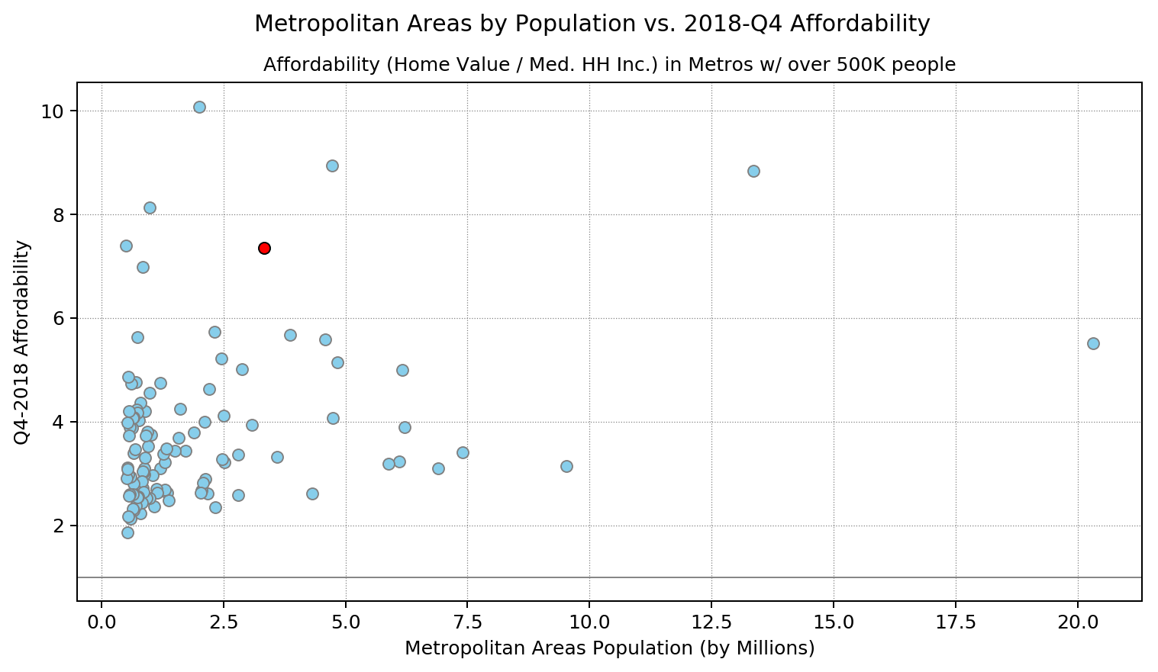
Comparison and Assessment of Housing and Income Appreciation Over The Past Decade
Courtney Gainor, Irwin Bahande Mier, Christopher Reutz, Kim Rones

Slide 2
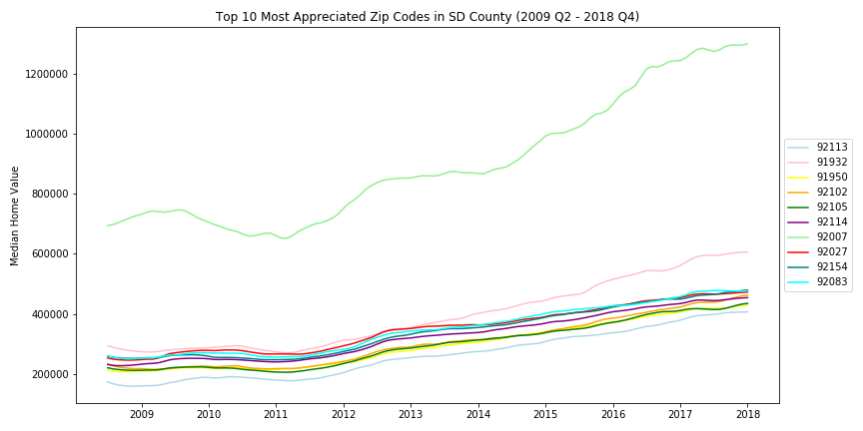
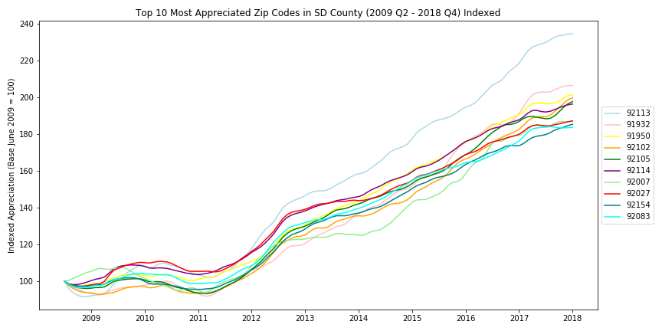
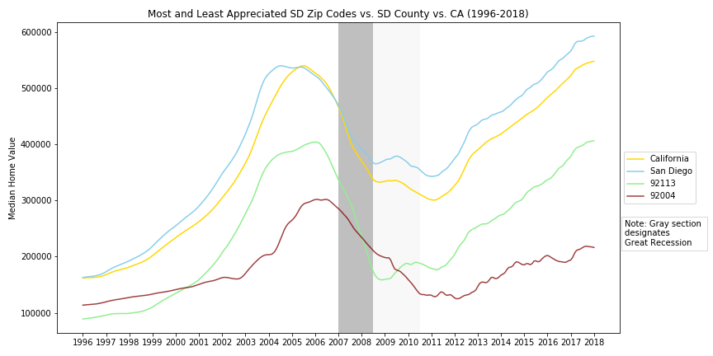
Comparison and Assessment of Housing and Income Appreciation Over The Past Decade
Courtney Gainor, Irwin Bahande Mier, Christopher Reutz, Kim Rones

