Slide 1
ETL Project Glassdoor Data Science Job Skill Database
Presented by
Saurabh Bhatt
Lidio Meireles
Pavitra Mohan Bagirthi
Christopher Reutz

Slide 2
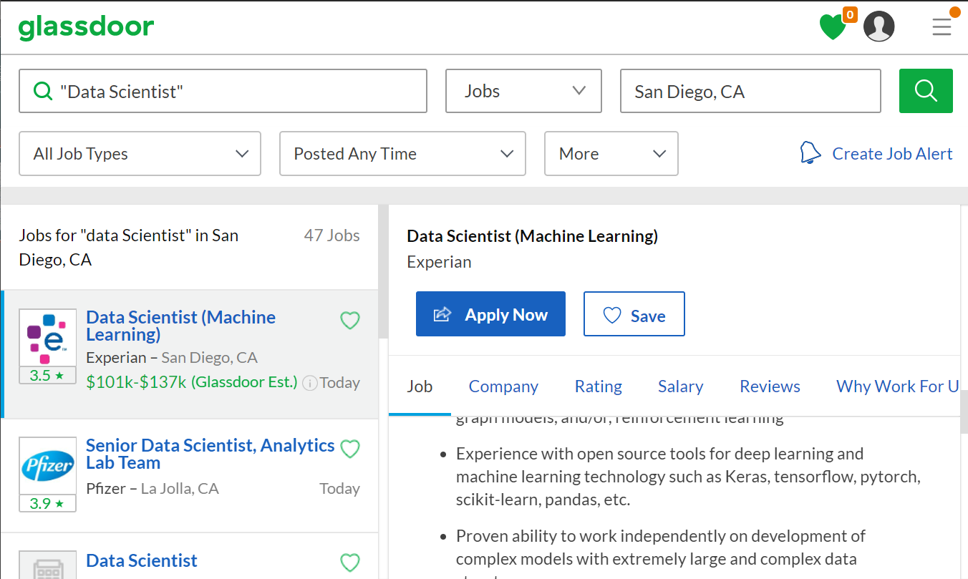
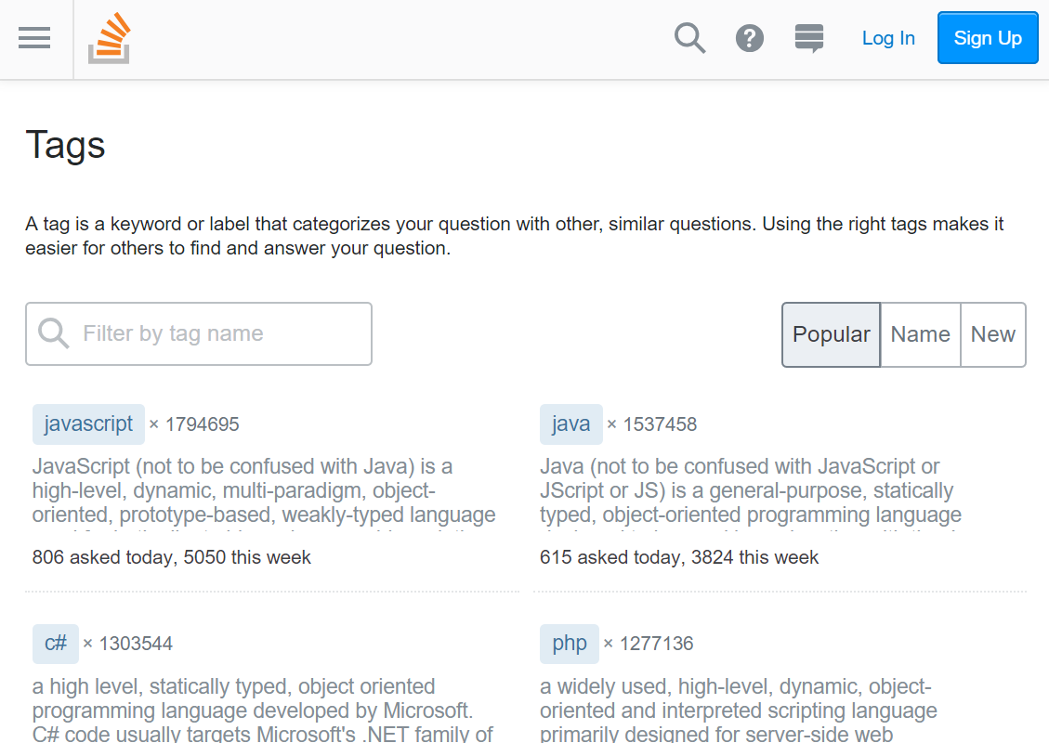
2. Match tags to job descriptions
1. Extract skills/tags from StackOverflow

Slide 3
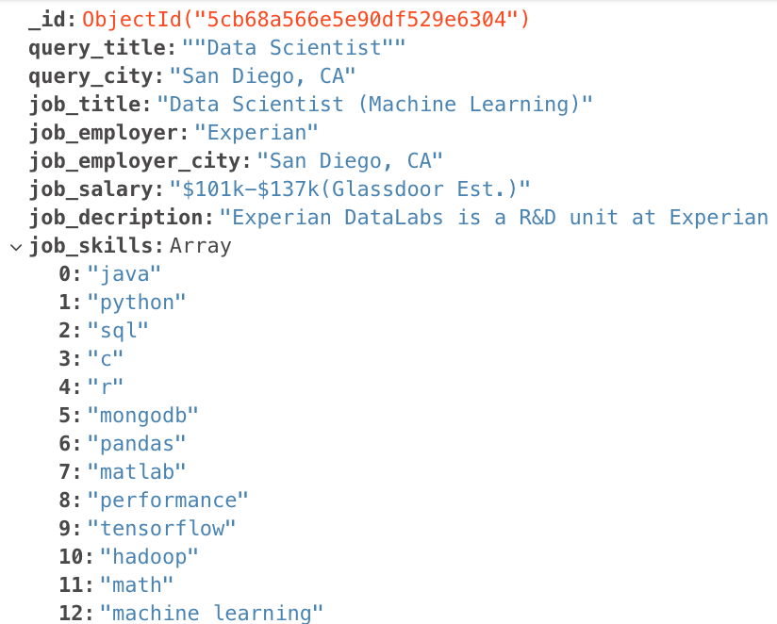
MongoDB representation (.json)

Slide 4
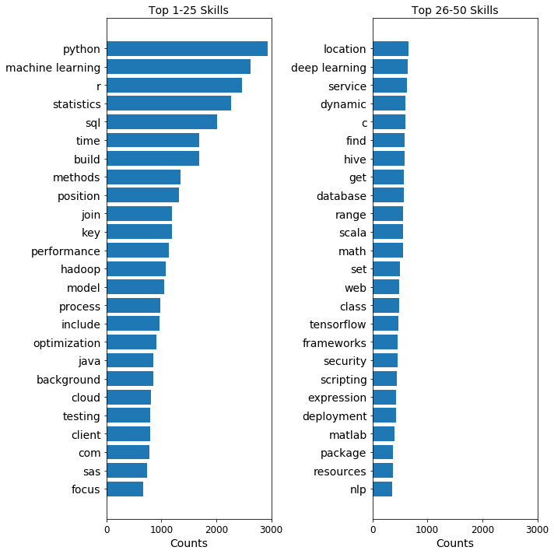
Most Frequent Skills in “Data Scientist” Job Descriptions

Slide 5
Challenges
Scraping the Skill Sets in the Job Description and adding to the Mongodb.
When we used regular expression to compare skill sets ‘c++’ was odd man out we used regular expression escape ‘++’
Not all question tags in Stack Overflow were skills necessarily, yet they matched in the job description text in other general areas of the job description.

Slide 6
Benefits
We have chose mongo db to allow us to add any number of skillsets for each document.
We have scraped entire information to Mongo Db we can do lot of visualizations and analysis on Data Scientist Jobs which can figure out which cities have more jobs, what skills are in popular demand, which cities have more salaries etc..

