Slide 1
CS Final Project – ATARI Breakout
Cameron Dresdner
Eunice Kim
Hyun Soo
Addis Flower

Slide 2
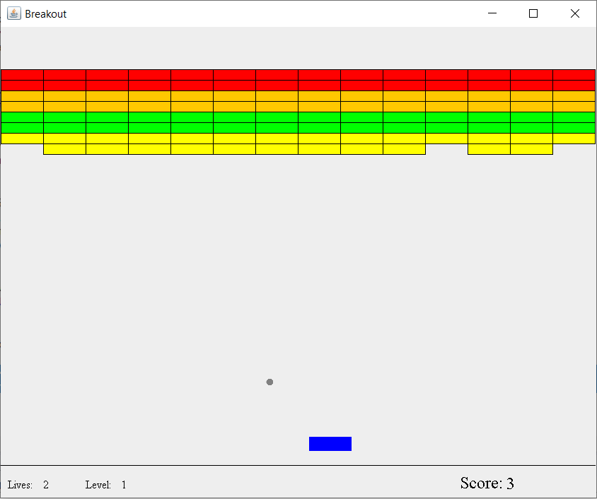
Features
Framework and Threading
Ball, Blocks, Paddle Objects
Power-Ups
Scoring, Levels, New Game
Ball Angles and Speed

Slide 3
Framework and Threading
Used Java AWT and Swing
AWT is a set of Java components that work with your operating system’s native Graphic API’s. It may behave differently on different operating systems.
Swing uses AWT to allow you to develop a nearly pure Java graphical user interface. It is 100% portable from one OS to another.
Main Panel is a Swing JPanel (AnimationPanel.java)
Implements a MouseListener (detects click events) and a MouseMotionListener (detects mouse movement)
It paints the various game components (ball, paddle, blocks, etc.)
Painting of the components is performed every 10 milliseconds from the main thread of Game.java
Moves the paddle left and right based on the location of the mouse pointer
Starts a new game when the mouse is clicked
Game.java is the Primary Controller for all of the Game Components
Lays out the blocks
Calculates position of the ball and power-ups
Determines when collisions occur and what to do
Ball collides with top or bottom of a block, sides of panel, top of panel
In the constructor of Game.java, the block and paddle positions are initially set. An AudioInputStream is used for a block breaking sound effect, and the AnimationPanel.java is instantiated.
There is no movement (the primary thread is not started)

Slide 4
Framework and Threading
Game.java is the Primary Controller for all of the Game Components (cont.)
Game.java implements java.lang.Runnable
Runnable provides the means for a class to be active while not sub-classing Thread.
A Thread is instantiated which takes Game.java: Thread t = new Thread(this);
The first time a game is initiated (user clicks the mouse), the thread is started. The thread never stops until the game is ended.
Movement of objects happens due to a while loop within the run method of Game.java. The run method is invoked when Thread t is started. The while loop runs forever and is never exited.
All object positions are calculated within the while loop.
The ball initially moves upward at an angle.
Movement is performed by calculating the ball’s x and y coordinates. Every 10 milliseconds, a call is made to AnimationPanel.java to cause it to repaint.
AnimationPanel.java has a reference to the ball object (as well as the other objects that require painting – blocks, paddle, etc.).
The paintComponent method of AnimationPanel.java is called by its parent class (JPanel) when Game.java calls animationPanel.repaint(); The paintComponent method has a Graphics object which is used to set the color and fill an oval shape using this color. It uses the ball’s x, y, width and height properties to layout the oval.

Slide 5
Framework and Threading
Game.java is the Primary Controller for all of the Game Components (cont.)
Pausing for 10 milliseconds is done using the command: Thread.sleep(10); This causes the currently executing thread to cease execution for that period of time.
When a block is hit, a flag is set that is checked within AnimationPanel.java to prevent it from being painted.
When the ball needs to stop moving (missed by the paddle, level completed), it’s position is set outside the boundary of the main panel x, y = (-15, -15). This way it will not be seen when painted.
New lives, new levels and new games are all handled within the while loop.

Slide 6
Ball, Blocks, Paddle Objects

Slide 7
Power-Ups

Slide 8
Scoring, Levels, New Game

Slide 9
Ball Angles and Speed

Slide 10
Thank You

