Slide 1
CareSys
Application overview
Caregiver careers and agency operations
Purpose, product snapshots and launch blueprint
Working local application with a proposed commercial roadmap
CareSys overview • October 2026
01
Notes:
Overview of the existing local implementation and the proposed platform roadmap. Sources: CareSys business requirements, functional specification, technical design and docs/platform-blueprint.md. Draft for discussion, 24 October 2026.

Slide 2
Purpose and aims
Help agencies manage care work while people keep control of their own professional identity.
Caregiver independence
Profiles and career choices continue across agency relationships.
Agency coordination
Recruitment and daily operations share an authorized workspace.
Clear decisions
Consent, agreements and reviews record who approved what.
CareSys overview • October 2026
02
Notes:
Source: CareSys_Agent_Business_Requirements.docx; current implementation-status.md. Benefits are design aims, not measured customer outcomes.

Slide 3
People and responsibilities
Caregivers and candidates
Manage profiles, disclosure choices, applications and joining decisions.
Agency teams
Owners, recruiters, schedulers and supervisors coordinate work.
Finance staff
Review expenses, worked-time exports, invoices and receipts.
Platform operators
Review agency verification and platform-level exceptions.
CareSys overview • October 2026
03
Notes:
Source: docs/demo-accounts.md and implementation-status.md. Twelve synthetic accounts demonstrate multiple role journeys across two agencies; these are not twelve production customers.

Slide 4
The care workforce journey
01 Profile and discovery
The person chooses what recruiters can see.
02 Application and history
An agency recruits; the candidate controls selected history disclosure.
03 Agreement and joining
Both parties accept a contract version; the person separately authorizes joining.
04 Work and review
The agency schedules visits, reviews time and records operational outcomes.
CareSys overview • October 2026
04
Notes:
Source: existing CareSys workflows. Each stage enforces its own permissions. A signed contract alone does not activate employment.

Slide 5
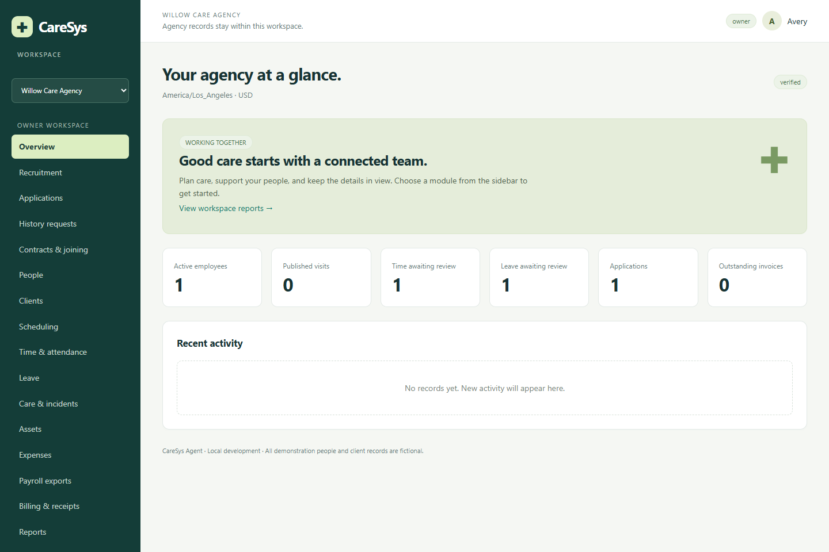
Agency overview
One workspace
An agency sees its own records and permitted modules.
Work awaiting review
The overview highlights applications, time and leave.
Role-based access
Each team member receives permissions for their responsibilities.
CareSys overview • October 2026
05
Notes:
Source: CareSys local demo, captured 24 October 2026. All people and care records shown are fictional.

Slide 6
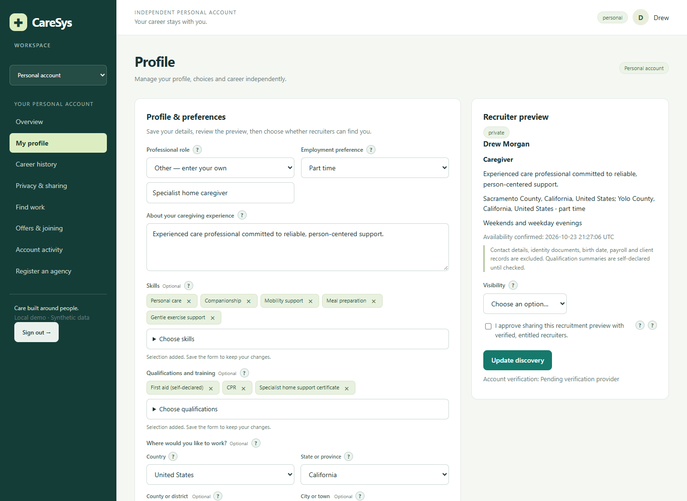
Profiles with guided forms
Standard choices
Roles, skills, qualifications, languages and care settings.
Flexible entries
Custom text remains available when a choice does not fit.
Location selection
Country, state, county and city replace manual code entry.
CareSys overview • October 2026
06
Notes:
Source: CareSys local demo, captured 24 October 2026. All people and care records shown are fictional. Qualifications shown in profiles are self-declared; agency acceptance is a separate workflow.

Slide 7
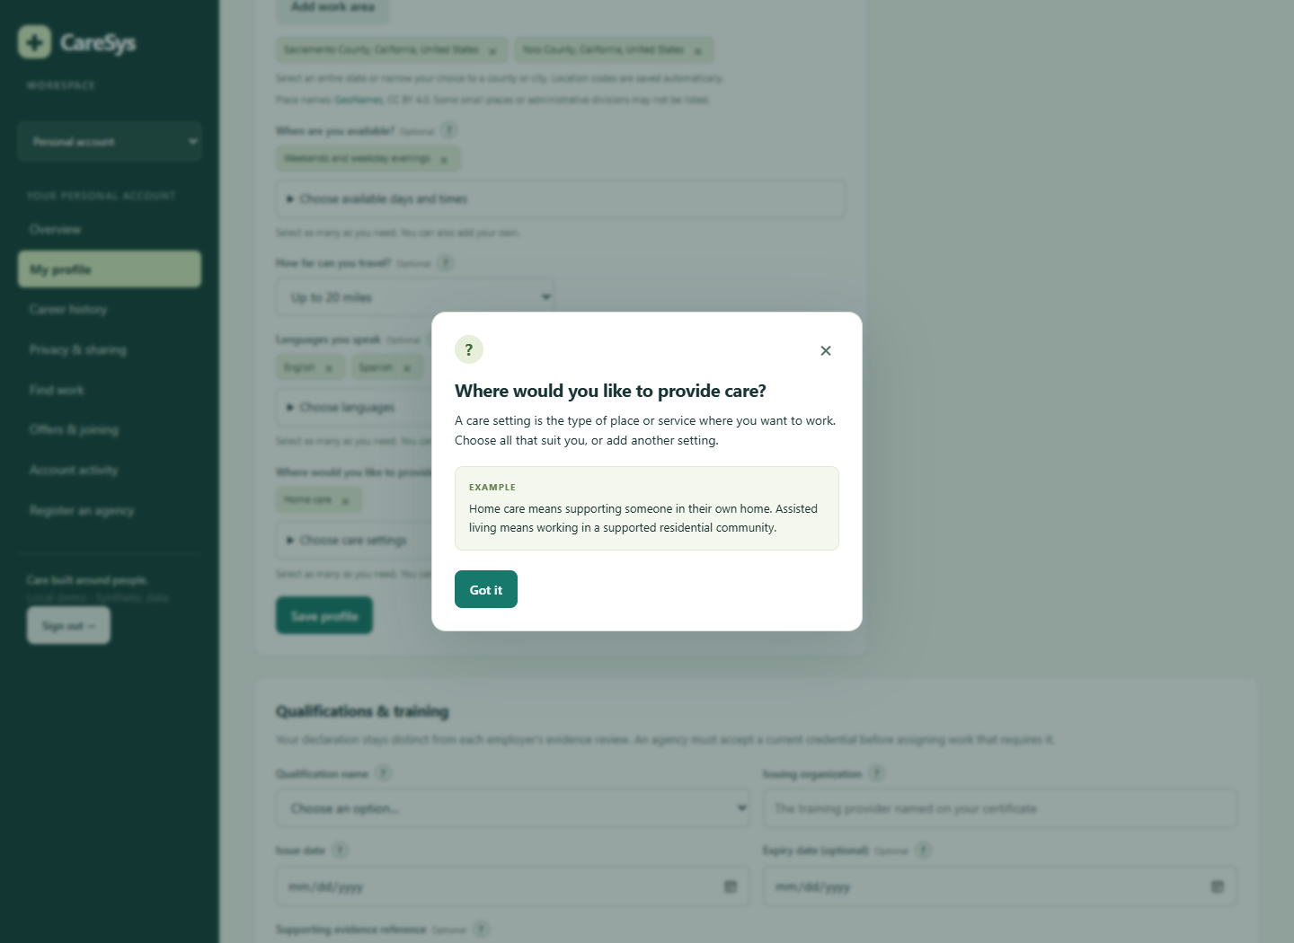
Help when a field is unclear
Brief explanations
Small question marks explain what the field means.
Examples
Users can see examples before entering information.
Consistent forms
Shared controls support the other application forms.
CareSys overview • October 2026
07
Notes:
Source: CareSys local demo, captured 24 October 2026. All people and care records shown are fictional.

Slide 8
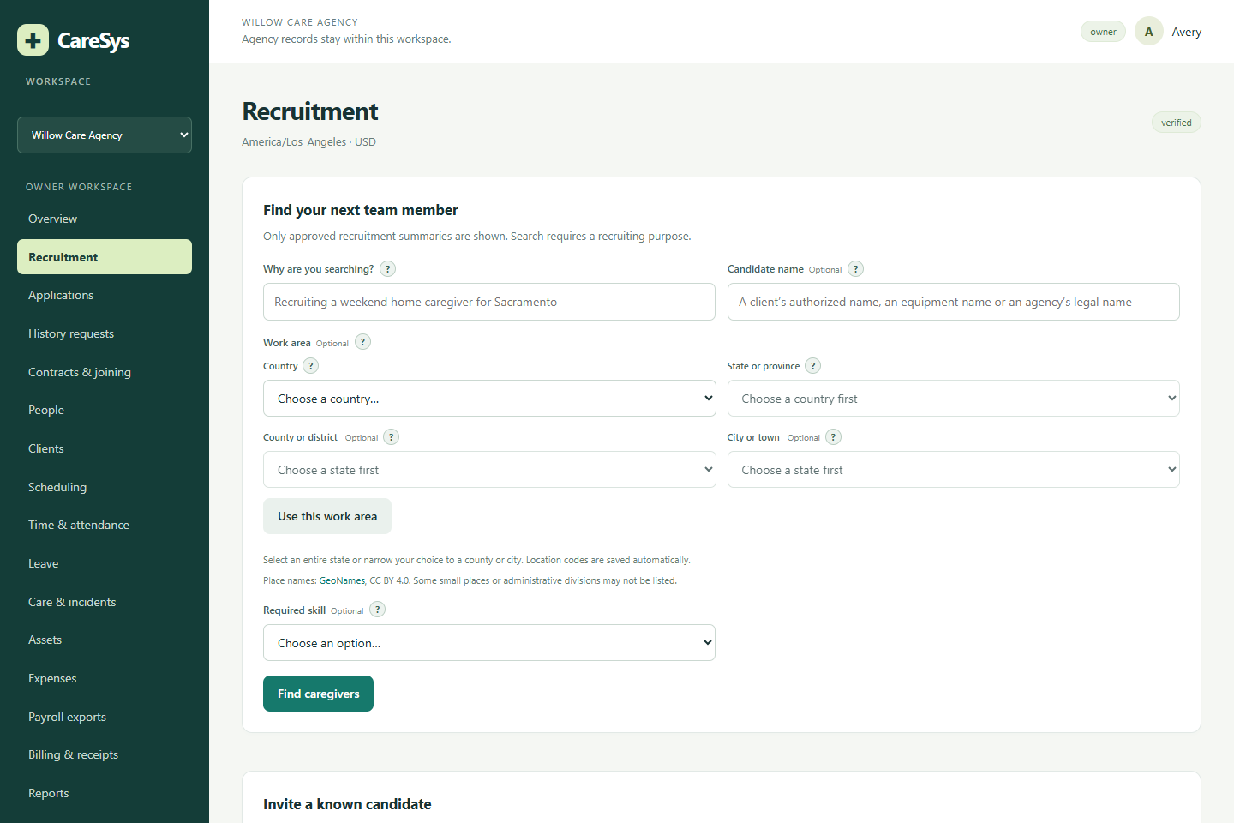
Recruitment and discovery
Purpose of search
Recruiters state why they are looking.
Approved summaries
Search uses the profile projection the person approved.
Candidate response
Invitations and applications retain a private response path.
CareSys overview • October 2026
08
Notes:
Source: CareSys local demo, captured 24 October 2026. All people and care records shown are fictional.

Slide 9
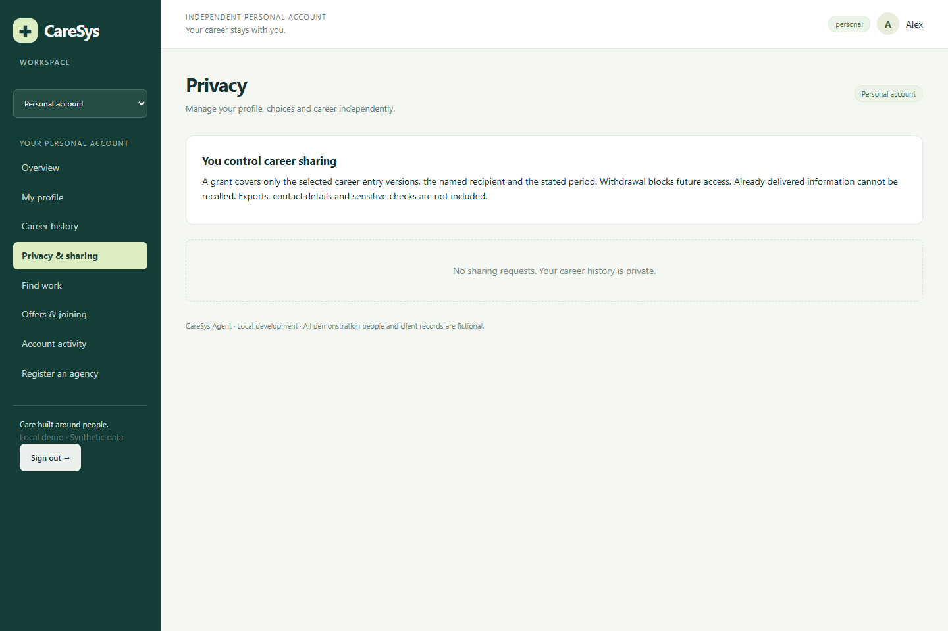
Consent and career privacy
Selective disclosure
History sharing specifies entries, recipient and purpose.
Expiry and withdrawal
Access follows the current grant and its conditions.
Continuing identity
Previous agency relationships do not transfer ownership of a person.
CareSys overview • October 2026
09
Notes:
Source: CareSys local demo, captured 24 October 2026. All people and care records shown are fictional.

Slide 10
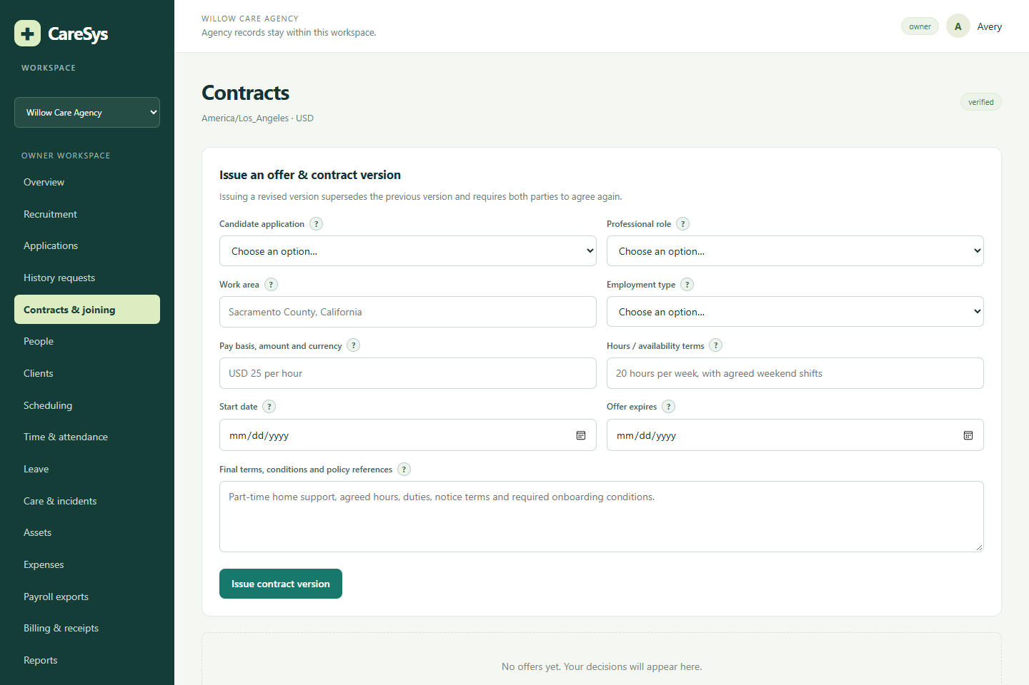
Contracts and joining
Versioned agreements
A revision records its own content and acceptance.
Separate permission
The candidate explicitly authorizes joining.
Reviewed activation
Conditions and effective dates control activation.
CareSys overview • October 2026
10
Notes:
Source: CareSys local demo, captured 24 October 2026. All people and care records shown are fictional. Password confirmation is implemented; certified signing and jurisdiction-specific legal validation remain planned work.

Slide 11
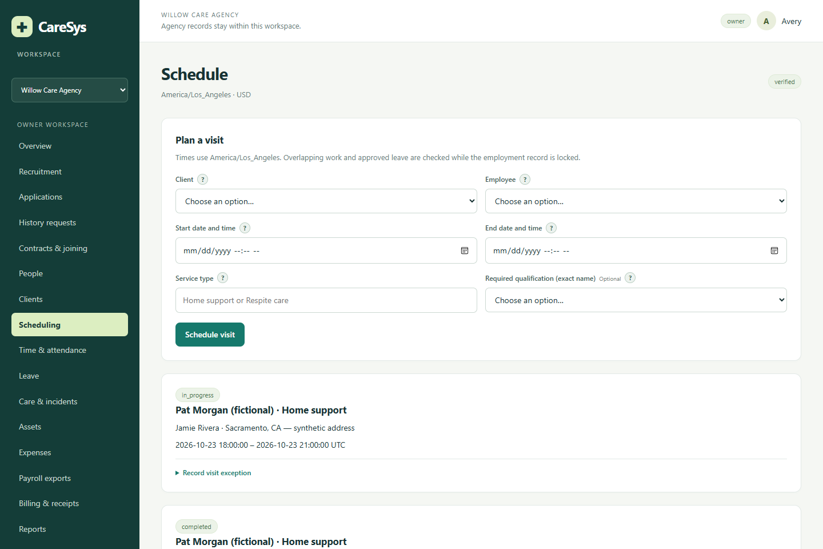
Scheduling and daily care
Visit assignment
Client visits connect to authorized caregivers.
Eligibility checks
Assignments check overlaps, leave and required credentials.
Care records
Teams can record notes and incidents for review.
CareSys overview • October 2026
11
Notes:
Source: CareSys local demo, captured 24 October 2026. All people and care records shown are fictional.

Slide 12
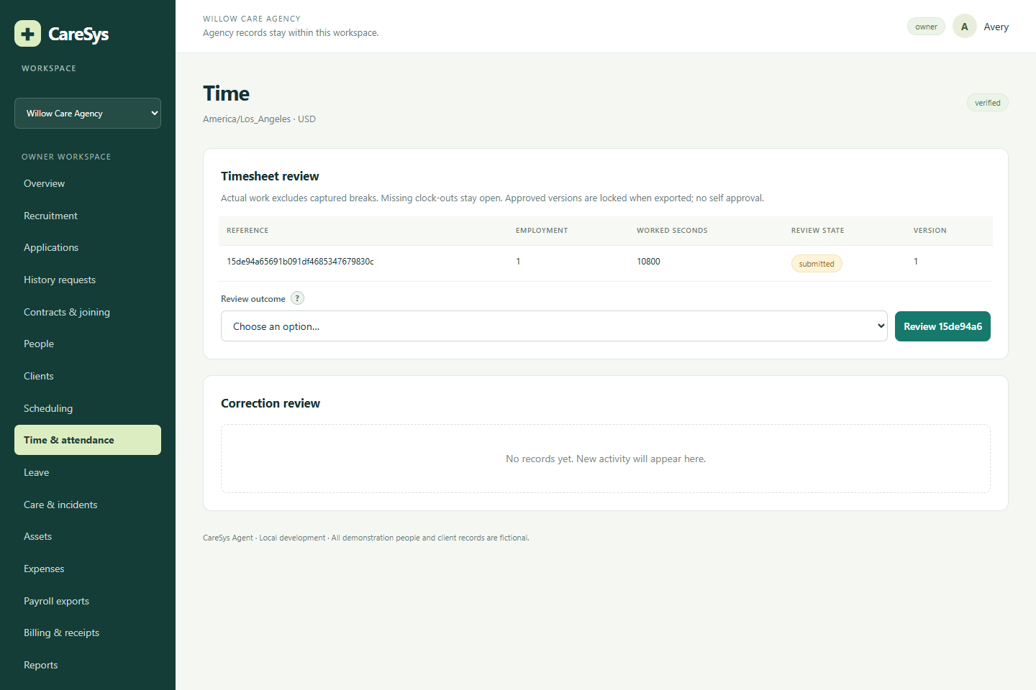
Time attendance and review
Clock events
Online events record starts, breaks and finishes.
Worked time
Elapsed time excludes recorded breaks.
Supervisor review
Version-aware approvals and corrections preserve accountability.
CareSys overview • October 2026
12
Notes:
Source: CareSys local demo, captured 24 October 2026. All people and care records shown are fictional. Offline mobile clocking is a future design item, not an available native-app feature.

Slide 13
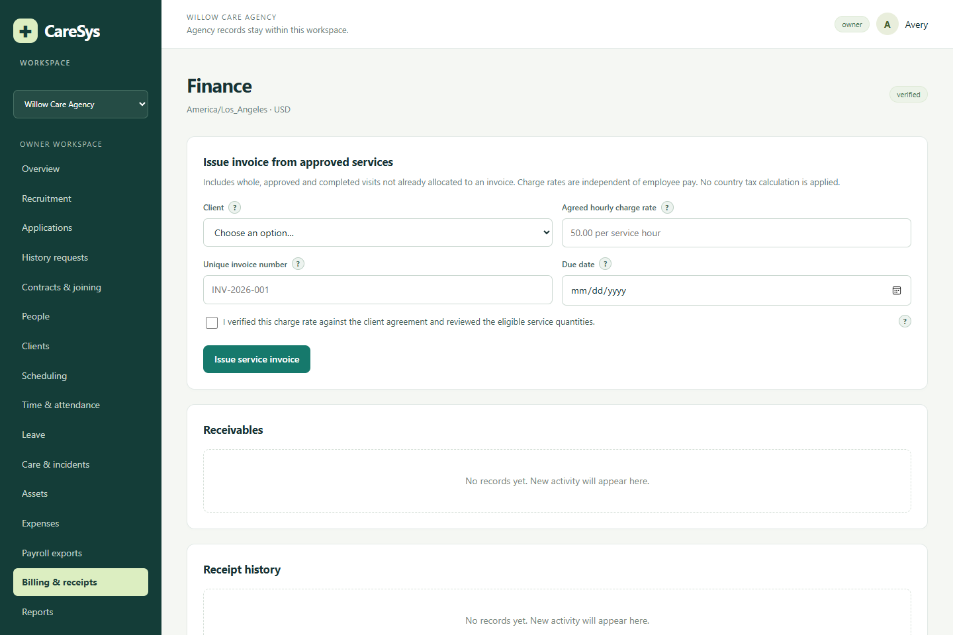
Finance and operational records
Billing records
Invoices, receipts and supported credits.
Workforce records
Expenses, assets and approved worked-time exports.
Integration boundary
External payroll submission and a complete accounting ledger remain future work.
CareSys overview • October 2026
13
Notes:
Source: CareSys local demo, captured 24 October 2026. All people and care records shown are fictional.

Slide 14
Application status
Working in the local implementation
Remaining before commercial launch
Profiles and consent
Recruitment and applications
Contracts and joining
Agency operational reviews
Core JSON endpoints
Production email and privileged MFA
Subscription billing and tax handling
Native mobile authentication and apps
Private files and retention workflows
Deployment, recovery and security review
Verification baseline: 30 automated tests and 108 assertions passed
CareSys overview • October 2026
14
Notes:
Source: docs/implementation-status.md; latest PHPUnit verification in this session passed 30 tests and 108 assertions. Previous browser smoke covered 12 accounts and 161 permitted page visits. These checks do not establish production security, capacity or accessibility certification.

Slide 15
Development staging and production
Environment | Purpose | Data and release controls
Development | Build features locally | Fictional records and isolated test database
Staging | Review a release online | Separate server, test payments, named reviewers
Production | Serve live customers | Separate secrets, backups and approval gate
One tested release artifact moves from staging to production after approval.
CareSys overview • October 2026
15
Notes:
Source: docs/platform-blueprint.md. Proposed deployment architecture, not provisioned infrastructure. Examples of domains require a domain purchase and DNS configuration.

Slide 16
Repositories and shared web services
Repository | Responsibility
CareSys | Web portal, API implementation and migrations
caresys-webservices | API contracts, examples and service tests
caresys-mobile | Shared Android and iOS application
caresys-website | Public information and regional pricing
caresys-infrastructure | Deployments, configuration and recovery runbooks
Test and production use the same source history with separate configuration.
CareSys overview • October 2026
16
Notes:
Source: docs/platform-blueprint.md; docs/api.md. Proposed repositories beyond the existing CareSys repository have not been created. API runtime initially stays in CareSys to share authorization and business rules.

Slide 17
Mobile apps and the public website
Android and iOS apps
Public CareSys website
One proposed Flutter codebase
Separate staging and live app identities
Profiles, visits, time and leave first
Secure device authentication
Offline sync in a later release
Purpose and feature information
Screenshots and demo requests
Pricing and country selector
Support and policy pages
Clear labels for planned features
Planned scope
CareSys overview • October 2026
17
Notes:
Source: docs/platform-blueprint.md. Both native mobile apps and the public marketing website are planned; the existing portal is responsive web.

Slide 18
Country-based subscription pricing
Suggested local currency
Approximate country detection chooses an initial display currency.
A visible country selector
Visitors can correct the location or choose another supported currency.
Controlled regional prices
USD is the base; reviewed local price lists use clear rounded amounts.
Consistent checkout
Confirm country, tax and final total; keep invoices and renewals consistent.
CareSys overview • October 2026
18
Notes:
Source: docs/platform-blueprint.md. Proposed product behavior; no regional price catalog is activated. Billing country requires confirmation and applicable tax review.

Slide 19
Proposed subscription plans
Plan | Monthly USD | Included active workers
Starter | $59 | 10
Operations | $129 | 30
Growth | $249 | 75
Extra worker proposal: $3/month. Larger organizations receive a scoped quote.
Candidate access remains free in the pilot. Prices require validation against actual costs.
CareSys overview • October 2026
19
Notes:
Source: docs/platform-blueprint.md. USD monthly pilot prices, unapproved and not active subscriptions. Active-worker definitions and entitlement enforcement remain implementation work. Taxes and separately priced services require disclosure.

Slide 20
Pilot cost and profit model
$45.60
$580.85
Monthly servers and VM backups
Full fixed monthly planning budget
10% target margin after modeled operating costs
Customer mix | Minimum agencies for the target
Starter only | 13
Operations only | 6
Growth only | 3
Illustrative assumptions; customer-specific usage and fees apply. No guaranteed profit.
CareSys overview • October 2026
20
Notes:
Source: docs/platform-blueprint.md. Provider sources checked 24 October 2026: https://www.digitalocean.com/pricing/droplets ; https://docs.digitalocean.com/products/backups/details/pricing/ ; https://stripe.com/pricing ; https://stripe.com/billing/pricing . F=$580.85 monthly; variable allowance $5/agency; US domestic reference fee 3.6%+$0.30 per monthly charge. Margin before income tax; actual provider fees, customer demand and workload may change it. Costs include maintenance $300, development recovery $100 and overhead/reserves.

Slide 21
Launch sequence and decisions
Foundation and staging
Choose the domain, budget and hosting; prove deployment and restore.
API and website
Complete mobile authentication, API tests and reviewed pricing content.
Mobile beta and pilot
Test devices and consent workflows with fictional data, then selected agencies.
Production release
Close readiness gaps, approve deployment and measure cost per customer.
Next decisions: domain, launch agency count, support budget and first-market data requirements.
CareSys overview • October 2026
21
Notes:
Source: docs/platform-blueprint.md and implementation-status.md. Sequence is a proposal, with no promised launch dates.

Slide 22
CareSys project references
Working application
http://localhost:8080/login
Source repository
https://github.com/cdrika/CareSys
Blueprint document
Documentation/CareSys_Platform_and_Commercial_Blueprint.docx
Requirements and acceptance
Original specifications and docs/implementation-status.md
Screenshots show fictional demo data. Commercial and mobile items are proposals.
CareSys overview • October 2026
22
Notes:
Presentation sources: local CareSys specification documents, implementation-status.md, api.md, demo-accounts.md and platform-blueprint.md. Additional platform references: https://developer.apple.com/help/account/membership/program-enrollment/ ; https://support.google.com/googleplay/android-developer/answer/6112435 ; https://developers.cloudflare.com/pages/functions/pricing/ . Apple current enrollment $99/year; Google Play $25 once. These fees are in the blueprint; enrollment and compliance are not completed.

