Slide 1
Call center staff planning concept
overall_1_132317668181207495 columns_1_132317668181207495
Christian Ruf
Munich, March 1st, 2021
Anonymized

Slide 2
Agenda
overall_1_132317677004503003 columns_1_132317677004503003
Overview of components
Inbound call volume forecast
Optimal staff levels
Optimal shift schedule
Questions

Slide 3
Staff planning comprises 3 components
overall_1_132317708703649333 columns_1_132317708703649333
Inbound call volume forecast
Purpose
Predict the volume of inbound calls
Provide intra-day volumes as basis for deriving the right staffing levels
Allow for timely recruiting
Approach
Time series analysis
Consider yearly, weekly, daily seasonality
Output
Estimated inbound call volume per hour for a 4 week period, 4 weeks out from now
Determine staffing levels
Purpose
Find the right staffing levels depending on the inbound call volume
Balance workforce costs and lost sales due to reneging to maximize profitability
Approach
Discrete event simulation
Queing system with impatient customers (reneging)
Output
Optimal number of agents for every possible customer arrival rate in steady state
Develop shift plans
Purpose
Organize the shifts so as to match the optimal staffing levels
Assign individual employees to these shifts
Approach
Mixed integer programming
Output
Optimal number of each shift type

Slide 4
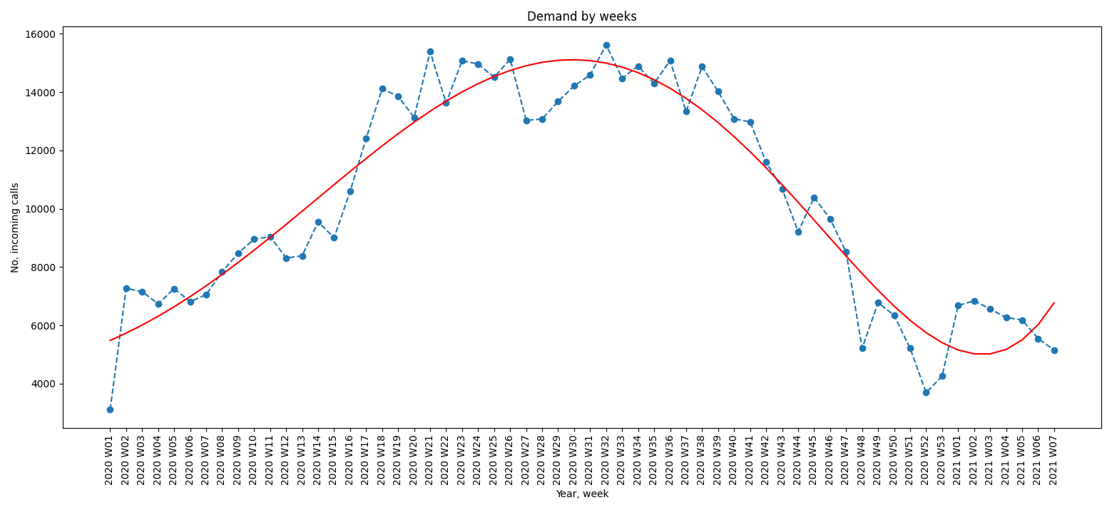
Inbound call volume seems to follow a yearly pattern

Slide 5
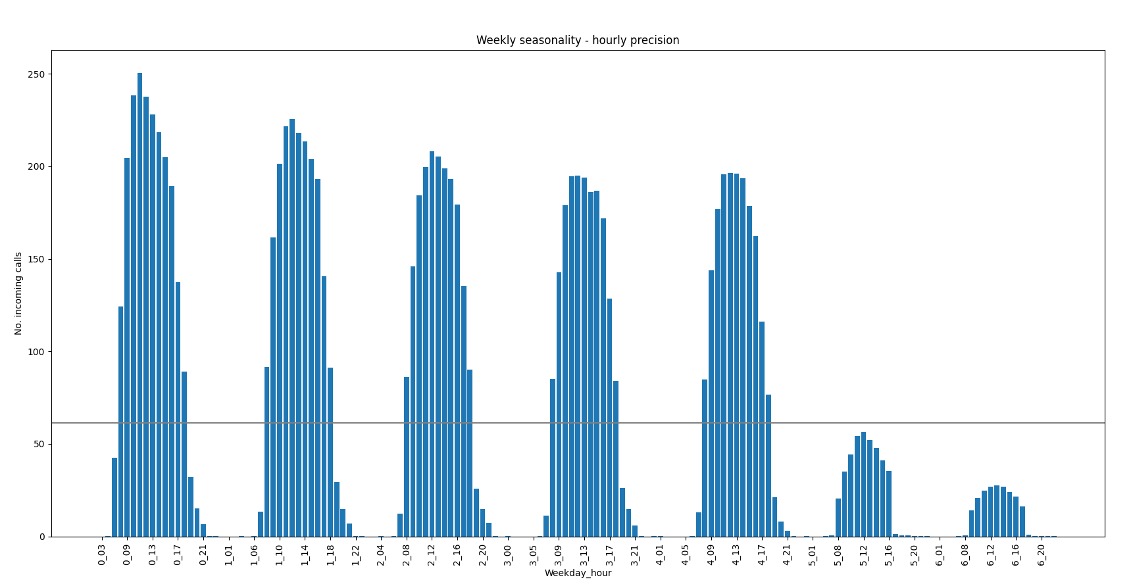
The data shows a strong seasonal pattern within each week and day

Slide 6
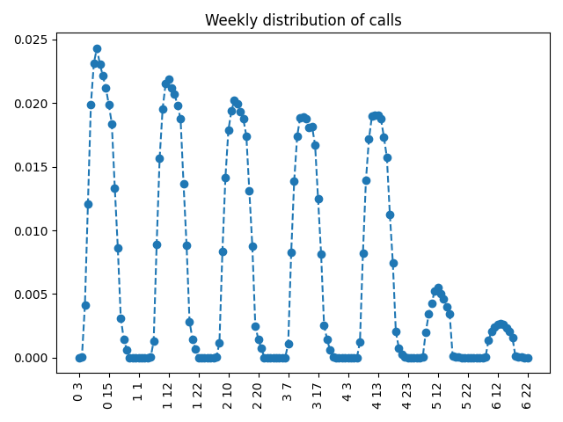
Inbound call volume is predicted for each individual hour
Step 1: Predict weekly call volume
Aggregate previous year data by week
Fit a curve to the weekly volumes
Predict next year‘s weekly volumes with the curve
Step 2: Distribute the predicted weekly call volume (~ 10300 calls per week on average)
Aggregate dataset to determine inner-weekly searsonality
Distribute the predicted weekly volume proportionally

Slide 7
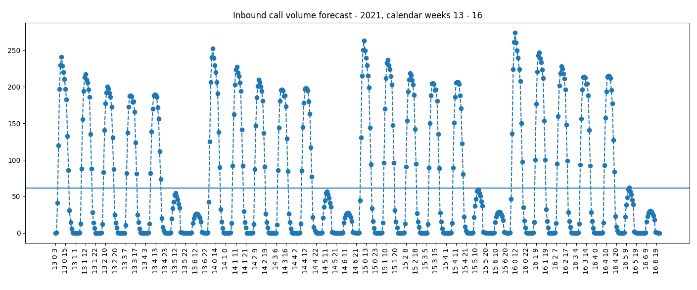
The forecast for calender weeks 13 – 16 exhibits the weekly pattern and a slight increase from week to week

Slide 8
The call center queue model helps to determine the right staffing levels depending on the call volume
reneged
Customer 1
Agent 1
Queue
Customer m
Agents n
Customer arrival process
Typically we assume a poisson process
The arrival rate is either based on historical data (baseline model) or on the forecast (using the model)
Reneging behaviour
Difficult to characterize customer reneging behaviour from the data
I determined all other assumptions first and then played with the reneging tendendy to match the historical key metrics
Patience ~ 2 minutes on average
Service time
Agent time = talk time + wrap time + hold time (?)
Fitted 70 distributions to the data, beta distribution came out best

Slide 9
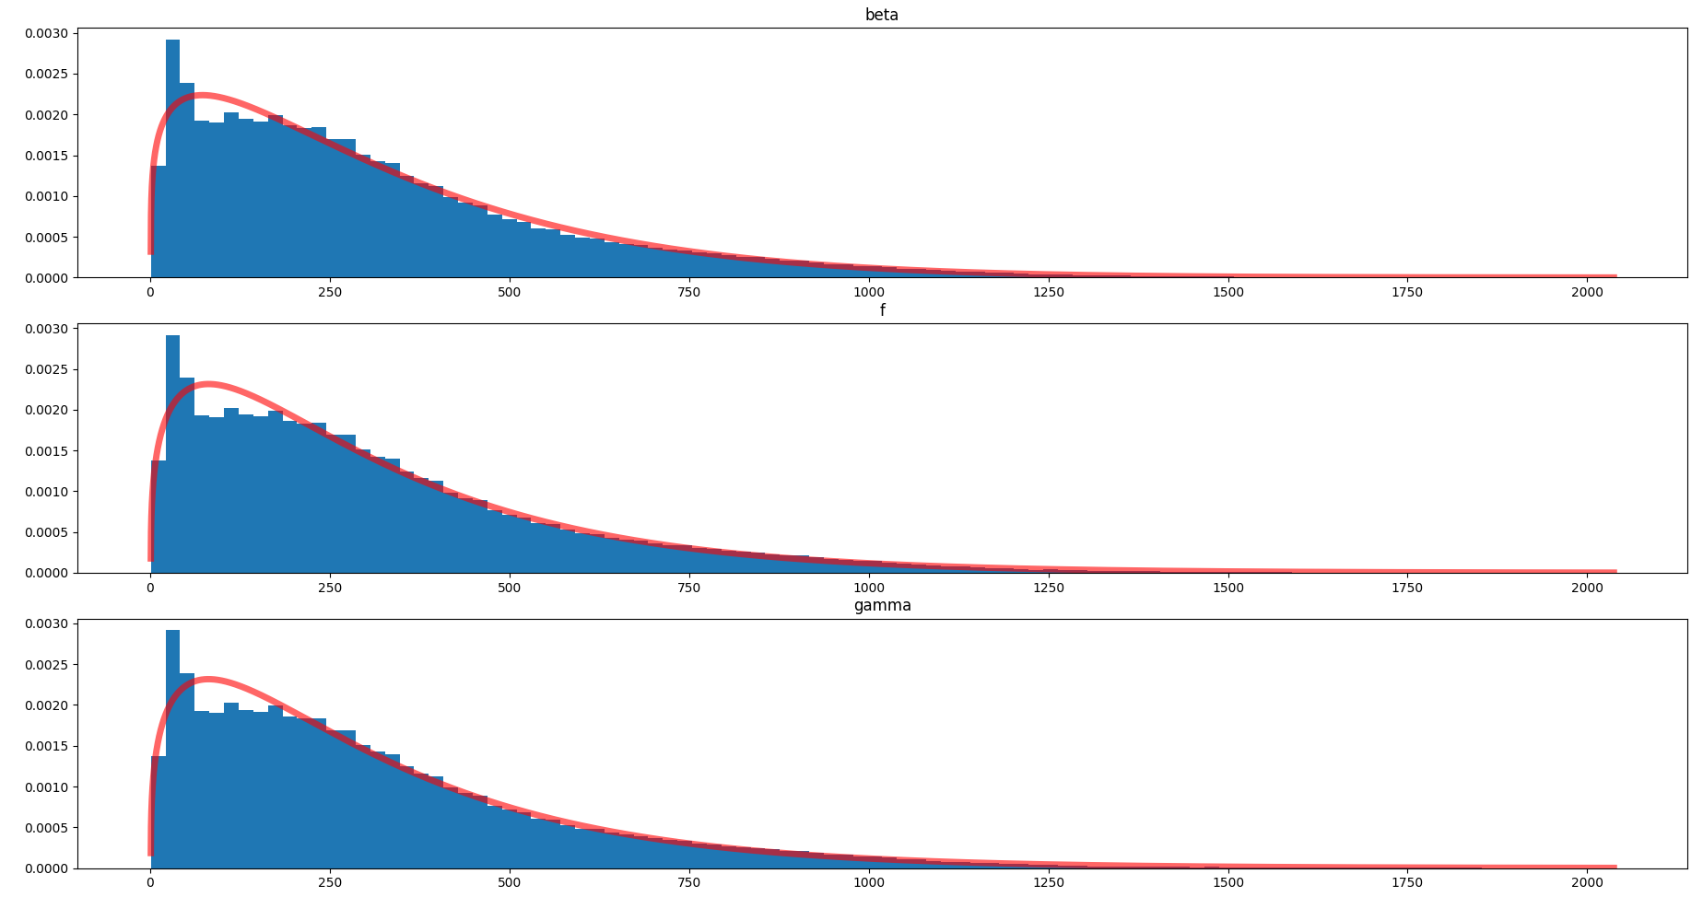
Calls usually have a minimum duration

Slide 10
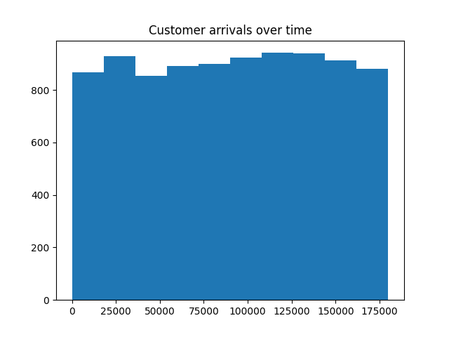
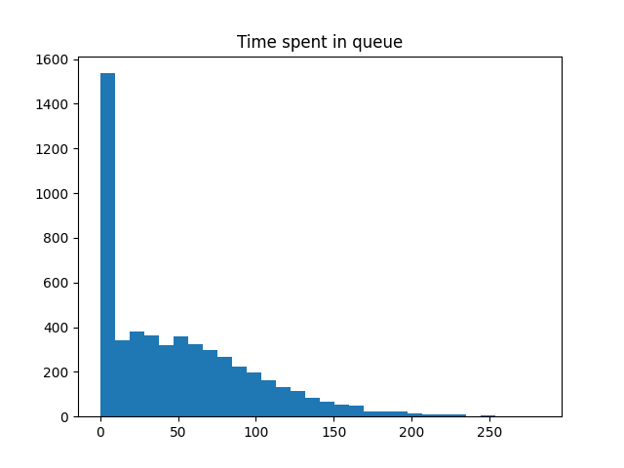
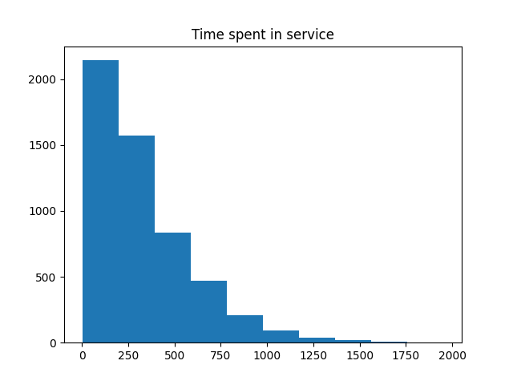
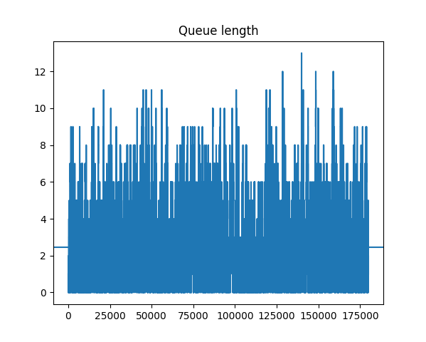
Each individual simulation run delivers insights and allows to calculate the expected profit
Customer arrivals over time
Time spent in queue historgram
Time spent in service histogram
Queue length over time
Number of served customers
Number of reneged customers
Workforce costs = No. agents * hours * hourly cost
Revenues = No. accepted calls * conversion rate * exp. revenue

Slide 11
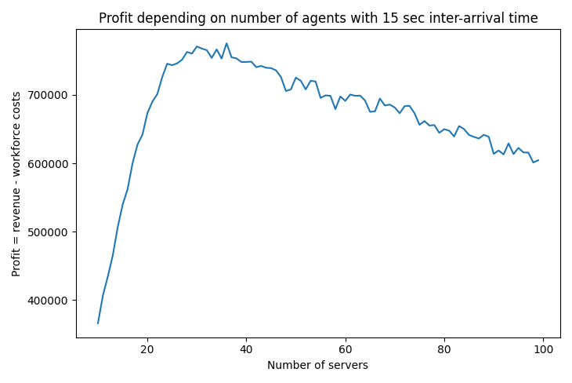
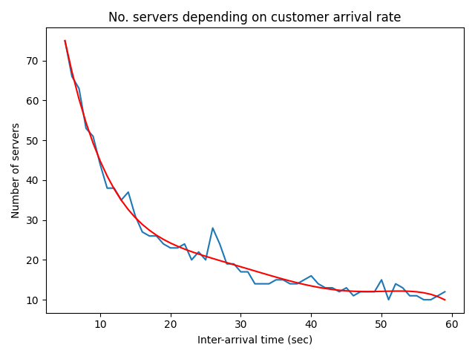
The simulation model generates the „optimal“ number of simultaneously staffed workers by call volume
Baseline model: Before the simulation can be used with confidence it must be validated based on the historical observations

Slide 12
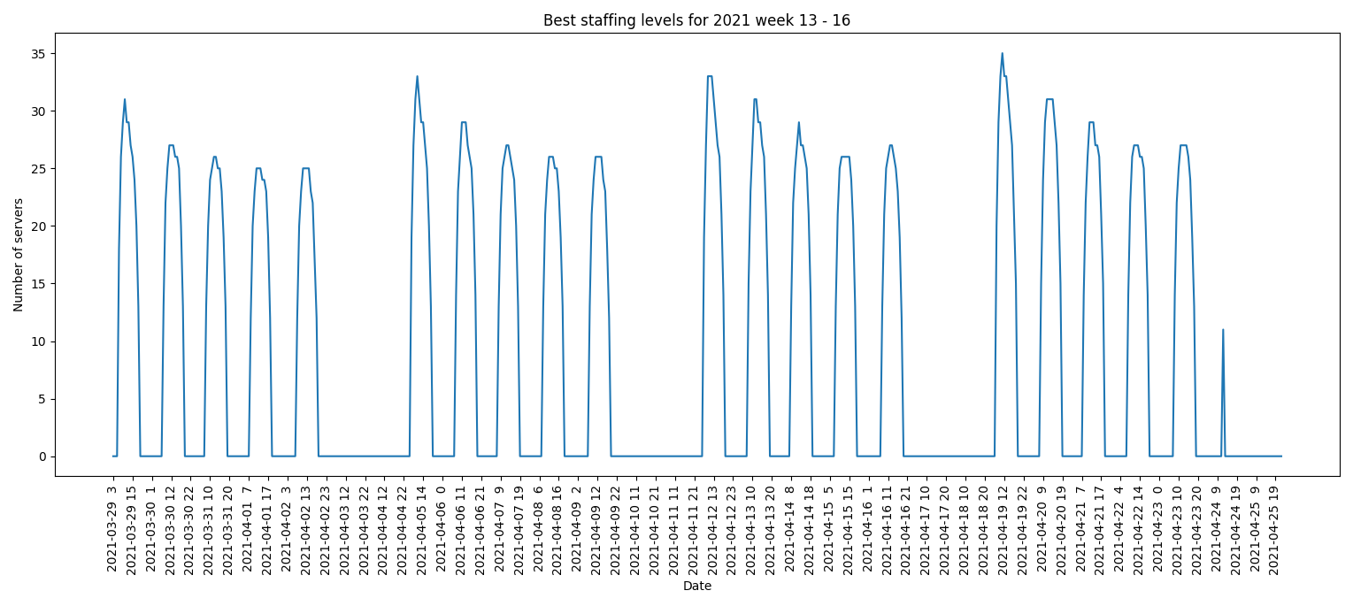
The optimal staffing levels are obtained by combingin call vol. forecast and optimal staffing levels by call vol.

Slide 13
Next steps
Clarify data irregularities
Verify assumptions of the simulation model
Make sure baseline scenario is realistic
Optimization model to assign shifts so as to match the optimal staffing levels
minimize workforce costs
subject to
meeting the staffing levels
allowable shift patterns and workplace restrictions
realistic ratio of shift patterns
one break a day
Hiring plan (can probably be done manually)

Slide 14
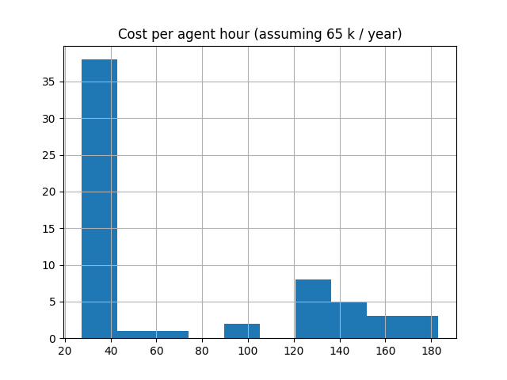
Some agents are paid more than others in relation to their call activity

Slide 15
