Slide 1

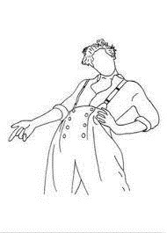



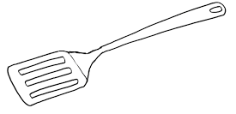

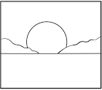
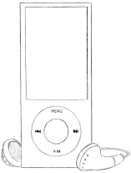



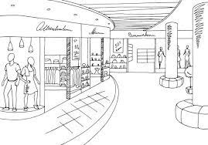
Images - November

Slide 2
Meal Prep & Log
Breakfast
Lunch
Dinner
M
T
W
R
F
A
U

Slide 3
November
Mon
M | T | W | R | F | A | U
1 | 2 | 3 | 4 | 5 | 6 | 7
8 | 9 | 10 | 11 | 12 | 13 | 14
15 | 16 | 17 | 18 | 19 | 20 | 21
22 | 23 | 24 | 25 | 26 | 27 | 28
29 | 30
Next Week
Tues
Wed
Thurs
Later
Fri

Slide 4
Sat
Sun
Notes

Slide 5
November 2021
Utilities
38
75
113
150
Groceries
75
150
225
300
Dining Out
75
150
225
300
Commute (ride count)
6
12
24
33
Cat Stuff
10
20
30
40
Beauty
10
20
30
40
Entertainment
38
113
150
75
113
75
Savings
125
250
375
500
Other
150
300
450
600

Slide 6
November 2021
Income
Fixed Expenses + Utilities
Expected | Earned
Total:
Expenses
Rent
Phone
Streaming
Nosaeron
Utilities
Groceries
Dining Out
Commute
Cat Stuff
Beauty
Entertainment
Savings
Other

Slide 7
November 2021
Itemized Lists
Dining Out
Entertainment
Beauty
Other
Cat Stuff

Slide 8
NOVEMBER
1 | 2 | 3 | 4
8 | 9 | 10 | 11
15 | 16 | 17 | 18
22 | 23 | 24 | 25
29 | 30
Notes

Slide 9
2021
5 | 6 | 7
12 | 13 | 14
19 | 20 | 21
26 | 27 | 28
Movie of the Month
TV of the Month
Music of the Month
Next Month

Slide 10
NOVEMBER
1
2
3
4
5
6
7
8
9
10
11
12
13
14
15

Slide 11
2021
16
17
18
19
20
21
22
23
24
25
26
27
28
29
30

Slide 12
November Review
Keep
Ditch
Change
Try
Goals
Best Moments

