Slide 1
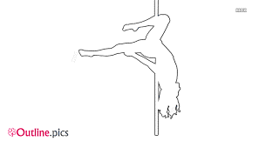

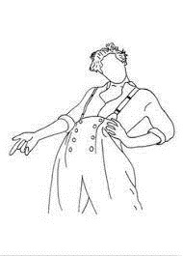





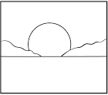
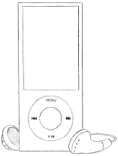



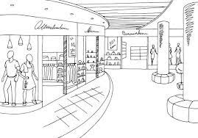
Images - November

Slide 2
November
Mon
M | T | W | R | F | A | U
1 | 2 | 3 | 4 | 5 | 6 | 7
8 | 9 | 10 | 11 | 12 | 13 | 14
15 | 16 | 17 | 18 | 19 | 20 | 21
22 | 23 | 24 | 25 | 26 | 27 | 28
29 | 30
Next Week
Tues
Wed
Thurs
Later
Fri

Slide 3
Sat
Sun
Notes

Slide 4
Meal Prep & Log
Breakfast
Lunch
Dinner
M
T
W
R
F
A
U

Slide 5
Weekly Tracker
M | T | W | R | F | A | U

Slide 6
NOVEMBER
1 | 2 | 3 | 4
8 | 9 | 10 | 11
15 | 16 | 17 | 18
22 | 23 | 24 | 25
29 | 30
Notes

Slide 7
2021
5 | 6 | 7
12 | 13 | 14
19 | 20 | 21
26 | 27 | 28
Movie of the Month
TV of the Month
Music of the Month
Next Month

Slide 8
November 2021
Income
Fixed Expenses + Utilities
Expected | Earned
Total:
Expenses
Rent
Phone
Streaming
Nosaeron
Utilities
Groceries
Dining Out
Commute
Cat Stuff
Beauty
Entertainment
Savings
Other

Slide 9
November 2021
Utilities
38
75
113
150
Groceries
75
150
225
300
Dining Out
75
150
225
300
Commute (ride count)
6
12
24
33
Cat Stuff
10
20
30
40
Beauty
10
20
30
40
Entertainment
38
113
150
75
113
75
Savings
125
250
375
500
Other
150
300
450
600

Slide 10
November 2021
Itemized Lists
Dining Out
Entertainment
Beauty
Other
Cat Stuff

Slide 11
November Review
Keep
Ditch
Change
Try
Goals
Best Moments

Slide 12
NOVEMBER
1
2
3
4
5
6
7
8
9
10
11
12
13
14
15

Slide 13
2021
16
17
18
19
20
21
22
23
24
25
26
27
28
29
30

Slide 14
DECEMBER

Slide 15


DEC
M | T | W | R | F | A | U
 |  | 1 | 2 | 3 | 4 | 5
6 | 7 | 8 | 9 | 10 | 11 | 12
13 | 14 | 15 | 16 | 17 | 18 | 19
20 | 21 | 22 | 23 | 24 | 25 | 26
27 | 28 | 29 | 30 | 31
NEXT WEEK
NEXT WEEK
LATER
LATER

Slide 16

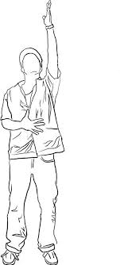
NOTES

Slide 17


Weekly Tracker
T
M
W
U
R
A
F

Slide 18

Weekly Expenditures
Itemized Lists
Dining Out
Entertainment
Cat Stuff
Other
Beauty
Groceries

Slide 19
DECEMBER
 |  | 1 | 2
6 | 7 | 8 | 9
13 | 14 | 15 | 16
20 | 21 | 22 | 23
27 | 28 | 29 | 30
Notes

Slide 20
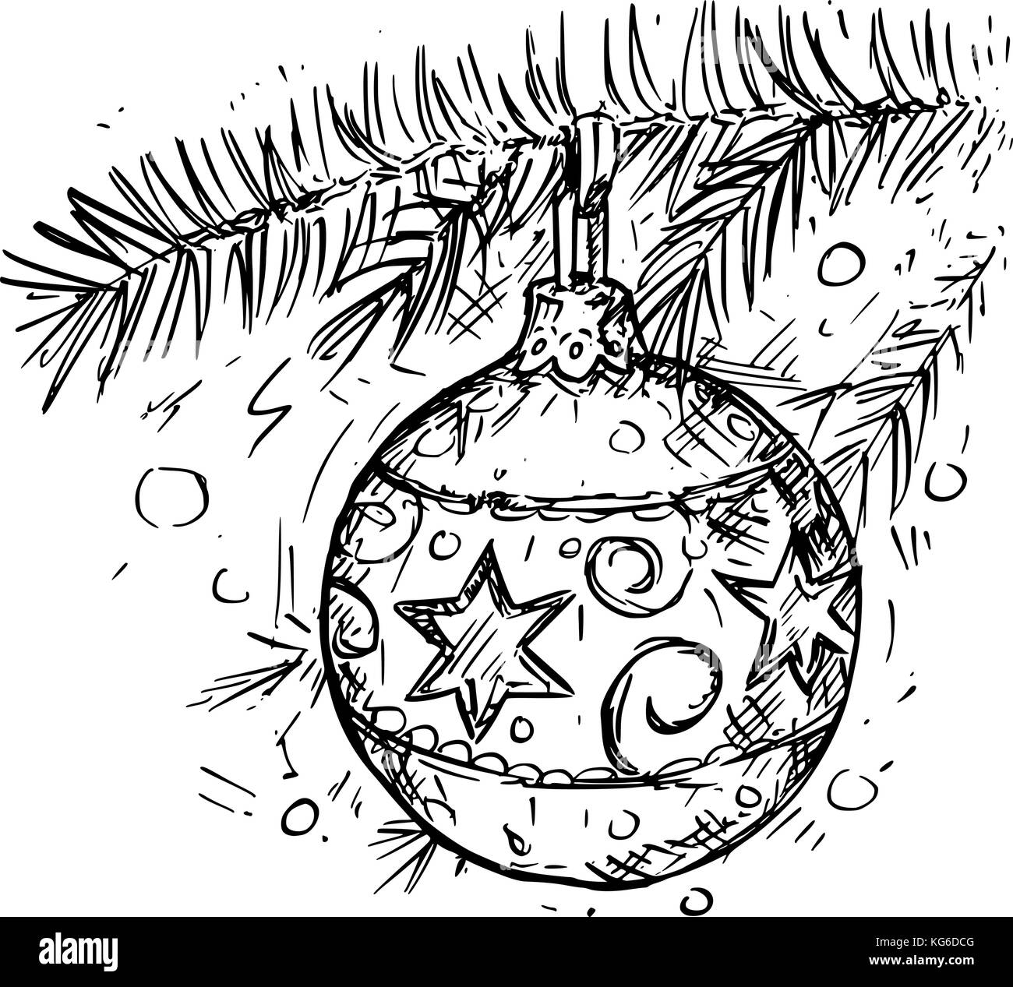

2021
3 | 4 | 5
10 | 11 | 12
17 | 18 | 19
24 | 25 | 26
31
Movie of the Month
TV of the Month
Music of the Month
Next Month

Slide 21
December 2021
Income
Fixed Expenses + Utilities
Expected | Earned
Total:
Expenses
Rent
Phone
Streaming
Nosaeron
Utilities
Groceries
Dining Out
Commute
Cat Stuff
Beauty
Entertainment
Savings
Other

Slide 22
December 2021
Utilities
25%
50%
75%
100%
Groceries
25%
50%
75%
100%
Dining Out
25%
50%
75%
100%
Commute (ride count)
25%
50%
75%
100%
Cat Stuff
25%
50%
75%
100%
Beauty
25%
50%
75%
100%
Entertainment
25%
50%
75%
100%
Savings
25%
50%
75%
100%
Other
25%
50%
75%
100%

Slide 23


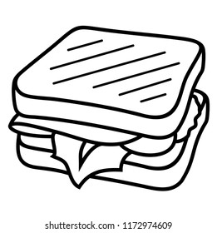


Meal Prep & Log
December
Breakfast
Lunch
Dinner

Slide 24

December Review
Keep
Ditch
Change
Try
Goals
Best Moments

Slide 25

MON
TUES
WED
THUR
FRI
SAT
SUN

Slide 26
Week of
Dining Out
Entertainment
Cat Stuff
Other
Beauty
Groceries

Slide 27
MON
DEC
M | T | W | R | F | A | U
 |  | 1 | 2 | 3 | 4 | 5
6 | 7 | 8 | 9 | 10 | 11 | 12
13 | 14 | 15 | 16 | 17 | 18 | 19
20 | 21 | 22 | 23 | 24 | 25 | 26
27 | 28 | 29 | 30 | 31
TUES
WED
NEXT WEEK
THUR
FRI
LATER
SAT
SUN

Slide 28
Week of
Expenditures
Commute
Dining Out
Entertainment
Cat Stuff
Other
Beauty
Groceries

Slide 29

2021
in review
What I’m Proud of:
Favorite Memories:
Things I Can Improve:
JAN
MAR
MAY
FEB
APR
JUNE

Slide 30

favorites
JULY
SEP
NOV
JULY
AUG
OCT
DEC

Slide 31
January

Slide 32

JANUARY
3 | 4 | 5 | 6
10 | 11 | 12 | 13
17 | 18 | 19 | 20
24 | 25 | 26 | 27
31
Notes

Slide 33
2022
 | 1 | 2
7 | 8 | 9
14 | 15 | 16
21 | 22 | 23
28 | 29 | 30
Movie of the Month
TV of the Month
Music of the Month
Next Month

Slide 34
January 2022
Income
Expected | Earned
Total:
Fixed Expenses + Utilities
Expenses
Rent
Phone
Streaming
Nosaeron
Utilities
House + Toiletries
Groceries
Dining Out
Commute
Cat Stuff
Beauty
Entertainment
Clothes
Fitness
Savings
Other

Slide 35
January 2022
Utilities
25%
50%
75%
100%
House + Toiletries
25%
50%
75%
100%
Groceries
25%
50%
75%
100%
Dining Out)
25%
50%
75%
100%
Commute (ride count)
25%
50%
75%
100%
Cat stuff
25%
50%
75%
100%
Beauty
25%
50%
75%
100%
Entertainment
25%
50%
75%
100%
Clothes
25%
50%
75%
100%
Fitness
25%
50%
75%
100%
Savings
25%
50%
75%
100%
Other
25%
50%
75%
100%

Slide 36
Meal Prep & Log
January
Breakfast
Lunch
Dinner

Slide 37
January Review
Keep
Ditch
Change
Try
Goals
Best Moments

Slide 38

MON
JAN
M | T | W | R | F | A | U
 |  |  |  |  | 1 | 2
3 | 4 | 5 | 6 | 7 | 8 | 9
10 | 11 | 12 | 13 | 14 | 15 | 16
17 | 18 | 19 | 20 | 21 | 22 | 23
24 | 25 | 26 | 27 | 28 | 29 | 30
31
TUES
WED
NEXT WEEK
THUR
FRI
LATER
SAT
SUN
NOTES

Slide 39
Weekly Expenditures
Itemized Lists
Commute:
Dining Out
Entertainment
Cat Stuff
Other
Beauty
Groceries

Slide 40
February

Slide 41


FEBRUARY
 | 1 | 2 | 3
7 | 8 | 9 | 10
14 | 15 | 16 | 17
21 | 22 | 23 | 24
28
Notes

Slide 42
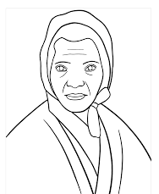
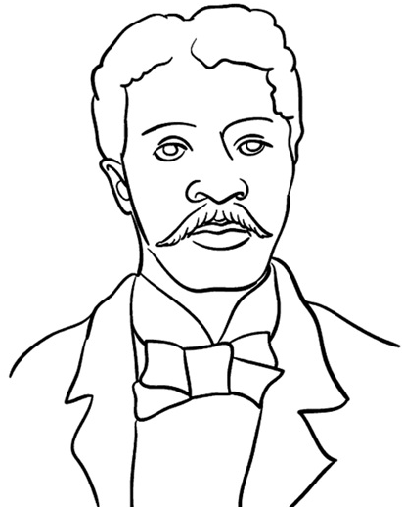
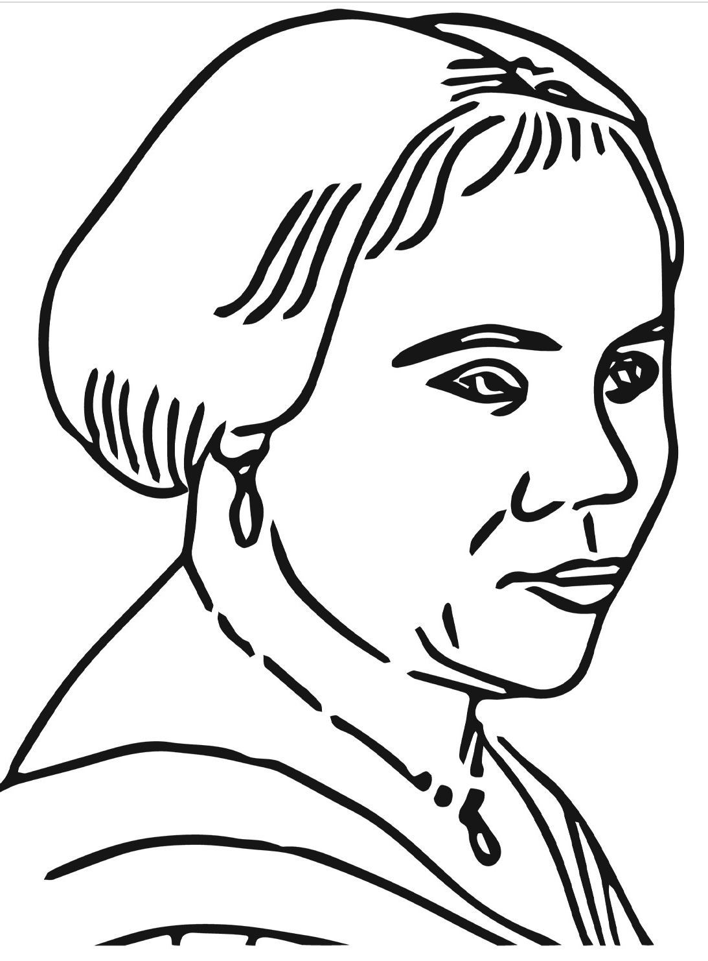
2022
4 | 5 | 6
11 | 12 | 13
18 | 19 | 20
25 | 26 | 27
Movie of the Month
TV of the Month
Music of the Month
George Washington Carver
Sojourner Truth
Madame C.J. Walker
Next Month

Slide 43
February 2022
Income
Expected | Earned
Total:
Fixed Expenses + Utilities
Expenses
Rent
Phone
Streaming
Nosaeron
Utilities
House + Toiletries
Groceries
Dining Out
Commute
Cat Stuff
Beauty
Entertainment
Clothes
Fitness
Savings
Other
Notes:
Streaming 25.60
Netflix 6.60
Spotify 10
Disney+ 4
Apple tv+ 5
Beauty 80
Eyebrows 10
Body wax 70
Fitness 67
Cat stuff
Backpack 45
Food
Grooming 60
Entertainment 75
Commute 120
Clothes
Grocery 125
Dining out 125
Phone 50
Nosaeron 17
Utilities 165
Wifi 55
Coned 90
Laundry 20
Rent 1995
2949

Slide 44
February 2022
Utilities
25%
50%
75%
100%
House + Toiletries
25%
50%
75%
100%
Groceries
25%
50%
75%
100%
Dining Out)
25%
50%
75%
100%
Commute (ride count)
25%
50%
75%
100%
Cat stuff
25%
50%
75%
100%
Beauty
25%
50%
75%
100%
Entertainment
25%
50%
75%
100%
Clothes
25%
50%
75%
100%
Fitness
25%
50%
75%
100%
Savings
25%
50%
75%
100%
Other
25%
50%
75%
100%

Slide 45
Meal Prep & Log
February
Breakfast
Lunch
Dinner

Slide 46
February Review
Keep
Ditch
Change
Try
Goals
Best Moments

Slide 47
MON
FEB
M | T | W | R | F | A | U
 | 1 | 2 | 3 | 4 | 5 | 6
7 | 8 | 9 | 10 | 11 | 12 | 13
14 | 15 | 16 | 17 | 18 | 19 | 20
21 | 22 | 23 | 24 | 25 | 26 | 27
28
TUES
WED
NEXT WEEK
THUR
FRI
LATER
SAT
SUN
NOTES

Slide 48
Weekly Expenditures
Itemized Lists
Commute:
Dining Out
Entertainment
Cat Stuff
Other
Beauty
Groceries

Slide 49
March

Slide 50


MARCH
 | 1 | 2 | 3
7 | 8 | 9 | 10
14 | 15 | 16 | 17
21 | 22 | 23 | 24
28 | 29 | 30 | 31
Notes

Slide 51

2022
4 | 5 | 6
11 | 12 | 13
18 | 19 | 20
25 | 26 | 27
Movie of the Month
TV of the Month
Music of the Month
Next Month

Slide 52
MARCH 2022
Income
Expected | Earned
Total:
Fixed Expenses + Utilities
Expenses
Rent
Phone
Streaming
Nosaeron
Utilities
House + Toiletries
Groceries
Dining Out
Commute
Cat Stuff
Beauty
Entertainment
Clothes
Fitness
Savings
Other
Notes:
Streaming 25.60
Netflix 6.60
Spotify 10
Disney+ 4
Apple tv+ 5
Beauty 80
Eyebrows 20
Body wax 19+25
Fitness 180
Cat stuff 100
Grooming 60
Food 40
Entertainment 75
Commute 120
Therapy 165
House + toiletries 50
Clothes 50
Grocery 125
Dining out 150
Phone 50
Nosaeron 17
Utilities 165
Wifi 55
Coned 90
Laundry 20
Rent 1995
Other 714

Slide 53
March 2022
Utilities
25%
50%
75%
100%
House + Toiletries
25%
50%
75%
100%
Groceries
25%
50%
75%
100%
Dining Out)
25%
50%
75%
100%
Commute (ride count)
25%
50%
75%
100%
Cat stuff
25%
50%
75%
100%
Beauty
25%
50%
75%
100%
Entertainment
25%
50%
75%
100%
Clothes
25%
50%
75%
100%
Fitness
25%
50%
75%
100%
Savings
25%
50%
75%
100%
Other
25%
50%
75%
100%

Slide 54
Meal Prep & Log
March
Breakfast
Lunch
Dinner

Slide 55
March Review
Changes
General Review
Goals
Best Moments

Slide 56
MON
MAR
M | T | W | R | F | A | U
 | 1 | 2 | 3 | 4 | 5 | 6
7 | 8 | 9 | 10 | 11 | 12 | 13
14 | 15 | 16 | 17 | 18 | 19 | 20
21 | 22 | 23 | 24 | 25 | 26 | 27
28 | 29 | 30 | 31
TUES
WED
NEXT WEEK
THUR
FRI
LATER
SAT
SUN
NOTES

Slide 57
Weekly Expenditures
Itemized Lists
Commute:
House/Toiletries
Entertainment
Other
Cat Stuff
Clothes
Beauty
Dining Out
Grocery

Slide 58
May

Slide 59
MAY
2 | 3 | 4 | 5
9 | 10 | 11 | 12
16 | 17 | 18 | 19
23 | 24 | 25 | 26
30 | 31
Notes

Slide 60
2022
 |  | 1
6 | 7 | 8
13 | 14 | 15
20 | 21 | 22
27 | 28 | 29
Movie of the Month
TV of the Month
Music of the Month
Next Month

Slide 61
MAY 2022
Income
Expected 3941 | Earned
Total:
Fixed Expenses + Utilities
Netflix
Spotify
Disney+
Apple TV+
Wifi
ConEd
Phone
Body & Pole
Expenses
Rent | 1970
Phone | 55
Streaming | 27
Utilities
House + Toiletries
Groceries
Dining Out
Cat Stuff
Beauty
Entertainment
Clothes
Fitness | 180
Savings
Other
Notes:
Streaming 25.60
Netflix 6.60
Spotify 10
Disney+ 4
Apple tv+ 5
Beauty 80
Eyebrows 20
Body wax 19+25
Fitness 180
Cat stuff 100
Grooming 60
Food 40
Entertainment 75
Commute 120
Therapy 165
House + toiletries 50
Clothes 50
Grocery 125
Dining out 150
Phone 50
Nosaeron 17
Utilities 165
Wifi 55
Coned 90
Laundry 20
Rent 1995
Other 714

Slide 62
May 2022
Utilities
25%
50%
75%
100%
House + Toiletries
25%
50%
75%
100%
Groceries
25%
50%
75%
100%
Dining Out)
25%
50%
75%
100%
Commute (ride count)
25%
50%
75%
100%
Cat stuff
25%
50%
75%
100%
Beauty
25%
50%
75%
100%
Entertainment
25%
50%
75%
100%
Clothes
25%
50%
75%
100%
Fitness
25%
50%
75%
100%
Savings
25%
50%
75%
100%
Other
25%
50%
75%
100%

Slide 63
Meal Prep & Log
May
Breakfast
Lunch
Dinner

Slide 64
May Review
Changes
General Review
Goals
Best Moments

Slide 65
MON
MAY
M | T | W | R | F | A | U
 |  |  |  |  |  | 1
2 | 3 | 4 | 5 | 6 | 7 | 8
9 | 10 | 11 | 12 | 13 | 14 | 15
16 | 17 | 18 | 19 | 20 | 21 | 22
23 | 24 | 25 | 26 | 27 | 28 | 29
30 | 31
TUES
WED
NEXT WEEK
THUR
FRI
LATER
SAT
SUN
NOTES

Slide 66
Weekly Expenditures
Itemized Lists
Commute:
House/Toiletries
Entertainment
Other
Cat Stuff
Clothes
Beauty
Dining Out
Grocery

