Slide 1

November
Mon
M | T | W | R | F | A | U
1 | 2 | 3 | 4 | 5 | 6 | 7
8 | 9 | 10 | 11 | 12 | 13 | 14
15 | 16 | 17 | 18 | 19 | 20 | 21
22 | 23 | 24 | 25 | 26 | 27 | 28
29 | 30
Next Week
Tues
Wed
Thurs
Fri

Slide 2

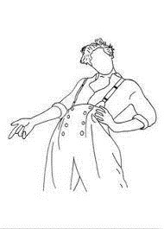
Sat
Sun
Notes

Slide 3

November 2021
Utilities
38
75
113
150
Groceries
75
150
225
300
Dining Out
75
150
225
300
Commute
6
12
24
33
Cat Stuff
10
20
30
40
Beauty
10
20
30
40
Entertainment
38
113
150
75
113
75
Savings
125
250
375
500
Other
150
300
450
600

Slide 4

November 2021
Income
Fixed Expenses + Utilities
Expected | Earned
Total:
Expenses
Rent
Phone
Streaming
Nosaeron
Utilities
Groceries
Dining Out
Commute
Cat Stuff
Beauty
Entertainment
Savings
Other

Slide 5
November 2021
Itemized Lists
Dining Out
Entertainment
Beauty
Other
Cat Stuff

Slide 6
Meal Prep & Log
Breakfast
Lunch
Dinner
M
T
W
R
F
A
U

