Slide 1
What is a Node?
It is an engine which runs JavaScript code on a backend server
Traditionally JavaScript code is to be run on browser. The creators of Node took that and made it to create
backend applications using JavaScript

Slide 2
Running Node
A simple JavaScript function to print
function printName(name){
console.log("Hello "+name);
}
printName('DigitalCrafts’)

Slide 3
Node Package Manager (npm)
The code we write is packaged and distributed and npm makes it easier
Each project is considered as a package
To create our own package for your project, do npm init –y and this will create a file called package.json

Slide 4
Node Package Manager (npm)
When we work on a project, we often use third party/external libraries and npm helps install them for us
To use third party/external libraries in your project, you do “npm install {package}”
npm install will update package.json file and create/update folder named “node_modules” which contains the
downloaded packages
Important: Add node_modules to your .gitignore so that you don’t commit that folder

Slide 5
Exercise

Slide 6
Creating a server
The most common use case for node is creating a web server to handle request and generate response
Recall the components of HTTP request
protocol which is http/https
server/host name for ex : learn.digitalcrafts.com
behind the scene a server would be listening on a particular port
headers if any
How to create a server in node?
Using the ‘http’ package one can easily setup a server. Example code here
const http = require("http");
const hostname = "127.0.0.1";
const port = 3000;
const server = http.createServer((req, res) => {
res.statusCode = 200;
res.setHeader("Content-Type", "text/plain");
res.end("Hello World");
});
server.listen(port, hostname, () => {
console.log(`Server running at http://${hostname}:${port}/`);
});

Slide 7
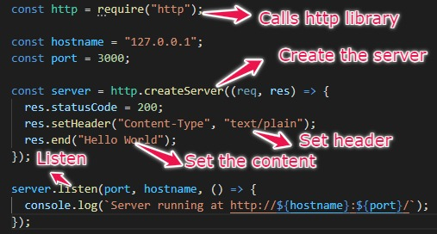
Creating a server

Slide 8
Handling different request types
Server code can be written to handle specific http method types
const methodType = req.method.toUpperCase();
switch (methodType) {
case 'GET':
//do something to handle get request
break;
case 'POST':
//do something to handle post request
break;
case 'PUT':
//do something to handle put request
break;
case 'DELETE':
//do something to handle delete request
break;
}

Slide 9
Server for Cat API
Now let us write our own server to simulate the Cat API we used
Requirements
The API would respond with the following JSON structure when calling the endpoint /breeds
{
"id":
"name":
"description":
"origin":
"child_friendly":
"stranger_friendly":
"life_span":
"description":
}

