Slide 1
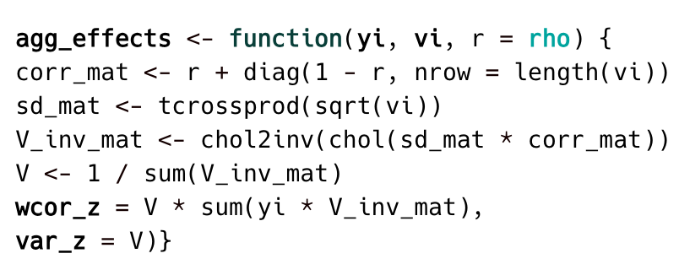
1.
r-to-z transform
2.
Group¹ correlations
3.
Aggregate correlations²
4.
z-to-r transform
panel | time_diff | gender | age_group | meas_cat | Item_num | domain | retest_cor | n | yi | vi
panel_A | 0.5 | F | 20-30 | fre | one | smo | 0.635 | 250 | 0.750 | 0.004
panel_A | 0.5 | F | 20-30 | fre | one | smo | 0.575 | 341 | 0.655 | 0.003
panel_B | 2 | F | 50-60 | fre | one | dru | 0.647 | 367 | 0.770 | 0.003
panel_A | 0.5 | F | 20-30 | fre | one | smo | 0.864 | 208 | 1.309 | 0.005
panel_C | 1 | F | 30-40 | fre | one | smo | 0.634 | 456 | 0.748 | 0.002
panel_A | 0.5 | F | 20-30 | fre | one | smo | 0.652 | 208 | 0.779 | 0.005
panel_B | 2 | F | 50-60 | fre | one | dru | 0.711 | 405 | 0.889 | 0.002
panel_B | 2 | F | 50-60 | fre | one | dru | 0.657 | 304 | 0.788 | 0.003
panel_C | 1 | F | 30-40 | fre | one | smo | 0.689 | 367 | 0.846 | 0.003
panel_C | 1 | F | 30-40 | fre | one | smo | 0.665 | 425 | 0.802 | 0.002
panel_A | 0.5 | F | 20-30 | fre | one | smo | 0.803 | 276 | 1.107 | 0.004
panel_C | 1 | F | 30-40 | fre | one | smo | 0.606 | 346 | 0.703 | 0.003
panel | …. | yi | vi
panel_A | ….. | 0.750 | 0.004
panel_A | ….. | 0.655 | 0.003
panel_A | ….. | 1.309 | 0.005
panel_A | ….. | 0.779 | 0.005
panel_A | …. | 1.107 | 0.004
wcor_z | var_z | wcor | var
0.824 | 0.002 | 0.677 | 0.001
panel_B | ….. | 0.770 | 0.003
panel_B | ….. | 0.889 | 0.002
panel_B | ….. | 0.788 | 0.003
0.842 | 0.002 | 0.687 | 0.001
0.775 | 0.001 | 0.65 | 0.001
panel_C | ….. | 0.748 | 0.002
panel_C | ….. | 0.846 | 0.003
panel_C | ….. | 0.802 | 0.002
panel_C | ….. | 0.703 | 0.003
¹ By panel, retest interval, gender, age group, measure category, number of items, and domain
2 Function from James E. Pustejovsky, J. E. (2019). Sometimes, aggregating effect sizes is fine.

