Slide 1


1A01 Say Hi, Say Goodbye
全球口语科技领导品牌
LEADING GLOBAL BRAND OF
SPOKEN LANGUAGE TECHNOLOGY

Slide 2


Warm up

Slide 3
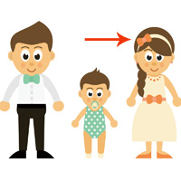
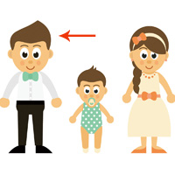
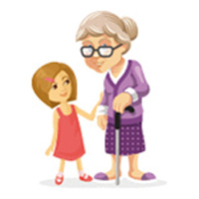
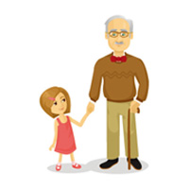
Vocabulary
mom
dad
grandma
grandpa

Slide 4

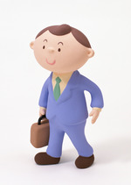
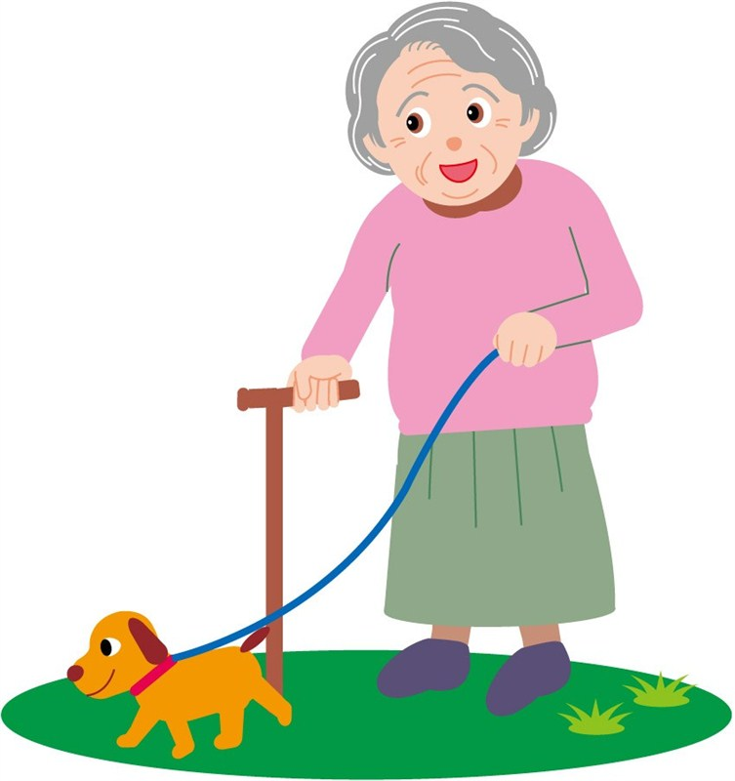
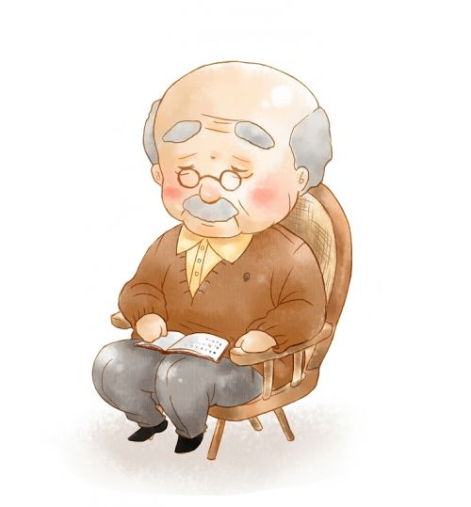
Vocabulary
mom
dad
grandma
grandpa

Slide 5

Vocabulary

Slide 6

Sentence
hi

Slide 7
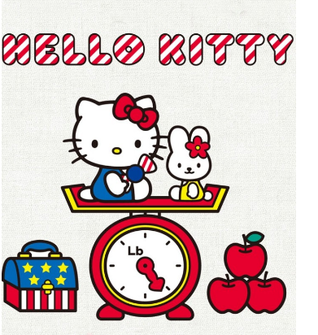
Sentence
hello

Slide 8
Sentence
hi
hello

Slide 9
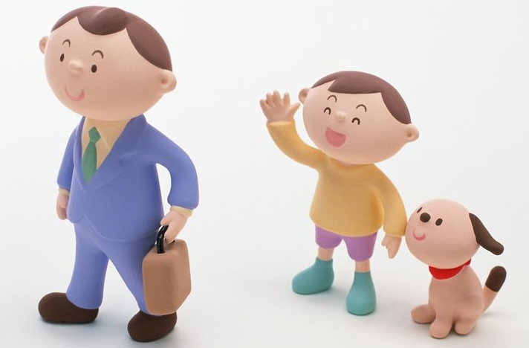
Sentence
goodbye

Slide 10
Sentence
goodbye
Goodbye, mom.

Slide 11





Letters

Slide 12


Slide 13


Slide 14
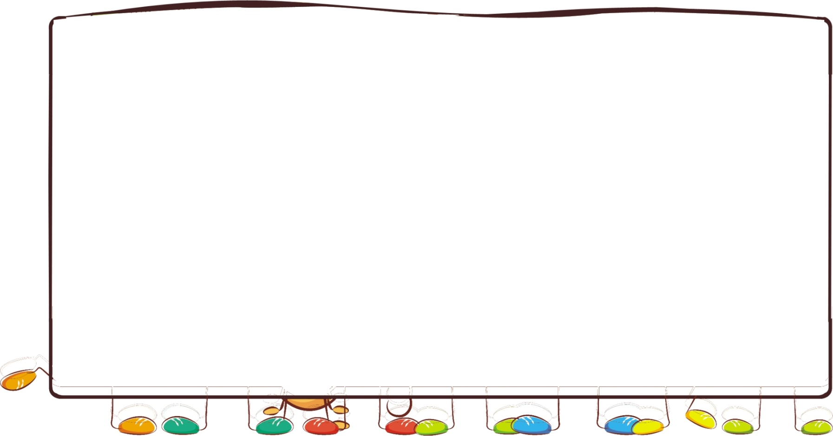
Text
Hi mom.
Hi dad.
Hi grandma.
Goodbye mom.
Goodbye dad.
Goodbye grandma.

Slide 15
Wrap up

Slide 16

See You
Have a nice day！

