Slide 1
Jorvik 3
Costs, benefits and comparisions

Slide 2
Intel and AMD comparison
Intel
Master/Storage Node
64GB DDR III 1600 ECC
Mellanox FDR 56GB single port card.
8 core Intel E5-2609 2.4GHz Ivy Bridge
500GB 10K RPM Raptor OS drive
63TB RAW disk space (21 * 3TB)
LSI 9271-4i RAID card with BBU
3 yrs NBD warranty – parts & labor
COST: $10,550.00
AMD
Master/Storage Node
64GB DDR III 1600 ECC
Mellanox FDR 56GB single port card.
8 core AMD 6328 3.0GHz CPU
500GB 10K RPM Raptor OS drive
63TB RAW disk space (21 * 3TB)
LSI 9271-4i RAID card with BBU
3yrs NBD warranty – parts & labor
COST: $10,950
APC Uninterruptable Power Supply (UPS) – SUA220RM2U – 2200V 110V
COST: $1,050

Slide 3
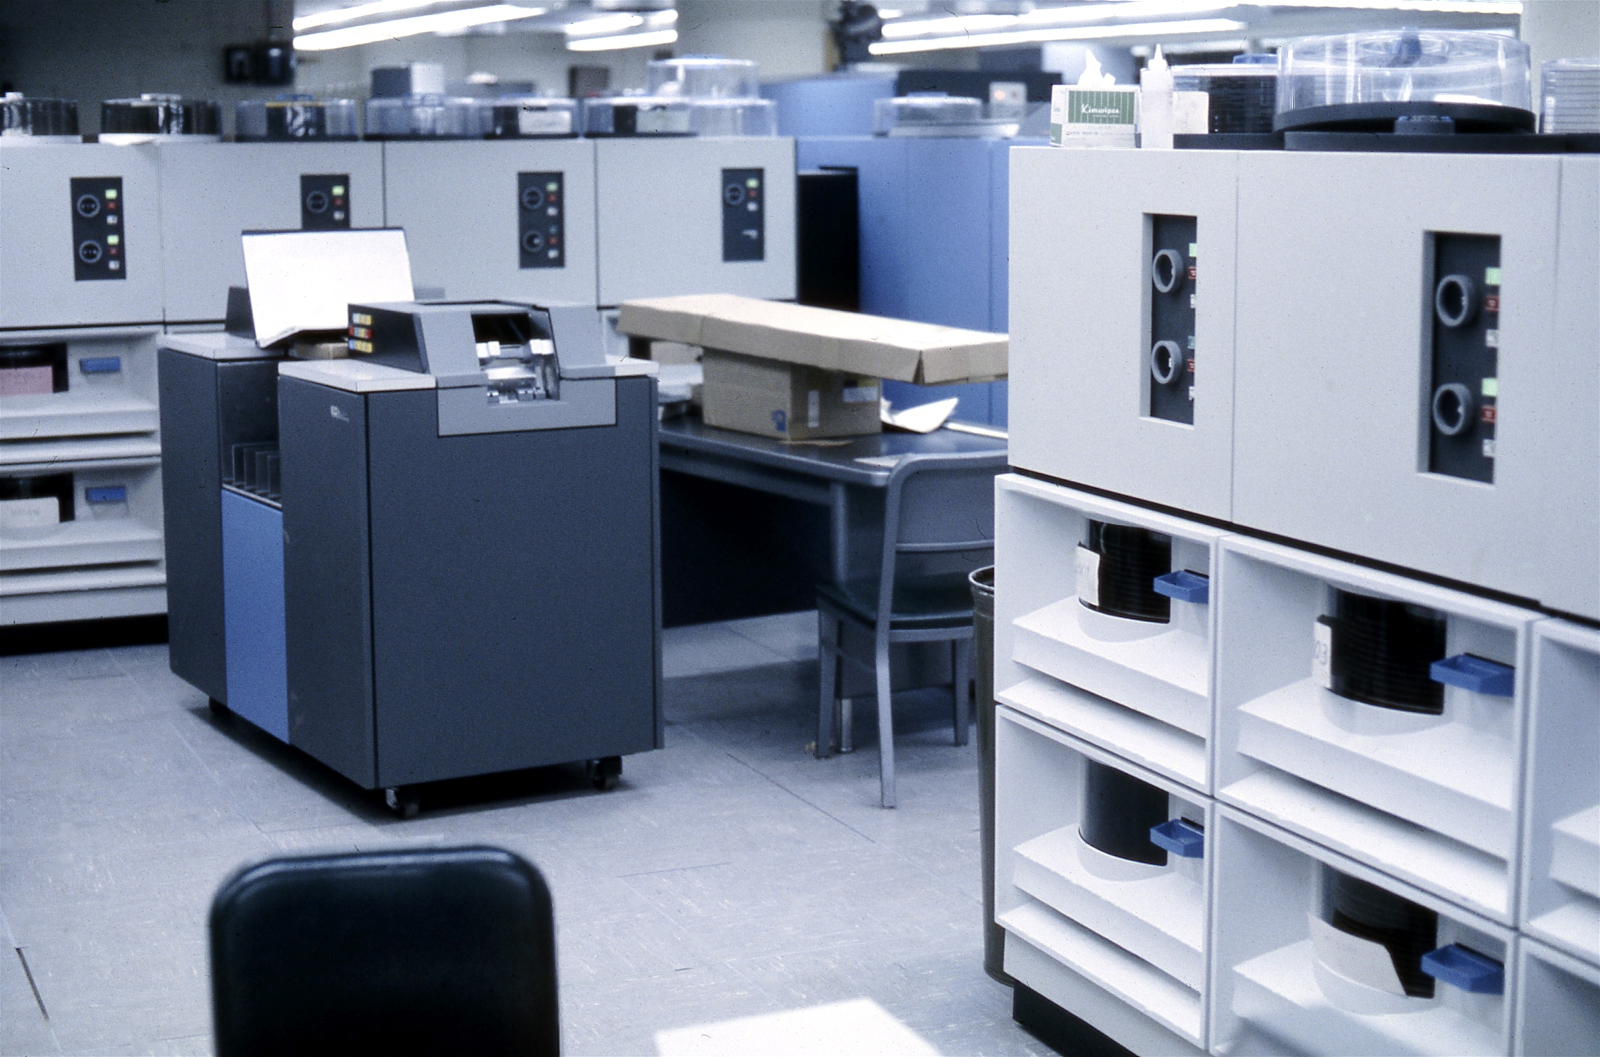
Layout of the least expensive computational node I could find –
I/O system accuracy depends on NOT dropping the punch cards.

Slide 4
Intel and AMD comparison
Intel
Computational Node
64GB DDR III 1600 ECC
Mellanox FDR 56GB single port card.
Intel E5-2695 2.4GHz 12 cores (24 total)
250GB 10K RPM Raptor OS drive
2TB local disk space
2 Tesla K20X GPUs
3 yrs NBD warranty – parts & labor
COST: $15,950 (12)
AMD
Computational Node
64GB DDR III 1600 ECC
Mellanox FDR 56GB single port card.
AMD 6376 2.3GHz 16 cores (32 total)
250GB 10K RPM Raptor OS drive
2TB local disk space
2 Tesla K20X GPUs
3yrs NBD warranty – parts & labor
COST: $12,380 (16)

Slide 5
Intel and AMD CPU specs
Intel
Number of Cores: 288
Number of ex-threads: 576
Total memory (GB): 768
Memory/Core (GB): 2.67
Memory/Thread (GB): 1.33
DATA POINTS:
Introduction Date: 9/10/13
Core Name: Ivy Bridge –EP
Mirco Arch Name: Ivy Bridge
L1 Cache: 384KB(code)/384KB(data)
L2 Cache: 3072KB
L3 Cache: 30720KB
Multiprocessing: 2
Street Price: $2336
AMD
Number of Cores: 512
Number of ex-threads: 512
Total Memory(GB): 1024
Memory/Core (GB): 2
Memory/Thread (GB): 2
DATA POINTS:
Introduction Date: 11/5/12
Core Name: Abu Dahbi
Micro Arch Name: Piledriver
L1 Cache: 512KB(code)/256KB(data)
L2 Cache: 16384KB
L3 Cache: 16384KB
Multiprocessing: 4
Street Price: $703

Slide 6
Networking
Mellanox SwitchX-2 SX6018 Managed FDR 56GB/s 18 port Infiniband – 3yr Warranty -- $9,380.00
Netgear 48 port Basic Switch with 48 CAT5E cables -- $750
Mellanox cabling 1M/2M/3M FDR 56GB Copper -- $90 each (12 – Intel / 16 – AMD)

Slide 7
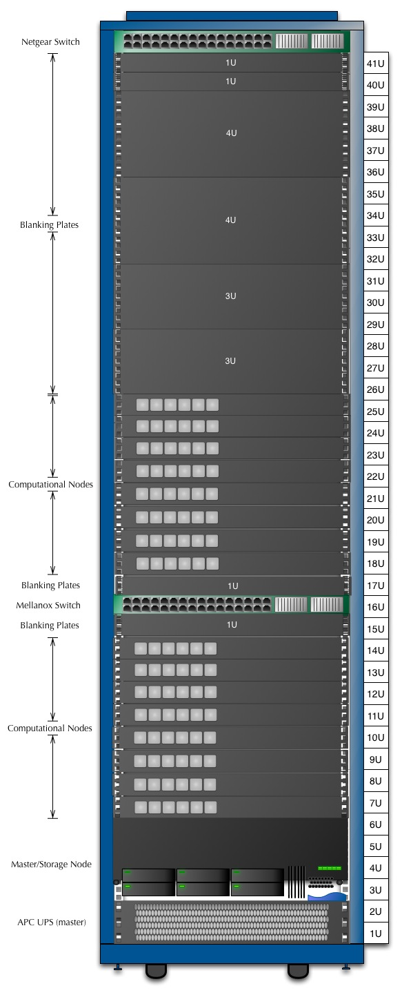
Jorvik 3 proposed rack.
The node count will change
depending on the
CPU architecture that is
chosen.

Slide 8
Notes
AMD cores have shared floating point modules (FPM).
Each CPU has 16 cores and 8 FPMs
Can cause bottleneck in FP operation (wait for resource)
Can assign flags to code targeting either odd or even cores for execution.
Both CPUs are rated at 115 watts
Intel has 2 QPI links, AMD has 4 HT links.

Slide 9
Discussion and Questions
Discussion

