Slide 1
Big Mountain Resort
Guided Capstone
Corey Schneider

Slide 2
Identifying Pricing Opportunities
Lift ticket prices do not properly reflect Big Mountain’s attributes
Current ticket price $81
Recently-installed chairlift is a clear opportunity to revisit
Increases in both costs and value need to be accounted for
Underpriced tickets hurt profitability
Statistical modeling can determine appropriate price
Other changes can further enhance profitability

Slide 3
Strategic Recommendations
Raise ticket price to $95
Market analysis shows that tickets are significantly undervalued
Close up to five least-used runs
Model suggests closing five runs would have minimal impact on perceived value of tickets while reducing operating cost

Slide 4
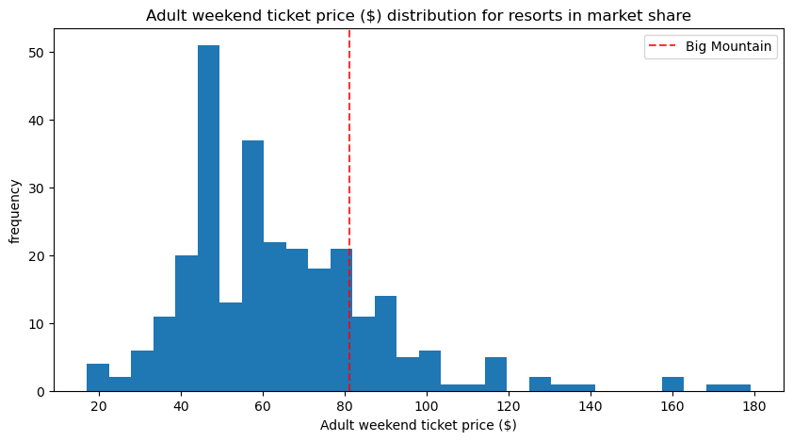
Model Overview
Data from 277 US ski resorts
Goal: determine what factors correlate with ticket price and estimate appropriate price for Big Mountain

Slide 5
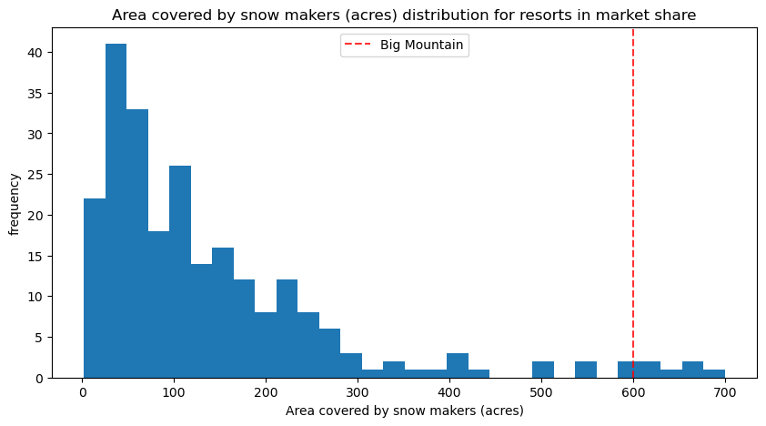
Key Factors
In our analysis, the factors most predictive of price:
Vertical drop
Snow-making area
Total chairs
Fast quad lifts
Number of runs
Longest run length
Big Mountain is very strong in most of these categories

Slide 6
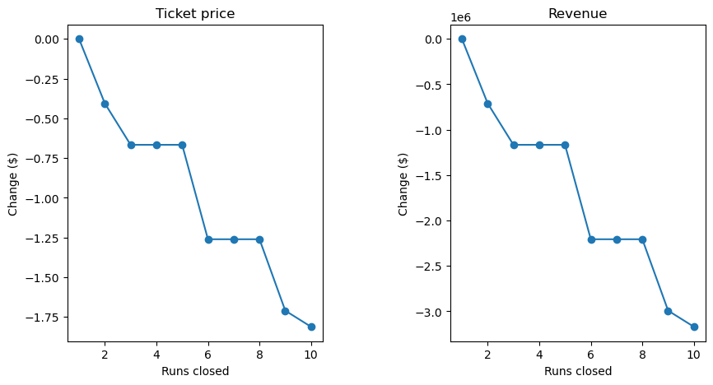
Consolidation of Underutilized Runs
Model shows up to five runs can be closed while reducing ticket value by less than one dollar
This represents more than one million dollars in revenue reduction, but increased profits due to cost savings
Further study needed to select appropriate runs and estimate savings

Slide 7
Summary and Conclusion
Big Mountain tickets currently undervalued, especially after opening new lift
Model suggests $95.87, compared to current $81
However, model estimates error ± $10.37
Further profitability enhancements through consolidation of runs
Up to 5 runs can be closed without decreasing price support by >$1/ticket
Continued expansion and price increases may be difficult to achieve with current customer base

