Slide 1
Platform Options for Machinekit
Current and Future
Charles Steinkuehler
charles@steinkuehler.net
Machinekit meetup
Tormach Facility
Waunakee, WI
November 7, 2015

Slide 2
Agenda
Introduction
Current platforms
Smart Hardware I/O
Future platforms
Questions

Slide 3
Current Platforms – x86
Standard x86 PC, 32 or 64 bit
Software stepping via parallel port (disappearing)
High performance, good graphics
Hardware interfaces available (PCI/PCIe/EPP)
Best choice for overall ease of application!

Slide 4
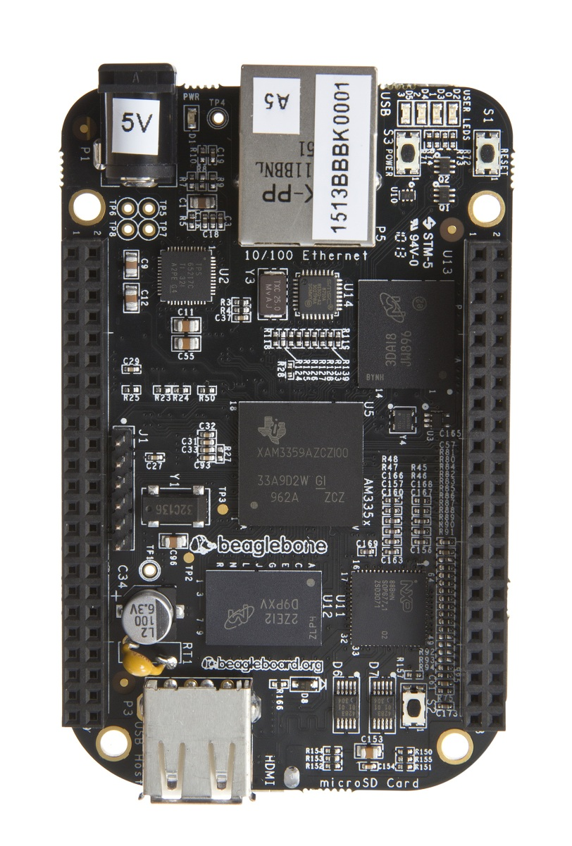
Current Platforms – ARM
BeagleBone
PRU to replace high-speed base thread
Several “capes” available
Industrial bus (CAN)
HW Encoder and PWM support
Poor graphics performance
Open design with data sheets

Slide 5
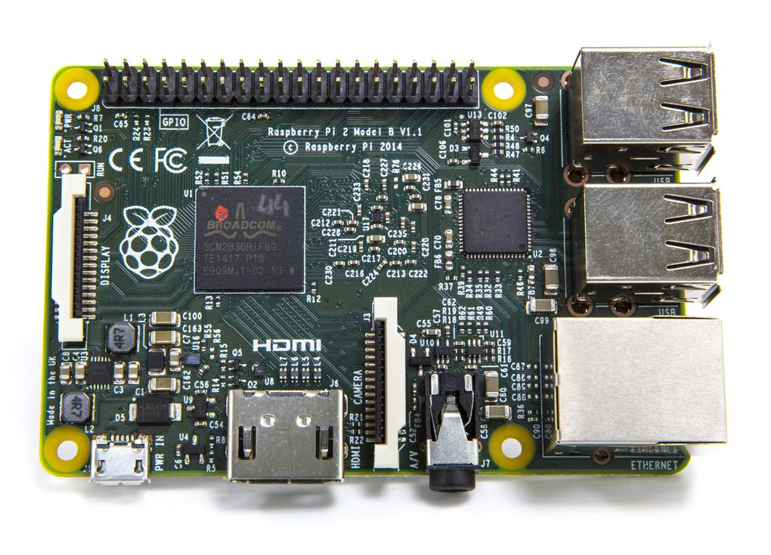
Current Platforms – ARM
Raspberry Pi 1 & 2
Good GPU performance
Limited interfaces to motors
Poor SW step generation
“Black box” CPU

Slide 6
Smart Hardware I/O
Mesanet, Pico Systems, Others?
Offloads step/dir, pwm, encoders, etc.
Connects via EPP, PCI/PCIe, Ethernet
Assorted choices available depending on system needs (steppers, servos, analog I/O, etc)
Highest performance option!
Reasonable costs

Slide 7
Future Platforms
Multi-core
  X86 – Don't count Intel out!
    Desperate for tablet / phone market share
  ARM: big.LITTLE
  Multiple flavors (Cortex A+M, DSP, etc)
CPU + FPGA (Altera SoC, Xilinx Zynq)
Expansion buses (PCIe) on SBCs
Fieldbus systems (Ethernet, CAN, etc)

Slide 8
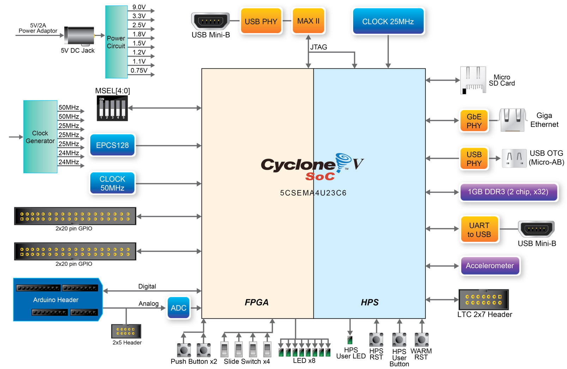
Altera SoC: DE0-Nano-SoC / Atlas
$99!
Dual-core ARM with FPGA
0.1” pin-headers
1 GB DDR3
Gigabit Ethernet
Arduino headers
No display

Slide 9
Other SoC Options
Xilinx Zynq
  Parallela board $99, but awkward I/O
  Zynq chip specifications similar to Altera SoC
Many other Xilinx and Altera boards are expensive, have limited or difficult to access I/O (custom high-density connectors)
Once one board is supported, others in the same family (Altera or Xilinx) should be easy to port
SoC platforms have been out long enough support is hitting mainline for Linux, u-Boot, etc.

Slide 10
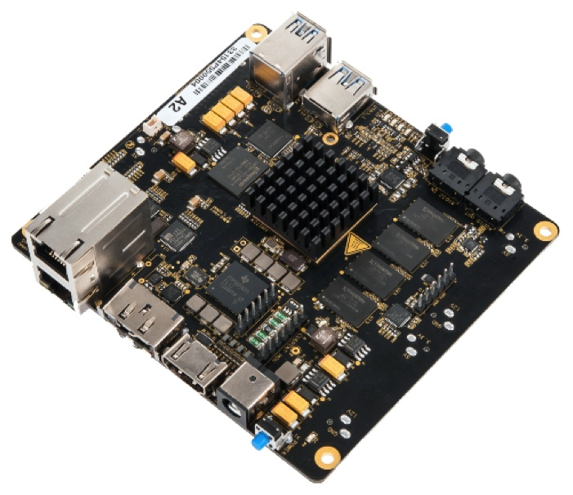
BeagleBoard X15 – Lots of CPUs
Lots of cores:
  2x 1.5 GHz Cortex-A15
  2x 700 MHz C66 FP-DSP
  2x Dual Cortex-M4
  4x 200 PRU
2GB DDR3 DRAM
2x Gigabit Ethernet
Multiple GPUs and video co-processor
eSATA
Expansion connectors w/PCIe

Slide 11
References
Mesanet hardware boards:
http://store.mesanet.com/index.php?route=product/category&path=83
Pico Systems hardware boards:
http://pico-systems.com/osc2.5/catalog/index.php
Altera SoC support site:
http://rocketboards.org/foswiki/view/Main/WebHome
Terasic DE0-Nano-SoC
http://www.terasic.com.tw/cgi-bin/page/archive.pl?Language=English&No=941
BeagleBoard x15
http://beagleboard.org/x15

Slide 12
License
Copyright (C) 2015 Charles Steinkuehler.
Permission is granted to copy, distribute and/or modify this document under the terms of the GNU Free Documentation License, Version 1.3 or any later version published by the Free Software Foundation; with no Invariant Sections, no Front-Cover Texts, and no Back-Cover Texts. A copy of the license may be obtained from the Free Software Foundation:
http://www.gnu.org/licenses/fdl.html

