Slide 1
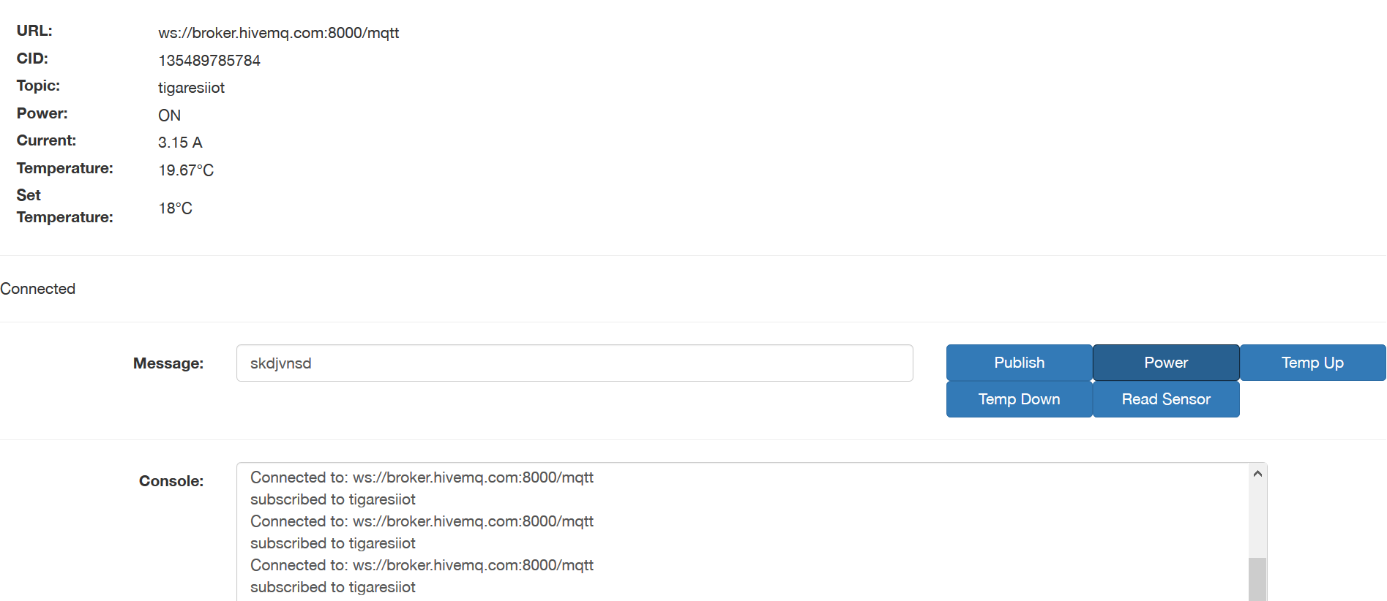
[url_f]
[cid_f]
[top_f]
[pow_f]
[cur_f]
[tem_f]
[tst_f]
[conn]
> publish_msg()
> toggle_power()
> temp_up()
[mqttmsg]
> temp_down()
> read_sensor()
[console_]

Slide 2
Si7021 temperature sensor
I²C
Air Conditioner
SCT013 current sensor
0~1V DC
AD7124 analog-to-digital converter
SPI
Raspberry Pi
Digital out
Infrared

Slide 3
Air Conditioner
SCT013 current sensor
0~1V DC
AD7124 analog-to-digital converter
Si7021 temperature sensor
SVDD
DGND
AVss
SCLK
MISO
MOSI
GND
VDD
SDA
SCL
2 3 23 28 29 30
1 2 3 4 5 6
100nF
→
→
10kΩ
200Ω
TSOP4838
IR Receiver
Raspberry Pi
OUT
GND
200Ω
VCC
15 2 8 10
23 21 19 1 3 6 5
RX
TX
V5.0
SCLK
SCL
MISO
GPIO22
MOSI
V3.3
SDA
GND
IR
→
→
NPN BC547/557

Slide 4
0~1V DC
AD7124 analog-to-digital converter
Si7021 temperature sensor module
Air Conditioner
SCT013 current sensor
+
+
AC +
-
-
AC -
~SS
GND
VDD
SCLK
MISO
GND
MOSI
VDD
SDA
SCL
GND
3.3V
TSOP4838
IR Receiver
module
Raspberry Pi/Development board
IN
5.0V
SCLK
SCL
MISO
GPIO22
GPIO18
CE0
MOSI
3.3V
SDA
GND
5V
GND
IR Blaster
module
3.3V
GND
OUT
5V
GND
External power supply

Slide 5
56t100c
current sensor
module
ADS1115 analog-to-digital converter
(I2C Address 0x49)
Si7021 temperature sensor module
(I2C Address 0x40)
Air Conditioner
0~5V DC
+
+
OUT
A0
-
GND
-
A1
GND
5.0V
ADDR
SCL
GND
VDD
GND
SDA
VDD
SDA
SCL
GND
5.0V
TSOP4838
IR Receiver
module
Raspberry Pi/Development board
TBN061807005
IN
5.0V
3.3V
SDA
GND
SCL
GPIO22
GPIO18
5V
GND
IR Blaster
module
3.3V
GND
OUT
5V
GND
External power supply

Slide 6
Sensors
AC
IR Command
Sensor data
Command
Embedded system
Subscribe command
MQTT broker
Subscribe command
HTML/JS client
Publish data
Publish data
Sensor data
[Event timer]
PHP client side
Server
(PHP + MySQL)
Push data
Show data

Slide 7
AC
MySQL Database
IR Command
Get data
Send query
Embedded system
Subscribe command
MQTT broker
Subscribe command
Server Engine
(C++, PHP, MySQL)
Publish data
Publish data
Sensor data
Get data
Send query
Sensors
HTML/JS client

Slide 8
Timestamp
Current
Log
Temperature
Log
Timestamp int | Current float | Temperature float

