Slide 1


Making it easy to say hello.

Slide 2
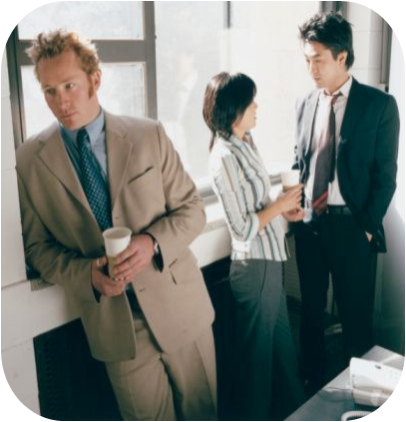
Problem
2
Meaningfully connecting with nearby strangers is SCARY.
Problem
Solution
Revenue
Market
Competitors
Go-to-Market

Slide 3
Of 34 interviewed strangers...
3
97%
are interested in learning about strangers’ stories.
find some difficulty in approaching others and in starting conversations
94%
Problem
Solution
Revenue
Market
Competitors
Go-to-Market

Slide 4
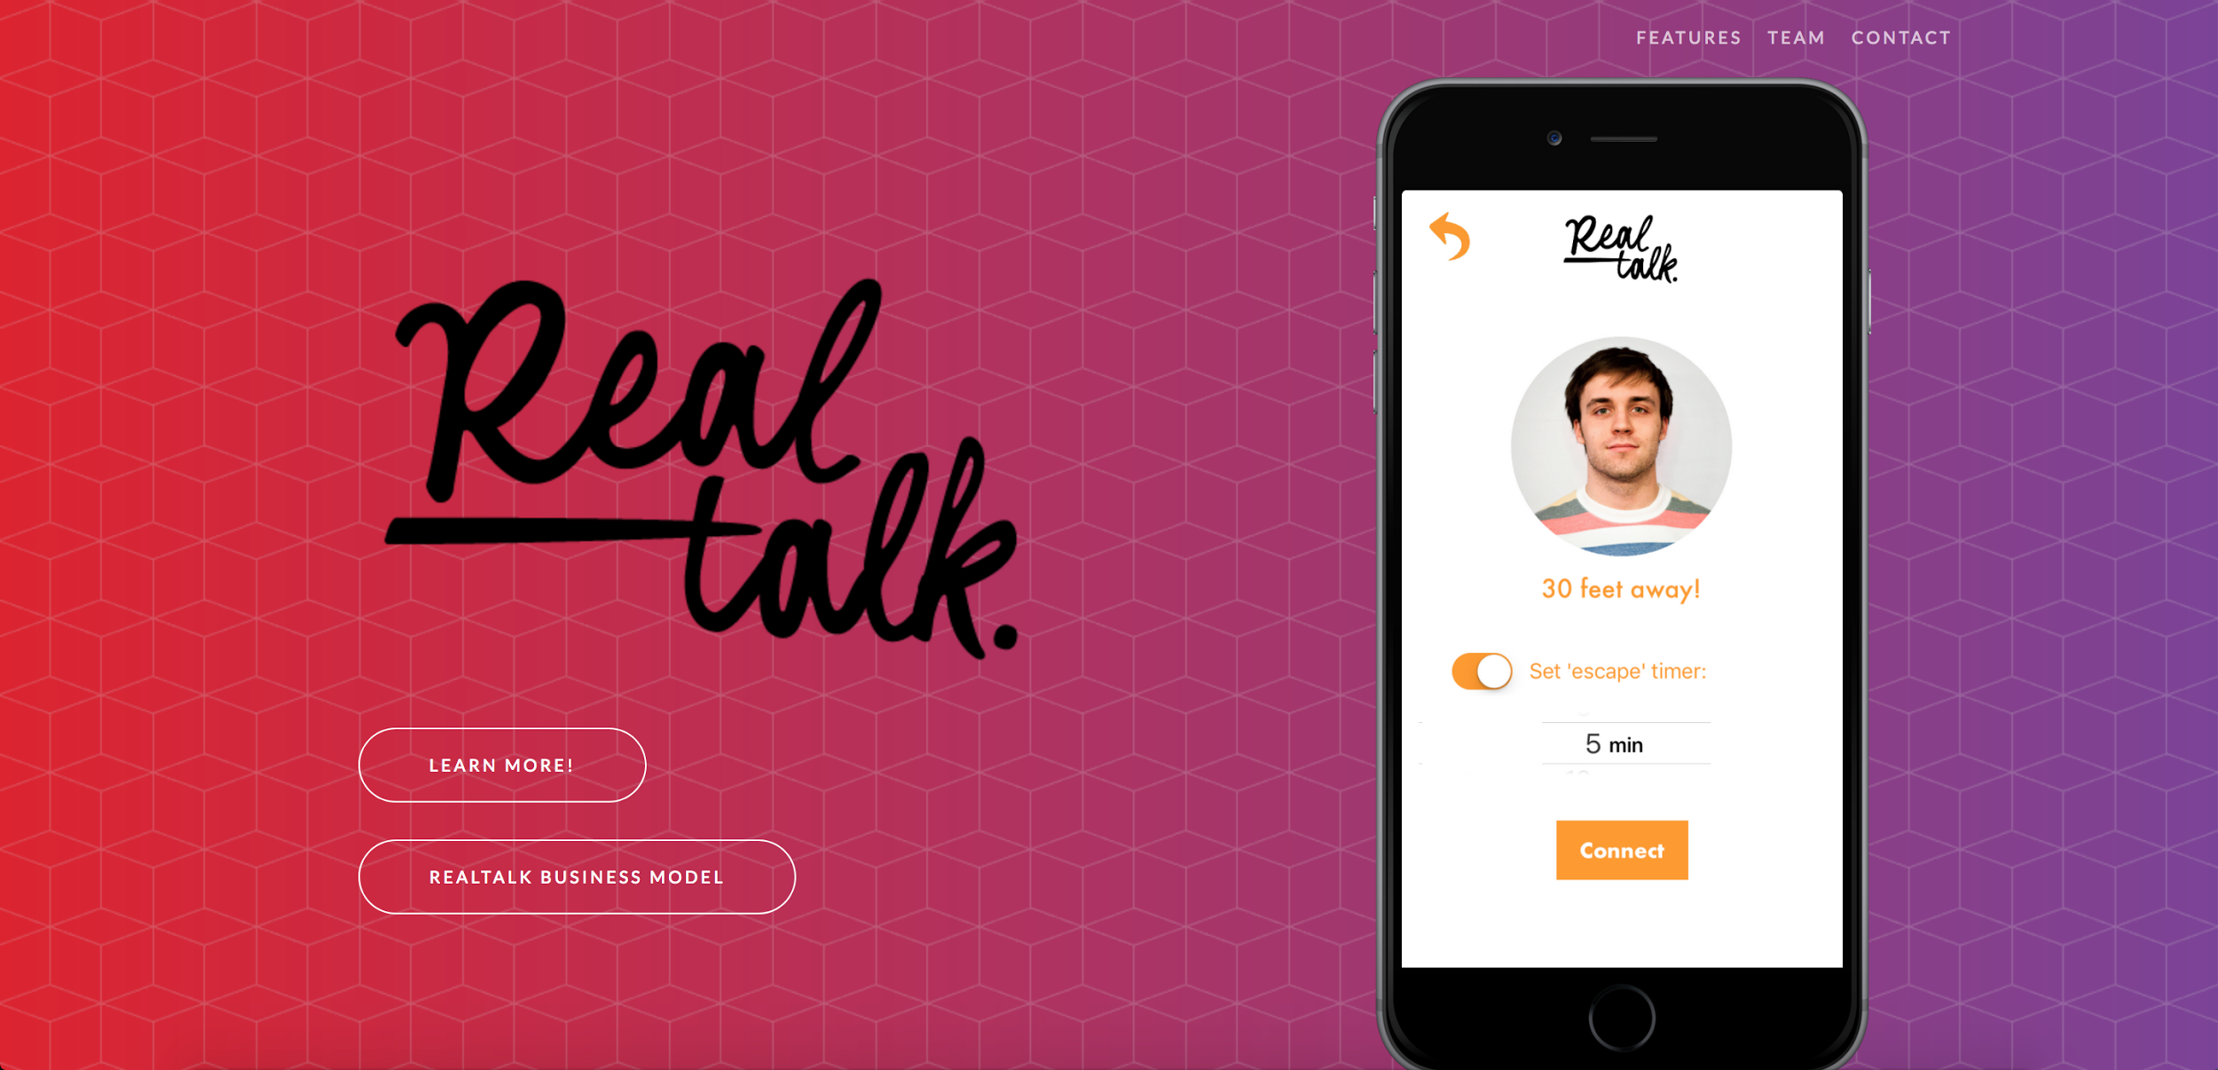


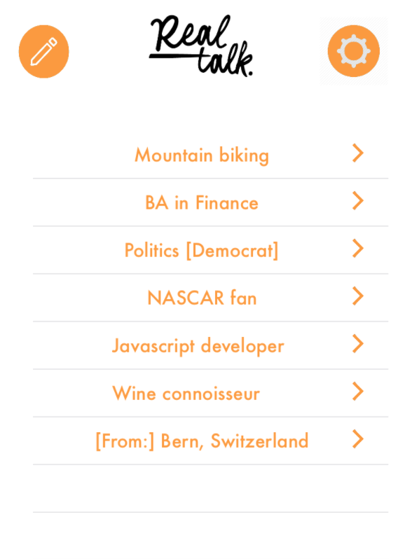
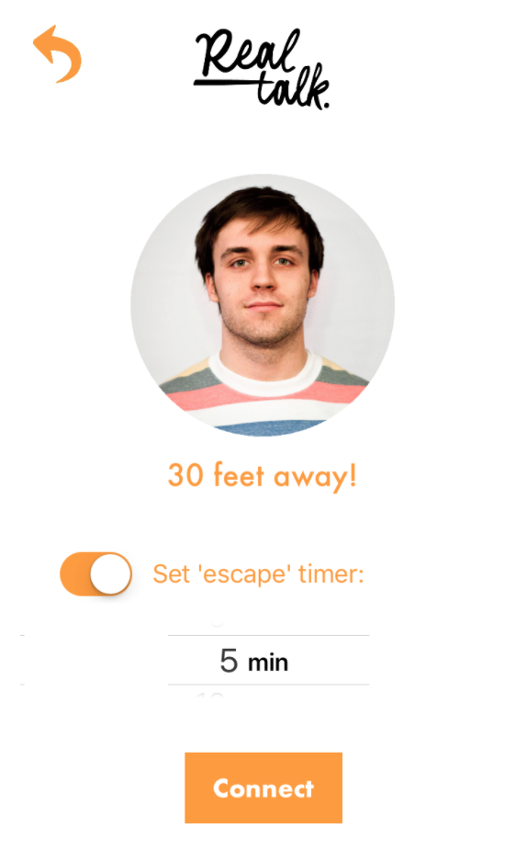
Solution: RealTalk
4
1. Open URL or app
cdt876.github.io
2. List interests / link
with Facebook
3. Start talking with
people!
Problem
Solution
Revenue
Market
Competitors
Go-to-Market

Slide 5
Revenue Model
5
Value-add: facilitating interactions among conference attendees
B2B revenue from organizations hosting networking conferences
Conference apps (Attendify, Eventboard, WebMobi)
$599 - $2450
RealTalk $500 / avg event
Problem
Solution
Revenue
Market
Competitors
Go-to-Market

Slide 6
Market Size
6
18M US businesses conducting networking events per year
2,000 Austin networking events
10,000 TX businesses networking events
$1M
$5M
$9B
Problem
Solution
Revenue
Market
Competitors
Go-to-Market

Slide 7





Competitive Landscape
7
Competitors | Interests | Anonymous | Real Time | “Escape” plan
Problem
Solution
Revenue
Market
Competitors
Go-to-Market

Slide 8
Go-to-Market Strategy
8
UT student organizations & large classes
Freshman orientation
MVP testing
Industry-focused meetup groups in Austin
Professional conferences
Immediate targets
Conferences, airport lounges, networking events, classrooms, coffee shops, companies
Looking forward
Problem
Solution
Revenue
Market
Competitors
Go-to-Market

Slide 9
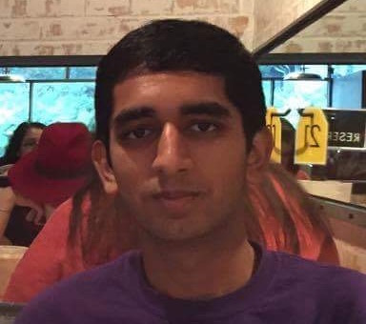
Team
1
Bhavin Gupta
UT Neuroscience
& Computer Science
Paul Aguilar
UT Economics
Tori Martinez
UT Social Work
& Spanish
Juan Trejo
UT Engineering
Masters
Carlos Trejo
IBM Software
Developer
Nicole Sun
UT Business Honors
& Plan II

Slide 10

Questions?
9

