Slide 1


An Introduction to AWS Cloud Computing (IAAS)
By
MANINDER SINGH BHUI

Slide 2
Major Topics
Computing Models
Evolution of Cloud Computing
Cloud as a Business
Benefits of Cloud Computing

Slide 3
Computing Models
Desktop Computing
Client Server Computing
Cluster Computing
Grid Computing
Cloud Computing

Slide 4

Desktop Computing
MS Office
Abode Reader
AutoCAD S/W
Photoshop
No Internet Connection is requires in this model

Slide 5
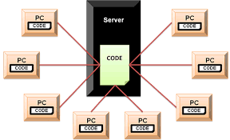
Client-Server Computing
It can run with both Internet & Intranet

Slide 6
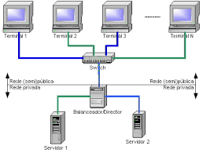
Cluster Computing

Slide 7
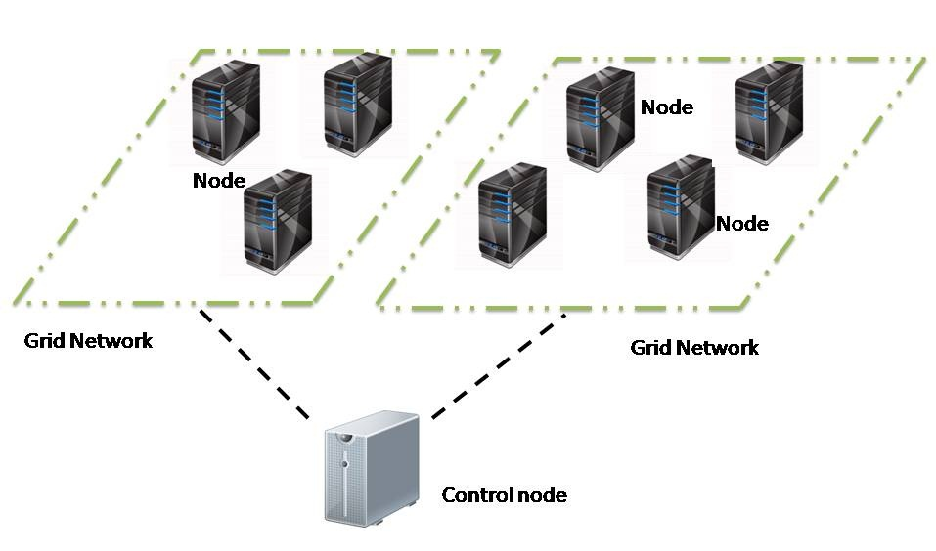
Grid Computing

Slide 8
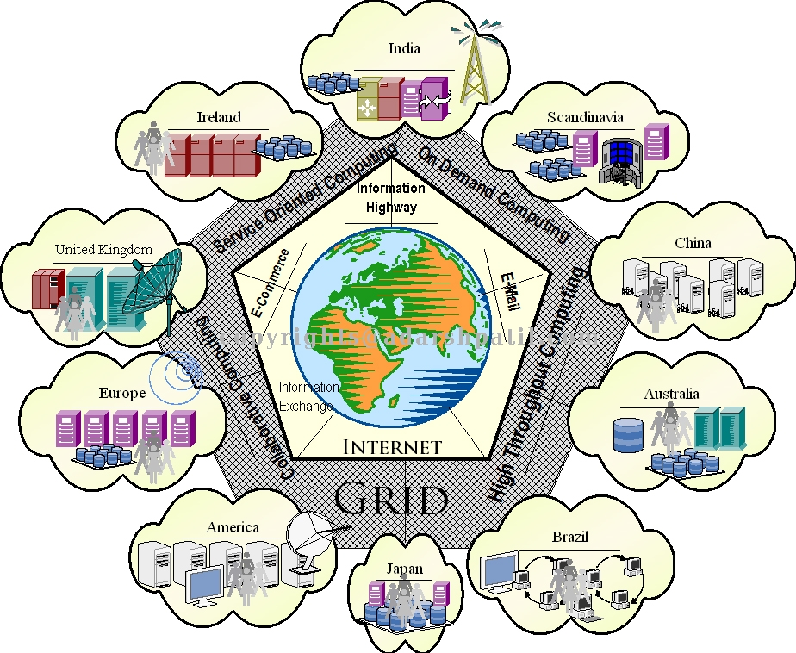
Cloud = Cluster + Grid

Slide 9
Does Cloud is Internet or Internet is Cloud ?
Little bit same things
Before proceed We’ll understand the Internet project that was started with Arpanet project in 1969

Slide 10
Evolution of Cloud Computing
About ARPANET Project
Started in 1969
Email Service Introduced in 1972
www (world wide web) born and made public in 1991

Slide 11
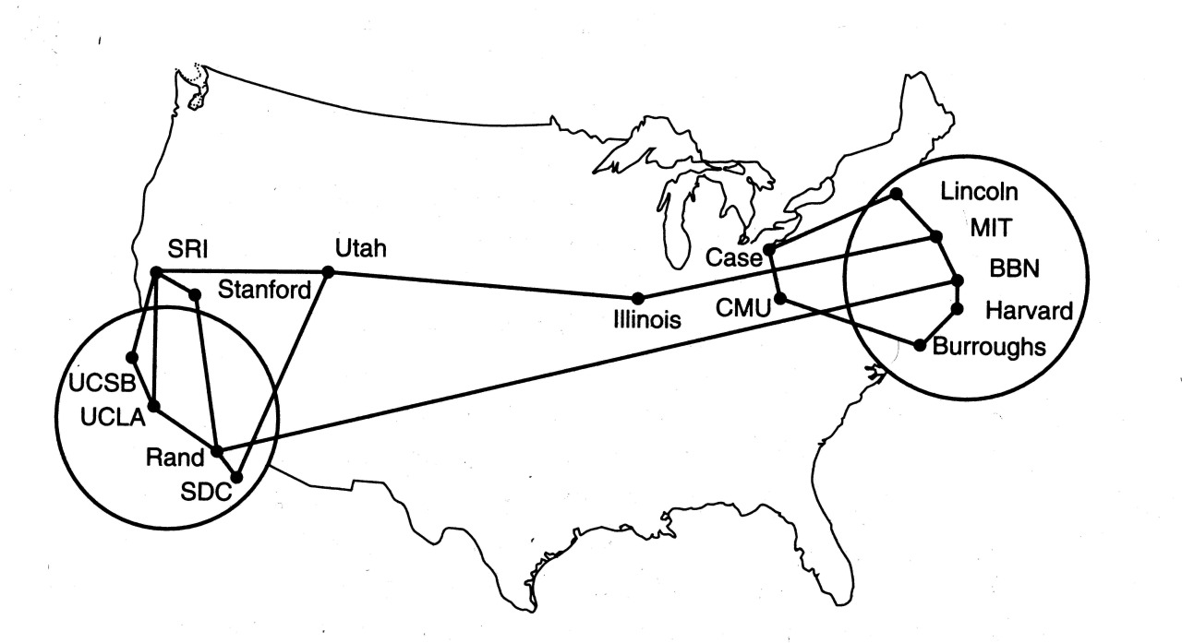
More About Arpanet

Slide 12
Growth of Contents
Contents plays key role in internet
Let internet users write the contents

Slide 13
Free Internet Service for Contents
Email - Gmail
Blogs- Blogger
Wikis- Wikipedia
Forum-topix.com
Chat- Yahoo , Skype, Google Hangouts
Social Networking - Facebook
Online Sale- eBay, Amazon, Flipkart

Slide 14
Private Cloud
Toyota
Citi Bank
WalMart

Slide 15
Cloud in Internet
Google
Microsoft
Salseforce
HP
IBM

Slide 16
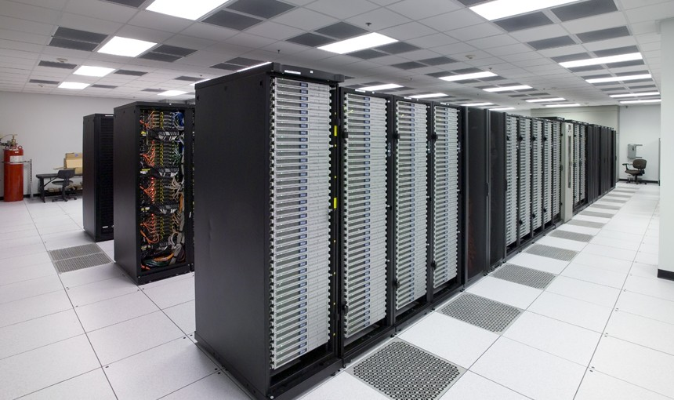
Data Centre: Private v/s Public

Slide 17
Server Requirement
Application
Operating System
Hardware Network
Software (ERP)
Platform
Infrastructure

Slide 18
Two Solutions
Buy more servers and recourses.
Move to Cloud

Slide 19
About Cloud Computing
“The practices of using a network of remote servers hosted on the Internet to store, manage, and process data, rather than a local server or a personal computer.”

Slide 20
Cloud Computing
Cloud Computing refers to both the applications delivered as services over the Internet and the hardware and systems software in the datacenters that provide those services.
The datacenter hardware and software is what we will call a Cloud.

Slide 21
Cloud Computing with Amazon Web Services
Amazon Web Services (AWS) is a secure cloud services platform, offering compute power, database storage, content delivery and other functionality to help businesses scale and grow.

Slide 22
Features of AWS Cloud Computing
Low Cost
Agility and Instant Elasticity
Open and Flexible
Secure
Multitents

Slide 23
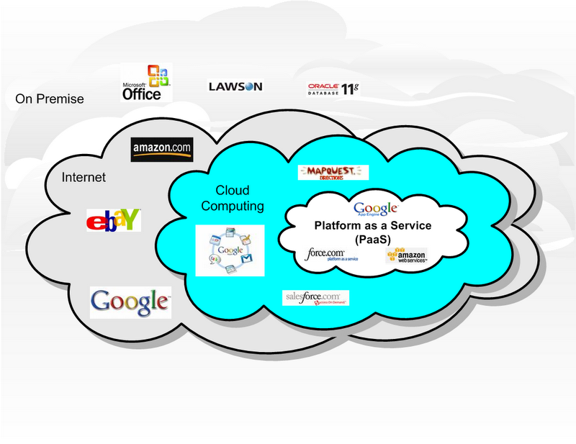
Cloud As a business: Cloud Service

Slide 24
Models of Cloud Computing
There are three main models for cloud computing. Each model represents a different part of the cloud computing stack.
Infrastructure as a Service (IaaS)
Platform as a Service (PaaS)
Software as a Service (SaaS)

Slide 25
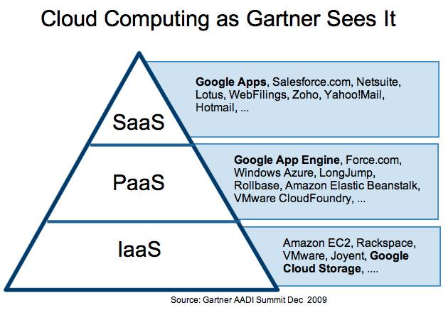

Slide 26
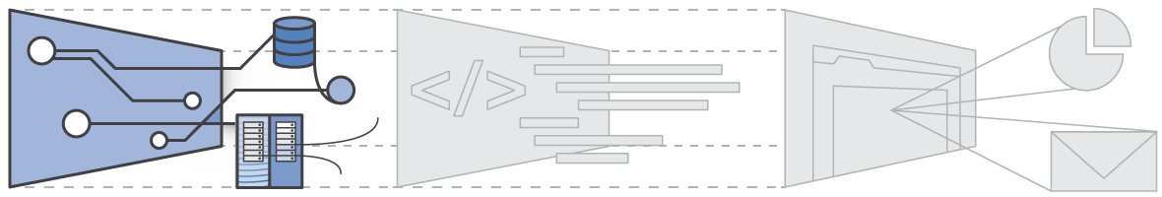
IAAS

Slide 27
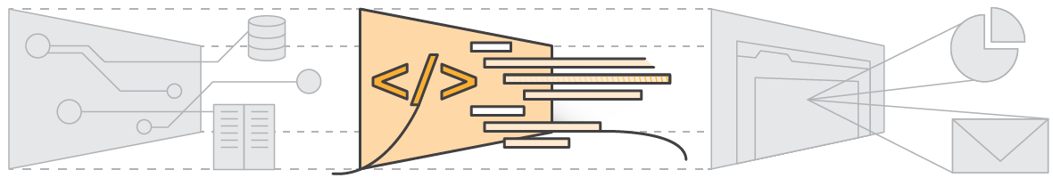
PAAS

Slide 28
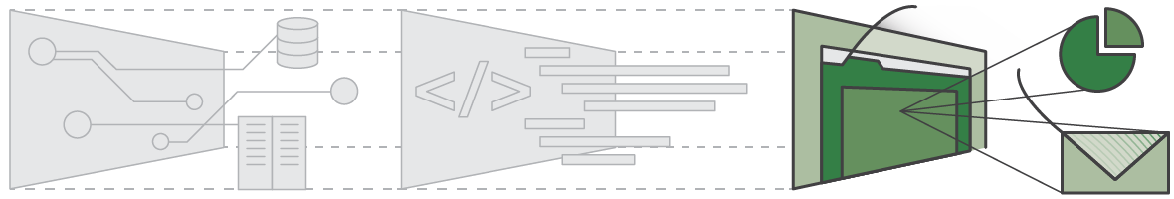
SAAS

Slide 29
USES
Helps to use applications without installations.
Access the personal files and data from any computer with internet access.
This technology allows much more efficient computation by centralizing storage, memory and processing .

Slide 30
5 Essential Cloud Characteristics
On-demand self-service
Broad network access
Resource pooling
Location independence
Rapid elasticity
Measured service
Pay as you go.

Slide 31
AMAZON EC2
Elastic Compute Cloud
Rent virtual machine instances to run your software. Monitor and increase / decrease the number of VMs as demand changes
How to use:
Create an Amazon Machine Image (AMI): applications, libraries, data and associated settings
Upload AMI to Amazon S3 (simple storage service)
Use Amazon EC2 web service to configure security and network access
Choose OS, start AMI instances
Monitor & control via web interface or APIs

Slide 32
AMAZON EC2
Characteristics:
Elastic: increase or decrease capacity within minutes
Monitor and control via EC2 APIs
Completely controlled: root access to each instances
Flexible: choose your OS, software packages…
Redhat, Ubuntu, openSuse, Windows Sever 2003,…
Small, large, extra large instances
Reliable: Amazon datacenters, high availability and redundancies
Secure: web interface to configure firewall settings
Cost:
CPU: small instance, $0.10 per hour for Linux, $0.125 per hour for Windows (1.0-1.2 GHz 2007 Opteron or 2007 Xeon processor)
Bandwidth: in $0.10, out $0.17 per GB
Storage: $0.10 per GB-month, $0.10 per 1 million I/O requests

Slide 33
How many CLOUD
Software and hardware to operate datacenters
Public cloud: cloud used to provide utility computing
Amazon EC2: Amazon datacenters, Xen, EC2 APIs and administrative interface
Google AppEngine: Google data center, GFS, AppEngine APIs, administrative interface…
Batch processing softwares: MapReduce, Hadoop, Pig, Dryad
Private cloud: datacenters, not available for rental
How about the academic clouds?
Protected clouds

Slide 34
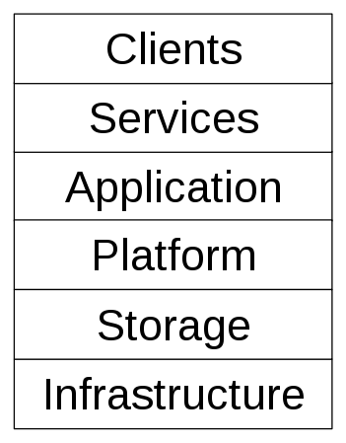
Cloud Components

Slide 35
Cloud Components
Application
A cloud application leverages the Cloud in software architecture, often eliminating the need to install and run the application on the customer's own computer, thus alleviating the burden of software maintenance, ongoing operation, and support.
Web application (Facebook)
Software as a service (Google Apps, SAP & Salesforce)
Software plus services (Microsoft Online Services)
Client
A cloud client consists of computer hardware and/or computer software which relies on The Cloud for application delivery, or which is specifically designed for delivery of cloud services and which, in either case, is essentially useless without it.
Mobile (Android, iPhone )
Thick client / Web browser (Google Chrome, Mozilla Firefox)

Slide 36
Cloud Components
Infrastructure
Cloud infrastructure, such as Infrastructure as a service, is the delivery of computer infrastructure, typically a platform virtualization environment, as a service.
For example:
Full virtualization (GoGrid, Skytap)
Grid computing (Sun Grid)
Compute (Amazon Elastic Compute Cloud)
Platform
A cloud platform, such as Platform as a service, the delivery of a computing platform, and/or solution stack as a service, facilitates deployment of applications without the cost and complexity of buying and managing the underlying hardware and software layers.
For example:
Web application frameworks
Ajax (Caspio)
Python Django (Google App Engine)
Ruby on Rails (Heroku)
Web hosting (Mosso, Clustered Cloud)

Slide 37
Cloud Components
Service
A cloud service includes "products, services and solutions that are delivered and consumed in real-time over the Internet.
For example:
Identity (OAuth, OpenID)
Payments (Amazon Flexible Payments Service, Google Checkout, PayPal)
Mapping (Google Maps, Yahoo! Maps)
Search (Alexa, Google Custom Search, Yahoo! BOSS)
Storage
Cloud storage involves the delivery of data storage as a service, including database-like services, often billed on a utility computing basis, e.g., per gigabyte per month.
For example:
Database (Amazon SimpleDB, Google App Engine's BigTable )
Web service (Amazon Simple Storage Service, Nirvanix )

Slide 38
CHALLENGES
Challenge | Opportunity
Availability | Multiple providers
Data lock-in | Standardization
Data Confidentiality | Encryption, VLANs, Firewalls
Online storage service The Linkup closed August 8, 2008
- 20,000 paying subscribers lost their data
Coghead, a cloud vendor closed its business in Feb 19,2009
- Customers need to rewrite their applications

Slide 39
CHALLENGES
Challenge | Opportunity
Data transfer bottlenecks | FedEx-ing disks, reuse data multiple times
Performance unpredictability | Improved VM support, flash memory
Scalable storage | Invent scalable storage
Bugs in large distributed systems | Invent Debugger using Distributed VMs
Scaling quickly | Invent Auto-Scaler

Slide 40
GROWTH CHALLENGES
Data transfer bottle neck
WAN cost reduces slowest:
2003 → 2008: WAN 2.7x, CPU 16x, storage 10x
Fastest way to transfer large data: send the disks
Performance unpredictability
Large variation in I/O operations
Inefficiency in I/O virtualization

Slide 41
Future of Cloud Computing
In a May 2008 report, Merrill Lynch estimated that 12% of the worldwide software market would go to the cloud in that period.
IBM said it would spend $360 million to build a cloud computing data center in Research Triangle Park, N.C., bringing to nine its total of cloud computing centers worldwide.
Dell CEO Michael Dell says. "Now it's a several-hundred-million-dollar business, and it will be a billion-dollar business in a couple of years—it's on a tear."
Microsoft, has made cloud computing one of five priorities for fiscal 2009, according to a recent memo from CEO Steve Ballmer.

Slide 42
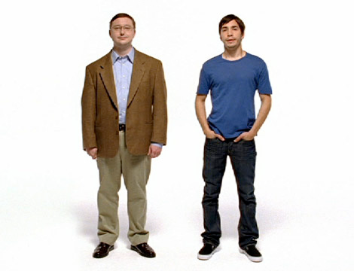
Look to the cloud!
Pay for the bandwidth and server resources that you need. When your work is done then turn the whole thing off!

Slide 43
References
Wikipedia http://en.wikipedia.org/wiki/Cloud_computing
Above the Clouds: A Berkeley View of Cloud Computing http://www.eecs.berkeley.edu/Pubs/TechRpts/2009/EECS-2009-28.pdf
How Cloud Computing Is Changing the World http://www.businessweek.com/technology/content/aug2008/tc2008082_445669.htm
The Future of Cloud Computing
http://mba.tuck.dartmouth.edu/digital/Programs/MBAFellowsProgramArchive/08_rana.pdf

