Slide 1

Out-data-ed: Automating the Indicator Snapshot
Catherine Du, Eliot Stanton, Jordan Graves
Supervised by Rebecca Hutchinson
Economic Indicators Division (EID)
Any opinions and conclusions expressed herein are those of the authors and do not necessarily represent the views of the U.S. Census Bureau.
Notes:
-read the title
-each introduce ourselves

Slide 2
Intro to EID and Issue:
Original Process
Before a release, most indicators produce an internal snapshot for the Deputy Secretary of Commerce, situating their data in the broader economy.
Excel Files
Problems
Labor-intensive
Decentralized data sources
Reporting data > analysis
Indicator Teams
Internal Census Data
External Sources
Notes:
-the purpose of the snapshot: to give the deputy sec of commerce the highlights, what they should take away
-the pain point: 460 hours/year spent on creating these
(speak about EID as “us”, problems as ours)

Slide 3
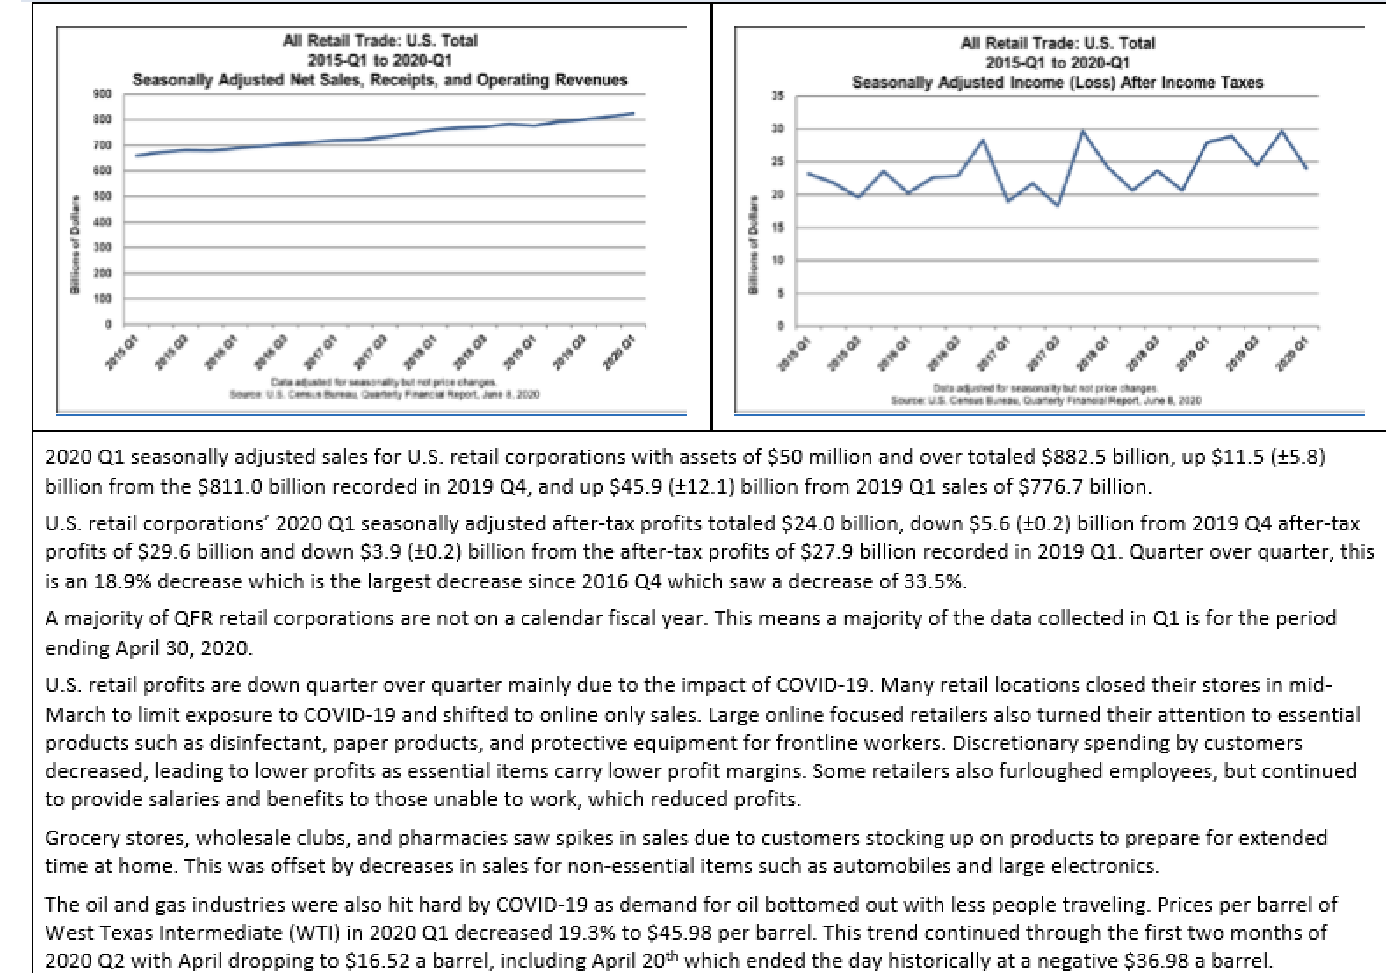
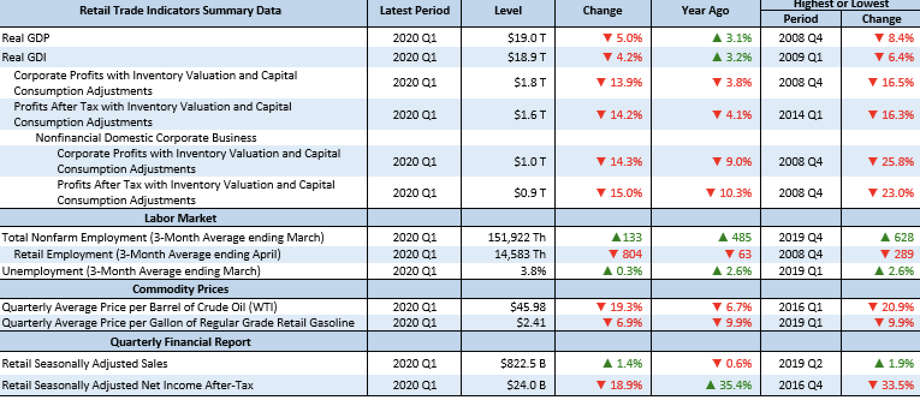
Sample Snapshot
Data visualization
Paragraph of text
Data table

Slide 4


Project Objectives
Snapshot Automation Tool
Dash web app → dashboard for building visualizations, tables, and text
MySQL database → centralized data source, automatic updates
Resulting Benefits
Save time and money
Easy access to data
Increased productivity
Indicator Teams
Python Dash
MySQL DB
Notes:
Draw attention to the database set up, that it is pulling in all of the data so that EID does not manually have to do that.
-analysts can spend more time on analysis, less on just reporting

Slide 5
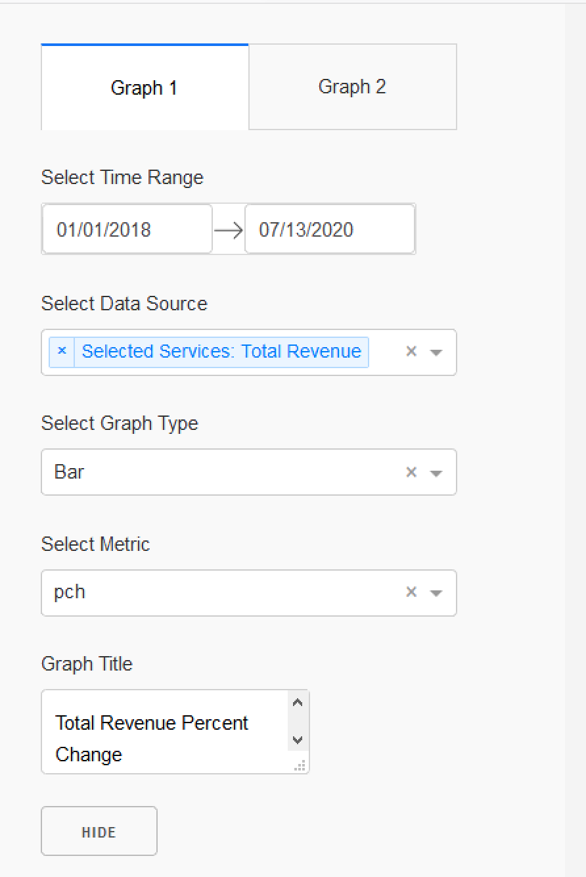
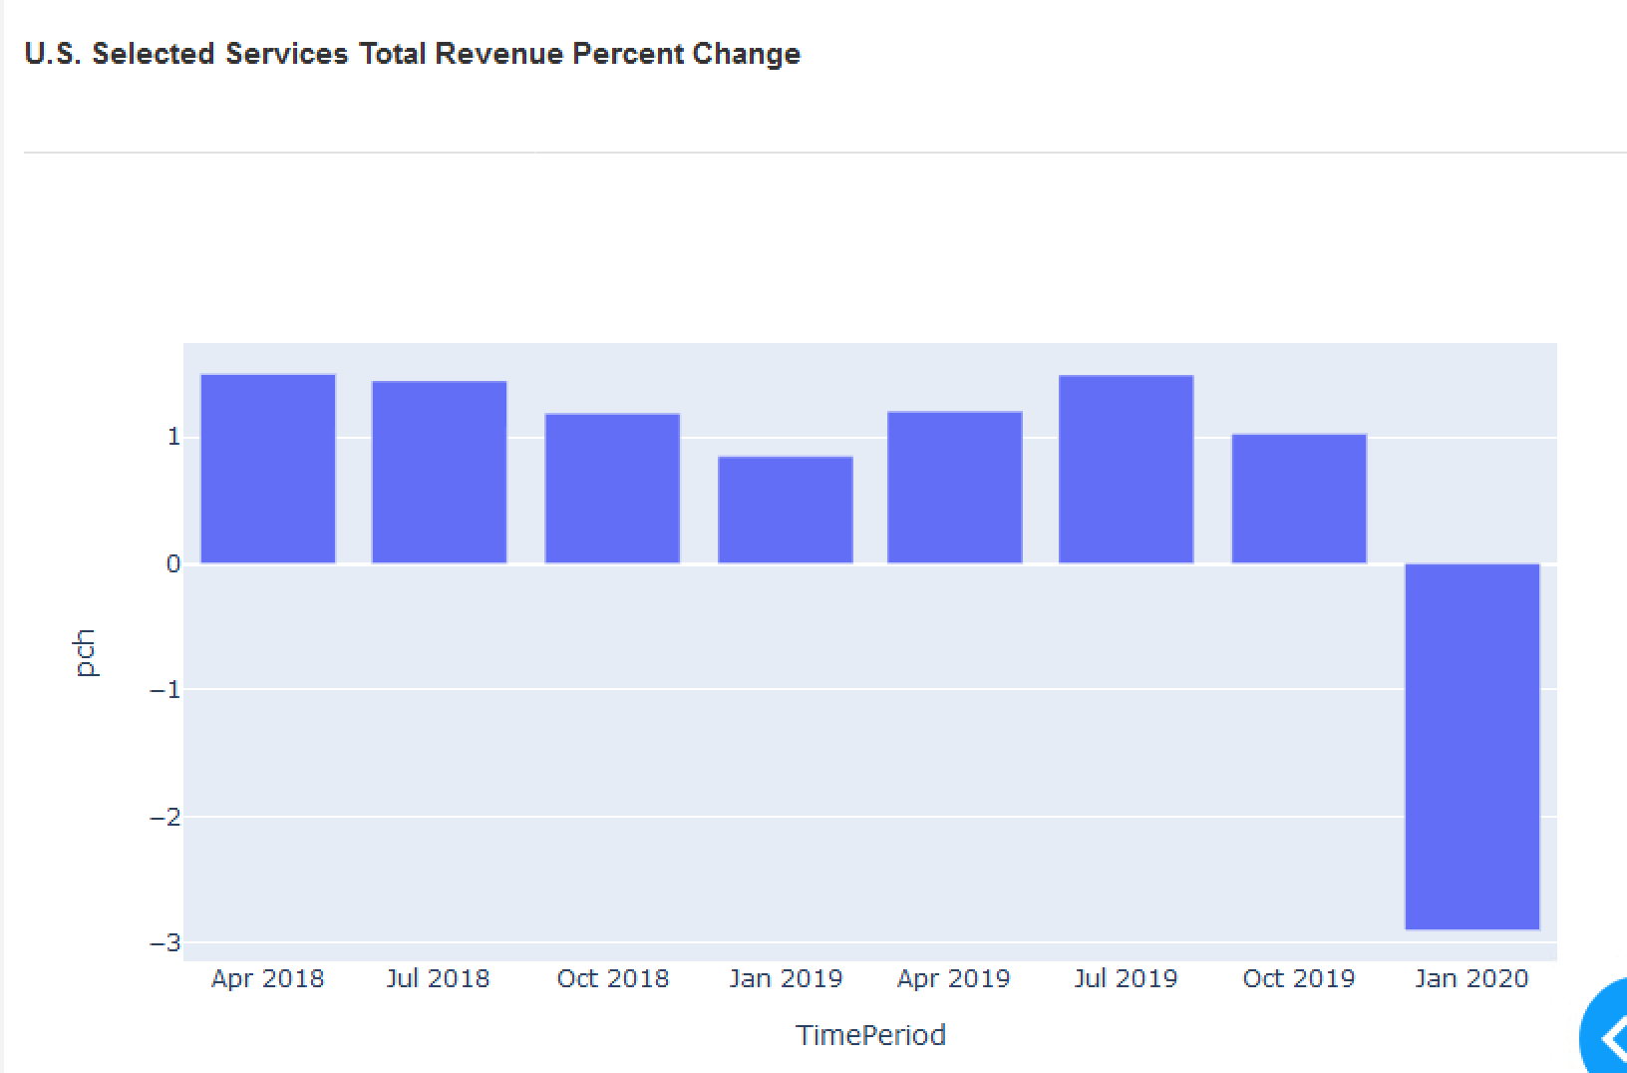
Tool Demo
Notes:
-mention the metrics available: values, Y/Y change, percent change, Y/Y percent change
-mention the graph types: bar, line, dot

Slide 6
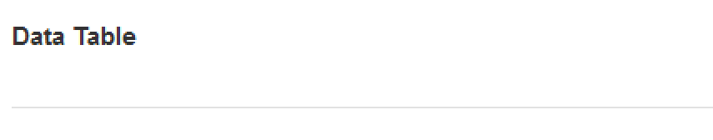
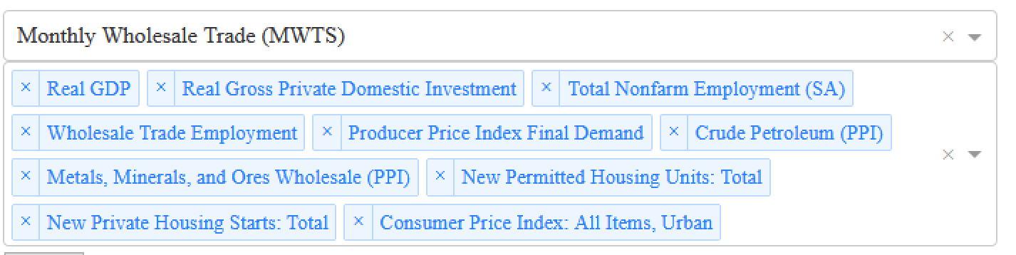
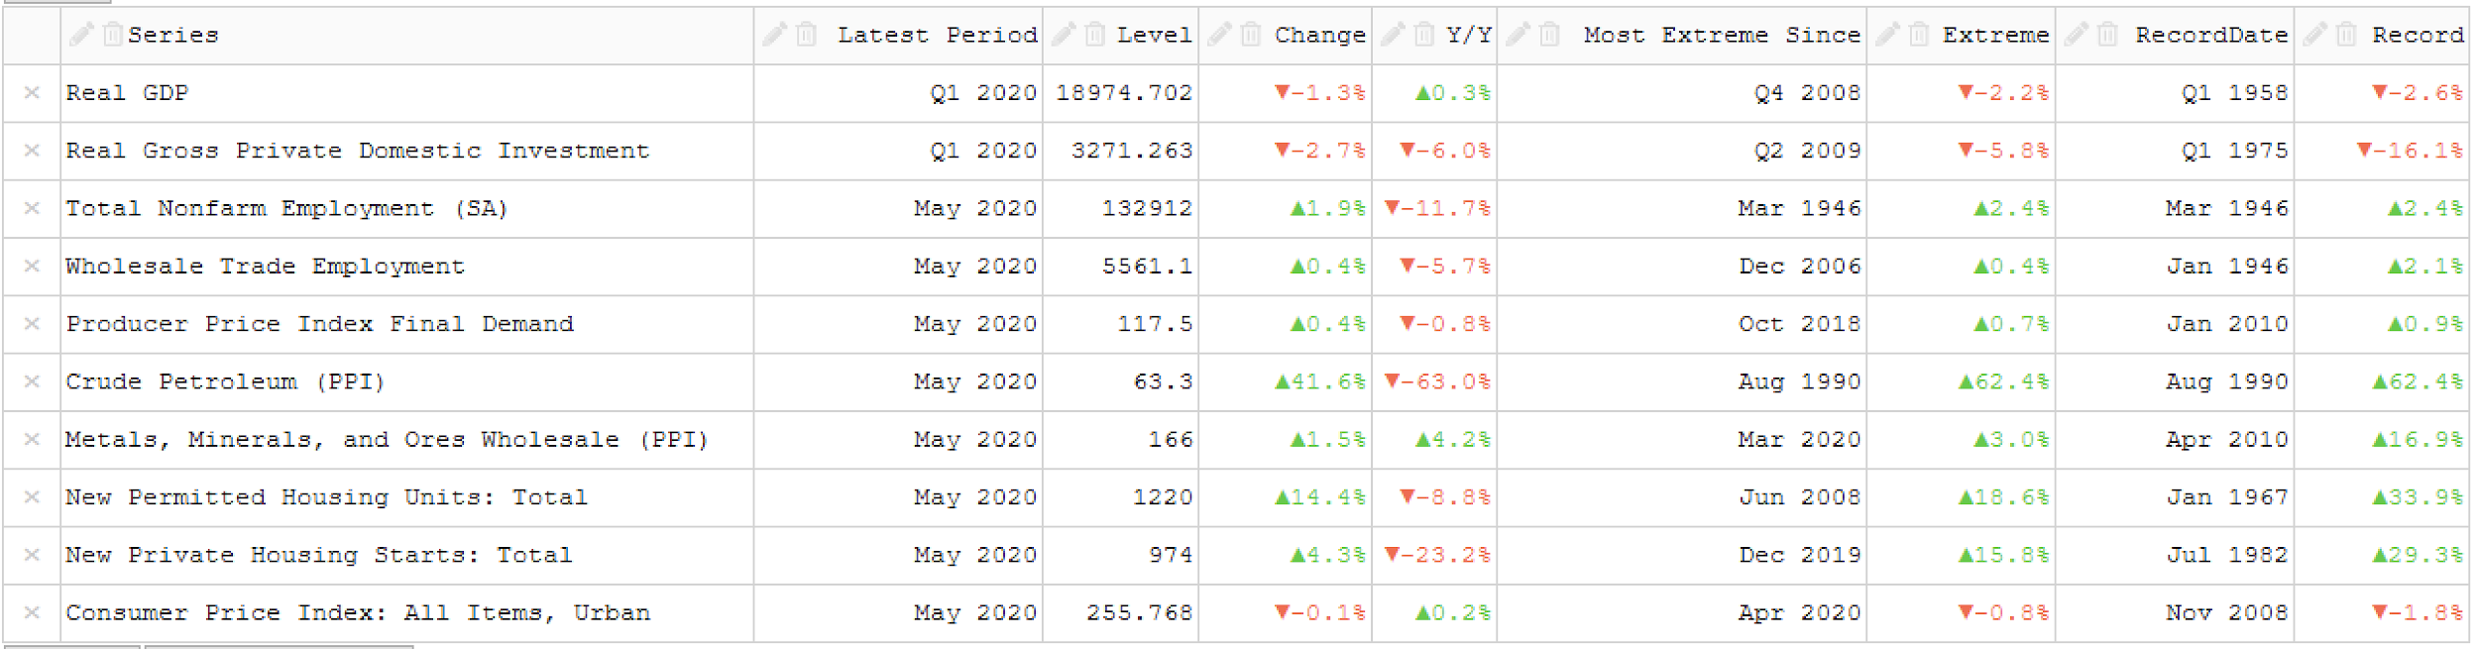
Notes:
-indicator filter to prepopulate
-manual functionality adding data sources
-for each source: most recent value, pch, Y/Y pch, last time change was this extreme, overall record of change in this direction
-putting the census data in context with other stats AND history

Slide 7
Deliverables
Centralized database with internal and external sources
Script for automatic transfer of newest releases to DB
Web application putting data at users’ fingertips for exploration, no coding required
Next steps: Incorporate prerelease data, make economy-wide snapshot
Notes:
-next steps- fine-tuning tool and adding functionality, incorporating sensitive prerelease data
-emphasis: paves the way for EID goal of economy-wide snapshot
-both the centralized DB and the web app for data vis/table-making can be applied to other projects, saving time/money there as well

