Slide 1
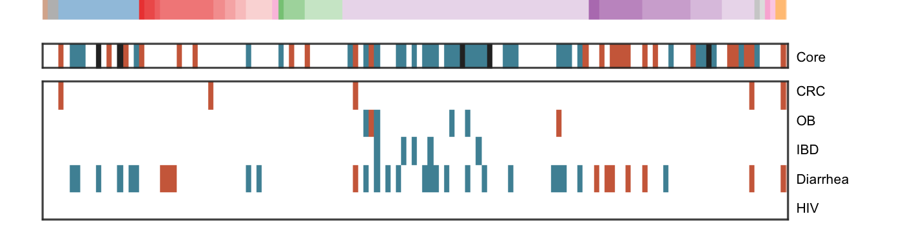
OTU table
Metadata
data/raw
data/analysis
src/analysis
src/figures
Read and clean data
Univariate tests
Phylogeny
Disease-wise “meta-analysis”
Core microbes
Plot Figure 3

