Slide 1
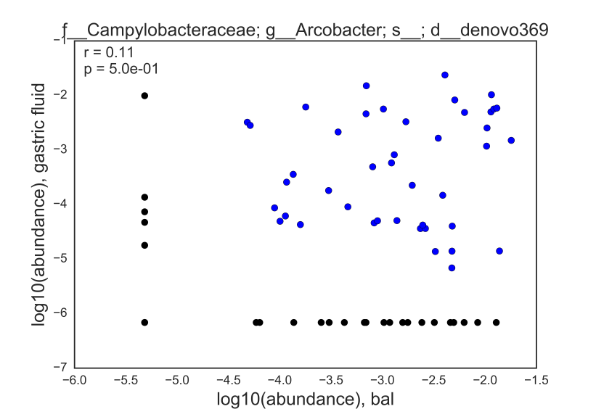
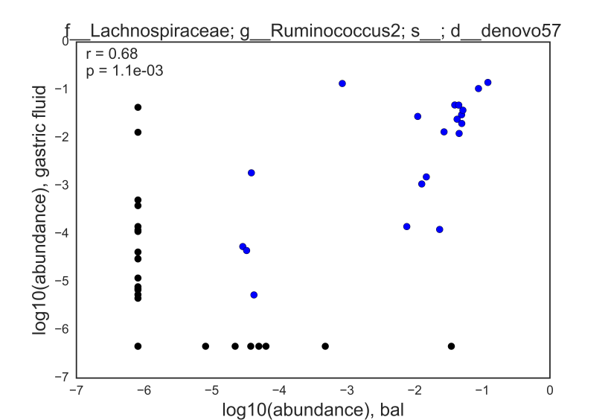



$$p_{s}=\frac{N_{co−occur}}{N_{total}}$$
$$q_{r}>0.05 or r_{s}<0$$
Not shared
$$q_{r}<0.05 and r_{s}>0$$

Slide 2
 | S1 | S2 | S3 | … | Sn
OTU1
OTU2
OTU3
OTU4
OTU5
…
OTUn
 | S1 | S2 | S3 | … | Sn
OTU1
OTU2
OTU3
OTU4
OTU5
…
OTUn
 | D1 | D2 | D3 | D4
ΔOTU2 | 0 | 1.5 | -2 | 0
ΔOTU3 | 0 | 0 | 0 | 0
ΔOTU4 | 0 | 2 | -3 | 1
… | … | … | … | …
Δα | -5 | -2 | -1 | 1
Δβ | -1 | 4 | 3 | 2
… | … | … | … | …
Obesity
 | S1 | S2 | S3 | … | Sn
OTU1
OTU2
OTU3
OTU4
OTU5
…
OTUn
IBD
 | S1 | S2 | S3 | … | S_{n}
OTU1 | 0 | 2 | 0 | … | 0
OTU2 | 10 | 25 | 0 | … | 29
OTU3 | 0 | 0 | 0 | … | 1
OTU4 | 1 | 2 | 0 | … | 0
OTU5 | 0 | 0 | 0 | … | 15
… | … | … | … | … | …
OTU_{n} | 21 | 15 | 2 | … | 6
Autism
Colorectal cancer

Slide 3
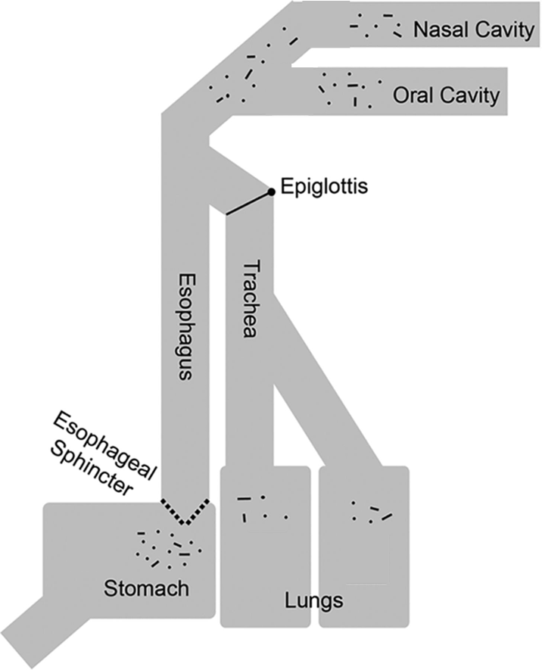

Slide 4
Approach
Literature Search
Existing Databases
Supervised Learning
Unsupervised Learning
Review articles
Text mining
ImG
IMNGS
FAPROTAX
Aim 2 datasets
Earth Microbiome Project
Large 16S cohorts
Human Microbiome Project
Sources
Inference
Experimentally validated annotations
Genome mining
Meta-analysis
Feature selection and cross-validation
Microbe
Sets
Pathogens
Functional groups
Inflammatory
Disease-associated
Sporulation
Acid tolerant
Environmental habitat
Tumorigenic
Aerobic/anaerobic
Short-chain fatty acid producers
Body site habitat

Slide 5
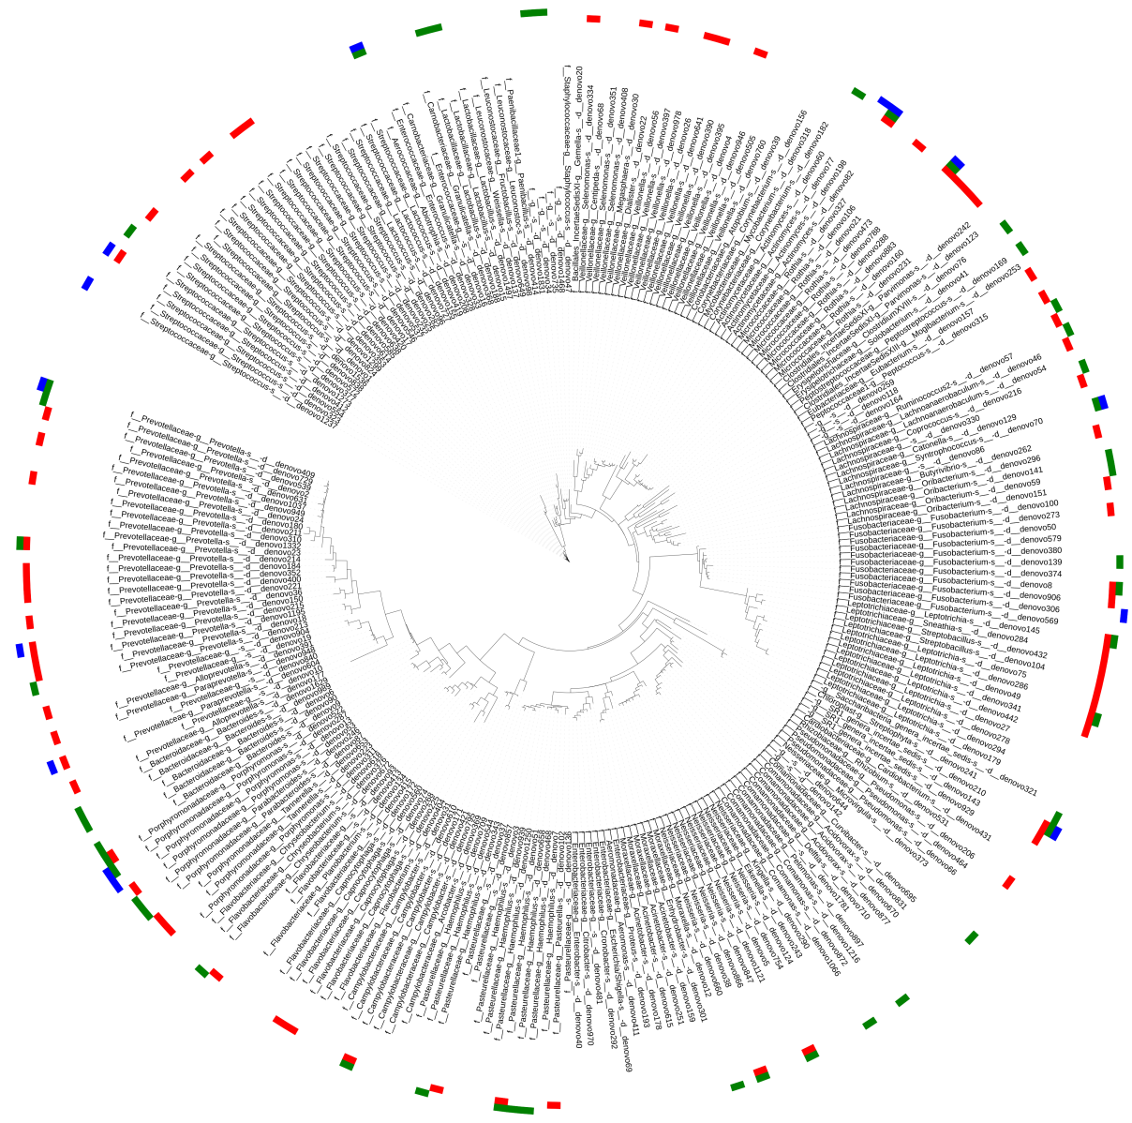

Slide 6
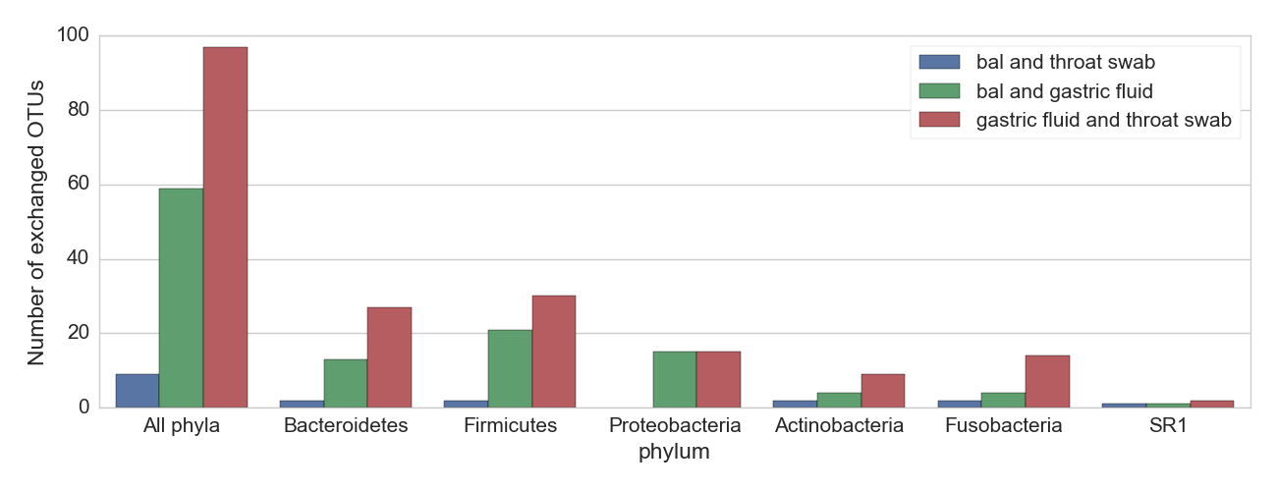

Slide 7
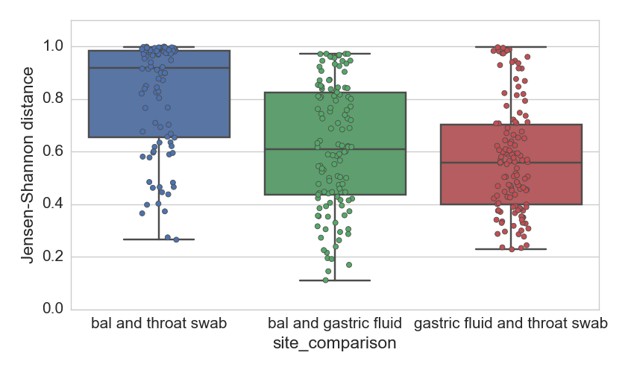
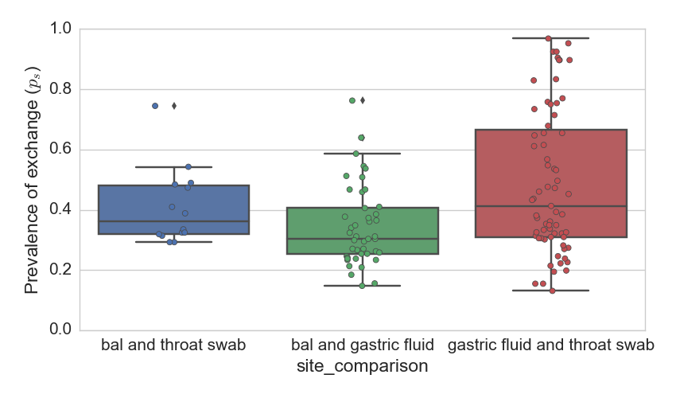
p < 0.001
p = 0.5
A
p = 0. 1
B
p = 0.001
p < 0.001
p = 0.04

Slide 8
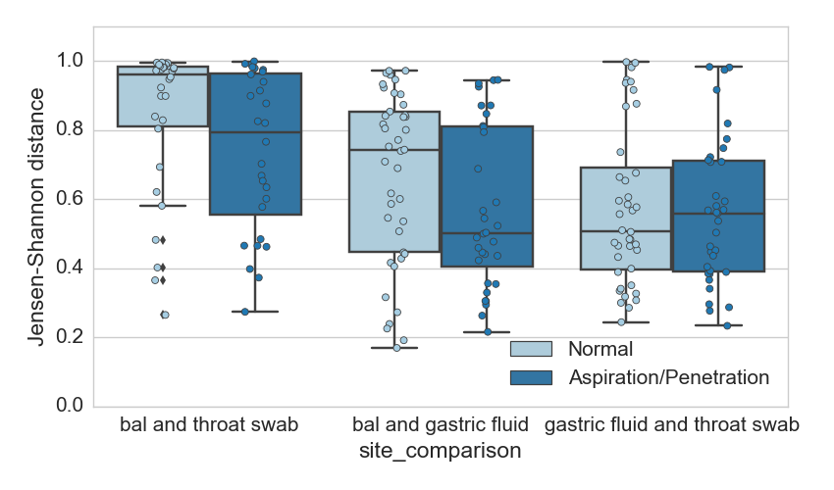
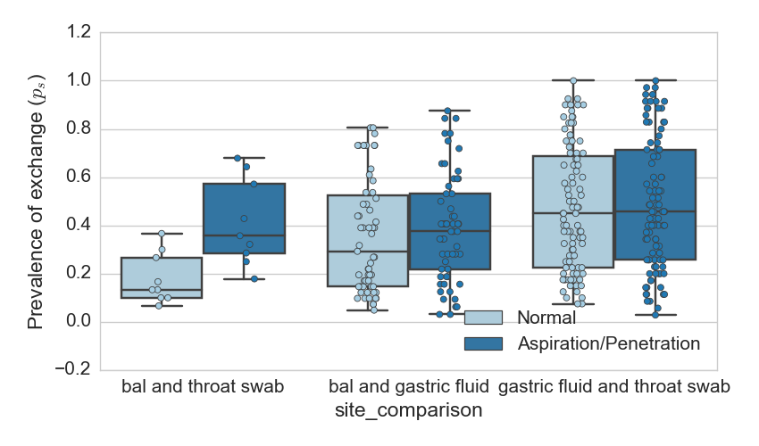
A
p = 0.04
p = 0.10
p > 0.5
B
p = 0.007
p = 0.3
p > 0.5

Slide 9
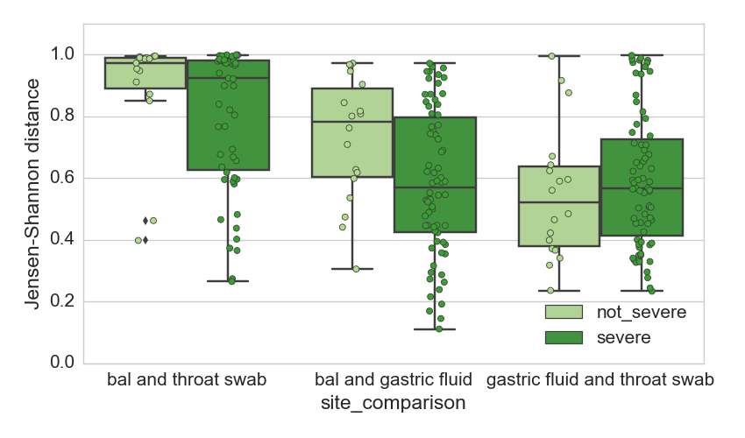
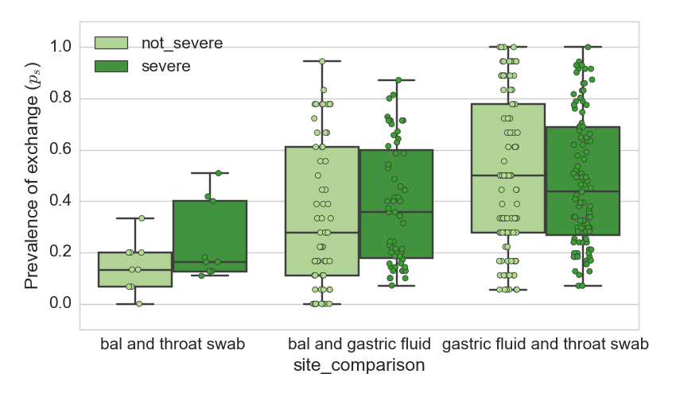
A
p = 0.23
p = 0.02
p = 0.4
B
p = 0. 26
p > 0.5
p = 0.35

Slide 10
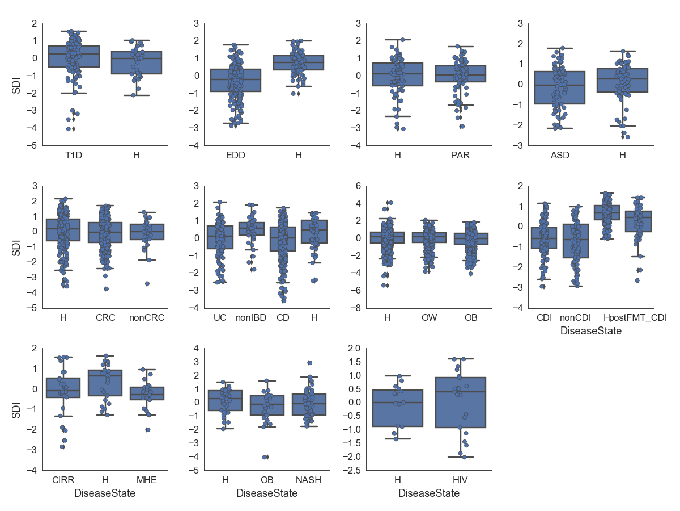
***
***
**
**
**
**
*
**

Slide 11
