Slide 1
Figure 2: Metadata required to re-analyze a dataset
Tables pasted as pictures (for grouping)
A
SRR1234567.fastq
B
@AWRGH170505:1:1103:25326:7271
TTAGAAACCCCAGTAGTCCGTCTGACTGAC
+
>>1>>3BCFAAA?C13BGDE0AAF1FB11B
@AWRGH170505:1:1103:25326:7271
TACCGCGGCTGCTGGCACACAATTACCATA
+
11>AA?11>00>111A0B0A00BA11B1DG
@AWRGH170505:1:1104:14877:1415
TACGGAGGATACGAGCGTTATCCGGATTTA
+
CCCCCCCCCFFFGFGGGGGGGGHGGGGGHH
SRR1234568.fastq
@AWRGH170505:1:1104:14877:1415
CCTGTTCGCTCCCCACGCTTTCGTGCCTCA
+
AAA>AFFBDBBBGGFEEEGEFGEABFGHHH
@AWRGH170505:1:1104:16451:1457
TACGGAAGGTCCGGGCGTTATCCGGATTTA
+
BABBBBAABFFFGEEEEEGGGGHGGEEGHH
@AWRGH170505:1:1104:16451:1457
CCAATTTGGTCCCCGCACTCTACCGCCACT
+
1111113311@11A110AA011110AA0B1
SRR1234572.fastq
@AWRGH170505:1:1104:21444:1611
TTAGAAACCCGTGTAGTCCGGCTGACTGAC
+
AA?>ADFFF@DAEGGGGGGGCGGGHHHFGH
@AWRGH170505:1:1104:21444:1611
TACCGCGGCTGCTGGCACACAATTACCATA
+
>>AA?DD@2ADAGGGFGGFFFA3DD5F5A3
@AWRGH170505:1:1105:21798:7487
TACGTAGGTGGCAAGCGTTGTCCGGAATTA
+
AAAAAFFAFFAFGGFGEFG?01DEFEGG1F
C

Slide 2
B
├── data
├── raw <- Raw data, which should never be
| changed, no matter how messy it
| is. Raw data = outputs of the
|. bioinformatics data processing,
| e.g. the original OTU table.
├── clean <- Intermediate data that has
| been cleaned up, e.g. OTU
| table with low QC samples
| removed.
└── analysis <- Outputs from analyses (e.g.
beta diversity, p-values, etc)
A
├── Makefile
├── README.md <- Every project must have a README
| describing what the project is,
| and orienting visitors to its
| contents.
|
├── data <- Input data and intermediate
| files (e.g. processing output,
| analysis results, etc) used to
| analyze your data and make your
| figures. For a microbiome project,
| this might be the OTU tables (if
| they’re small enough files),
| QIIME 2 outputs, metadata excel
| files, phylogenetic trees, etc.
│
├── src <- All code: scripts, notebooks, etc.
|
└── final <- Final figures, supp files, tables.
C
├── src
├── data <- Code used to wrangle and
| clean data.
|── exploration <- Jumble of iPython notebooks
| with preliminary work. Label
| these by date + brief description.
├── analysis <- Scripts used to produce files
| in data/analysis/. For the most
| part, Makefile calls these.
├── figures <- Scripts to make figures.
└── util <- If you want, files with commonly
re-used functions
D
├── final
├── figures <- Where you save final png's,
| also pushed to GitHub if you want.
|── tables <- If you're feeling ambitious,
| markdown versions of tables
└── supp_files <- Files that would otherwise be
supplementary Excel files

Slide 3
Plot Figure 2
Disease-wise “meta-analysis”
Disease-wise microbes
Raw OTU table
Clean OTU table
Univariate tests
q-values
Read and clean data
Core microbe analysis
Core microbes
Raw metadata
Clean metadata
Plot Figure 1
Phylogeny
Plot Figure 3a
Location in project folder
Classification AUCs
Data
data/raw
data/clean
data/analysis
Source code
src/data
src/analysis
src/figures
Random Forests
ROC Curves
Plot Figure S1

Slide 4
Scratch

Slide 5
Figure 2: Metadata required to re-analyze a dataset
Editable tables
A
B
SRR1234567.fastq
@AWRGH170505:1:1103:25326:7271
TTAGAAACCCCAGTAGTCCGTCTGACTGAC
+
>>1>>3BCFAAA?C13BGDE0AAF1FB11B
@AWRGH170505:1:1103:25326:7271
TACCGCGGCTGCTGGCACACAATTACCATA
+
11>AA?11>00>111A0B0A00BA11B1DG
@AWRGH170505:1:1104:14877:1415
TACGGAGGATACGAGCGTTATCCGGATTTA
+
CCCCCCCCCFFFGFGGGGGGGGHGGGGGHH
SRR Run | Sample ID | Primers | Barcode
SRR1234567 | S1 | FWD: ATCGGATCG REV: GGCCAATGA | GTACGAAA
SRR1234568 | S2 | FWD: ATCGGATCG REV: GGCCAATGA | GTACGGCC
SRR1234572 | S3 | FWD: ATCGGATCG REV: GGCCAATGA | GATCAGGA
SRR1234568.fastq
@AWRGH170505:1:1104:14877:1415
CCTGTTCGCTCCCCACGCTTTCGTGCCTCA
+
AAA>AFFBDBBBGGFEEEGEFGEABFGHHH
@AWRGH170505:1:1104:16451:1457
TACGGAAGGTCCGGGCGTTATCCGGATTTA
+
BABBBBAABFFFGEEEEEGGGGHGGEEGHH
@AWRGH170505:1:1104:16451:1457
CCAATTTGGTCCCCGCACTCTACCGCCACT
+
1111113311@11A110AA011110AA0B1
SRR1234572.fastq
@AWRGH170505:1:1104:21444:1611
TTAGAAACCCGTGTAGTCCGGCTGACTGAC
+
AA?>ADFFF@DAEGGGGGGGCGGGHHHFGH
@AWRGH170505:1:1104:21444:1611
TACCGCGGCTGCTGGCACACAATTACCATA
+
>>AA?DD@2ADAGGGFGGFFFA3DD5F5A3
@AWRGH170505:1:1105:21798:7487
TACGTAGGTGGCAAGCGTTGTCCGGAATTA
+
AAAAAFFAFFAFGGFGEFG?01DEFEGG1F
C
Sample ID | Subject ID | Disease Status | Sampling day
S1 | 1 | H | 0
S2 | 1 | H | 10
S3 | 2 | CRC | 0

Slide 6
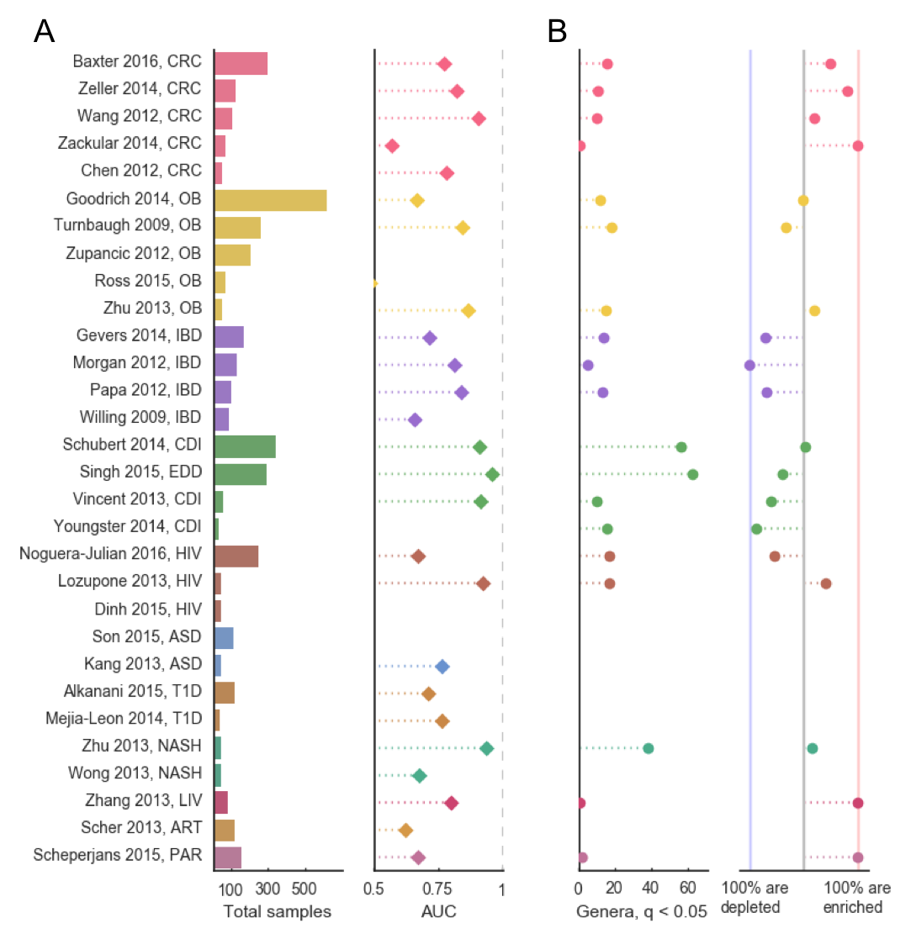
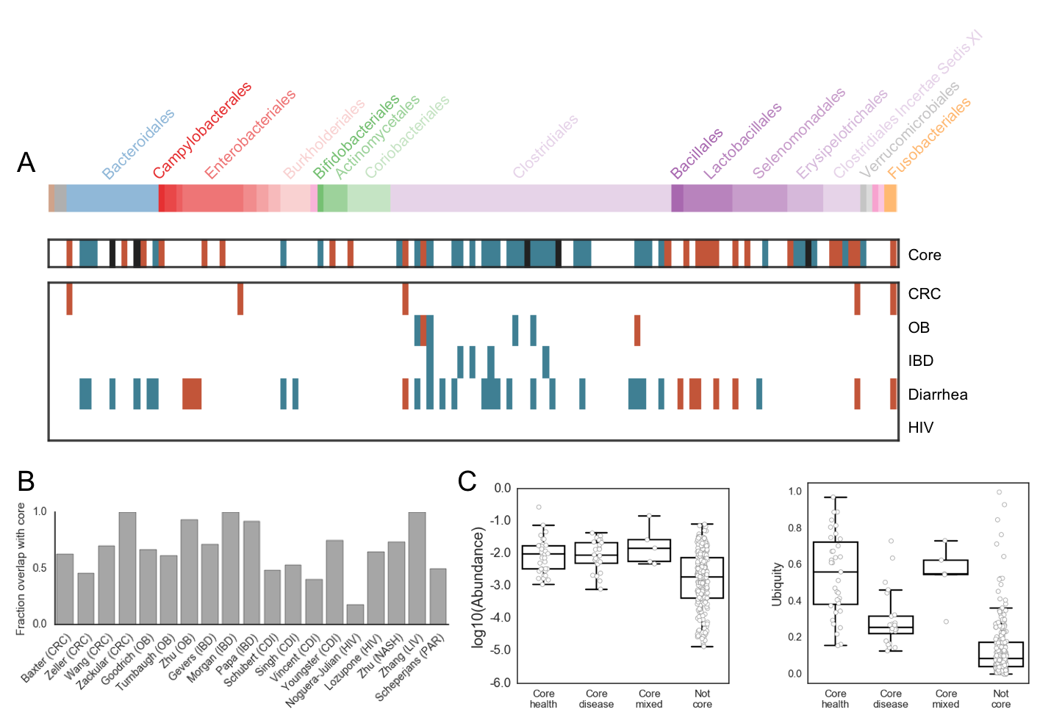
Disease-wise “meta-analysis”
OTU table
Read and clean data
Univariate tests
Plot Figure 3
Metadata
Core microbes
Random Forests
Phylogeny
Plot Figure 1
data/raw
data/analysis
src/analysis
src/figures

Slide 7
data/raw
data/analysis
src/analysis
src/figures
Phylogeny
Disease-wise “meta-analysis”
OTU table
Read and clean data
Random Forests
Plot Figure 3
Metadata
Core microbes
Univariate Tests
Plot Figure 1

Slide 8
make paper
Read and clean data
Get sample sizes
Univariate tests
Random forests

Slide 9
make paper
Read and clean data
Univariate tests
Phylogeny
Disease-wise “meta-analysis”
Core microbes

Slide 10
OTU table
Metadata
data/raw
data/analysis
src/analysis
src/figures
Read and clean data
Univariate tests
Phylogeny
Disease-wise “meta-analysis”
Core microbes
Plot Figure 3

