Slide 1
Remote Objects with Python: Pyro
CS 403/534
Distributed Systems

Slide 2
Remote Objects
An object encapsulates data (state) and operations.
Operations on object data are methods, accessible through interfaces
Objects interact with each other
by calling each other’s methods
Client proxy implements the interface on client side
Object server is responsible for a collection of objects
Server stubs (skeleton) handles un/marshalling and method invocation (returning results) for remote object

Slide 3
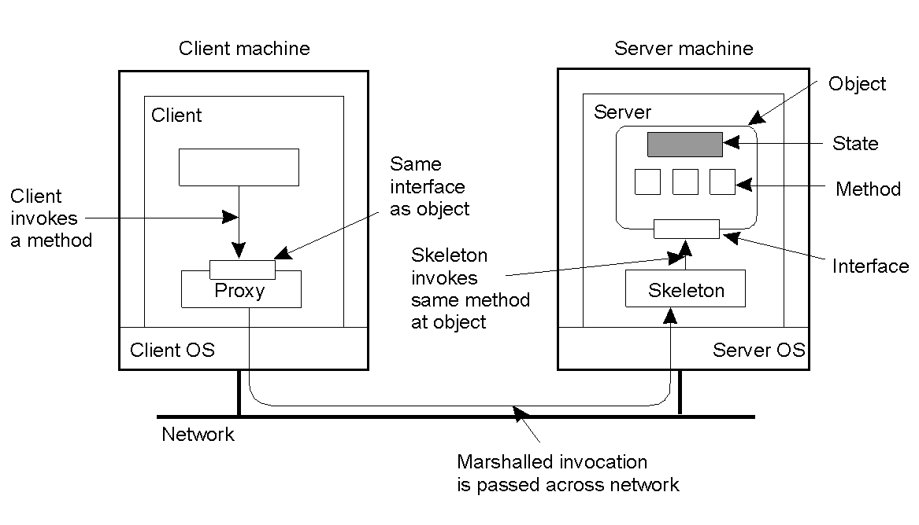
Invoking a Remote Object
Common organization of a remote object with client-side proxy

Slide 4
Python Remote Objects: Pyro4
It is a library that enables you to build applications, in which objects can talk to each other over the network, with minimal programming effort.
You can just use normal Python method calls to call objects on other machines.
Pyro is a pure Python library and runs on many different platforms and Python versions.

Slide 5
Pyro4: Key Concepts
Proxy:
A proxy is a substitute object for “the real thing”.
It intercepts the method calls you would normally do on an object as if it was the actual object.
Pyro then performs some magic to transfer the call to the computer that contains the real object, where the actual method call is done, and the results are returned to the caller.
This means the calling code doesn’t have to know if it’s dealing with a normal or a remote object, because the code is identical.
The class implementing Pyro proxies is Pyro4.Proxy (shortcut for Pyro4.core.Proxy)

Slide 6
Pyro4: Key Concepts
URI (Unique resource identifier):
This is what Pyro uses to identify every object. (similar to what a web page URL is to point to the different documents on the web). Its string form is like this: “PYRO:” + object name + “@” + server name + port number.
There are a few other forms it can take as well. You can write the protocol in lowercase too if you want (“pyro:”) but it will automatically be converted to uppercase internally.
The class implementing Pyro uris is Pyro4.URI (shortcut for Pyro4.core.URI)

Slide 7
Pyro4: Key Concepts
Pyro object:
This is a normal Python object but it is registered with Pyro so that you can access it remotely.
Pyro objects are written just as any other object
but the fact that Pyro knows something about them makes them special, in the way that you can call methods on them from other programs.
A class can also be a Pyro object, but then you will also have to tell Pyro about how it should create actual objects from that class when handling remote calls.

Slide 8
Pyro4: Key Concepts
Pyro daemon (server):
This is the part of Pyro that listens for remote method calls,
dispatches them to the appropriate actual objects,
and returns the results to the caller.
All Pyro objects are registered in one or more daemons.

Slide 9
Pyro4: Key Concepts
Pyro name server:
The name server is a utility that provides a phone book for Pyro applications:
you use it to look up a “number” by a “name”.
The name in Pyro’s case is the logical name of a remote object.
The number is the exact location where Pyro can contact the object.
Usually there is just one name server running in your network.

Slide 10
Pyro4: Key Concepts
Serialization:
This is the process of transforming objects into streams of bytes that can be transported over the network.
The receiver deserializes them back into actual objects.
Pyro needs to do this with all the data that is passed as arguments to remote method calls, and their response data.
Not all objects can be serialized, so it is possible that passing a certain object to Pyro won’t work even though a normal method call would accept it just fine.

Slide 11
Pyro4: Key Concepts
Configuration:
Pyro can be configured in a lot of ways.
Using environment variables (they’re prefixed with PYRO_) or by setting config items in your code.
The default configuration should be ok for most situations though, so you many never have to touch any of these options at all!

Slide 12
Example Code: Server
# saved as server.py
import Pyro4
import random
@Pyro4.expose
class GreetingMaker(object):
def get_fortune(self, name):
return "Hello, {arg1}. Today’s lucky number is: {arg2}." \ .format(arg1=name,arg2=random.randint(0,10**6))
daemon = Pyro4.Daemon() # make a Pyro daemon
ns = Pyro4.locateNS() # find the name server
uri = daemon.register(GreetingMaker) # register the greeting maker as a Pyro object
ns.register("example.greeting", uri) # register the object with a name in the name server
print "Ready."
daemon.requestLoop() # start the event loop of the server to wait for calls

Slide 13
Example Code: Client
# saved as client.py
import Pyro4
name = input("What is your name?").strip()
greeting_maker = Pyro4.Proxy("PYRONAME:example.greeting") # use name server object lookup uri shortcut
Print greeting_maker.get_fortune(name)
First, you should start the name server by typing the following command:
python -m Pyro4.naming

Slide 14
Different Ways for RMI
# saved as server.py
import Pyro4
import random
@Pyro4.expose
class GreetingMaker(object):
def get_fortune(self, name):
return "Hello, {arg1}. Today's lucky number is {arg2}." \
.format(arg1=name,arg2=random.randint(0,10**6))
daemon = Pyro4.Daemon() # make a Pyro daemon
ns = Pyro4.locateNS() # find the name server
uri = daemon.register(GreetingMaker) # register the greeting maker as a Pyro object
ns.register("example.greeting", uri, metadata={"fortune", "ugurlu sayi"}) # register the object with a name in the name server
print "Ready. Object URI: ", uri
daemon.requestLoop() # start the event loop of the server to wait for calls

Slide 15
Different Ways for RMI
# saved as greeting-client.py
import Pyro4
Pyro4.config.NS_HOST="localhost" # only needed for remote machine
Pyro4.config.NS_PORT=9090 # usually not needed (default)
name = raw_input("What is your name? ")
uri = raw_input("What is the Pyro uri of the greeting object? ") # Ask for object reference (URI)
server_ref = Pyro4.Proxy(uri) # use object reference: URI
print server_ref.get_fortune(name) # name server is not needed
server_name = Pyro4.Proxy("PYRONAME:example.greeting") # use object name (name server)
server_name.get_fortune(name)
server_tag=Pyro4.Proxy("PYROMETA:fortune") # use object tag (name server)
print server_tag.get_fortune(name)

Slide 16
Example Run
Start name server
erkays@erkays-Inspiron:~/Masaüstü/pyro$ python -m Pyro4.naming
Not starting broadcast server for localhost.
NS running on localhost:9090 (127.0.0.1)
Warning: HMAC key not set. Anyone can connect to this server!
URI = PYRO:Pyro.NameServer@localhost:9090

Slide 17
Example Run
Server
erkays@erkays-Inspiron:~/Masaüstü$ python greeting-server.py
ready. Object URI:
PYRO:obj_5623eb9e52154a6191a9a37d4d6510b2@localhost:39831
Client
erkays@erkays-Inspiron:~/Masaüstü$ python greeting-client.py
Server name: localhost
What is your name? Erkay
What is the Pyro uri of the greeting object? PYRO:obj_5623eb9e52154a6191a9a37d4d6510b2@localhost:39831
Hello, Erkay. Today's lucky number is 117154.
Hello, Erkay. Today's lucky number is 526906.
Hello, Erkay. Today's lucky number is 287967.

