Slide 1

- E-Commerce
ÇİĞDEM CEYDA DÜZGEÇ
ALEYNA BESTE ÖZHAN
MUSTAFA OZAN YILDIRIM
SERAY AYAKTA
ONAT KUTLU
ILGIN SARA HACIPOĞLU

Slide 2

Agenda
Project Content
Project Overview
Solution Architecture
Future Work
Conclusion

Slide 3

GREETINGS FROM THE FUTURE !
Greentings has great pleasure in bringing you a selection of environmentally friendly, sustainable, fair trade and organic products. We carefully research our products knowing that making ethical choices is important to you and we think we are the ideal place to shop.
Why Shop Green?
Protect The Environment
Promote Health
Promote Animal Welfare

Slide 4
Project Content
2 factor authentication register system
User friendly shopping experience
Fully implemented roles for system management with detailed screens
Fully informed payment system with order management and invoice
A safe user experience with post report system

Slide 5
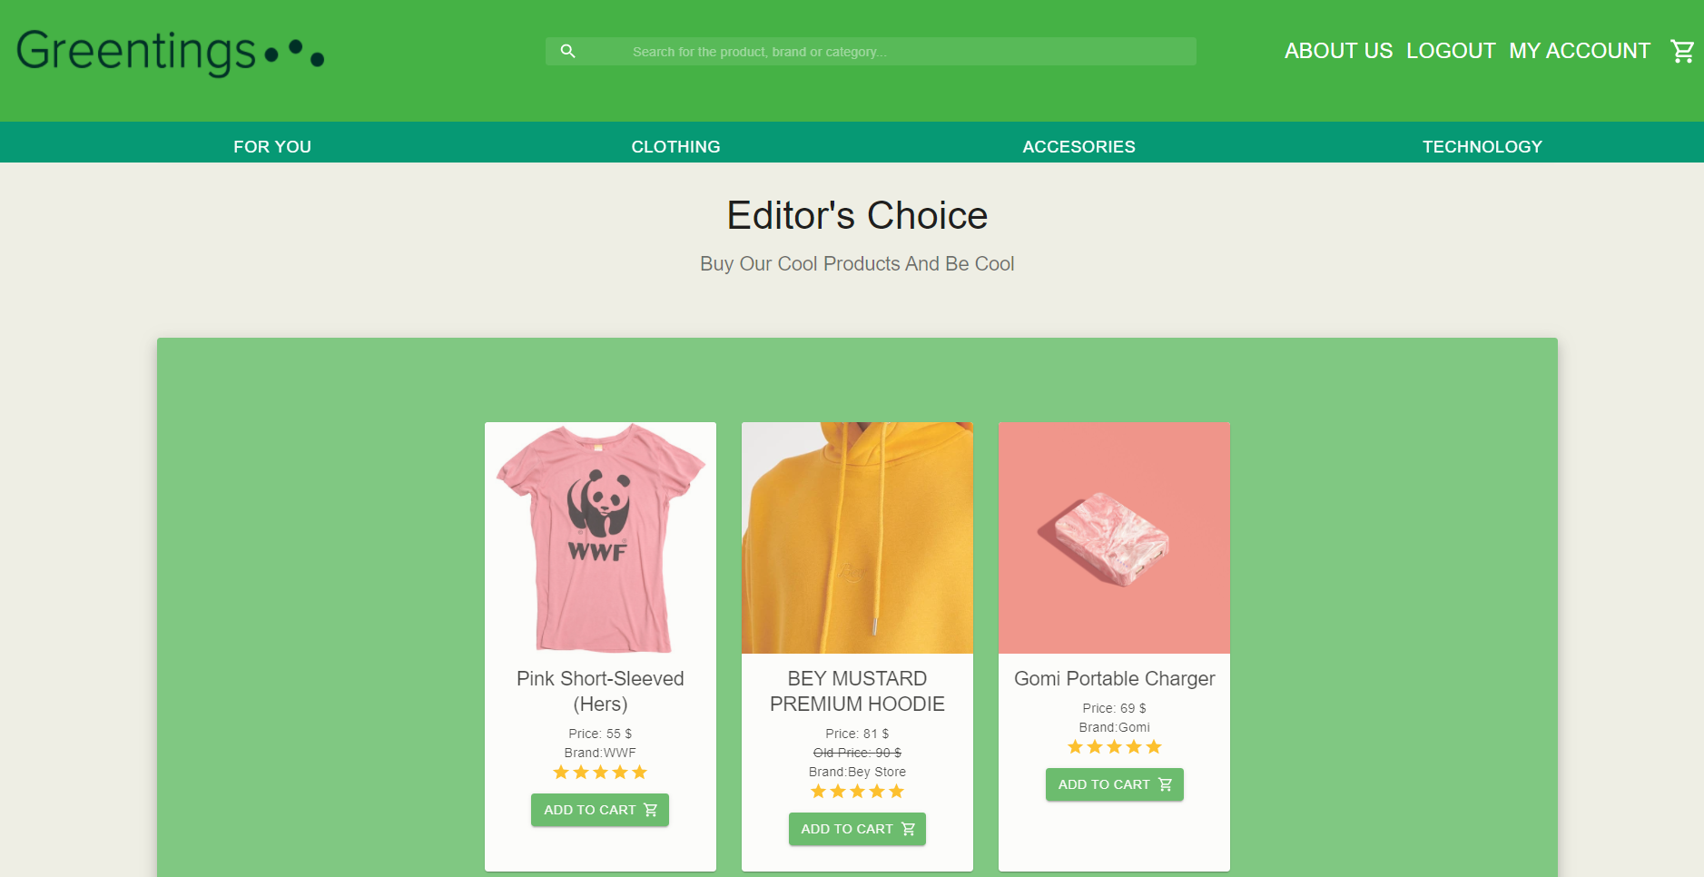
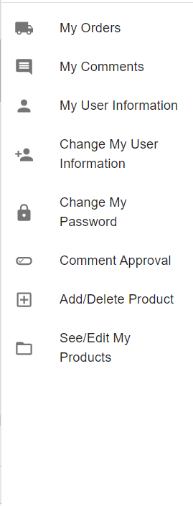
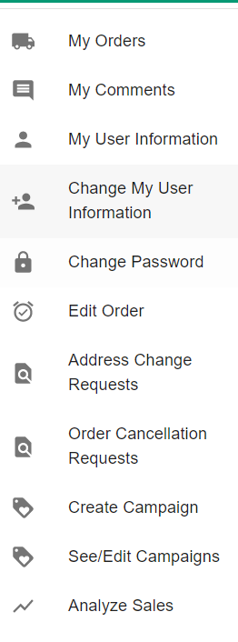
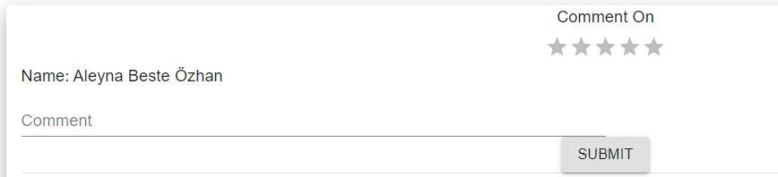
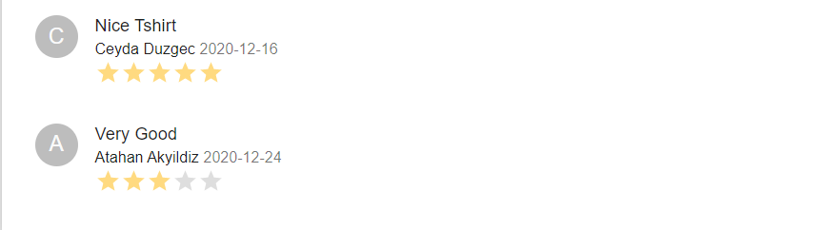

Slide 6
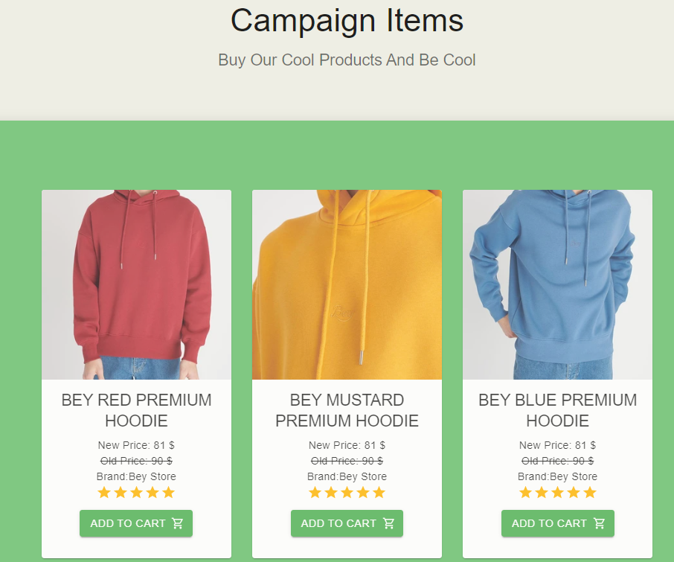

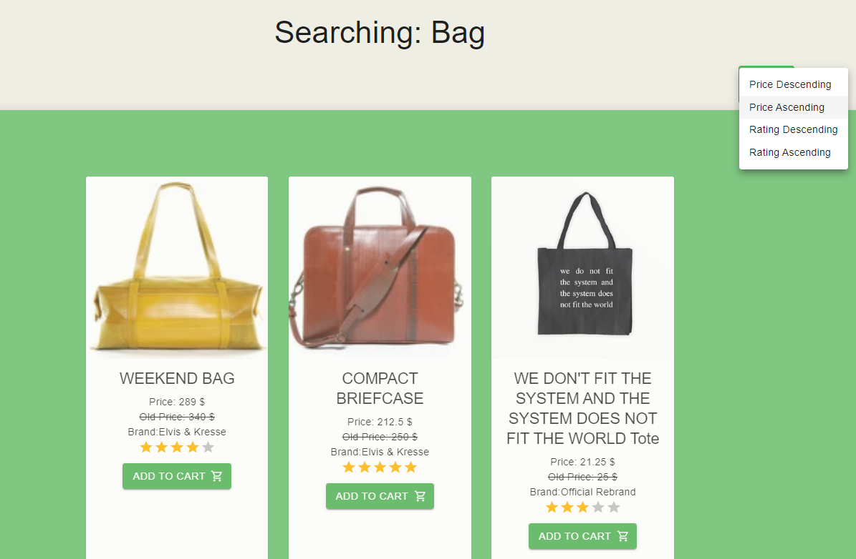
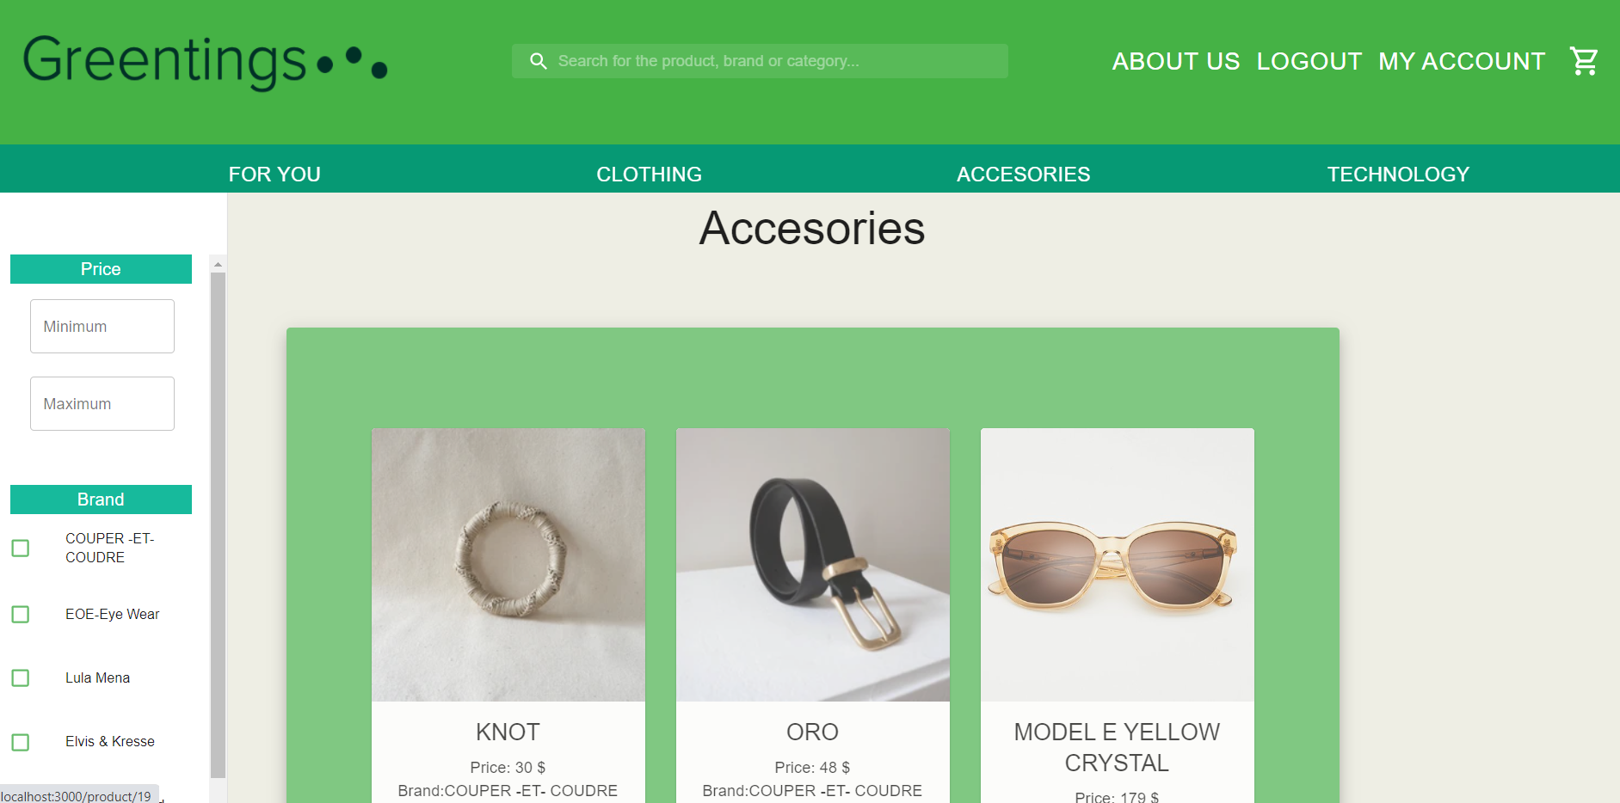

Slide 7
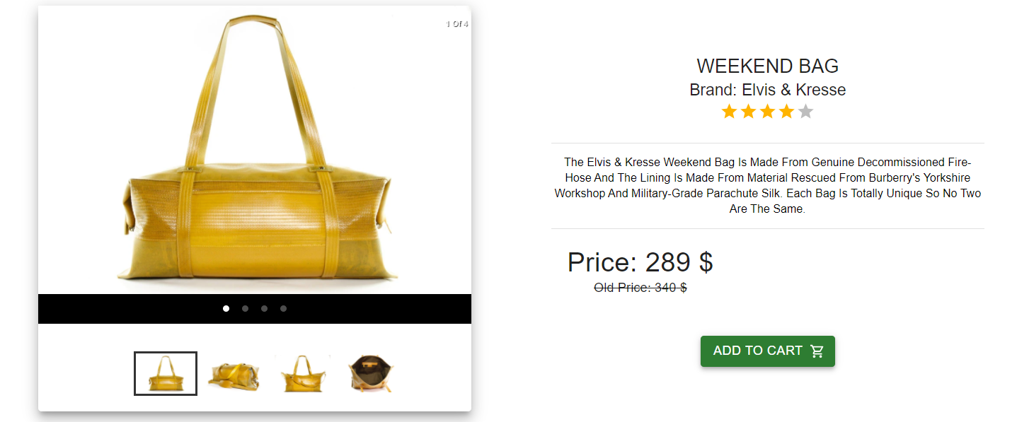
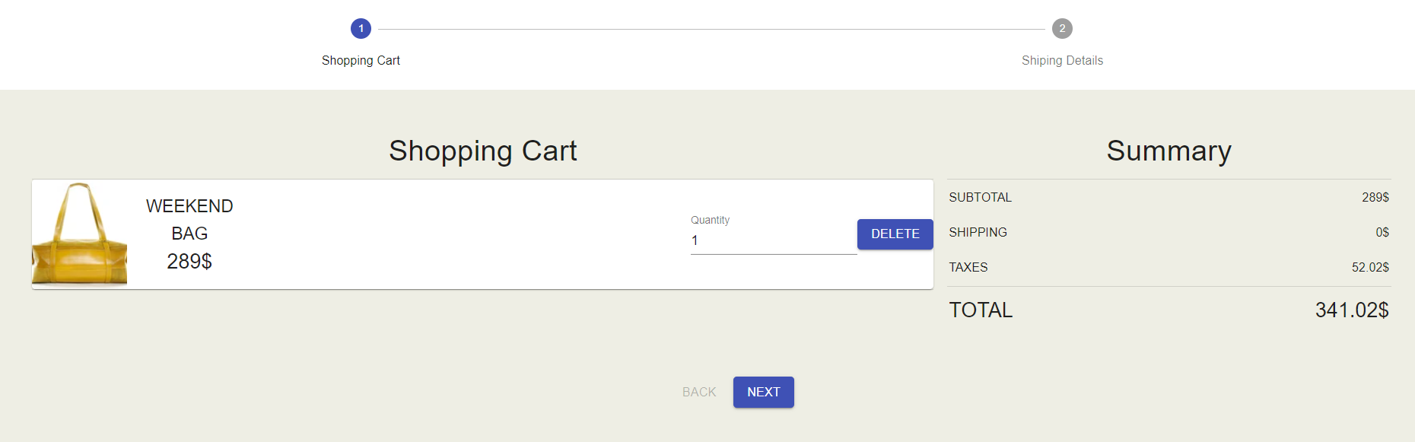
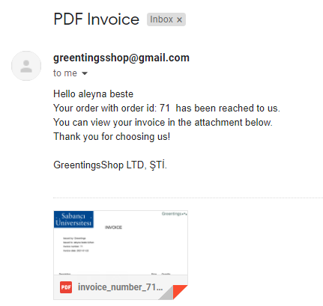

Slide 8
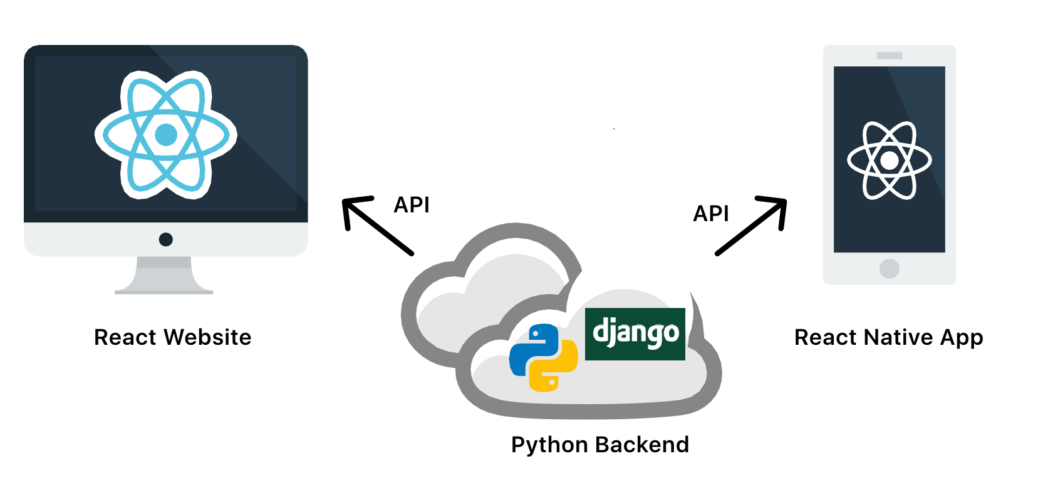
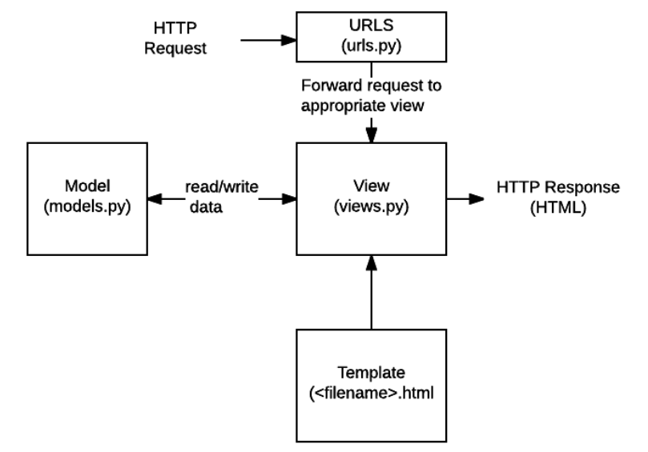
Solution Architecture
WHY REACT?
Fast, Simple, Scalable
Don’t Repeat Yourself, Write Once
Easy to Learn
Widely Used
Vast Availability of Libraries
React Native is similar to React, except it compiles to Android and iOS instead of a website
WHY DJANGO?
Fast, Scalable
Suits any Web Application Project
Fully Loaded
Widely Used
Cross-platform
Secure
Pragmatic Design
https://medium.com/proximistyle/building-your-startup-with-python-react-react-native-and-aws-286afd94a29c

Slide 9

Solution Architecture
PROVIDED FUNCTIONALITIES
Campaign Deployment & Management
Automatic Price, Tax Calculation
Invoice Reporting
Recommendation System
Quick Order & Cancel System
Guest Checkout
Informative User Services via Mailing System
Product & Sales Manager Authorization
easy-to-use checkout

Slide 10
FUTURE WORK
Different options for shipment system with different pricing such as fast delivery
Automatic detection of profanity in user comments
An integrated blog or articles section
Improvements on page speed
FAQs section
Custom report features

Slide 11
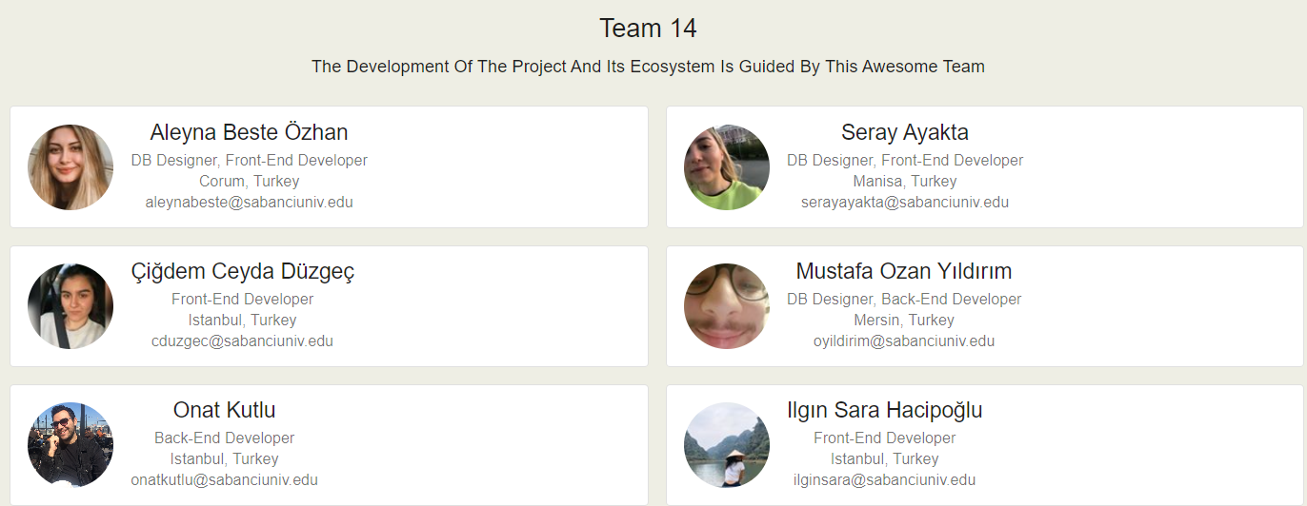

Conclusion
We gained experience on Django, React JS and React Native
We learned agile development methodology
We also worked on the idea behind our project, and design our theme and front end accordingly
It was a great experience working with the team

