Slide 1
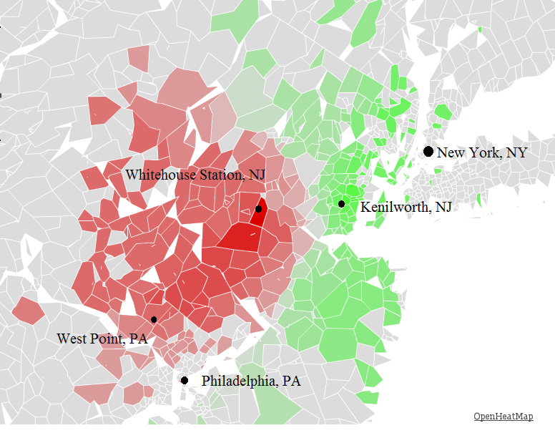
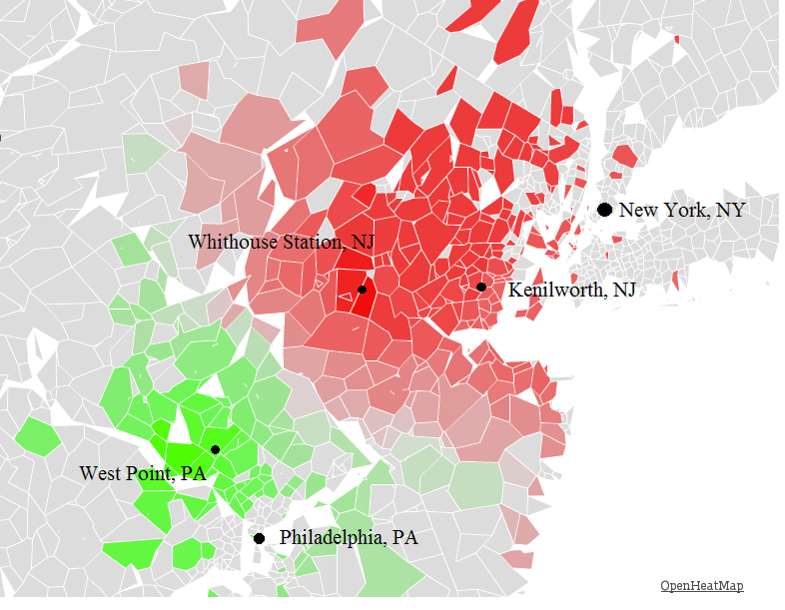
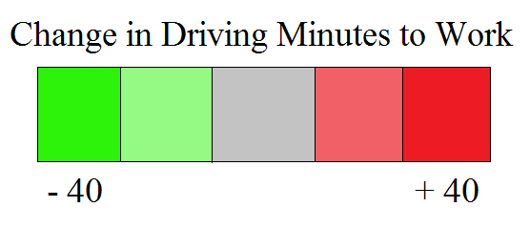
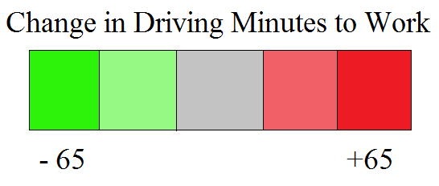
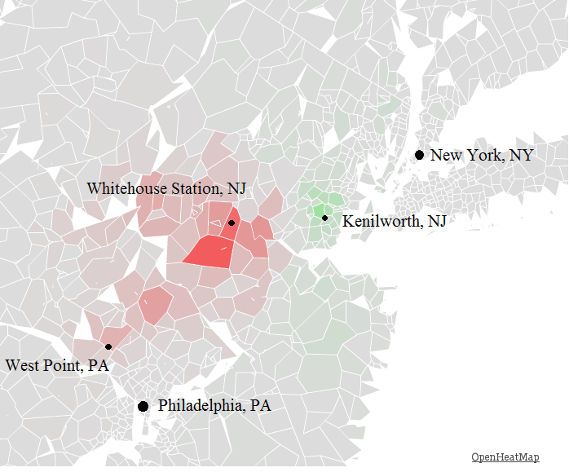
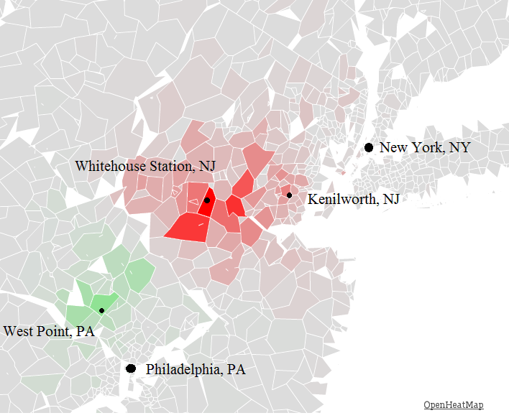
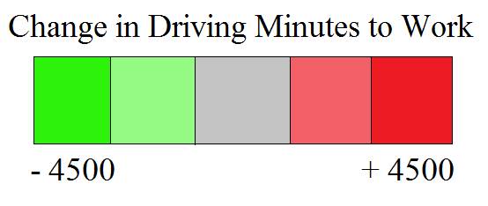
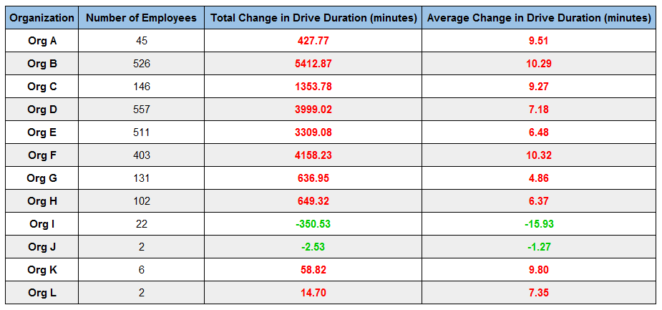
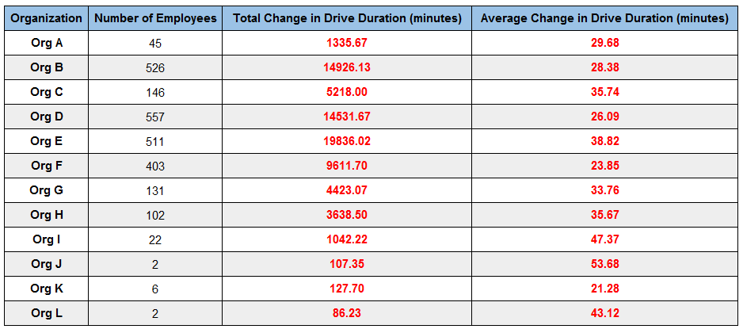
Effect on Drive to Work for move to
Kenilworth, NJ
Effect on Drive to Work for Move to
West Point, PA
Change in Drive Duration per Zip Code
Change in Drive Duration per Zip Code
Interactive Map available at: http://www.openheatmap.com/view.html?map=ConcubinarianIntercommunionXenic
Interactive Map available at: http://www.openheatmap.com/view.html?map=SubcaudateCystogenousPygmyism
Weighted Change in Drive Duration by Number of Employees
Weighted Change in Drive Duration by Number of Employees
Interactive Map available at: http://www.openheatmap.com/view.html?map=XviiControversalLallations
Interactive Map available at: http://www.openheatmap.com/view.html?map=FregataCumbernauldsDiluent
Average Change per Organization
Average Change per Organization

