Slide 1
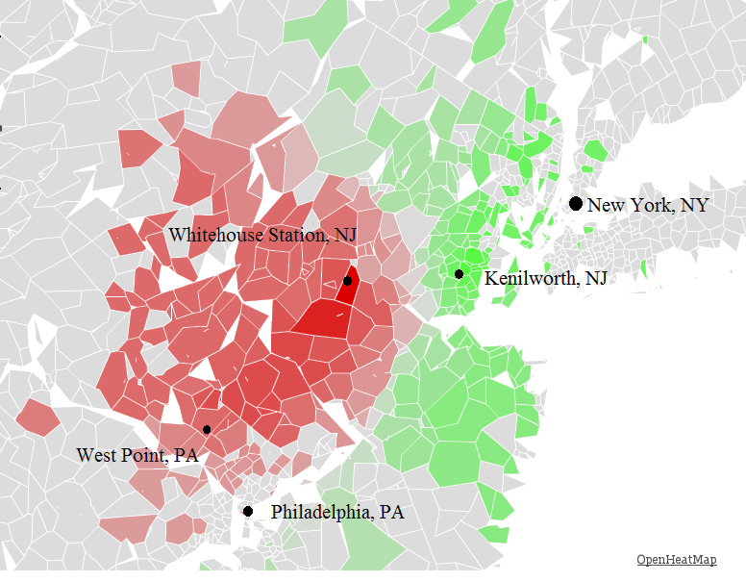
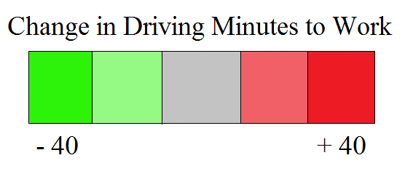
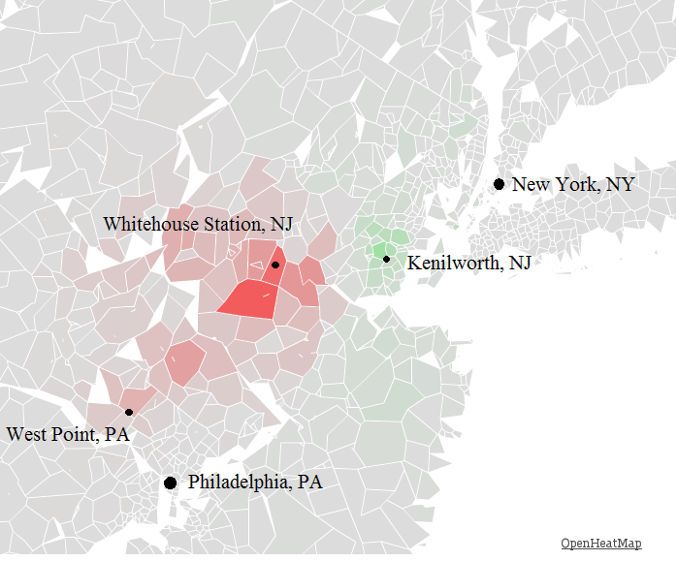
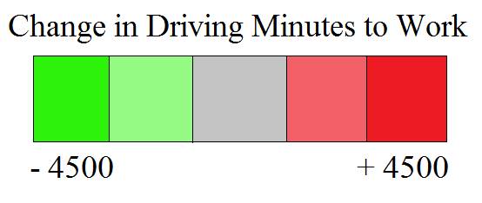
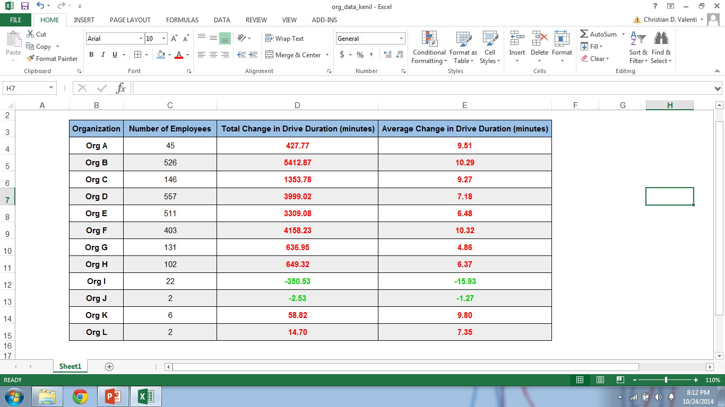
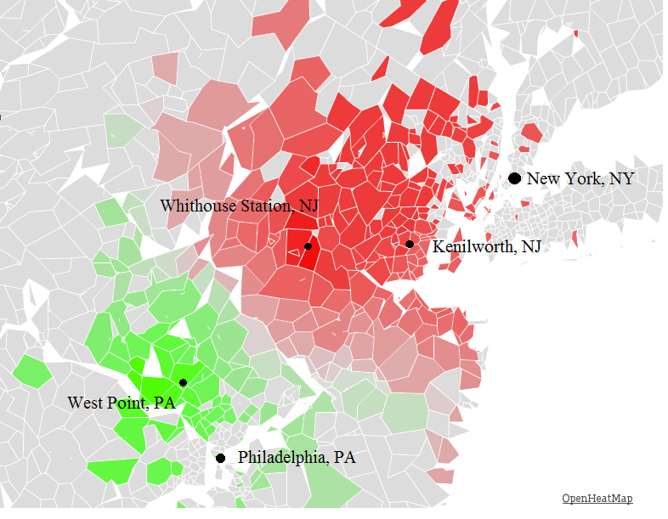
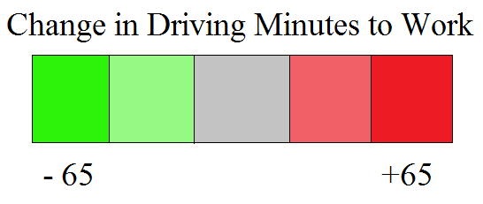
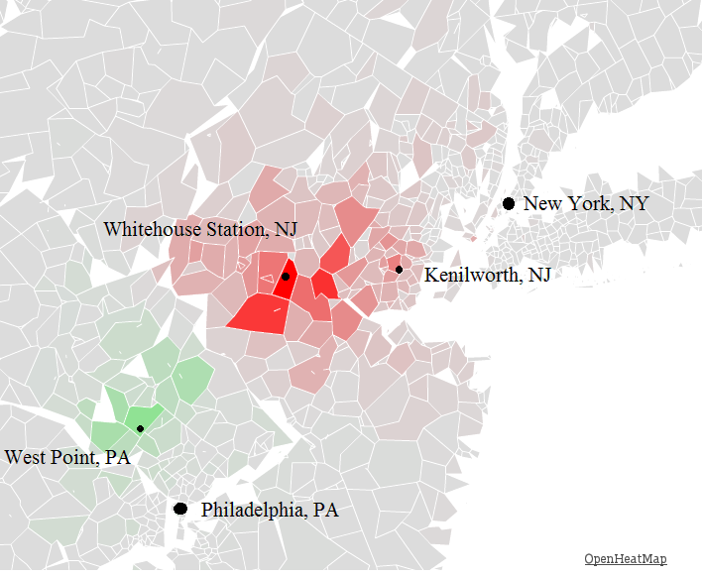
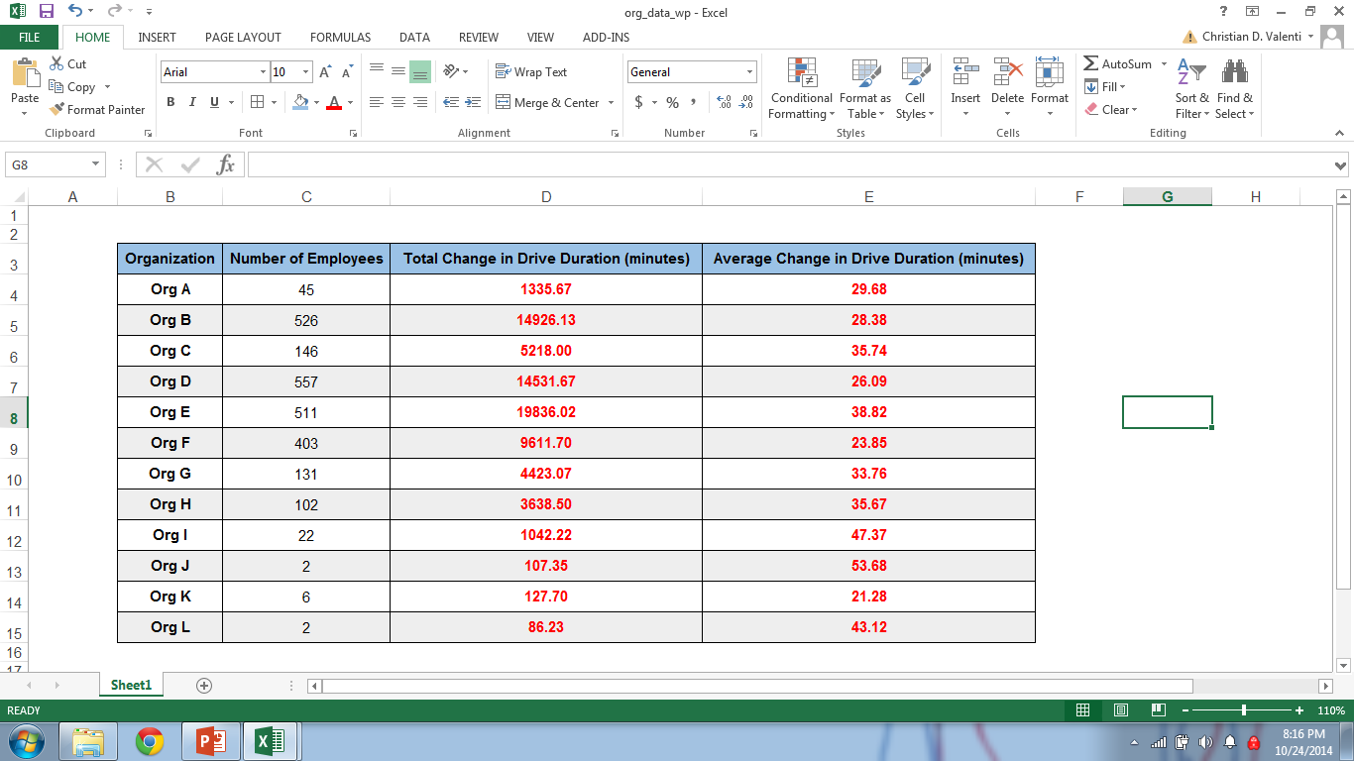
Effect on Drive to Work for move to
Kenilworth, NJ
Change in Drive Duration per Zip Code
Each zip code's change in drive duration for move from Whitehouse Station, NJ to Kenilworth, NJ.
Interactive Map available at: http://www.openheatmap.com/view.html?map=ConcubinarianIntercommunionXenic
Weighted Change in Drive Duration by Number of Employees
Interactive Map available at: http://www.openheatmap.com/view.html?map=XviiControversalLallations
Average Change per Organization
Effect on Drive to Work for Move to
West Point, PA
Change in Drive Duration per Zip Code
Interactive Map available at: http://www.openheatmap.com/view.html?map=SubcaudateCystogenousPygmyism
Weighted Change in Drive Duration by Number of Employees
Interactive Map available at: http://www.openheatmap.com/view.html?map=FregataCumbernauldsDiluent
Average Change per Organization

