Slide 1

Machine Learning for Geosciences
By Francisco Mendoza
mentofran@gmail.com
Course material:
https://github.com/mathphysmx/teaching-ml

Slide 2
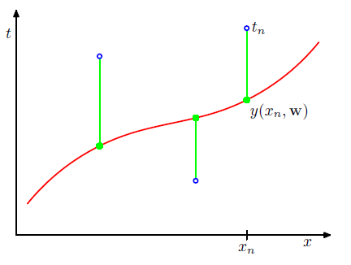
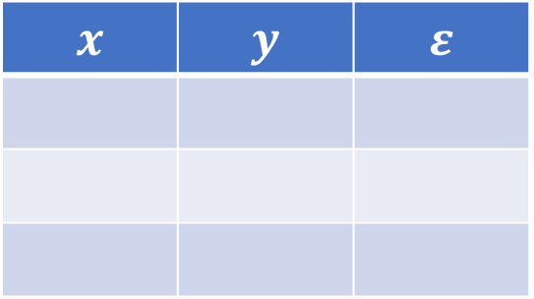

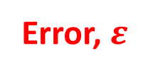

Basic concepts
Labels, $y$
Error, $ε$
Feature, $x$
Training set
Features
Labels
Error
$$x$$ | $$y$$ | $$ε$$

Slide 3
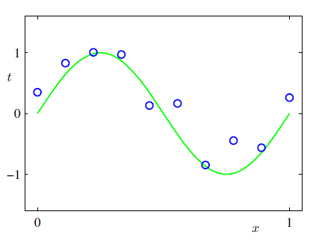
Machine learning. Introduction

Slide 4
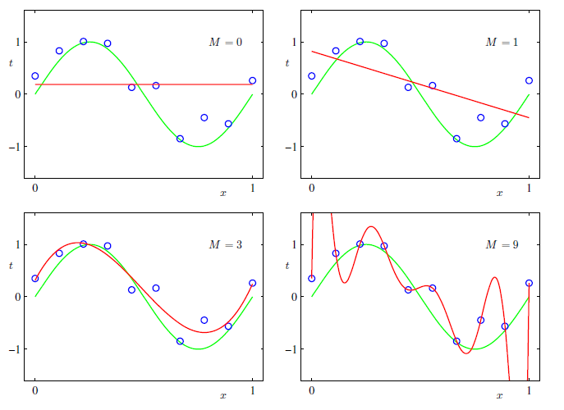
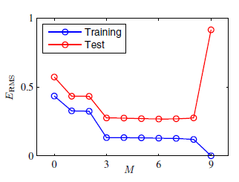
Model selection

Slide 5
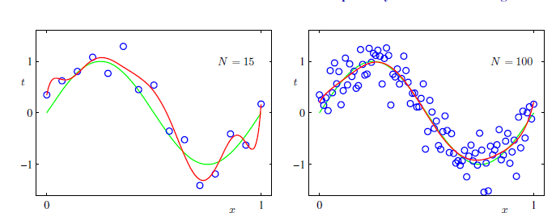
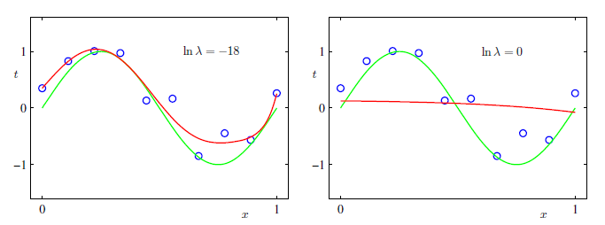
Over-fitting?

Slide 6
Concepts review
Notes:
What are the concepts leaned? Feature, labels, error, training set. (By asking this question, students are move to speak in English, at least some words)

Slide 7

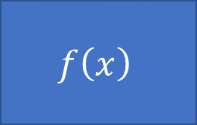


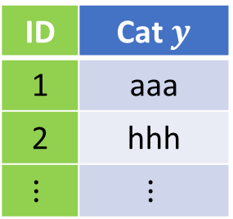

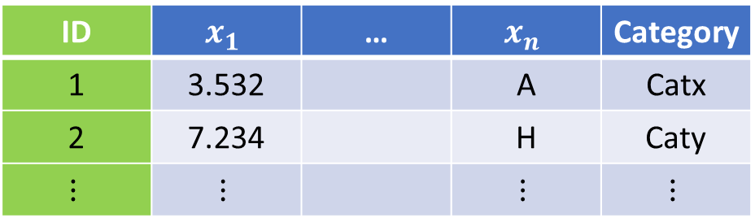


Type of problems, data types
Model
$$f\left(x\right)$$
$$x→y$$
Supervised
$$x$$
$$y$$
$$(x_{1},x_{2},…,x_{n})→y$$
$$(x_{1},x_{2},…,x_{n})→(y_{1},y_{2},…,y_{k})$$
$$f:X→Y$$
Unsupervised
ID | $$x_{1}$$ | … | $$x_{n}$$ | Category
1 | 3.532 |  | A | Catx
2 | 7.234 |  | H | Caty
$$⋮$$ | $$⋮$$ |  | $$⋮$$ | $$⋮$$
ID | Cat $y$
1 | aaa
2 | hhh
$$⋮$$ | $$⋮$$

Slide 8
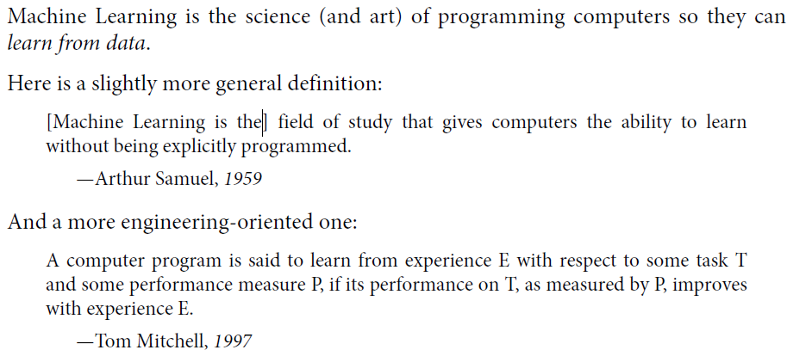
What is ML

Slide 9
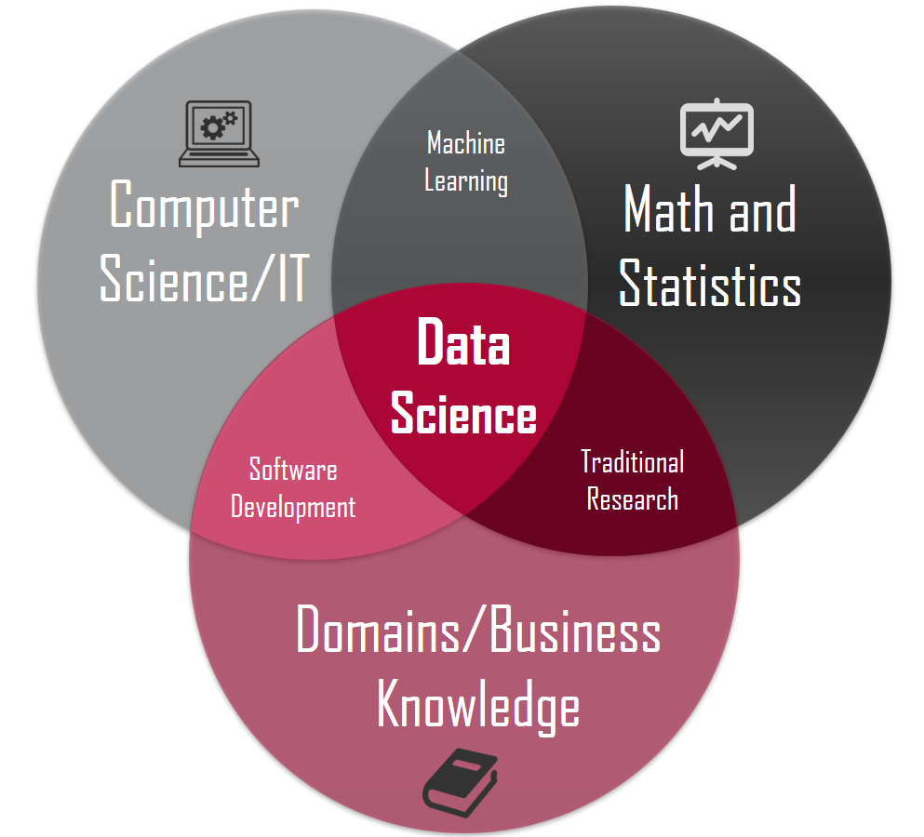
Related areas. Data Science
Data manipulation (50 – 80 %)
Machine Learning
Deep learning

Slide 10
Applications in this course
Hydrology, geothermal, radioactive waste disposal, oil and gas, CO2 sequestration, mining
Fluid volume production from a well
Porosity from depth (Pyrcz)
…
Mostly based on the book of Guangren Shi

Slide 11
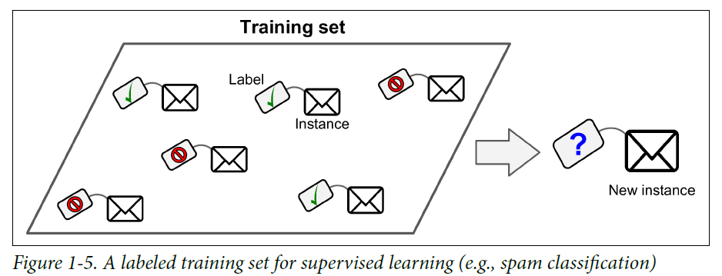
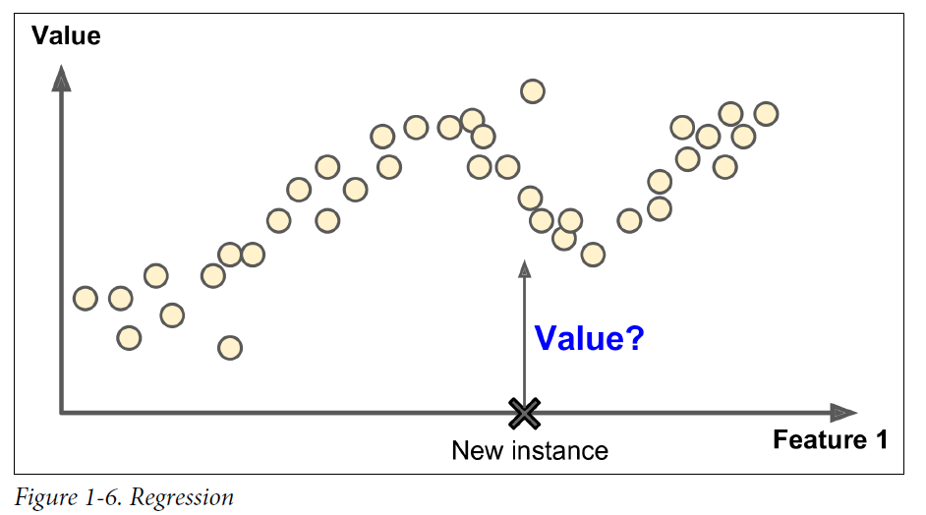
Types of Machine learning algorithms
Supervised
• k-Nearest Neighbors
• Linear Regression
• Logistic Regression
• Support Vector Machines (SVMs)
• Decision Trees, Ensemble methods
• Neural networks
Unsupervised
Clustering: K-means, Hierarchical Cluster Analysis (HCA)
Visualization and dimensionality reduction (Kernel)? PCA, t-distributed Stochastic Neighbor Embedding (t-SNE)
Reinforcement learning
Batch and Online learning

Slide 12
Grading
20% Theoretical
20% Computational exercises
20% Exams
20% Oral presentation of application of ML in Geosciences
20% MOOC (Coursera, Udemy, …)

Slide 13
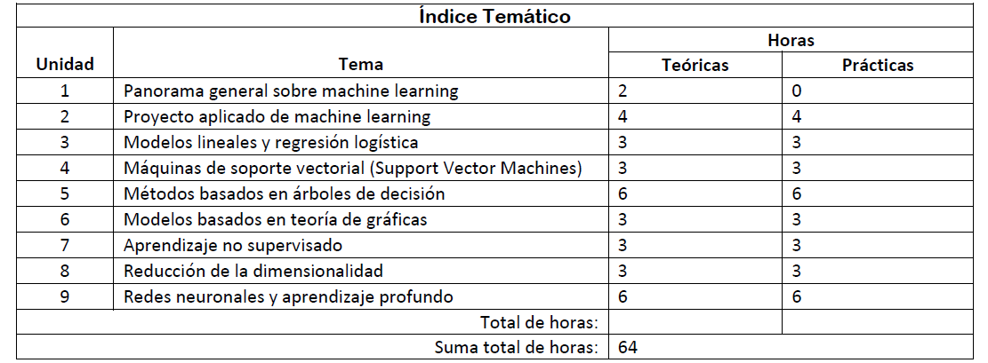
Table of Content (TOC)

Slide 14
Bibliography

Slide 15
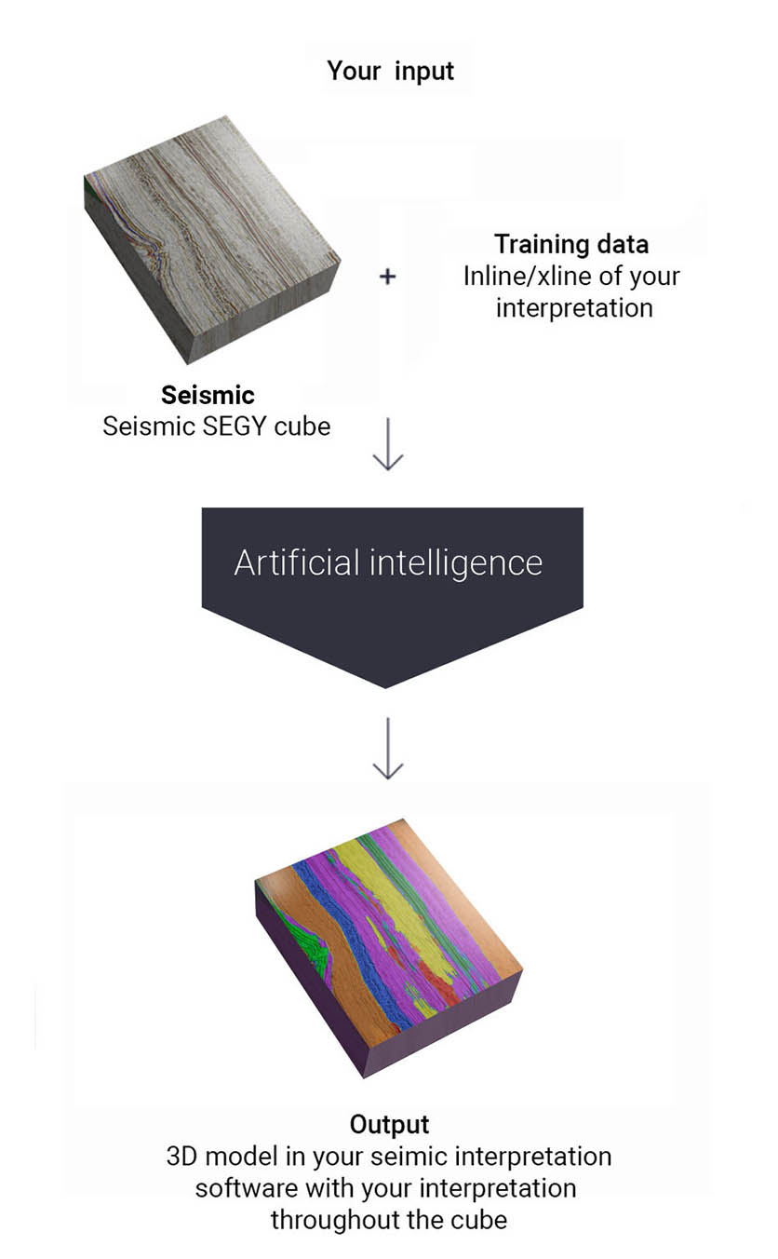

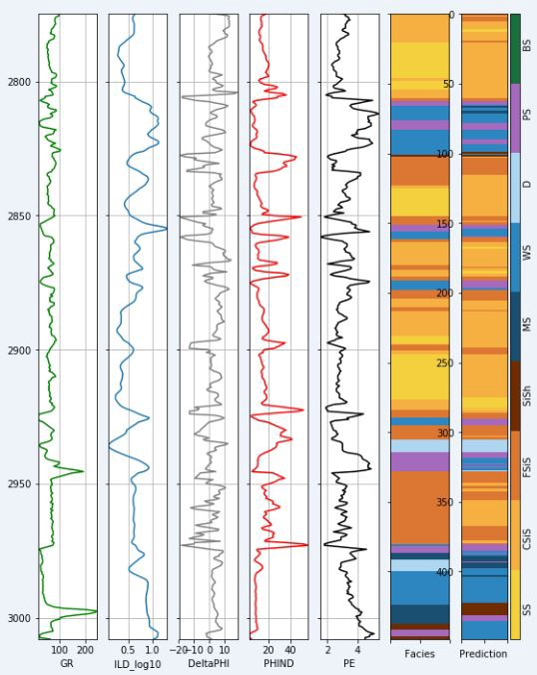



Companies
All big companies +
Well spacing
Earth models
Seismic horizons interpretation

Slide 16
Concepts review
Notes:
What are the concepts leaned? Feature, labels, error, training set. (By asking this question, students are move to speak in English, at least some words)

Slide 17








Software stack

Slide 18
Machine Learning for Geosciences
By Francisco Mendoza
mentofran@gmail.com
Course material:
https://github.com/mathphysmx/teaching-ml

