Slide 1

Machine Learning for Geosciences
By Francisco Mendoza
mentofran@gmail.com
Course material:
https://github.com/mathphysmx/teaching-ml

Slide 2
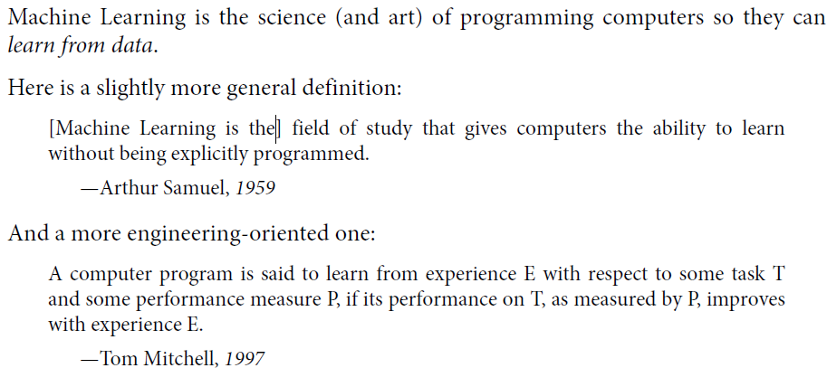
What is ML

Slide 3
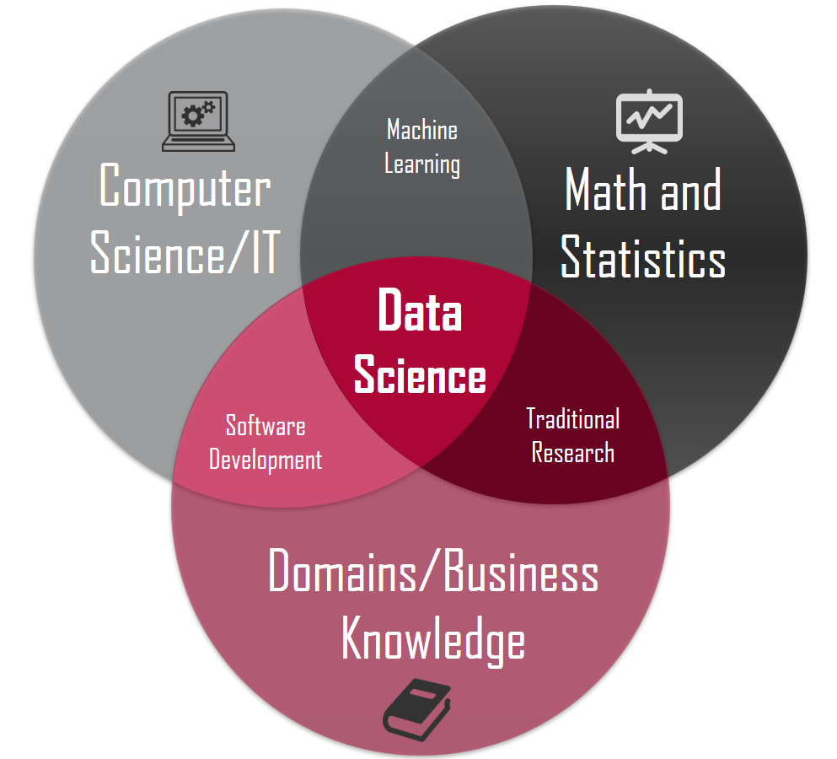
Related areas. Data Science
Data manipulation (50 – 80 %)
Machine Learning
Deep learning

Slide 4
Applications in this course
Based on the book of Guangren Shi
Hydrology, geothermal, radioactive waste disposal, oil and gas,
Fluid volume production from a well ()
Porosity from depth (Pyrcz)

Slide 5
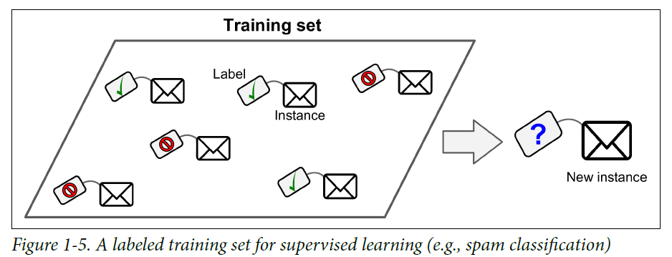
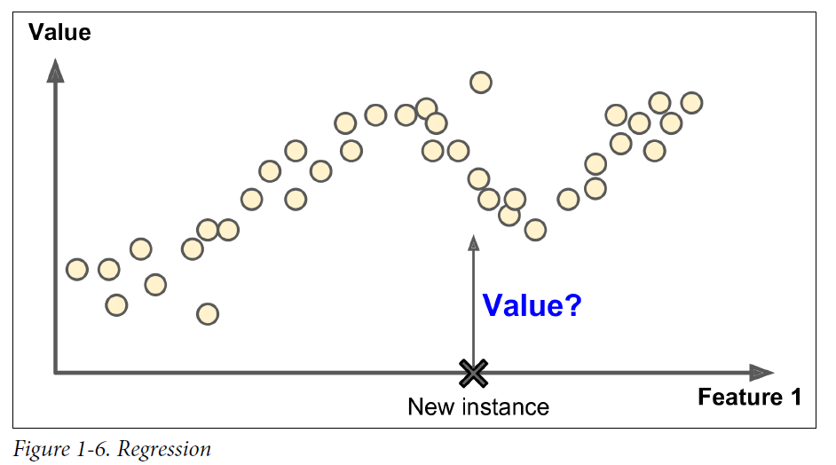
Types of Machine learning algorithms
Supervised
• k-Nearest Neighbors
• Linear Regression
• Logistic Regression
• Support Vector Machines (SVMs)
• Decision Trees, Ensemble methods
• Neural networks
Unsupervised
Clustering: K-means, Hierarchical Cluster Analysis (HCA)
Visualization and dimensionality reduction (Kernel)? PCA, t-distributed Stochastic Neighbor Embedding (t-SNE)
Reinforcement learning
Batch and Online learning

Slide 6

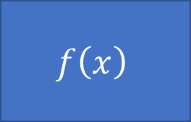


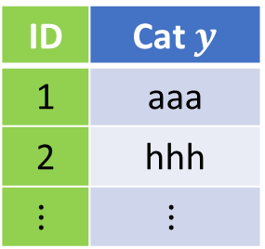

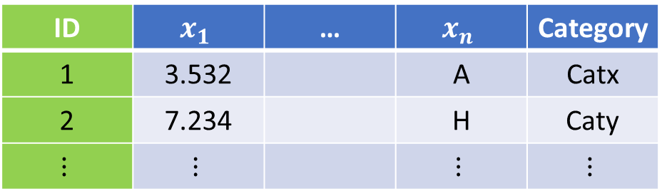


Type of problems, data types
Model
$$f\left(x\right)$$
$$x→y$$
Supervised
$$x$$
$$y$$
$$(x_{1},x_{2},…,x_{n})→y$$
$$(x_{1},x_{2},…,x_{n})→(y_{1},y_{2},…,y_{k})$$
$$f:X→Y$$
Unsupervised
ID | $$x_{1}$$ | … | $$x_{n}$$ | Category
1 | 3.532 |  | A | Catx
2 | 7.234 |  | H | Caty
$$⋮$$ | $$⋮$$ |  | $$⋮$$ | $$⋮$$
ID | Cat $y$
1 | aaa
2 | hhh
$$⋮$$ | $$⋮$$

Slide 7
Grading
20% Theoretical
20% Computational exercises
20% Exams
20% Oral presentation of application of ML in Geosciences
20% MOOC (Coursera, Udemy, …)

Slide 8
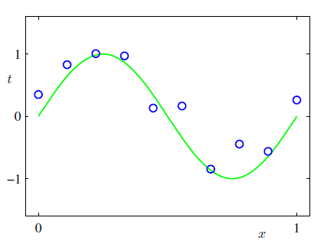
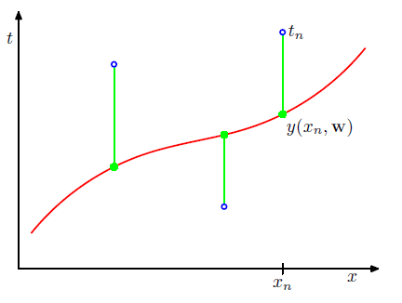
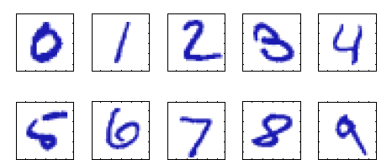
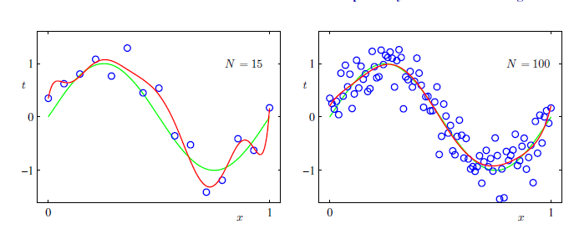
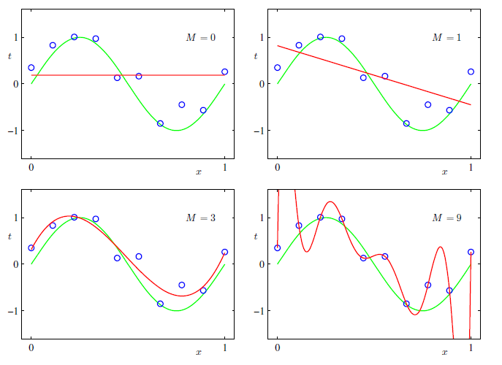
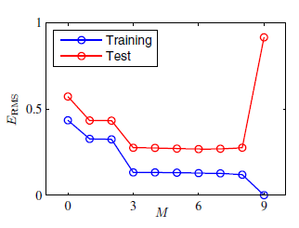
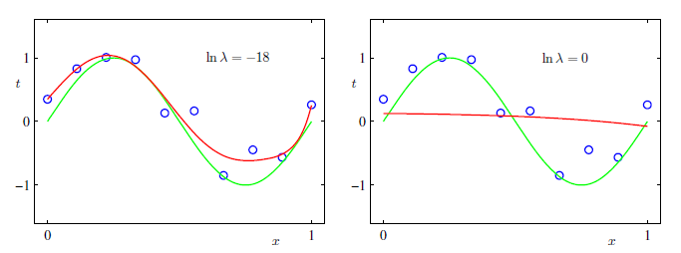

Slide 9
Basic concepts
Labels
Training set
Test set
Feature (independent variable)
Error

Slide 10
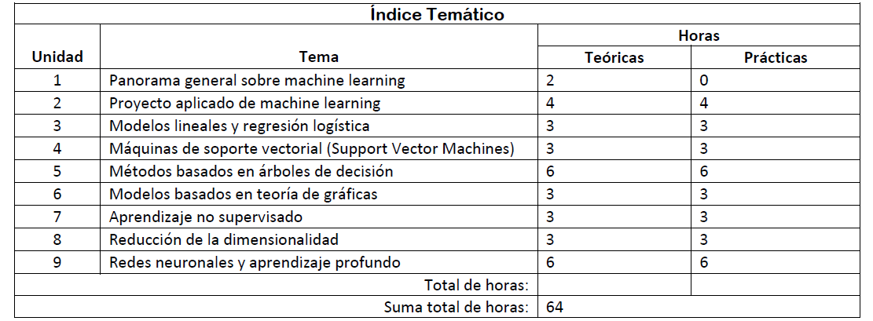
Table of Content (TOC)

Slide 11
Bibliography

Slide 12
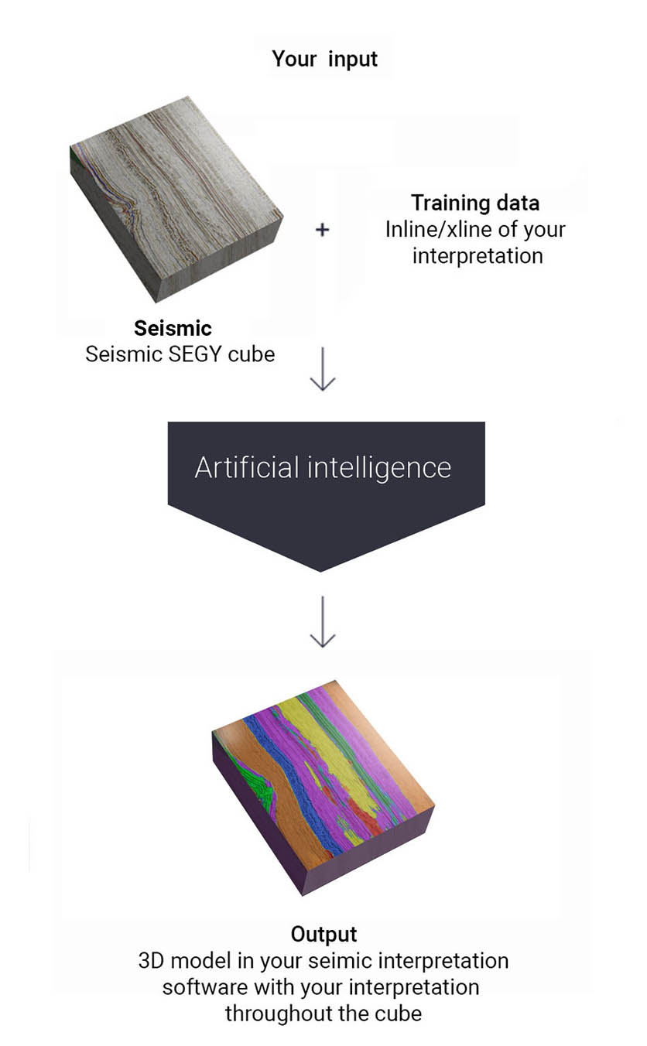

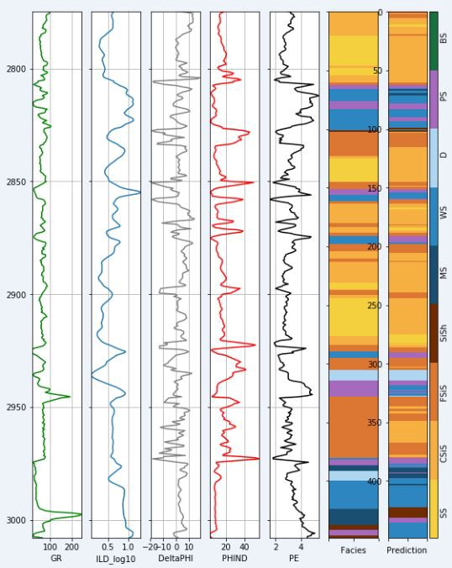



Companies
All big companies +
Well spacing
Earth models
Seismic horizons interpretation

Slide 13
Machine Learning for Geosciences
By Francisco Mendoza
mentofran@gmail.com
Course material:
https://github.com/mathphysmx/teaching-ml

