Slide 1
Linea models

Slide 2
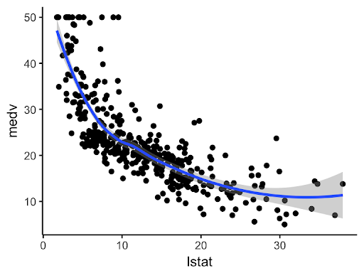
Content
Linear Regression
Non-Linear Regression

Slide 3
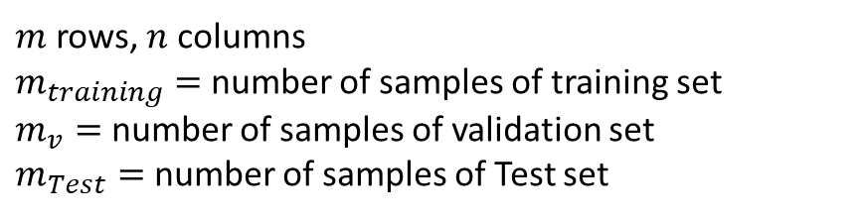
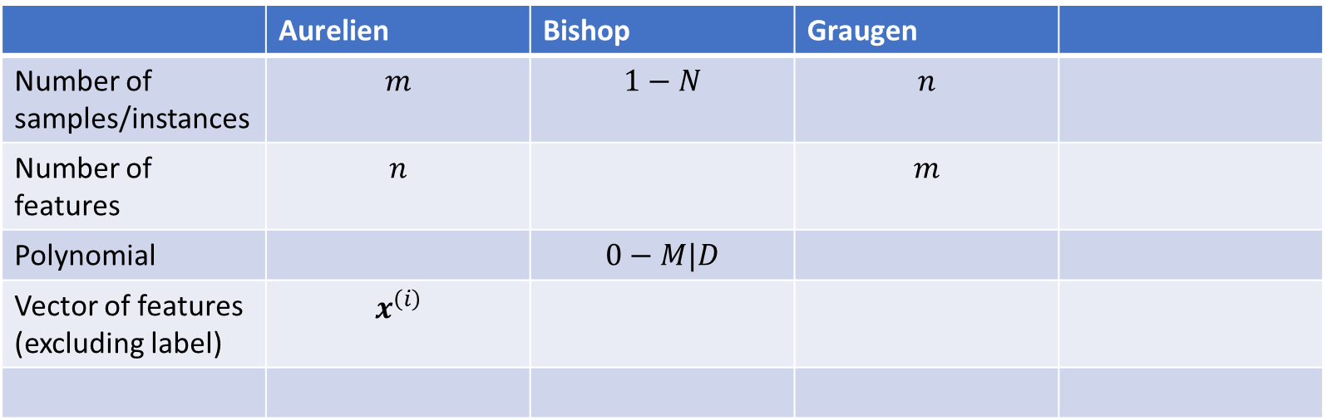
Notation
 | Aurelien | Bishop | Graugen
Number of samples/instances | $$m$$ | $$1−N$$ | $$n$$
Number of features | $$n$$ |  | $$m$$
Polynomial |  | $$0−M|D$$
Vector of features (excluding label) | $$x^{\left(i\right)}$$
$m$ rows, $n$ columns
$m_{training}=$ number of samples of training set
$m_{v}=$ number of samples of validation set
$m_{Test}=$ number of samples of Test set

Slide 4
Linear regression
Notes:
Besides regression, what other kind of ML problem exists?

Slide 5
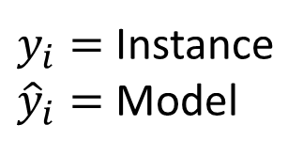





Error definition
$y_{i}=$ Instance
${\hat{y}}_{i}=$ Model
Green
Model
$$ε ∝ {\hat{y}}_{i}−y_{i}$$
$$ε=0$$
$$ε=0$$
$$\left(12, 15\right)$$
Blue
Model
$$\left(7, 5\right)$$
Notes:
Which model has less error?
How can we define de error?
How many instances are there in this problem? 2 observations

Slide 6
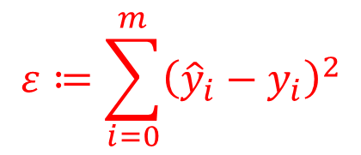
Error definition
Green
Model
$$ε ∝ {\hat{y}}_{i}−y_{i}$$
$$ε=0$$
$$ε=0$$
$$\left(12, 15\right)$$
Blue
Model
Solution:
$$\left(7, 5\right)$$
$$ε≔\sum_{i=0}^{m}{{\left({\hat{y}}_{i}−y_{i}\right)}^{2}}$$
Notes:
Which model has less error?
How can we define de error?

Slide 7

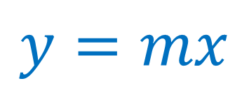


$$y=mx$$
$$n=1$$
$$ε$$
$$\left(12, 4\right)$$
Notes:
How many colors do we see in the image? What do you think each color represents?
ToDo: Create an interactive plot (charts.js?) with a slider to change the slope $m$ of the line in order to visualize the error variation with respect to this varaible $m$.

Slide 8




$$y=mx$$
$$n=1$$
$$y=mx$$
$ε$?
$$\left(12, 4\right)$$
$$y_{i}$$
$$x_{i}$$
Notes:
How many colors do we see in the image? What do you think each color represents?
ToDo: Create an interactive plot (charts.js?) with a slider to change the slope $m$ of the line in order to visualize the error variation with respect to this varaible $m$.

Slide 9

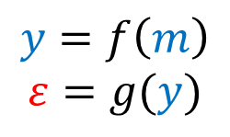




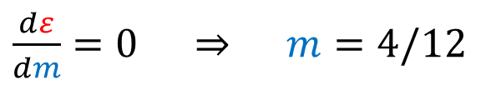
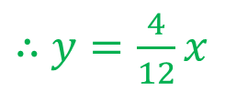
$$y=mx$$
$$n=1$$
$$ε= {\left( y −4 \right)}^{2}$$
$$={\left(12m −4\right)}^{2}$$
$$y=mx$$
$$={\left(x_{i}m −y_{i}\right)}^{2}$$
$\frac{dε}{dm}=0$ $⇒$ $m=4/12$
$$=y_{i}/x_{i}$$
$$ε$$
$$\left(12, 4\right)$$
$∴$ $y=\frac{4}{12}x$
$$y_{i}$$
$$x_{i}$$
$$y=f\left(m\right)$$
$$ε=g(y)$$
$⇒$ $ε=h(m)$
Notes:
How many colors do we see in the image? What do you think each color represents?
Function compositions $ε=g∘y=g(y(m))$
ToDo: Create an interactive plot (charts.js?) with a slider to change the slope $m$ of the line in order to visualize the error variation with respect to this varaible $m$.

Slide 10






$$y=mx$$
$$n=1$$
>_ Code
$∴$ $y=\frac{4}{12}x$
$$y=mx$$
import matplotlib.pyplot as plt
xi = 12 # data points o o o o o
yi = 4
m = yi/xi
plt.scatter(xi,yi)
# model
x = np.linspace(10, 14, num = 5)
y = m * x
plt.plot(x, y)
plt.axis('equal')
plt.show()
$$ε$$
$$\left(12, 4\right)$$
$$y_{i}$$
$$x_{i}$$
Notes:
How many colors do we see in the image? What do you think each color represents?
ToDo: Create an interactive plot (charts.js?) with a slider to change the slope $m$ of the line in order to visualize the error variation with respect to this varaible $m$.

Slide 12


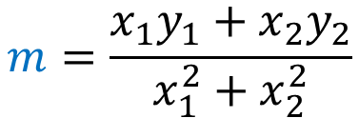
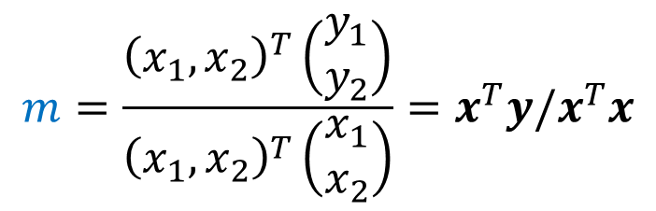
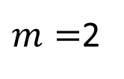



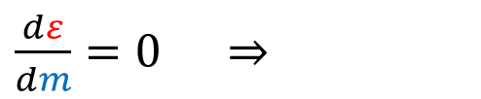

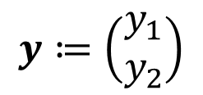



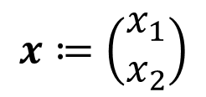
$$y=mx$$
$m=$2
$$ε= {\left(mx_{1} −y_{1} \right)}^{2}$$
$$y=mx$$
$${+\left(mx_{2} −y_{2} \right)}^{2}$$
$$x_{2}=\left(3, 9\right)$$
$\frac{dε}{dm}=0$ $⇒$
$$m=\frac{x_{1}y_{1}+x_{2}y_{2}}{x_{1}^{2}+x_{2}^{2}}$$
$$x_{1}=\left(12, 4\right)$$
Matrix form for fast vectorized computations
$$x≔\left(\begin{matrix}x_{1} \\ x_{2}\end{matrix}\right)$$
$$y≔\left(\begin{matrix}y_{1} \\ y_{2}\end{matrix}\right)$$
$$m=\frac{{\left(x_{1},x_{2}\right)}^{T}\left(\begin{matrix}y_{1} \\ y_{2}\end{matrix}\right)}{{\left(x_{1},x_{2}\right)}^{T}\left(\begin{matrix}x_{1} \\ x_{2}\end{matrix}\right)}=x^{T}y/x^{T}x$$
$$y=f\left(m\right)$$
$$ε=g(y)$$
$⇒$ $ε=h(m)$
$$⇒$$
>_ Code
Notes:
Why matrix form is important? Because it makes notations easier, it helps to abstract up theory, it’s the preferred way to compute since there is compiler speed up for vectorized form, in contrast to (for) loops.
Simple cases:
(0, 5), (5,0)
(0, a), (b, 0) # what happens to the fit line when a = b, a < b. What is the behavior of the line as with decreasing values of $a$.

Slide 14
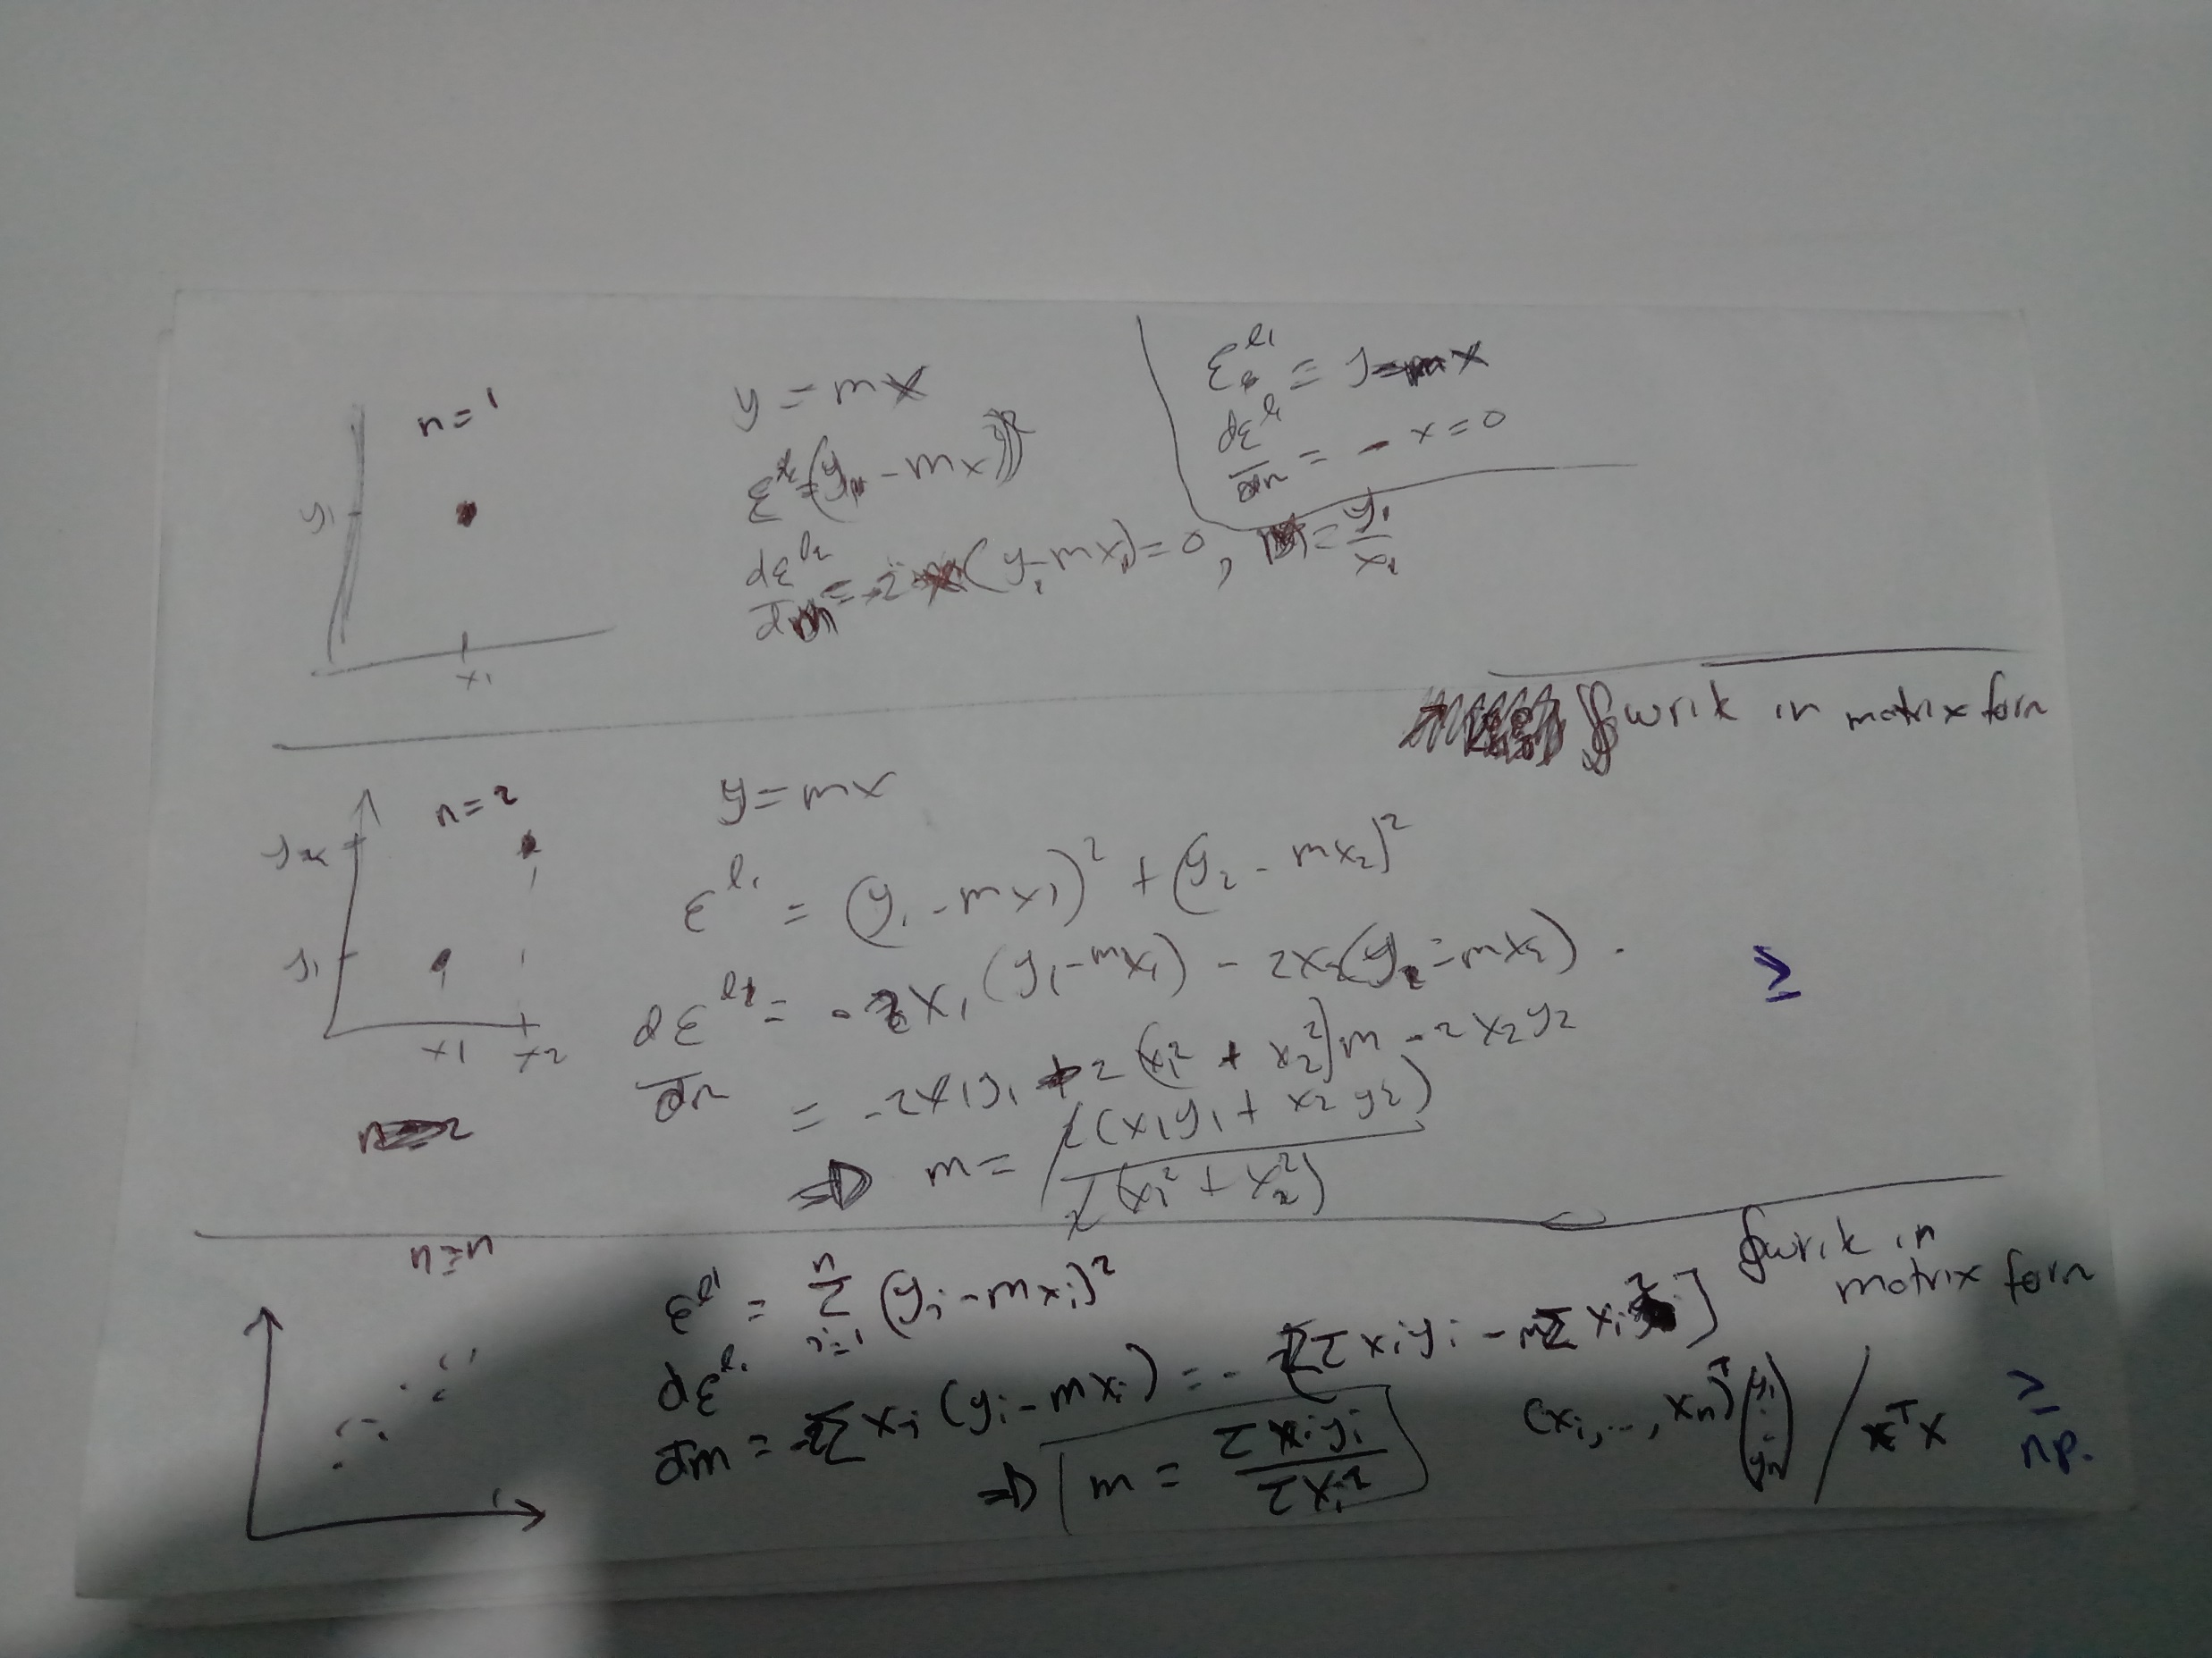

$$n=n$$

Slide 15

Your turn
$$y=A\sin{(x)}$$

Slide 16
