Slide 1

Machine Learning for Geosciences
By Francisco Mendoza
mentofran@gmail.com
Course material:
https://github.com/mathphysmx/teaching-ml

Slide 2
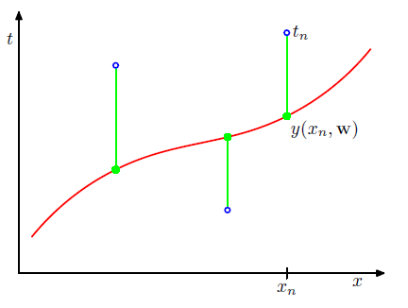
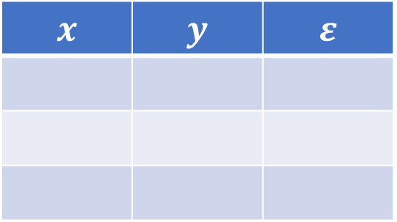

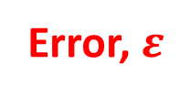

Basic concepts
Instances
Labels, $y$
Error, $ε$
All previous concepts used in statistics such as (in)?dependent variable, input/output variables,…
Feature or predictor, $x$
Training set
Features
Labels
Error
$$x$$ | $$y$$ | $$ε$$
Instances

Slide 3
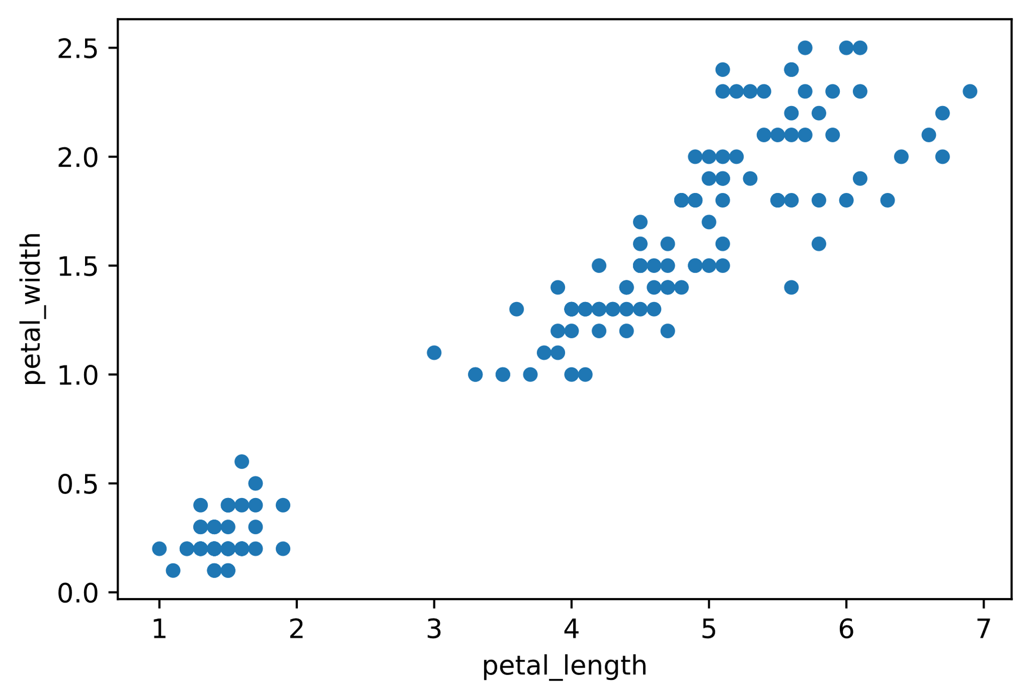
Notes:
%matplotlib inline
import seaborn as sns
iris = sns.load_dataset('iris')
iris.plot(kind = 'scatter', x = 'petal_length', y = 'petal_width')
# sns.pairplot(iris)

Slide 4
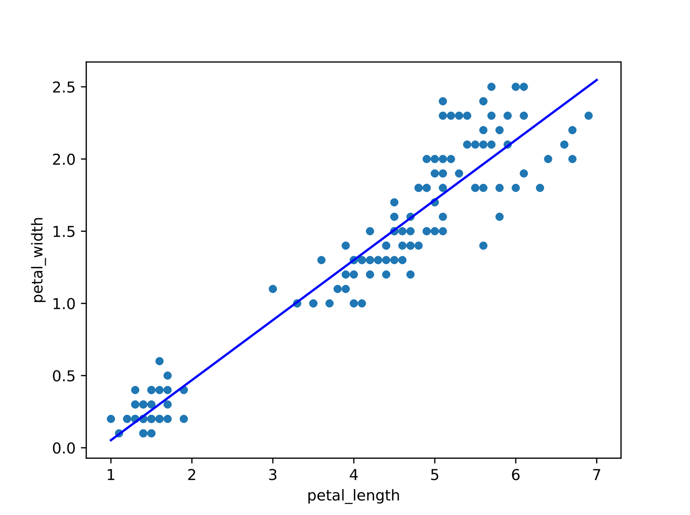

Slide 5
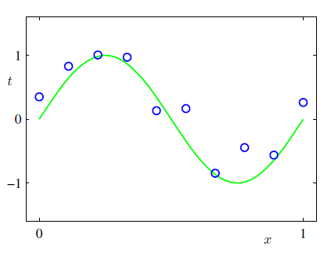
Machine learning. Introduction

Slide 6
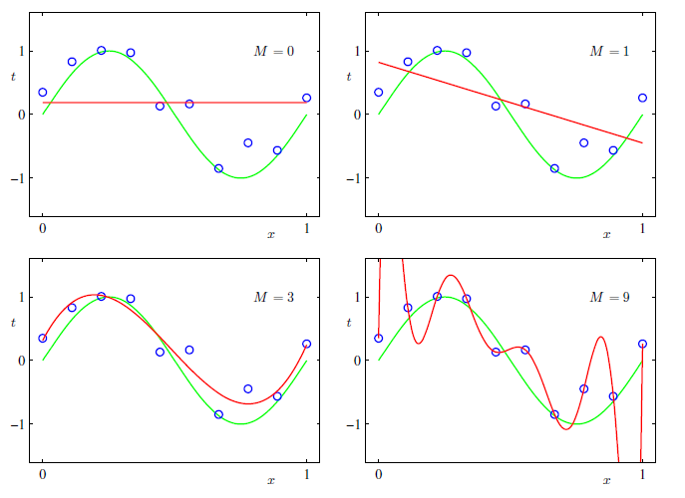
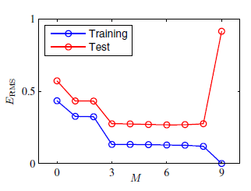
Model selection

Slide 7
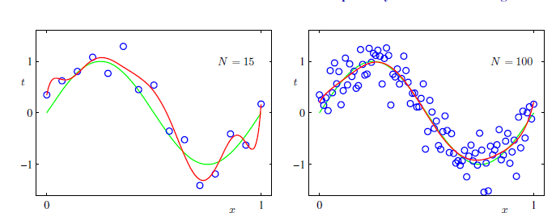
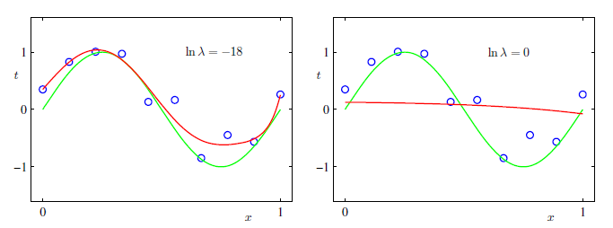
Over-fitting?

Slide 8
Concepts review
Notes:
What are the concepts leaned? Feature, labels, error, training set. (By asking this question, students are move to speak in English, at least some words)

Slide 9

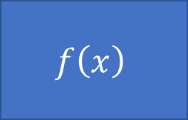


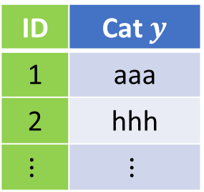

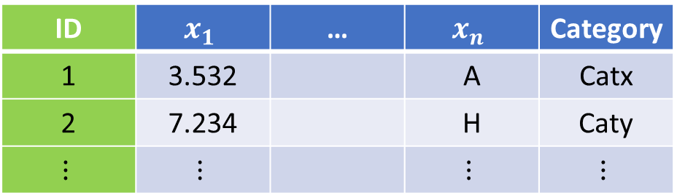


Type of problems, data types
Model
$$f\left(x\right)$$
$$x→y$$
Supervised
$$x$$
$$y$$
$$(x_{1},x_{2},…,x_{n})→y$$
$$(x_{1},x_{2},…,x_{n})→(y_{1},y_{2},…,y_{k})$$
$$f:X→Y$$
Unsupervised
ID | $$x_{1}$$ | … | $$x_{n}$$ | Category
1 | 3.532 |  | A | Catx
2 | 7.234 |  | H | Caty
$$⋮$$ | $$⋮$$ |  | $$⋮$$ | $$⋮$$
ID | Cat $y$
1 | aaa
2 | hhh
$$⋮$$ | $$⋮$$

Slide 10
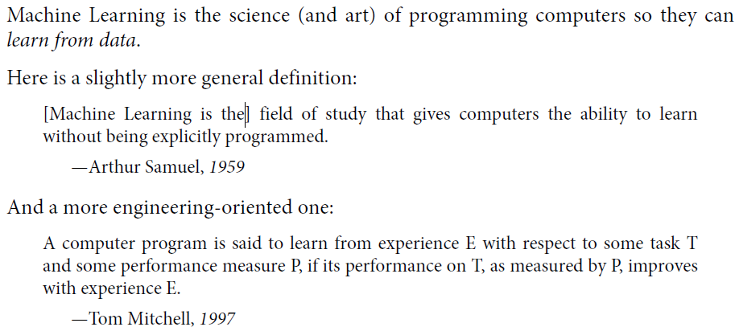
What is ML

Slide 11
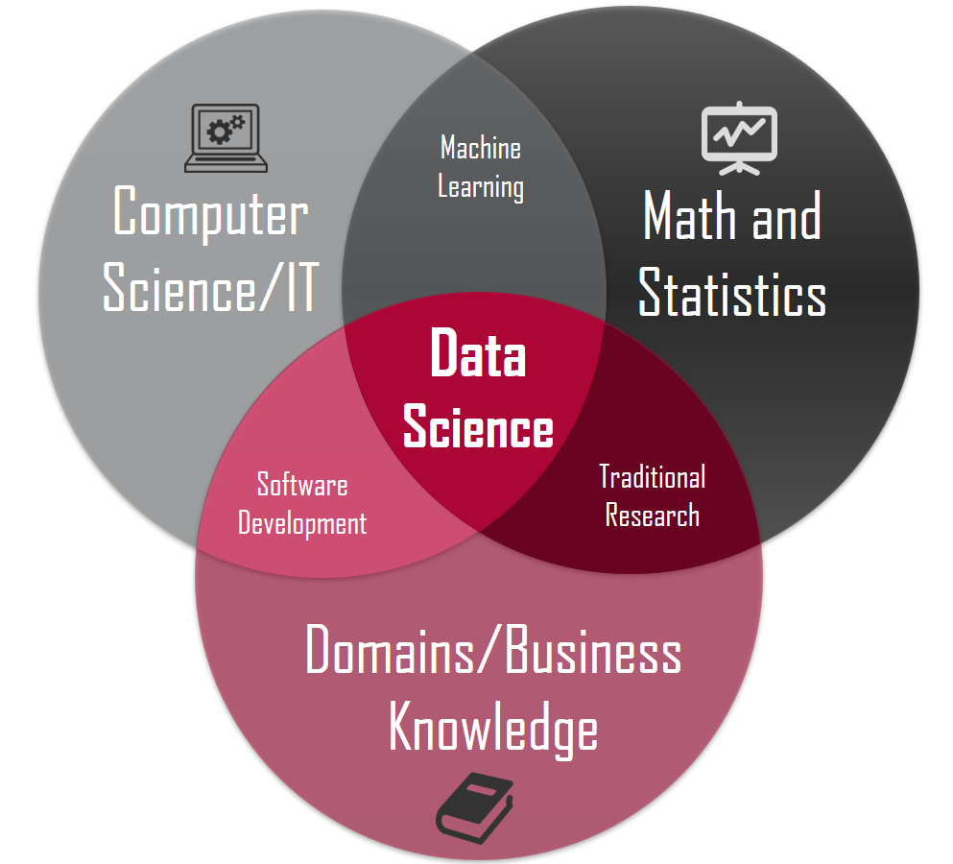
Related areas. Data Science
Data manipulation (50 – 80 %)
Machine Learning
Deep learning
http://sitiobigdata.com/2018/08/27/los-tres-nucleos-de-data-science/

Slide 12
Applications in this course
Hydrology, geothermal, radioactive waste disposal, oil and gas, CO2 sequestration, mining
Fluid volume production from a well
Porosity from depth (Pyrcz)
…
Mostly based on
https://github.com/GeostatsGuy
Guangren Shi, 2014. Data Mining and Knowledge Discovery for Geoscientists

Slide 13
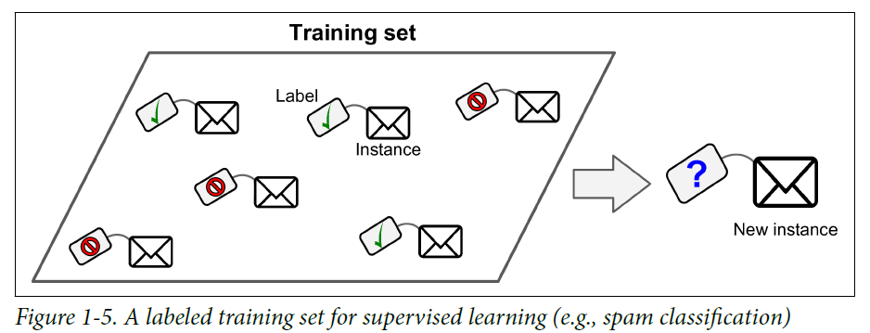
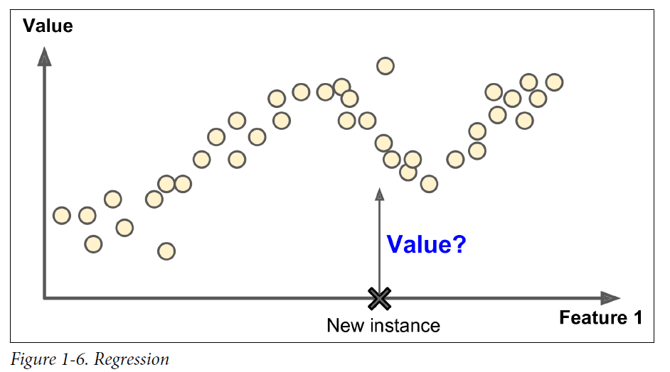
Types of Machine learning algorithms
Supervised
• k-Nearest Neighbors
• Linear Regression
• Logistic Regression
• Support Vector Machines (SVMs)
• Decision Trees, Ensemble methods
• Neural networks
Unsupervised
Clustering: K-means, Hierarchical Cluster Analysis (HCA)
Visualization and dimensionality reduction (Kernel)? PCA, t-distributed Stochastic Neighbor Embedding (t-SNE)
Reinforcement learning
Batch and Online learning

Slide 14
Grading
20% Theoretical
20% Computational exercises
20% Exams
20% Oral presentation of application of ML in Geosciences
20% MOOC (Coursera, Udemy, …)

Slide 15
Current research (Journals)
Mathematical Geosciences
Neural Networks
Machine learning
Computer and Geosciences
Neural networks
TensorFlow
Machine learning
Computational Geosciences
Neural Networks
TensorFlow
Machine learning

Slide 16
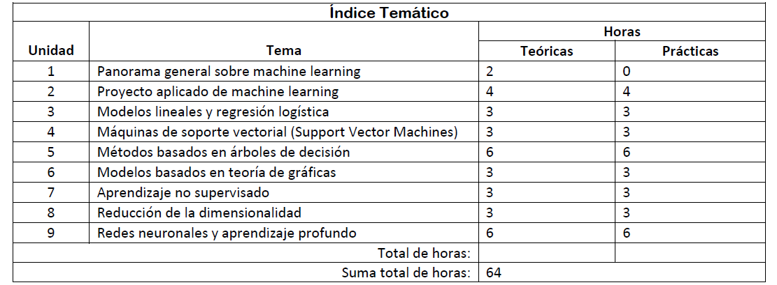
Table of Content (TOC)

Slide 17
Bibliography

Slide 18
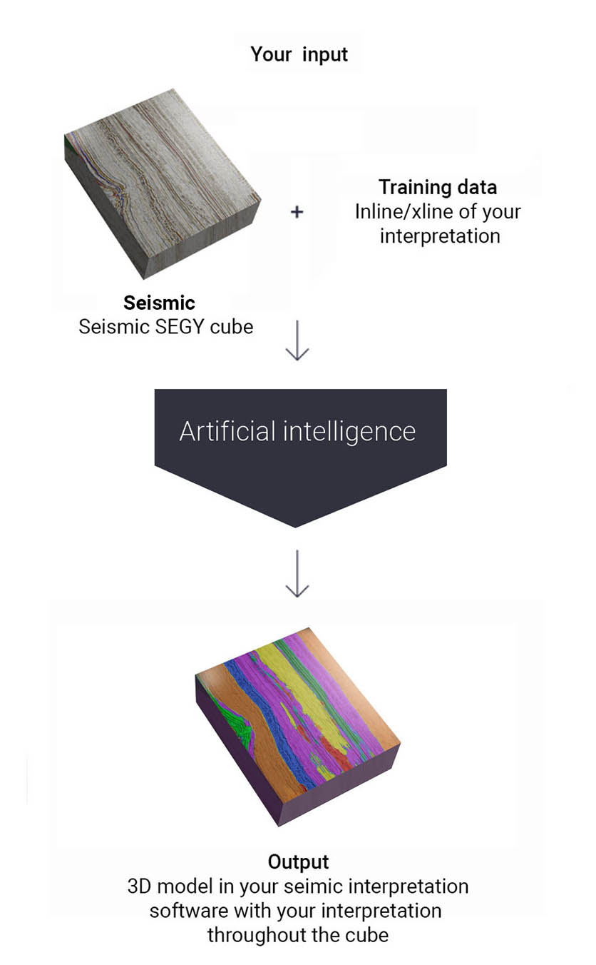

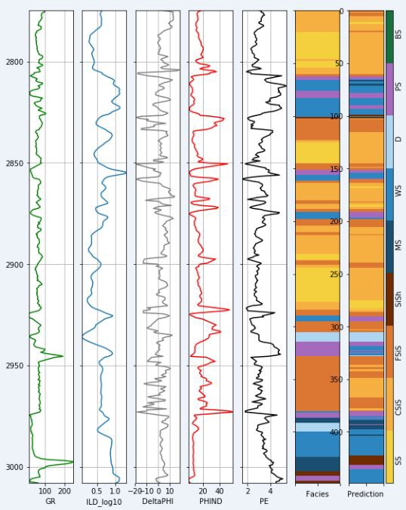



Companies
All big companies +
Well spacing
Earth models
Seismic horizons interpretation

Slide 19
Concepts review
Notes:
What are the concepts leaned? Feature, labels, error, training set. (By asking this question, students are move to speak in English, at least some words)

Slide 20


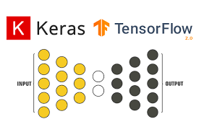






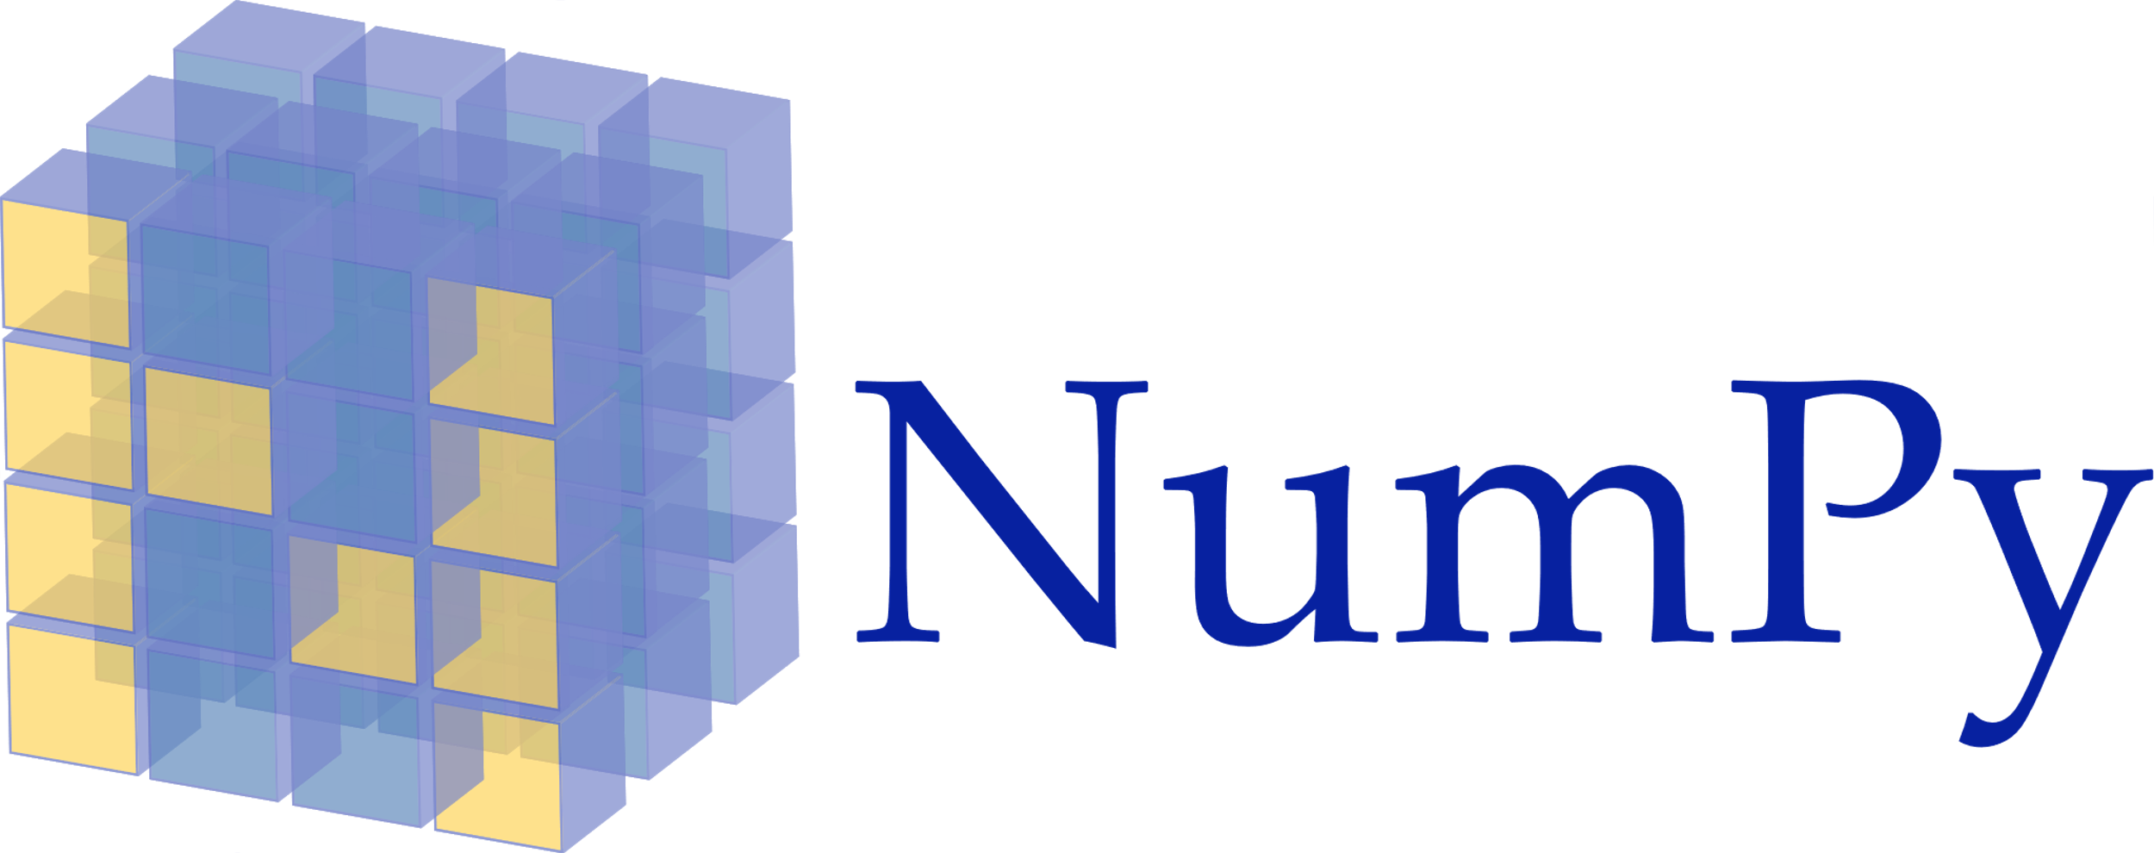


Software stack

Slide 21
See also
YouTube Michael Pyrcz 00 Machine Learning: Introduction
YouTube Michael Pyrcz 06 Machine Learning: Intro to Machine Learning

Slide 22
Machine Learning for Geosciences
By Francisco Mendoza
mentofran@gmail.com
Course material:
https://github.com/mathphysmx/teaching-ml

