Slide 1
Software tutorial

Slide 2
VSCode
Install Visual Studio Code
Explain the GUI of VSCode
Show example of MarkDown visualization
Show example of installing VSCode extensions

Slide 3
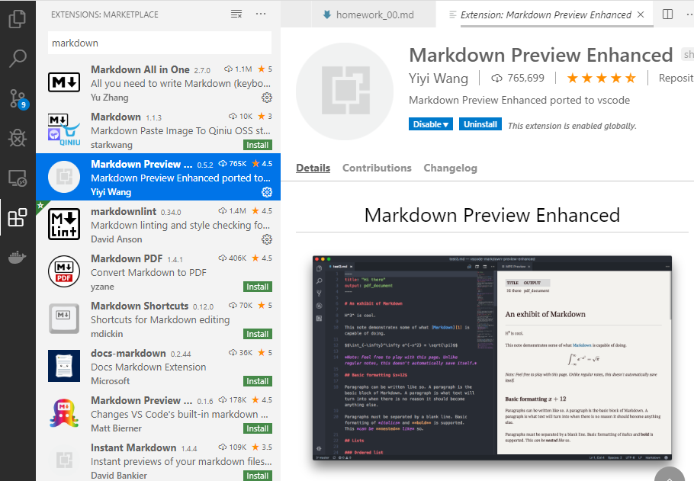


VSCode MarkDown (.md)

Slide 4

VSCode (Conda Python Envs)

Slide 5

Python

Slide 6

Jupyter Lab Notebooks

Slide 7
VSCode Extensions
Markdown
Python
Dash/Zeal
Ctrl+H

