Slide 1
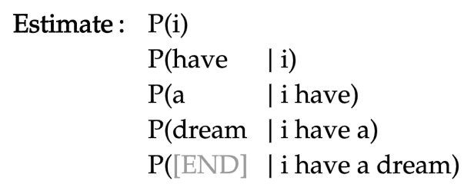

Slide 2
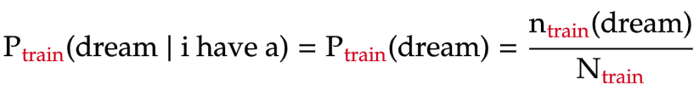
total number of words in training text

Slide 3
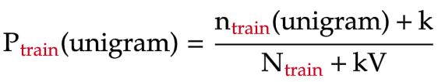
unigram vocabulary size
(number of unique unigrams in training text)

Slide 4


Slide 5
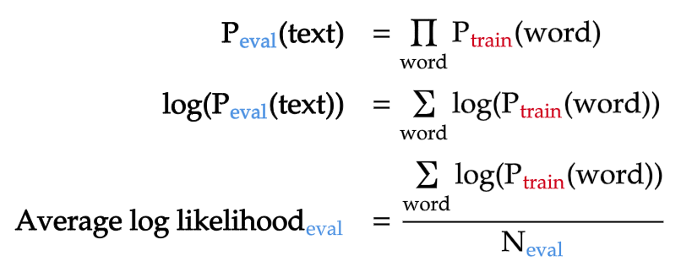
total number of words in evaluation text

Slide 6
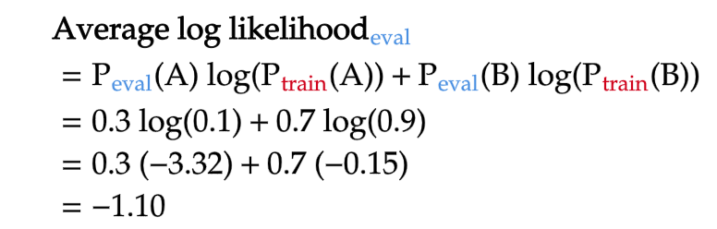

Similar unigram distributions between training and evaluation texts
Different unigram distributions between training and evaluation texts

Slide 7
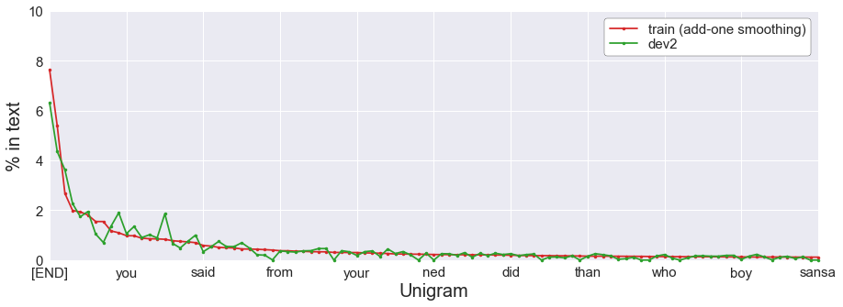
her
she
his

Slide 8
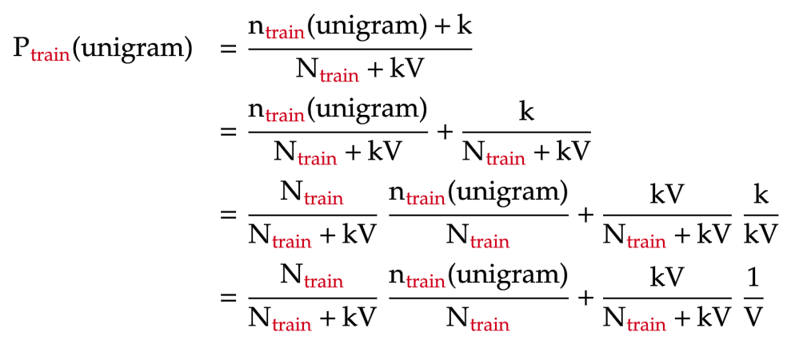
un-smoothed unigram probability
uniform probability

Slide 9
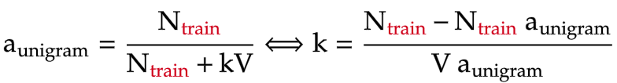
proportion of un-smoothed unigram model

Slide 10


interpolation weight of un-smoothed unigram model
0
0.2 | 106
0.4 | 40
0.6 | 18
0.8 | 7
1 | 0

Slide 11
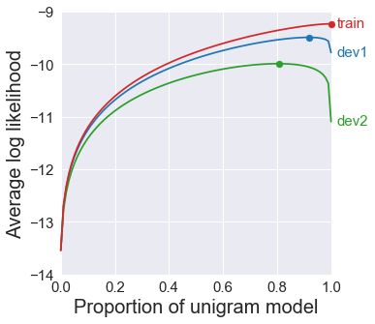
100%
uniform
100%
unigram
Overfit
Low bias
High variance
Underfit
High bias
Low variance

Slide 12



train
dev1
dev2

