Slide 1
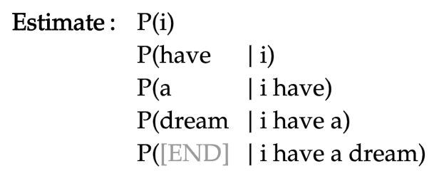

Slide 2
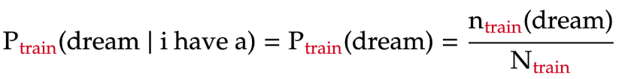
total number of words in training text

Slide 3
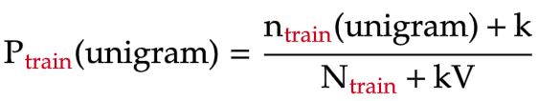
unigram vocabulary size
(number of unique unigrams in training text)

Slide 4


Slide 5
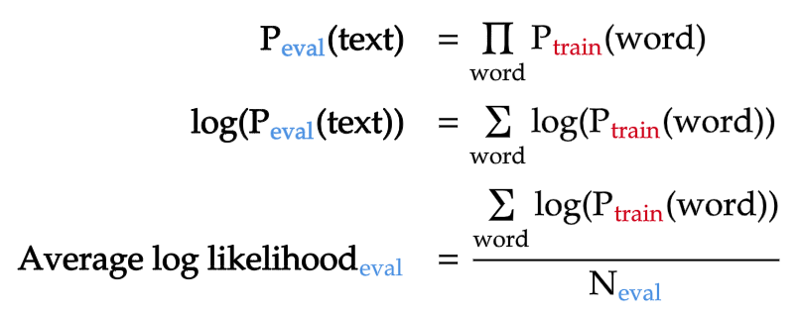
total number of words in evaluation text

Slide 6
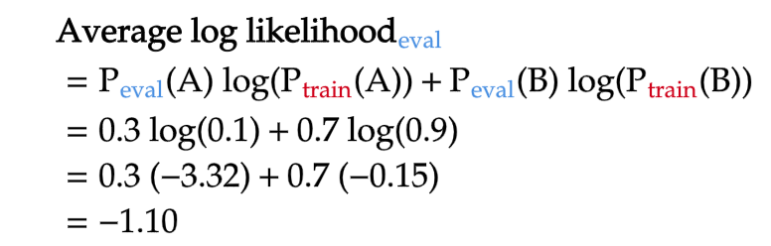

Similar unigram distributions between training and evaluation texts
Different unigram distributions between training and evaluation texts

Slide 7
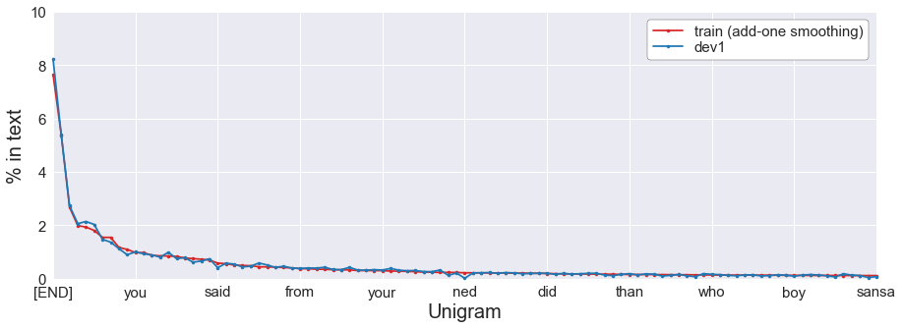


Slide 8
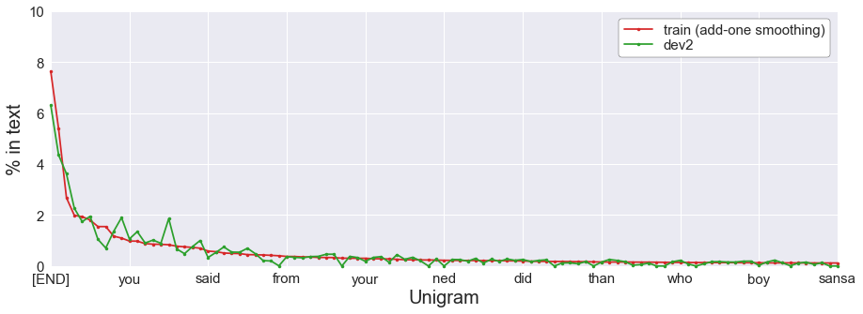
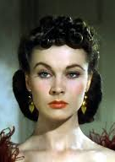
her
she
his

Slide 9
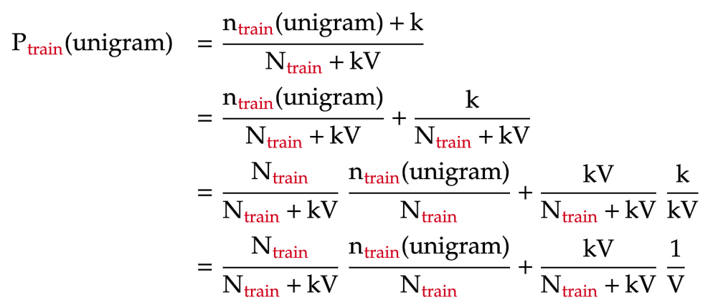
un-smoothed unigram probability
uniform probability

Slide 10
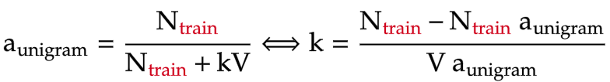
proportion of un-smoothed unigram model

Slide 11


interpolation weight of un-smoothed unigram model
0
0.2 | 106
0.4 | 40
0.6 | 18
0.8 | 7
1 | 0

Slide 12
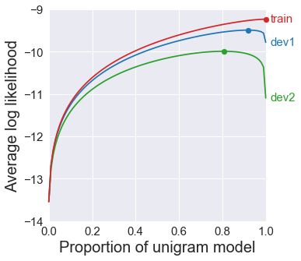
100%
uniform
100%
unigram
Overfit
Low bias
High variance
Underfit
High bias
Low variance

Slide 13



train
dev1
dev2

Slide 14
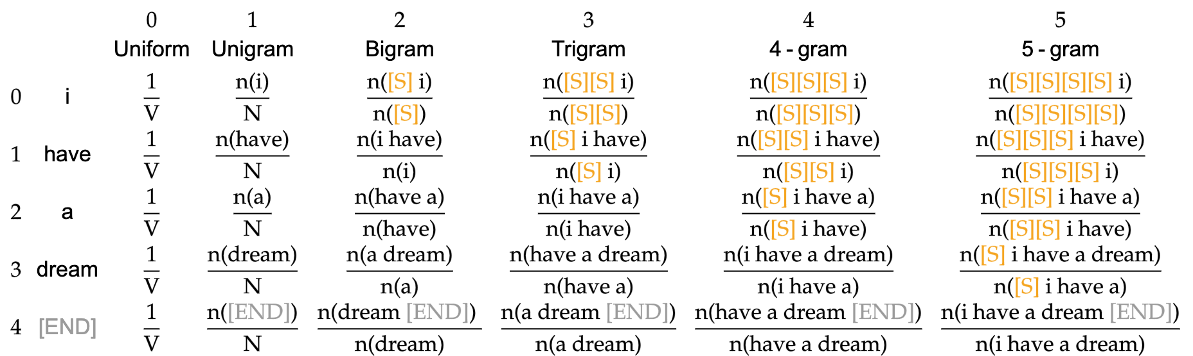

N-gram length
=
=
=
=
=
Token position in sentence
=
...

Slide 15
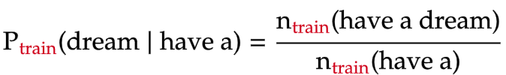

Slide 16
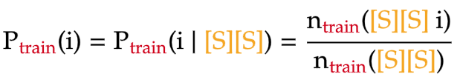
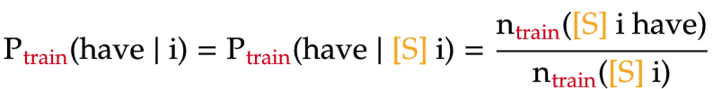

Slide 17
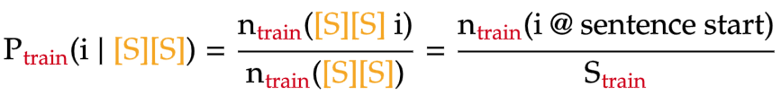

Slide 18
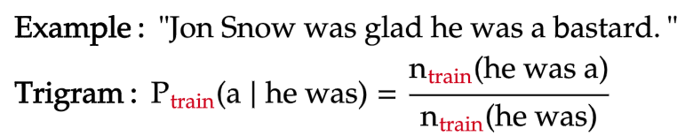

Slide 19
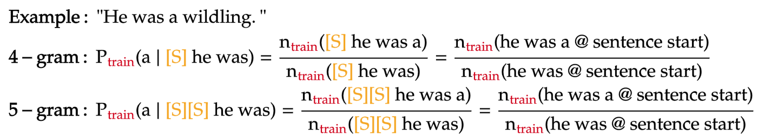

Slide 20
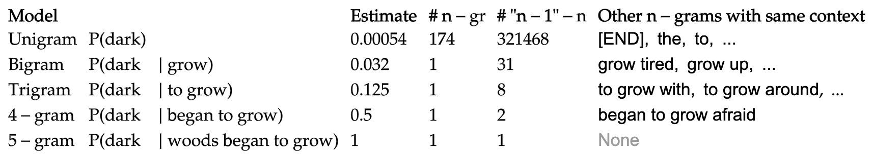
Model | Probability | Estimate | # n-gram | # (n-1)-gram | Other n-grams with same context

Slide 21



Slide 22
Model | Number of unknown n-grams | Percent of unknown n-grams
Unigram | 11500 | 3.2
Bigram | 108509 | 30.7
Trigram | 233681 | 66.2
4-gram | 284413 | 80.5
5-gram | 296048 | 83.8

Slide 23
