Slide 1
Outline
Laplace smoothing as model interpolation
Interpolation of individual n-gram models
Interpolation among several n-gram models
What: which models to interpolate?
How: how much to weigh each model during interpolation?
Going further:
Current state of ngram language models
Current state of language models

Slide 2
Outline
Laplace smoothing as model interpolation
Interpolation of individual n-gram models
Interpolation among several n-gram models
What: which models to interpolate?
How: how much to weigh each model during interpolation?
Going further:
Current state of ngram language models
Current state of language models

Slide 3






Laplace smoothing as interpolation
Unigram probability:
# of words in training text
Unigram probability
(Laplace smoothing):
unigram vocabulary (# of unique unigrams) in training text
unknown unigram
Why interpolate with the uniform?
Assign small probabilities to unknown words in test set

Slide 4




Interpolating with uniform = reduce overfit of ngram model
The more similar the unigram distribution between train and test
The higher the average test log-likelihood

Slide 5
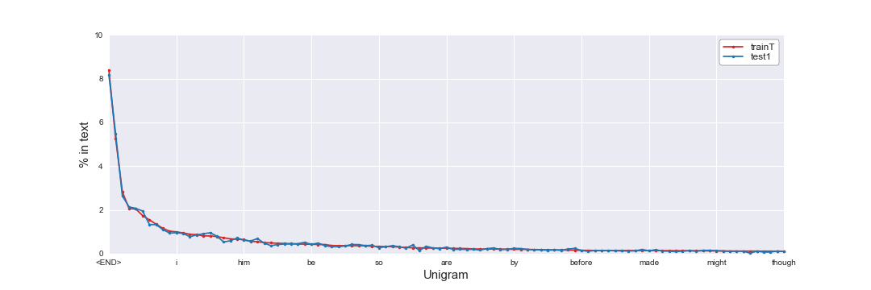
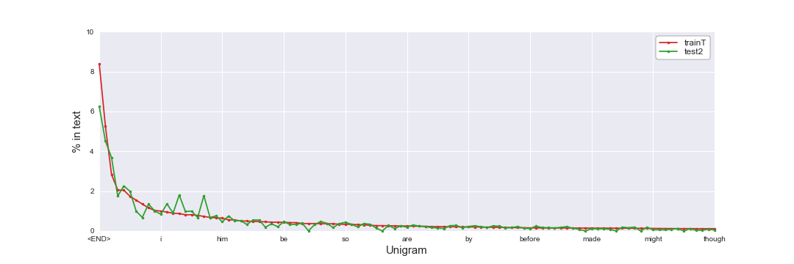
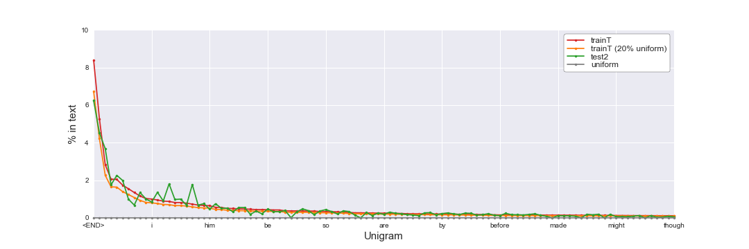
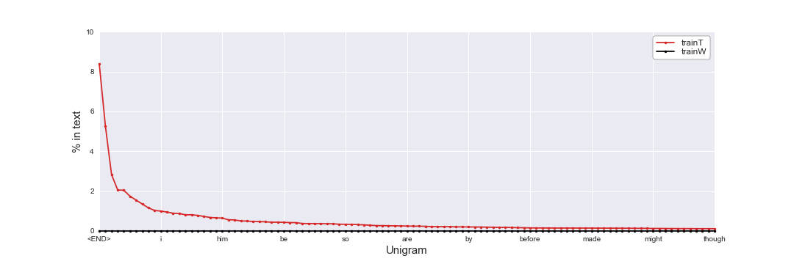
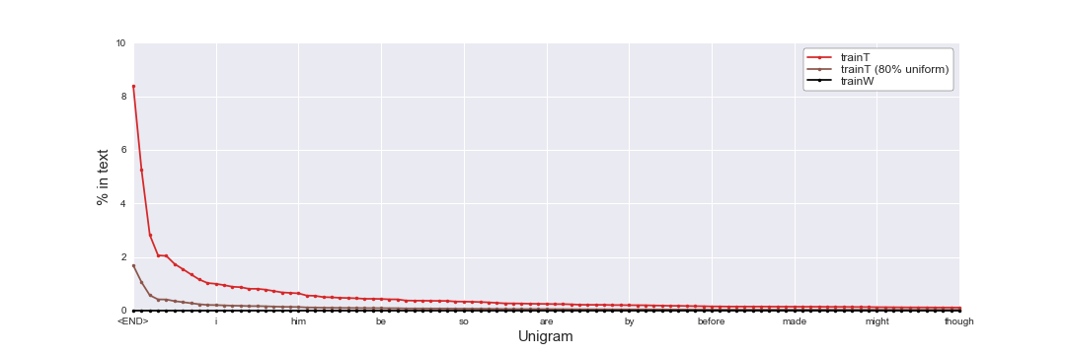
Interpolating with uniform = reduce overfit of ngram model

Slide 6
Interpolating with uniform = reduce variance of model
Unigram model
(unsmoothed)
Uniform model
https://towardsdatascience.com/holy-grail-for-bias-variance-tradeoff-overfitting-underfitting-7fad64ab5d76

Slide 7
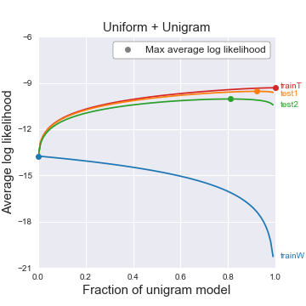
Interpolating with uniform = reduce variance of model
High bias
Low variance
Low bias
High variance
100% uniform
100% unigram (unsmoothed)

Slide 8
Outline
Laplace smoothing as model interpolation
Interpolation of individual n-gram models
Interpolation among several n-gram models
What: which models to interpolate?
How: how much to weigh each model during interpolation?
Going further:
Current state of ngram language models
Current state of language models

Slide 9
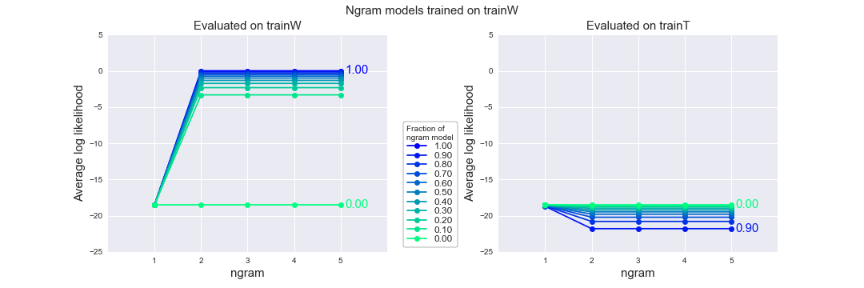
trainW => trainW
trainW
1. a
2. aa
3. aaa
4. aah
5. aahed
…
370102. zwitter
370103. zwitterion
370104. zwitterionic
The more interpolation with uniform, the worse the model gets on the training set

Slide 10
trainW => trainT
trainW
trainT
1. a
2. aa
3. aaa
4. aah
5. aahed
…
370102. zwitterion
370103. zwitterionic
370104. <END>
1. prologue
2. <END>
3. the
4. day
5. was
…
370102. and
370103. bright
370104. <END>
Interpolating with uniform model improves the model performance on the test set !
P(day|the) = n(the day) / n(the) = 0

Slide 11
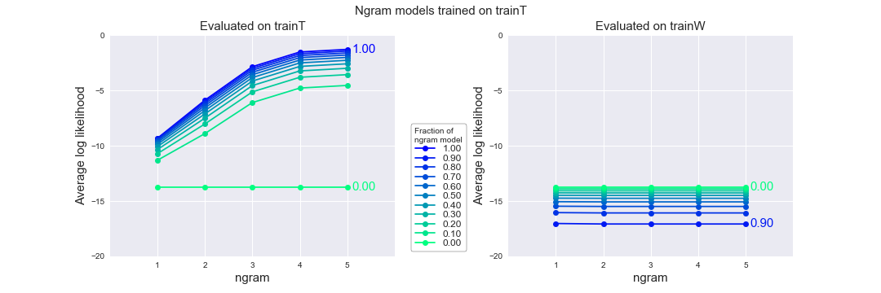
trainT => trainT
trainT
1. prologue
2. <END>
3. the
4. day
5. was
…
370102. and
370103. bright
370104. <END>
The more interpolation with uniform, the worse the model is on the training set

Slide 12
trainT => trainW
trainW
trainT
1. a
2. aa
3. aaa
4. aah
5. aahed
…
370102. zwitterion
370103. zwitterionic
370104. <END>
1. prologue
2. <END>
3. the
4. day
5. was
…
370102. and
370103. bright
370104. <END>
Interpolating with uniform model improves the model performance on the test set !
P(aaa) = 0
P(aaa|aa) = n(aa aaa) / n(aa) = 0
“Statistical models are likely to be useless as predictors if the training sets and the test sets are as different as Shakespeare and The Wall Street Journal” – Jurafsky & Martin (2019)
Choice of dataset matters a lot!

Slide 13
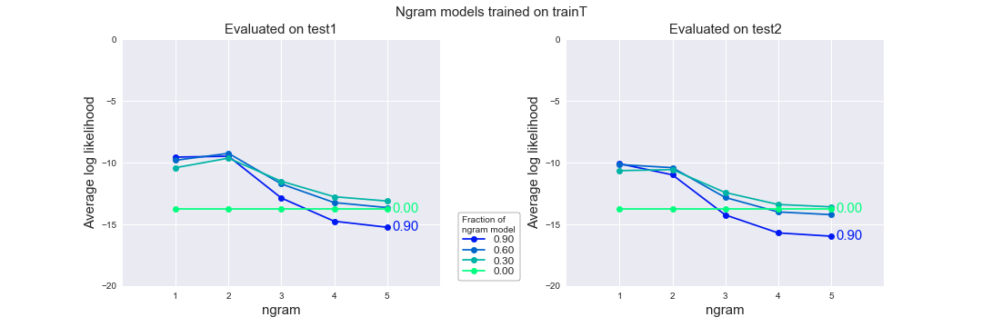
trainT => test1
trainT
test1
1. prologue
2. <END>
3. the
4. day
5. was
…
370102. and
370103. bright
370104. <END>
1. prologue
2. <END>
3. the
4. night
5. was
…
370102. play
370103. the
370104. <END>
Bigram model is slightly better than unigram model

Slide 14
trainT => test1
Example:
P(yarwyck) = 0.000003
P(yarwyck|othell) = 1
Othell Yarwyck
Bigram model is slightly better than unigram model

Slide 15
trainT => test1
Why?
Many new trigrams, 4-gram, 5-gram in test1 that have never appeared in trainT
=> P(ngram) = 0
Out of 370104 tokens in test1:
4788 new unigrams
113861 new bigram
246254 new trigrams
299264 new 4-grams
310940 new 5-grams
Complex != better (especially when data is small)
Higher ngram models perform terribly!

Slide 16
trainT => test2
Performance on test2 is slightly worse than on test1 (for same ngram and interpolation with uniform)

Slide 17
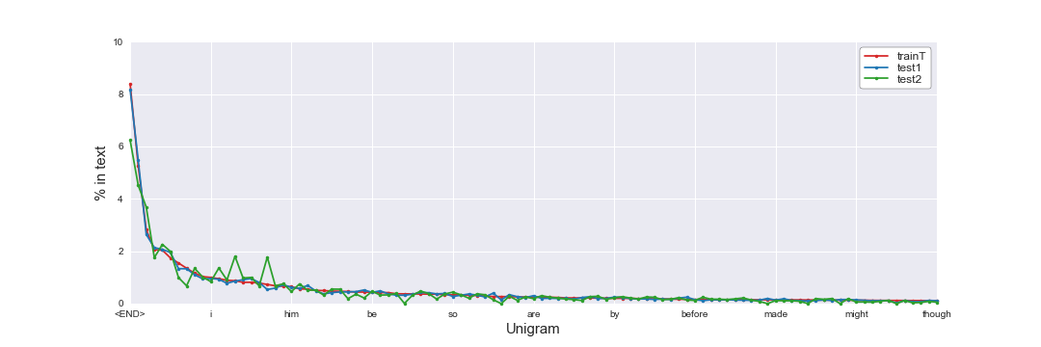
Why is model worse on test2 than test1 ?
Ngram distribution different effect: test2 has different ngram distribution to trainT than train1

Slide 18
Why is model worse on test2 than test1 ?
Unknown ngram effect: test2 has much more new ngrams than train1
New ngram (ouf of 370104 ngrams) | Test1 | Test2
Unigram | 4788 | 9331
Bigram | 113861 | 163999
Trigram | 246254 | 285432
4-gram | 299264 | 326694
5-gram | 310940 | 333143

Slide 19
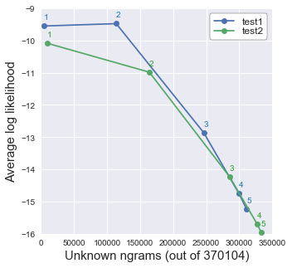
Why is model worse on test2 than test1 ?
Ngram distribution difference effect dominates for lower ngram models
Unknown ngram effect dominates for higher ngram models
Choose training sets that are similar to your NLP task

Slide 20
In most cases, interpolating with the uniform model improves the model performance on test set !

Slide 21
Outline
Laplace smoothing as model interpolation
Interpolation of individual n-gram models
Interpolation among several n-gram models
What: which models to interpolate?
How: how much to weigh each model during interpolation?
Going further:
Current state of ngram language models
Current state of language models

Slide 22
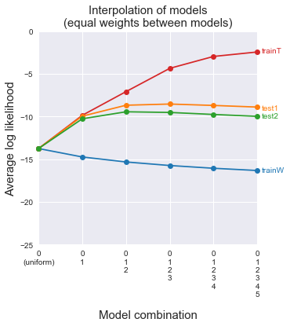
What to interpolate: which models to include?
Higher n-gram models do not help
Unigram and bigram models help

Slide 23
How to interpolate: how to weight model contributions?
Average weighting:
Custom weighting:
Objective function:

Slide 24
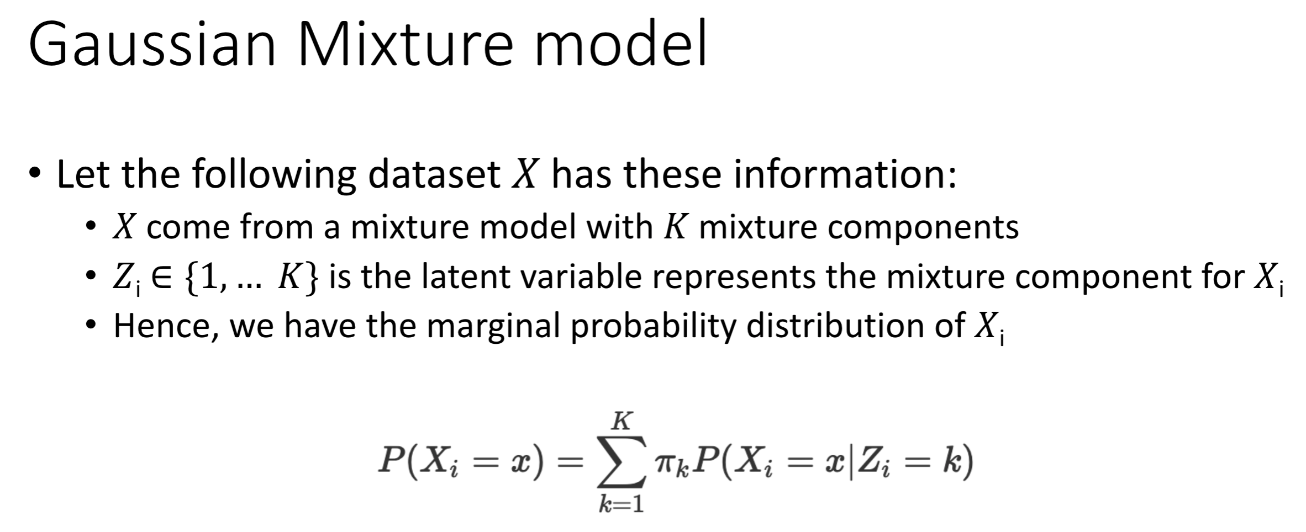
How to interpolate: how to weight model contributions?
Phuc & Huy 2019 “Gaussian Mixture Model”

Slide 25
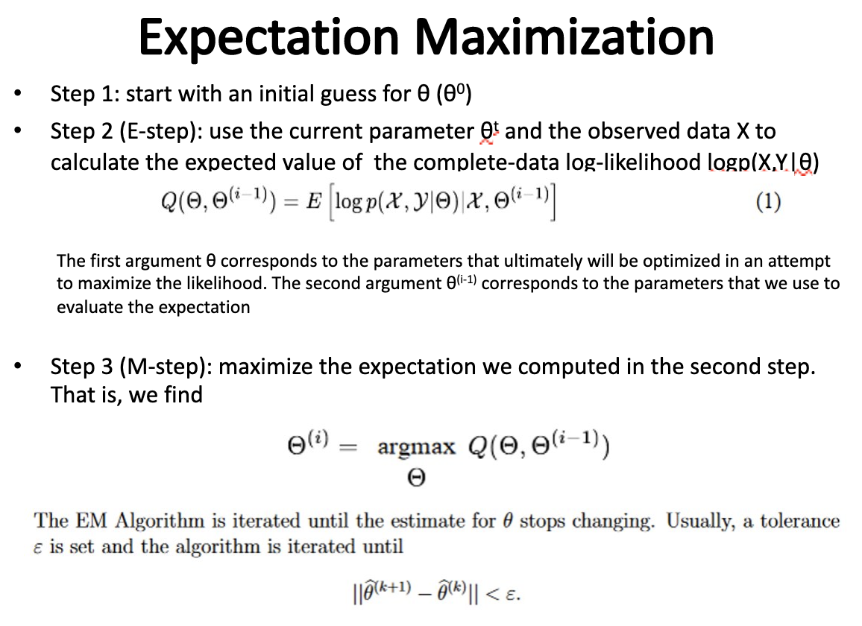
How to maximize objective function?
Objective function:
Approaches:
Gradient descent
Mai 2019 “Expectation Maximization”

Slide 26
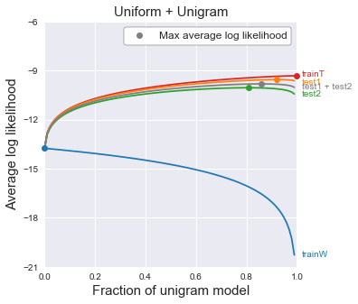

How does EM work?

Slide 27
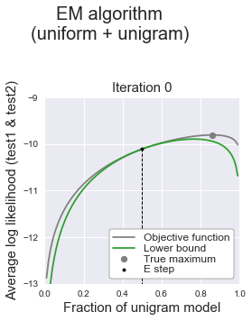
Step 1: Expectation (E-step)
Construct a lower bound to objective function at some point

Slide 28
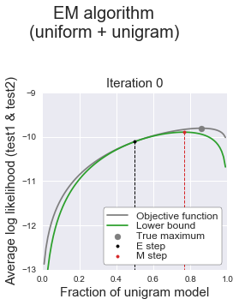
Step 2: Expectation (M-step)
Maximize the lower bound of the objective function

Slide 29
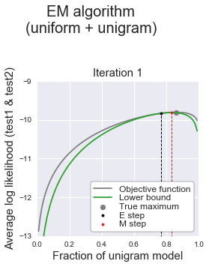
Step 3: Repeat E-step & M-step until convergence

Slide 30
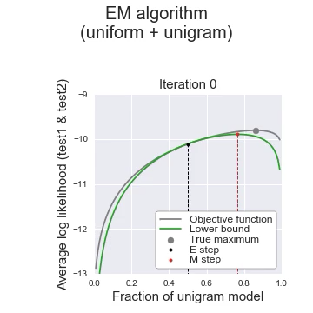
Visualize EM algorithm

Slide 31
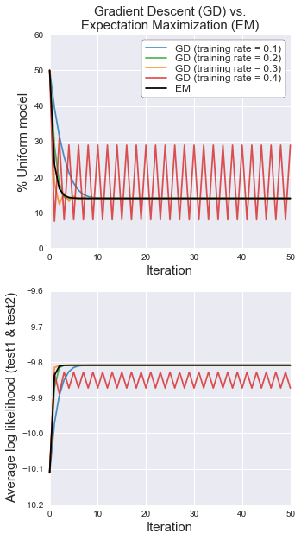
Why EM algorithm?
Ensure mixture weights add up to 1
Do not need to set learning rate (unlike gradient descent) !
Disadvantage: often converges to local max (not a problem here)

Slide 32
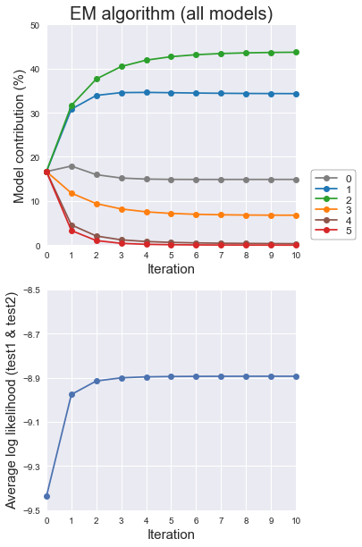
Interpolate all ngram models with EM

Slide 33
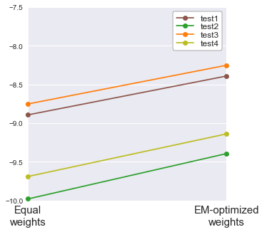




Final benchmark of EM algorithm

Slide 34
Outline
Laplace smoothing as model interpolation
Interpolation of individual n-gram models
Interpolation among several n-gram models
What: which models to interpolate?
How: how much to weigh each model during interpolation?
Going further:
Current state of ngram language models
Current state of language models

Slide 35
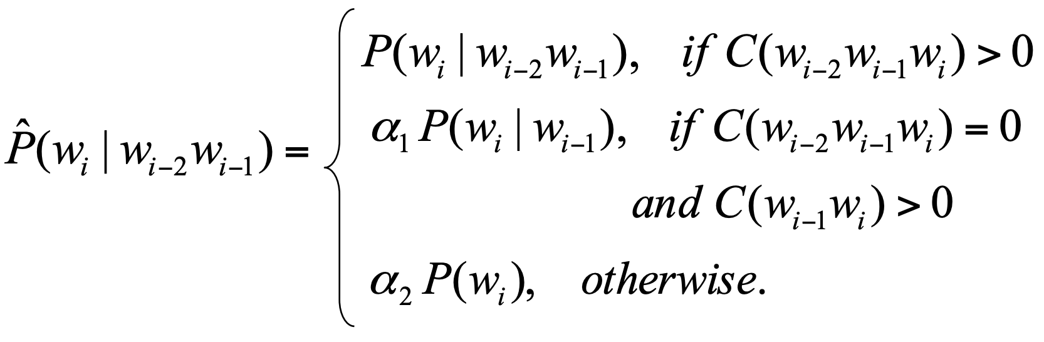
Current state of ngram models
Alternative to interpolation of ngram models: backoff models
https://www.cs.cornell.edu/courses/cs4740/2014sp/lectures/smoothing+backoff.pdf
Selection of ngram models:
Good-Turing smoothing
Jelinek-Mercer smoothing
Church-Gale smoothing
Witten-Bell smoothing
Katz backoff
Good-Turing backoff
Stupid backoff
Kneser-Ney smoothing
Interpolated Kneser-Ney smoothing
Modified Kneser-Ney smoothing
Modified interpolated Kneser-Ney smoothing

Slide 36

Current state of language models
Disadvantage of ngram language models
They are big
They are dumb
Current SOTA (state-of-the-art) models
Word embeddings learned by neural networks (RNNs, transformers)
I know ”Hulk Smash”, but what is “Hulk Crash” ?

Slide 37
Summary
Choice of dataset matters
More complex != better (especially when data is small)
Interpolate ngram models with uniform model to improve model performance on test set (less overfit, lower variance)
Use EM to best determine interpolation weights between models
If you want to build a language model in 2020, look to neural networks, not ngram models

