Slide 1
Outline
Laplace smoothing as model interpolation
Interpolation of individual n-gram models
Interpolation among several n-gram models
What: which models to interpolate?
How: how much to weigh each model during interpolation?
Going further:
Current state of ngram language models
Current state of language models

Slide 2
Outline
Laplace smoothing as model interpolation
Interpolation of individual n-gram models
Interpolation among several n-gram models
What: which models to interpolate?
How: how much to weigh each model during interpolation?
Going further:
Current state of ngram language models
Current state of language models

Slide 3





Laplace smoothing as interpolation
Unigram probability:
# of unigrams in training text
Unigram probability
(Laplace smoothing):
unigram vocabulary (# of unique unigrams) in training text
unknown unigram
Why interpolate with the uniform?
Assign small probabilities to unknown words in test set

Slide 4


Interpolating with uniform = reduce overfit of ngram model
The more similar the unigram distribution between train and test
The higher the average test log-likelihood

Slide 5
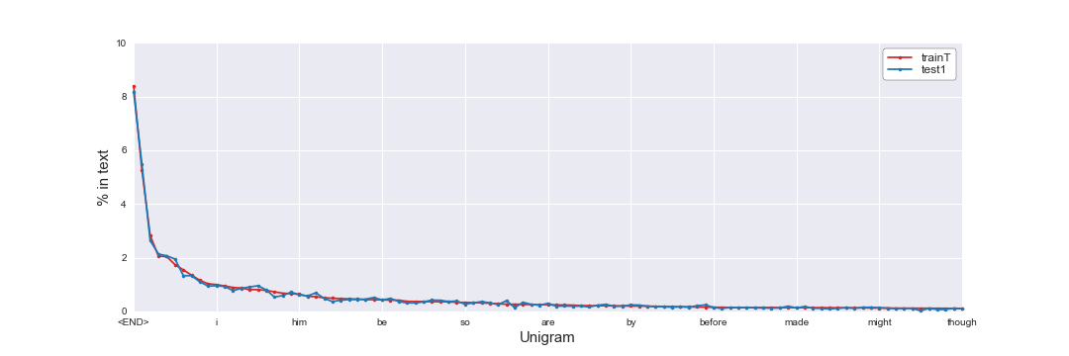
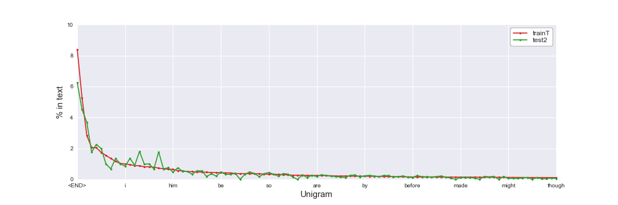
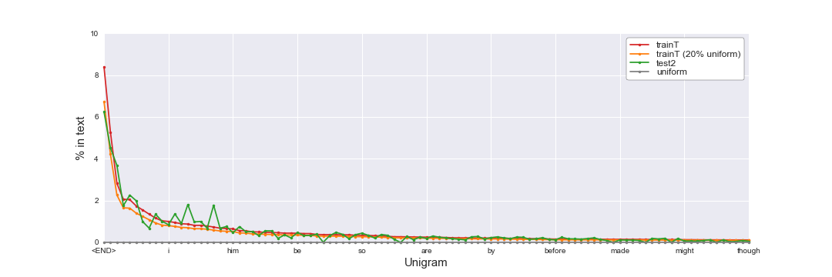
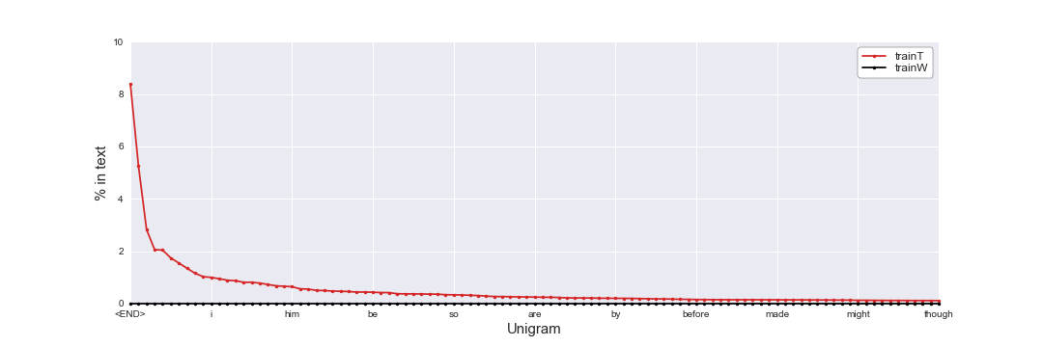
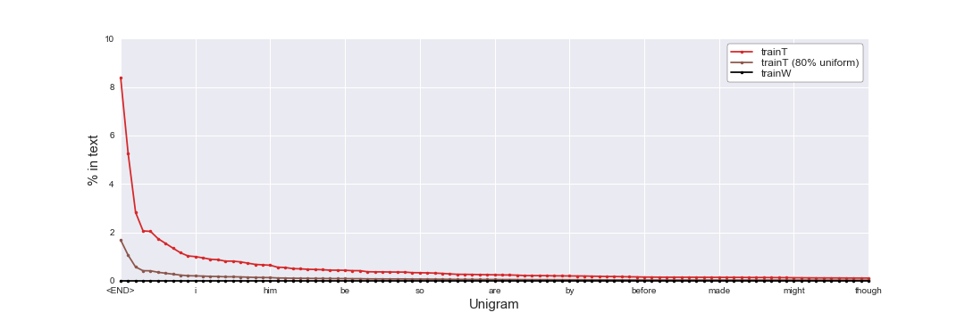
Interpolating with uniform = reduce overfit of ngram model

Slide 6
Interpolating with uniform = reduce variance of model
Unigram model
(unsmoothed)
Uniform model
https://towardsdatascience.com/holy-grail-for-bias-variance-tradeoff-overfitting-underfitting-7fad64ab5d76

Slide 7
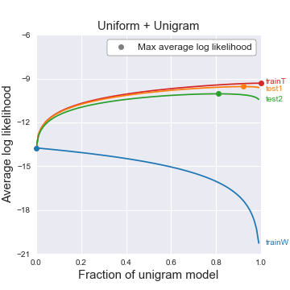
Interpolating with uniform = reduce variance of model
High bias
Low variance
Low bias
High variance
100% uniform
100% unigram (unsmoothed)

Slide 8
Outline
Laplace smoothing as model interpolation
Interpolation of individual n-gram models
Interpolation among several n-gram models
What: which models to interpolate?
How: how much to weigh each model during interpolation?
Going further:
Current state of ngram language models
Current state of language models

Slide 9
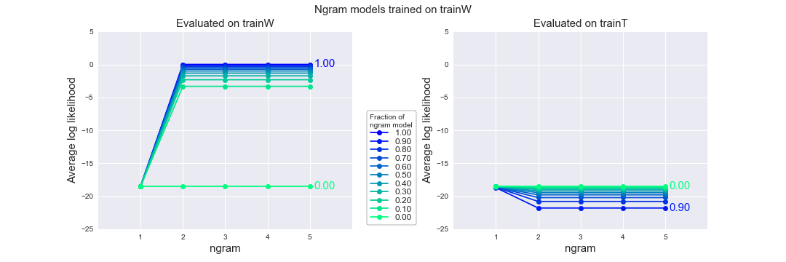
trainW => trainW
Bigram model: P(aa|a) = 1
5-gram model: P(aahed|a,aa,aaa,aah) = 1
trainW
1. a
2. aa
3. aaa
4. aah
5. aahed
…
370102. zwitter
370103. zwitterion
370104. zwitterionic
The more interpolation with uniform (lower fraction of ngram model), the worse the model gets
Unigram model on trainW = uniform model
P(word) = 1 / 370104

Slide 10
trainW => trainT
trainW
trainT
1. a
2. aa
3. aaa
4. aah
5. aahed
…
370102. zwitterion
370103. zwitterionic
370104. <END>
1. prologue
2. <END>
3. the
4. day
5. was
…
370102. and
370103. bright
370104. <END>
Interpolating with uniform model improves the model performance!
P(day|the) = n(the day) / n(the) = 0

Slide 11
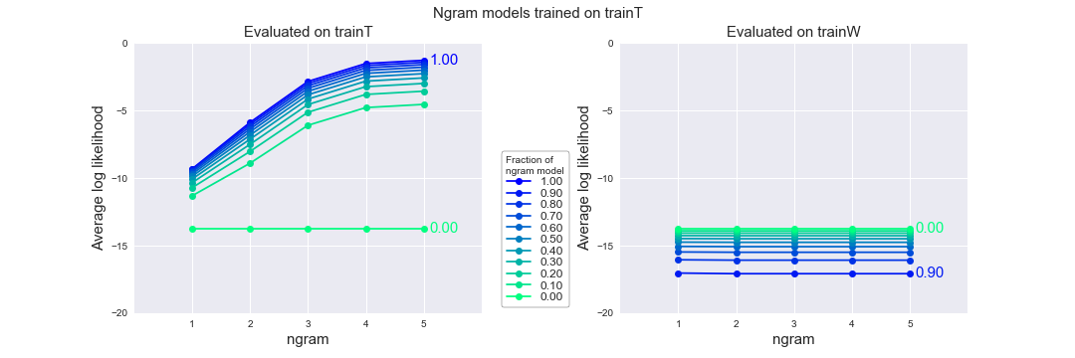
trainT => trainT
The higher ngram, the better the model
trainT
1. prologue
2. <END>
3. the
4. day
5. was
…
370102. and
370103. bright
370104. <END>
The more interpolation with uniform (lower fraction of ngram model), the worse the model gets

Slide 12
Why are higher ngram models better?
Goal: estimate the probability of the word “and”
Model | Estimated probability | Other ngrams with same history
Unigram | P(and) = 0.028 | Many others!
Bigram | P(and|grey) = 0.13 | “grey goose feathers”, “cold grey downpour”
Trigram | P(and|was gray) = 0.80 | “The world was grey darkness, …” “The lower story was grey stone, …”
4-gram | P(and|day was grey) = 1 | None
5-gram | P(and|the day was grey) = 1 | None
Why doesn’t 5-gram model have perfect performance (log likelihood = 0)?
Author still repeats some 4-gram:
“day was grey and bitter”
“day was grey and overcast”
“day was grey and rainy”

Slide 13
trainT => trainW
trainW
trainT
1. a
2. aa
3. aaa
4. aah
5. aahed
…
370102. zwitterion
370103. zwitterionic
370104. <END>
1. prologue
2. <END>
3. the
4. day
5. was
…
370102. and
370103. bright
370104. <END>
Interpolating with uniform model improves the model performance
P(aaa) = 0
P(aaa|aa) = n(aa aaa) / n(aa) = 0
“Statistical models are likely to be useless as predictors if the training sets and the test sets are as different as Shakespeare and The Wall Street Journal” – Jurafsky & Martin (2019)
Choice of dataset matters a lot!

Slide 14
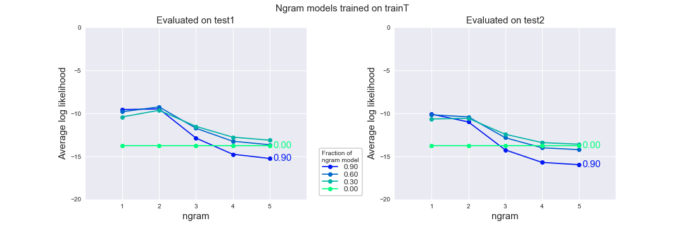
trainT => test1
trainT
test1
1. prologue
2. <END>
3. the
4. day
5. was
…
370102. and
370103. bright
370104. <END>
1. prologue
2. <END>
3. the
4. night
5. was
…
370102. play
370103. the
370104. <END>
Bigram model is slightly better than unigram model

Slide 15
trainT => test1
Example:
P(yarwyck) = 0.000003
P(yarwyck|othell) = 1
Othell Yarwyck
Bigram model is slightly better than unigram model

Slide 16
trainT => test1
Why?
Many new trigrams, 4-gram, 5-gram in test1 that have never appeared in trainT
=> P(ngram) = 0
Out of 370104 tokens in test1:
4788 new unigrams
113861 new bigram
246254 new trigrams
299264 new 4-grams
310940 new 5-grams
Complex != better (especially when data is small)
Higher ngram models perform terribly!

Slide 17
trainT => test2
Performance on test2 is slightly worse than on test1 (for same ngram and interpolation with uniform)

Slide 18
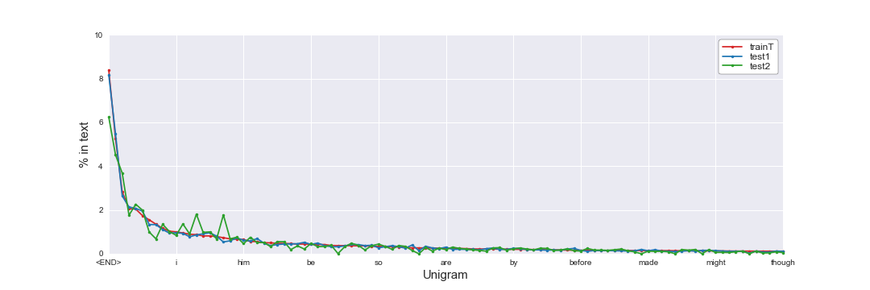
Why is model worse on test2 than test1 ?

Slide 19
Why is model worse on test2 than test1 ?
New ngram (ouf of 370104 ngrams) | Test1 | Test2
Unigram | 4788 | 9331
Bigram | 113861 | 163999
Trigram | 246254 | 285432
4-gram | 299264 | 326694
5-gram | 310940 | 333143

Slide 20
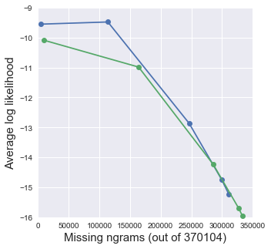
Why is model worse on test2 than test1 ?
Choose training sets that are similar to your NLP task

Slide 21
In most cases, interpolating with the uniform model improves the model performance on test set !

Slide 22
Outline
Laplace smoothing as model interpolation
Interpolation of individual n-gram models
Interpolation among several n-gram models
What: which models to interpolate?
How: how much to weigh each model during interpolation?
Going further:
Current state of ngram language models
Current state of language models

Slide 23
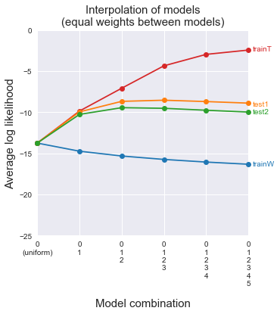
What to interpolate: which models to include?
Higher n-gram models do not help
Unigram and bigram models help

Slide 24
How to interpolate: how to weight model contributions?
Average weighting:
Custom weighting:
Objective function:

Slide 25
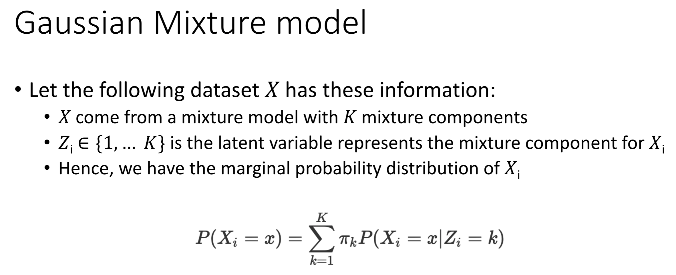
How to interpolate: how to weight model contributions?
Phuc & Huy 2019 “Gaussian Mixture Model”

Slide 26
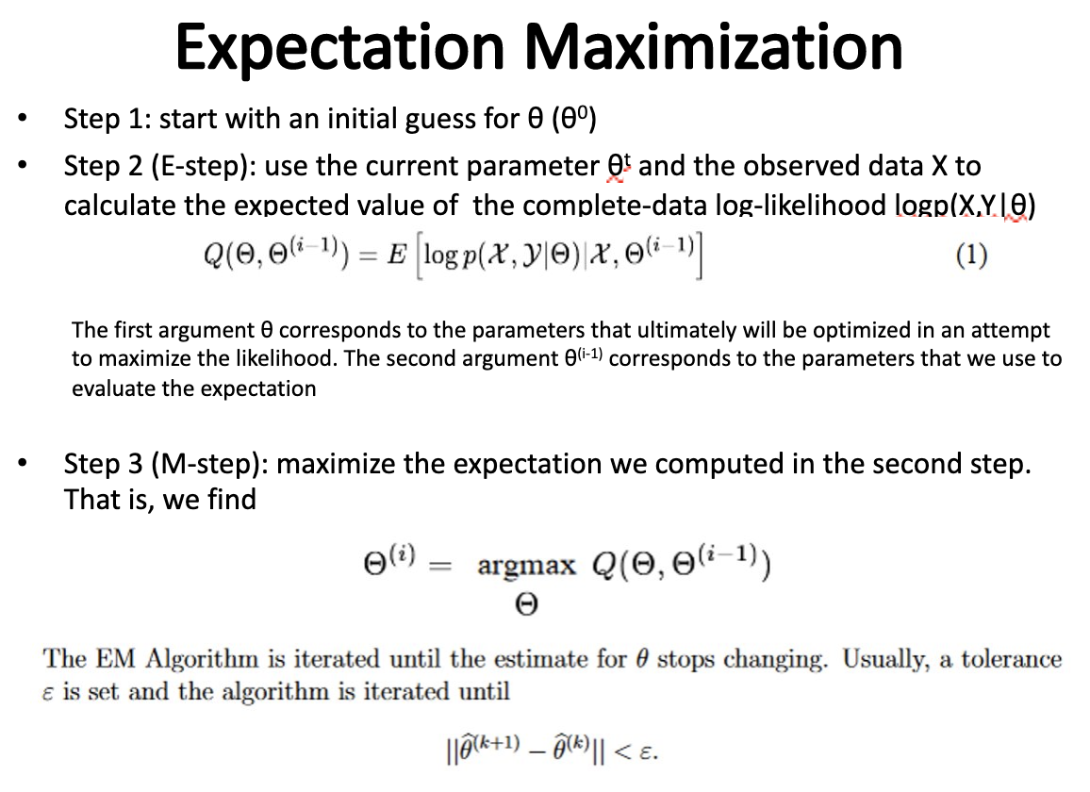
How to maximize objective function?
Objective function:
Approaches:
Gradient descent
Mai 2019 “Expectation Maximization”

Slide 27
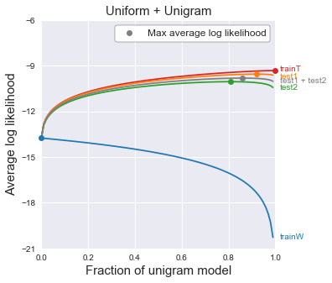

How does EM work?

Slide 28
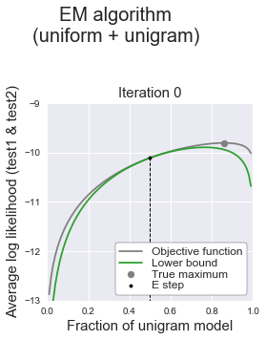
Step 1: Expectation (E-step)
Construct a lower bound to objective function at some point

Slide 29
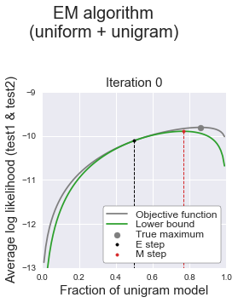
Step 2: Expectation (M-step)
Maximize the lower bound of the objective function

Slide 30
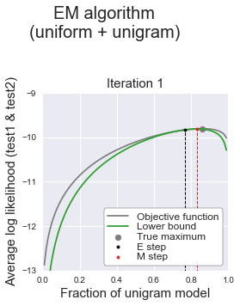
Step 3: Repeat E-step & M-step until convergence
Maximize the lower bound of the objective function

Slide 31
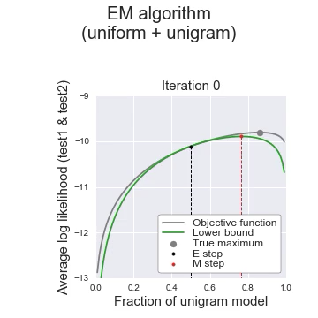
Visualize EM algorithm

Slide 32
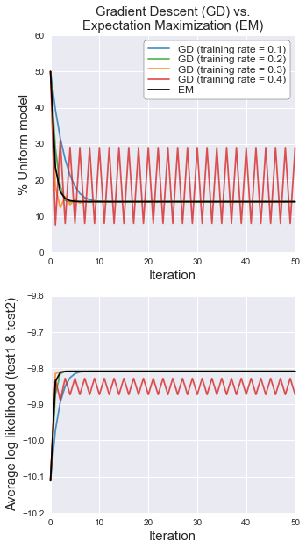
Why EM algorithm?
Ensure mixture weights add up to 1
Do not need to set learning rate (unlike gradient descent) !
Disadvantage: often converges to local max (not a problem here)

Slide 33
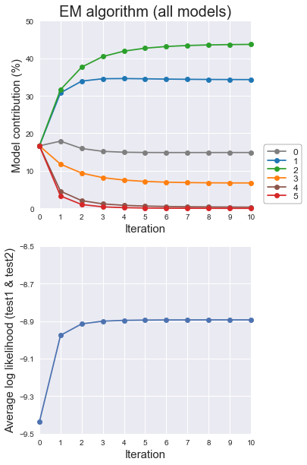
Interpolate all ngram models with EM

Slide 34
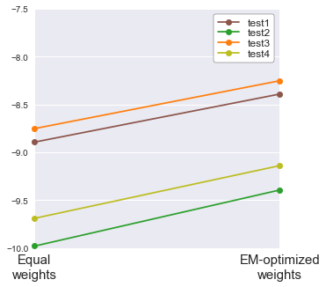




Final benchmark of EM algorithm

Slide 35
Outline
Laplace smoothing as model interpolation
Interpolation of individual n-gram models
Interpolation among several n-gram models
What: which models to interpolate?
How: how much to weigh each model during interpolation?
Going further:
Current state of ngram language models
Current state of language models

Slide 36
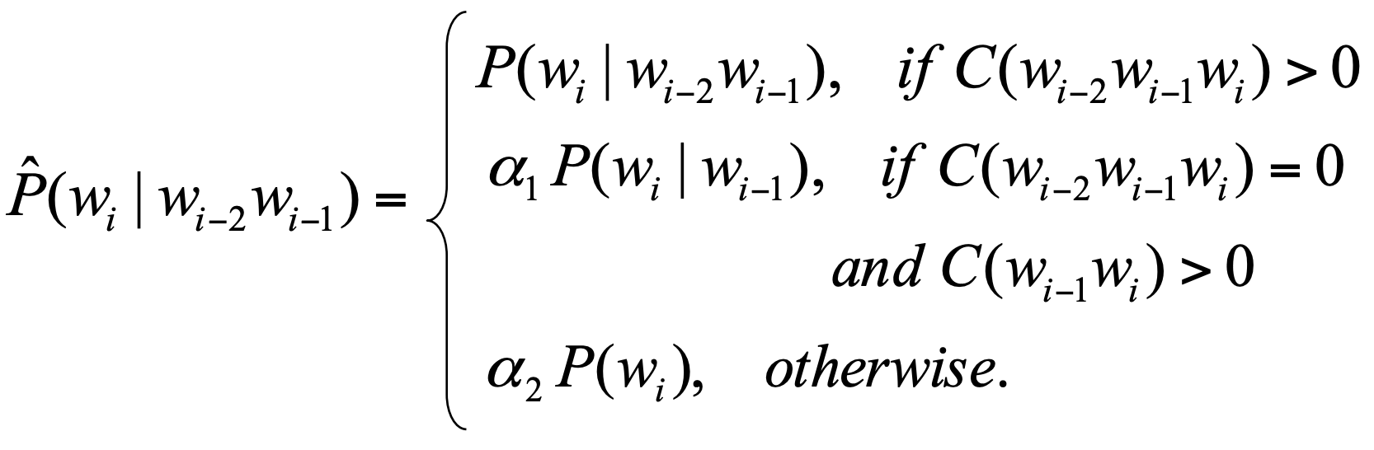
Current state of ngram models
Alternative to interpolation of ngram models: backoff models
https://www.cs.cornell.edu/courses/cs4740/2014sp/lectures/smoothing+backoff.pdf
Selections of ngram models:
Good-Turing smoothing
Jelinek-Mercer smoothing
Church-Gale smoothing
Witten-Bell smoothing
Katz backoff
Good-Turing backoff
Stupid backoff
Kneser-Ney smoothing
Interpolated Kneser-Ney smoothing
Modified Kneser-Ney smoothing
Modified interpolated Kneser-Ney smoothing

Slide 37

Current state of language models
Disadvantage of ngram language models
They are big
They are dumb
Current SOTA (state-of-the-art) models
Word embeddings learned by neural networks (RNNs, transformers)
I know ”Hulk Smash”, but what is “Hulk Crash” ?

Slide 38
Summary
Choice of dataset matters
More complex != better (especially when data is small)
Interpolate ngram models with uniform model to improve model performance on test set (less overfit, lower variance)
Use EM to best determine interpolation weights between models
If you want to build a language model in 2020, look to neural networks, not ngrams

