Slide 1
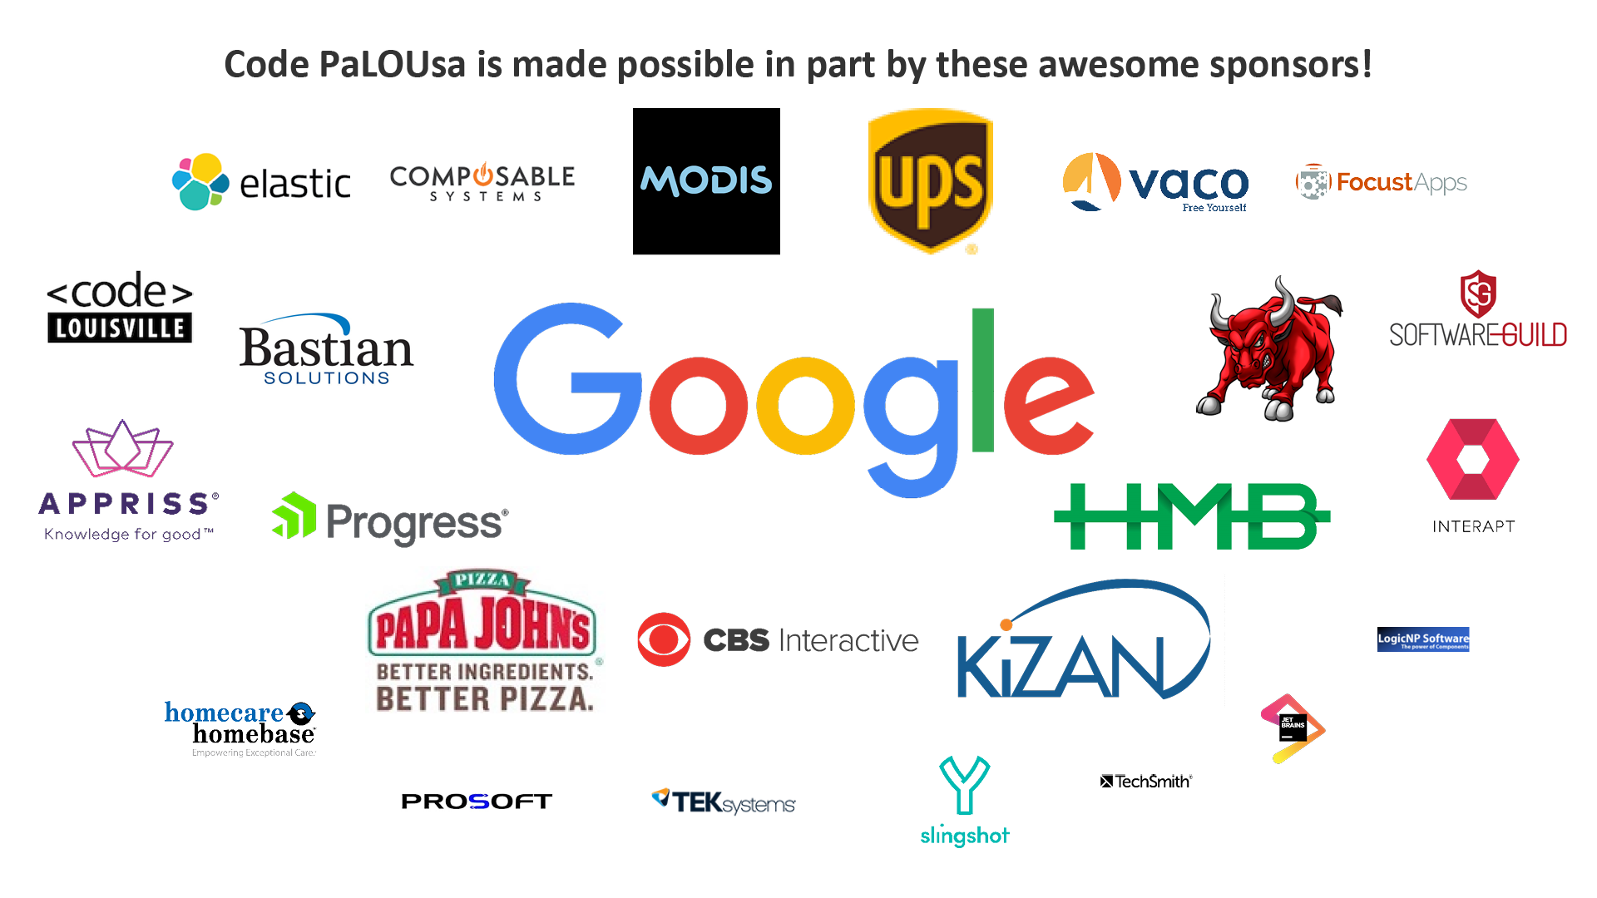

Give Your ASP.NET API Superpowers Using Swashbuckle (and make your front end devs happy)
C Daniel Waddell
Software Engineer
 www.cdwaddell.com
 @CDanielWaddell
↑ CDWaddell
 CDWaddell

Slide 2
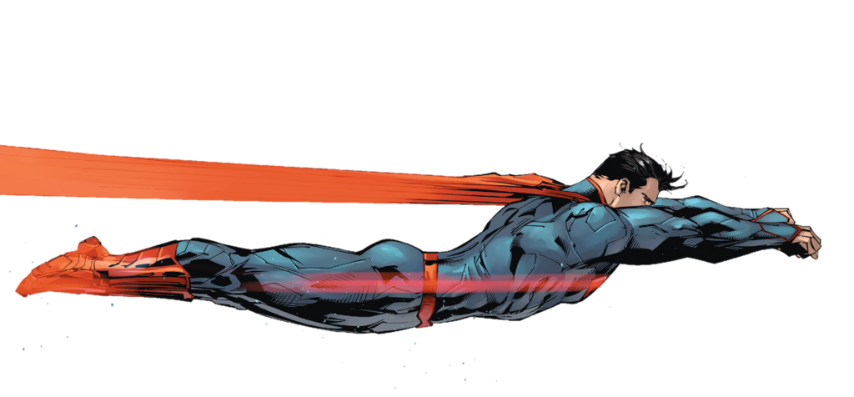




Superpower, what superpower?

Slide 3
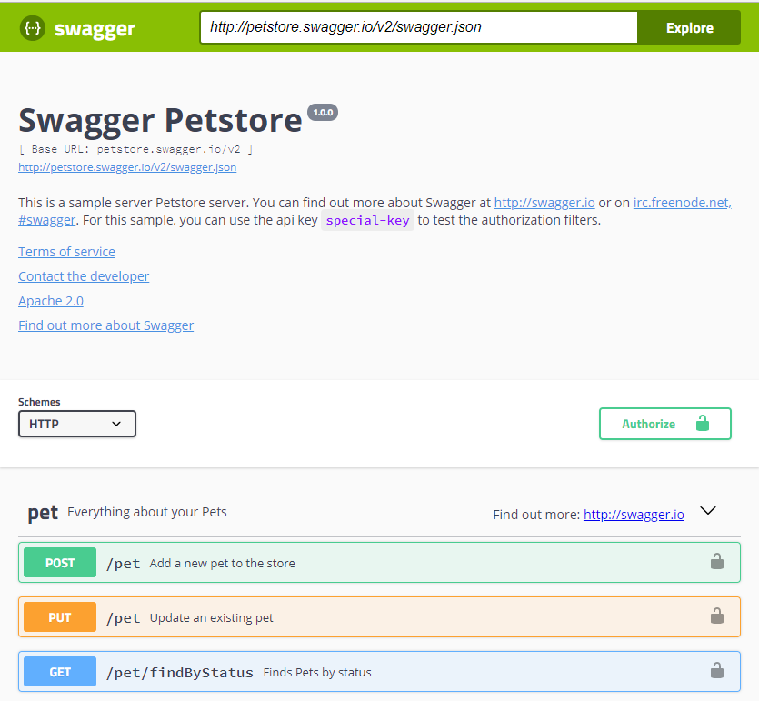
OpenAPI Specification
OpenAPI Specification (formerly Swagger Specification) is an API description format for REST APIs. An OpenAPI file allows you to describe your entire API, including:
Available endpoints (/users) and operations on each endpoint (GET /users, POST /users)
Operation parameters Input and output for each operation
Authentication methods
Contact information, license, terms of use and other information.
API specifications can be written in YAML or JSON. The format is easy to learn and readable to both humans and machines.
https://github.com/OAI/OpenAPI-Specification/blob/master/versions/3.0.0.md

Slide 4

Swashbuckle
Auto-generated Swagger 2.0
Seamless integration of swagger-ui
Reflection-based Schema generation for describing API types
Extensibility hooks for customizing the generated Swagger doc
Extensibility hooks for customizing the swagger-ui
Out-of-the-box support for leveraging Xml comments
Support for describing ApiKey, Basic Auth and OAuth2 schemes ... including UI support for the Implicit OAuth2 flow

Slide 5
Microsoft.AspNetCore.Mvc.ApiExplorer
Do as I do, not as I say.
ApiExplorer is an abstraction layer that allows you to obtain a description of the structure of your Web APIs.
ProducesAttribute
ProductesResponseTypeAttribute
RouteAttribute
Http[Verb]Attribute
Etc…
This is about what WebAPI does and/or cares about, not about documentation!

Slide 6
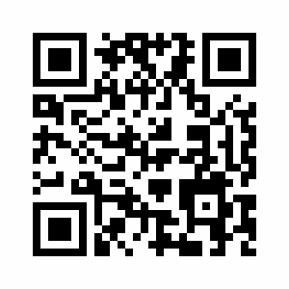
GitHub
https://github.com/cdwaddell/DemoApi
Step0 – Vanilla API
Step1 – Simple documentation
Step 2 – ApiVersioning
Step 3 – Oauth
Step 4 – Comment Documentation
Step 5 – Themes
Step 6 – Filters
Step 7 – Formatters

Slide 7
Attributions
Superman by Unknown (MayanTimeGod) is licensed under CC BY-ND
Invisible Man by Unknown (dan121314) is licensed under CC BY
Wolverine by Unknown (Xadeon) is licensed under CC BY-NC-ND
Documentation Writing by Unknown (martinhumanities) is licensed under CC BY-NC-SA
Hulk by Unknown (Class of 1999) is licensed under CC BY-NC-ND
Piratey, by J.J., released into the public domain

