Slide 1
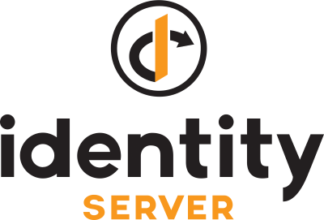

Roll Your Own SSO using &
https://github.com/IdentityServer/IdentityServer4
https://github.com/dotnet/core
C Daniel Waddell
With lots of help from document by Brock Allen & Dominick Baier
https://identityserver4.readthedocs.io/en/release/

Slide 2
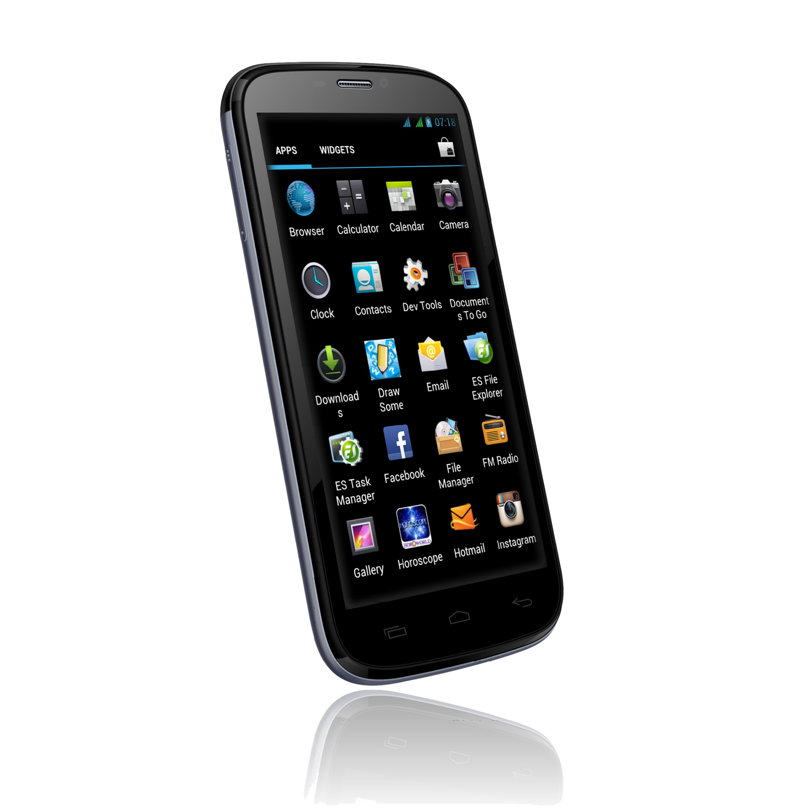











Why Single Sign-On?
No School Today!

Slide 3
Why Single Sign-On?
No School Today!

Slide 4

OpenID Connect Options http://openid.net/developers/certified/
C - Apache mod_auth_openidc 2.3.1
C# - IdentityModel.OidcClient 2.0
Erlang - oidcc 1.0.1
Node - node openid-client ^1.3.0
JavaScript - oidc-client-js 1.3
PHP - phpOIDC 2016 Winter
Python - pyoidc 0.9.4
Ruby - openid_connect rubygem v1.0.3
TypeScript - angular-auth-oidc-client 1.0.2

Slide 5
What is IdentityServer4
IdentityServer is a free, open source OpenID Connect and OAuth 2.0 framework for ASP.NET Core.
Founded and maintained by Dominick Baier and Brock Allen
IdentityServer4 incorporates all the protocol implementations and extensibility points needed to integrate token-based authentication, single-sign-on and API access control in your applications.
IdentityServer4 is officially certified by the OpenID Foundationand thus spec-compliant and interoperable.
It is part of the .NET Foundation, and operates under their code of conduct. It is licensed under Apache 2 (an OSI approved license).

Slide 6
Why IdentityServer4?
Open Source: https://github.com/IdentityServer/IdentityServer4
Extensive Documentation: http://docs.identityserver.io/en/release/
Samples, Samples, Samples: https://github.com/leastprivilege/AspNetCoreSecuritySamples
Very active community: https://stackoverflow.com/questions/tagged/?tagnames=identityserver4&sort=newest
Did I already say the community is very active: https://github.com/IdentityServer/IdentityServer4/issues
You can customize everything!
Part of .NET Foundation, so it works with all of your Microsoft stack.

Slide 7
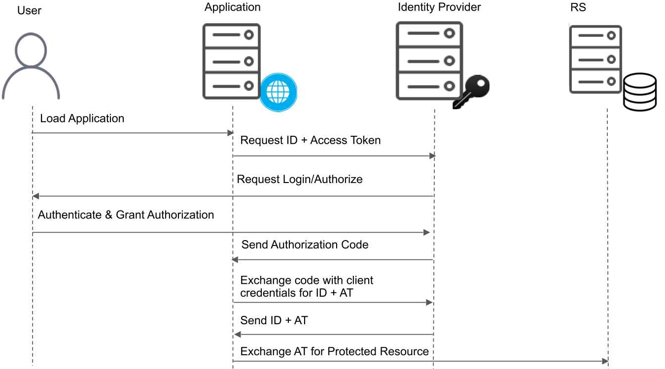
OpenID Connect Overview

Slide 8

Scopes, and Claims, and Bears Oh My!
Scope: Profile
Username
First Name
Last Name
What are scopes?
The first thing you typically define in your system are the resources that you want to protect. That could be identity information of your users like profile data or email addresses or access to APIs.
Identity
Identity Scopes define your user data and are provided in the Identity Token
Scope: Email
Email Address
Is Email Confirmed?
Scope: Phone
Phone Number
Is Text Message Confirmed?
Scope: Customer
Customer ID
Shipping Address
…

Slide 9
Resource Scopes, and API Scopes - Facebook
Read Permissions - User Attributes
email
public_profile
read_custom_friendlists
user_about_me
user_birthday
user_education_history
user_friends
user_hometown
user_location
…
Messenger Platform Permissions
pages_messaging
pages_messaging_payments
pages_messaging_phone_number
pages_messaging_subscriptions
Instagram Platform Permissions
instagram_basic
instagram_manage_comments
instagram_manage_insights

Slide 10
Grant Types
Authorization Code Flow
The authorization code flow returns an authorization code that can then be exchanged for an identity token and/or access token. This requires client authentication using a client id and secret to retrieve the tokens from the back end and has the benefit of not exposing tokens to the user agent (i.e. a web browser). This flow allows for long lived access through the use of refresh tokens. Clients using this flow must be able to maintain a secret.
Implicit Flow
The implicit flow requests tokens without explicit client authentication, instead using the redirect URI to verify the client identity. Because of this, refresh tokens are not allowed, nor is this flow suitable for long lived access tokens. From the client application's point of view, this is the simplest to implement, as there is only one round trip to the OpenID Connect Provider.
Hybrid Flow
The hybrid flow is a combination of aspects from the previous two. This flow allows the client to make immediate use of an identity token and optionally retrieve an authorization code via one round trip to the authentication server. This can be used for long lived access (again, through the use of refresh tokens). Clients using this flow must be able to maintain a secret.
Client Credential
Get an access token based on client id and secret
Password
Get an access token and id token based on a user’s username and password an client id and secret

Slide 11
Lets look at some code

