Slide 1


Azure App Services
Presented By
Nigel Wardle
CSA CDW

Slide 2
Introduction – What is IaaS?
Infrastructure as a Service
Consumer manually chooses Windows or Linux Virtual Machine
Consumer manually adds native platform: – IIS, MS SQL Server, Exchange Server, Dynamics AX - Ubuntu, Apache, MySQL, PostgreSQL
Consumer creates application or database
Consumer deploys code or data
Consumer manually configures platform for: scaling, performance, availability
Consumer manually configures backup
Consumer has a lot to manage

Slide 3
What is PaaS?
Platform as a Service
Consumer initiates creation of PaaS instance on Vendors Cloud
Instance creates a VM or Service behind the scenes
Consumer deploys application code or data
Consumer typically has no visibility nor access to the underlying VM or Service
Cloud Vendor manages updates and patching
Much automation built in: Backup, Scaling etc.
Built in SLA; 99.xxx availability
Examples: Azure: App Service, SQL, AWS: Elastic Beanstalk, RDS
Consumer has a lot less to manage

Slide 4




What is Azure APP Service?
Azure App Service is a Web Application hosted in Azure PaaS
Has Pre-installed Platform: IIS
Pre-installed runtimes: .NET, .NET Core, PHP, Python, Java, Ruby. Limited configuration options
Docker Support
Linux Containers – SLA
Windows Containers - Preview
15-year-old web apps – Webforms?
Autoscale, Auto-backup, auto-restart, vendor patching

Slide 5
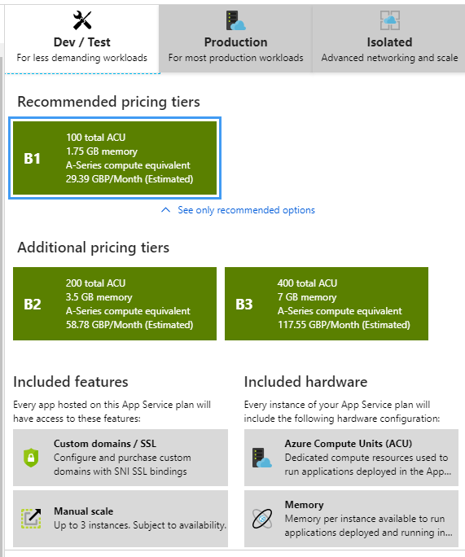

What is an Azure App Service Plan?
Hidden Web Farm of Virtual Machines that host App Service
Windows or Linux
Different tiers – Free, Shared Basic, Standard, Premium
Different performance levels for each tier - Small, Medium, Large
Manually or Programmatic Scale Up/Down tier/performance
Scale In or Out – Adding/Removing instances
Multiple App Services can run in a single App Plan for cost savings
Public lP Address OR Isolated - but Expensive
Storage (content should be hosted in Blob storage)
Custom Domains & SSL/TLS Certificates

Slide 6
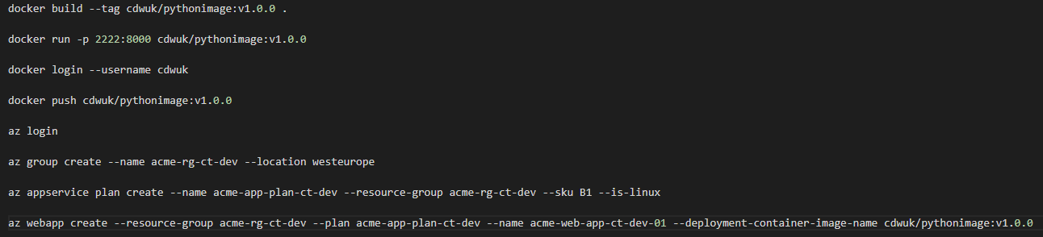
App Service - Deployment
Standard Deployment: Visual Studio – Web Deploy, Azure DevOps, FTP, Local Git, Git-Hub, Bitbucket, Dropbox, OneDrive
Docker Image Deployment to a Container: Visual Studio – Web Deploy, Portal, Azure CLI

Slide 7
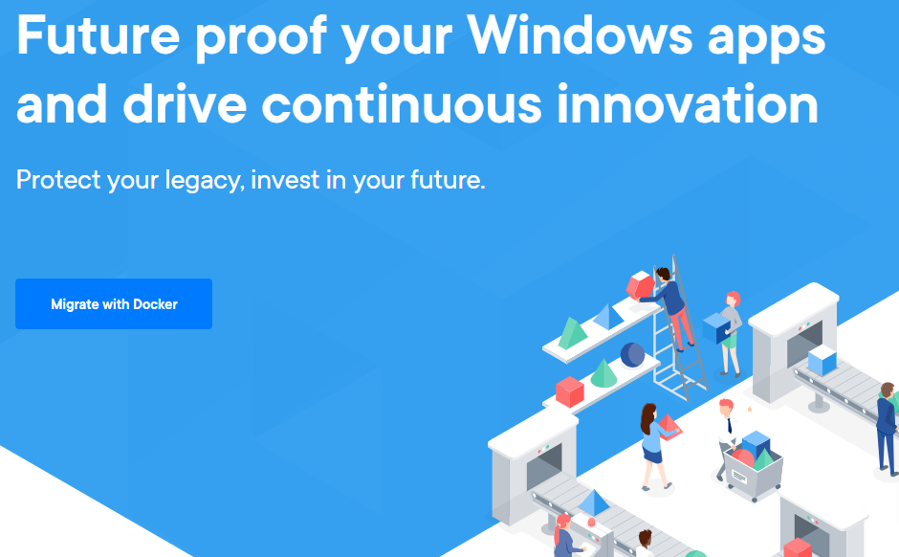
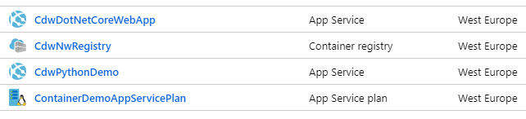
App Service - Docker Container Support
Azure Web Apps for Containers
Pack in many Docker Containers for cost efficiency
Different Performance & Tiers
Production SLA
Azure Container Instances
Run Docker Containers as a Group
Consumption Model
Dev/Test – No SLA

Slide 8
Azure APP Service – Shared – Dev/Test
Multiple App Services can share a common App Plan
Each App Service runs as a virtual application on same VM
Cheaper
Good for Dev, Test, UAT…
App Services Compete for shared VM Resources
Load testing will severely degrade all App Services in same App Plan
Each Scaled Out VM instance has a copy of each App Service
Switch to Free Mode overnight?
Not for Production

Slide 9
Azure APP Service – Prod & Pre-Prod Slots
Prod App Service has Production App Plan
Create Pre-Prod slot in Prod App Service - A/B testing
Prod & Pre-Prod each run as a virtual application on each scaled out VM
Must not preform load testing on Pre-Prod as will remove resources from Prod

Slide 10
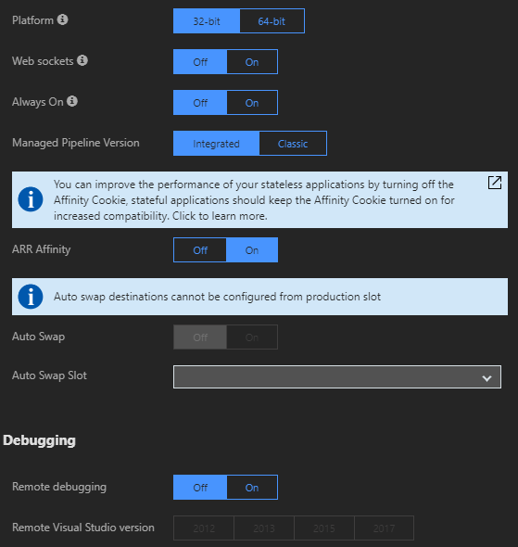
Azure APP Service Configuration
Always On (IIS Worker Process?)
ARR Affinity – Sticky Sessions
Remote Debugging (Visual Studio)
Apps should have Application Insights code embedded
Apps monitored by Application Insight

Slide 11
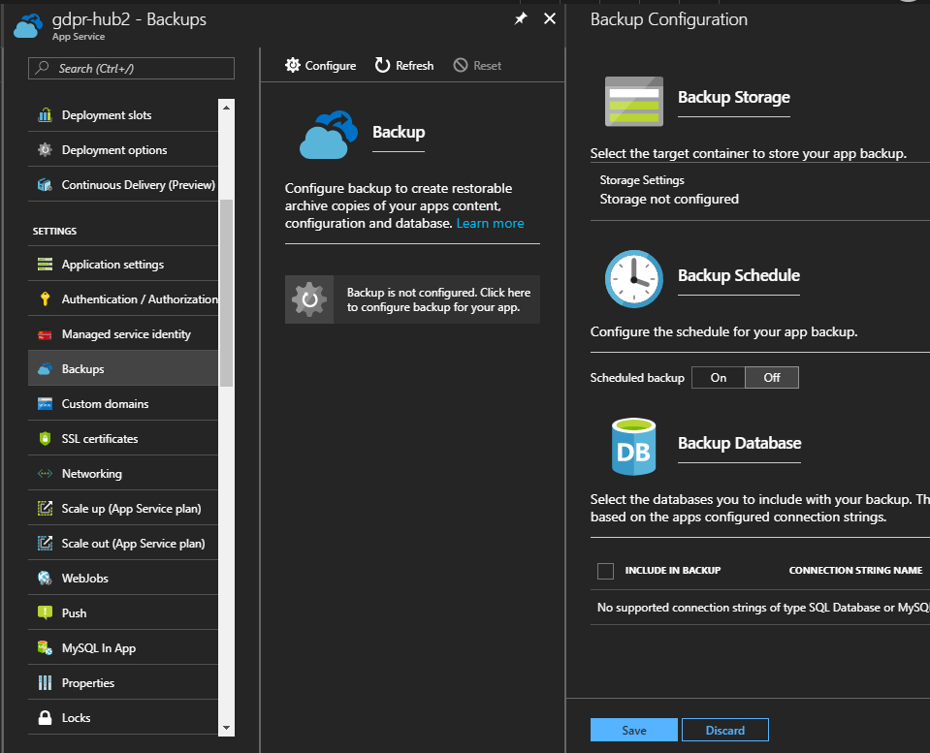
Azure APP Service – Backup
Frequency of Backups dependant on App Plan
If content external and using slots - diminishing requirement to backup

Slide 12
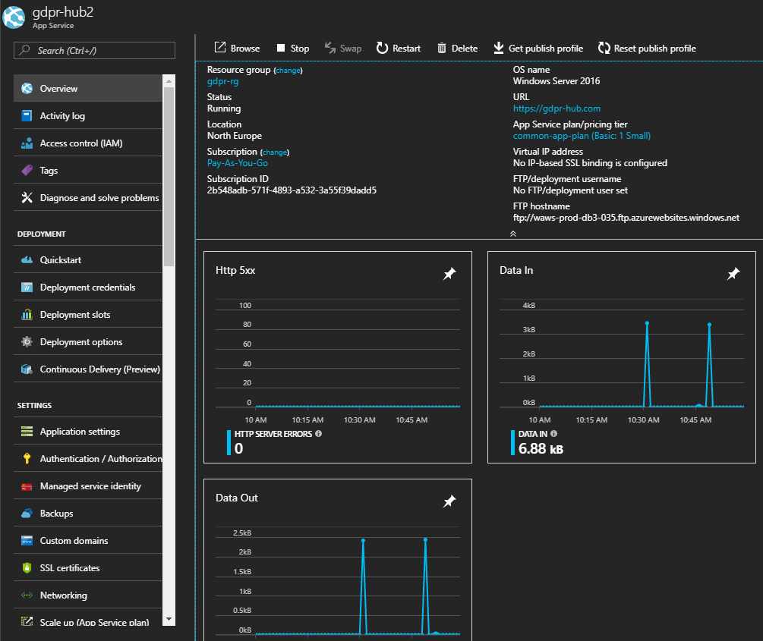
Azure APP Service – Overview/Monitor
Monitoring
Email Alerts
Webhook Alerts
Application Insites

Slide 13
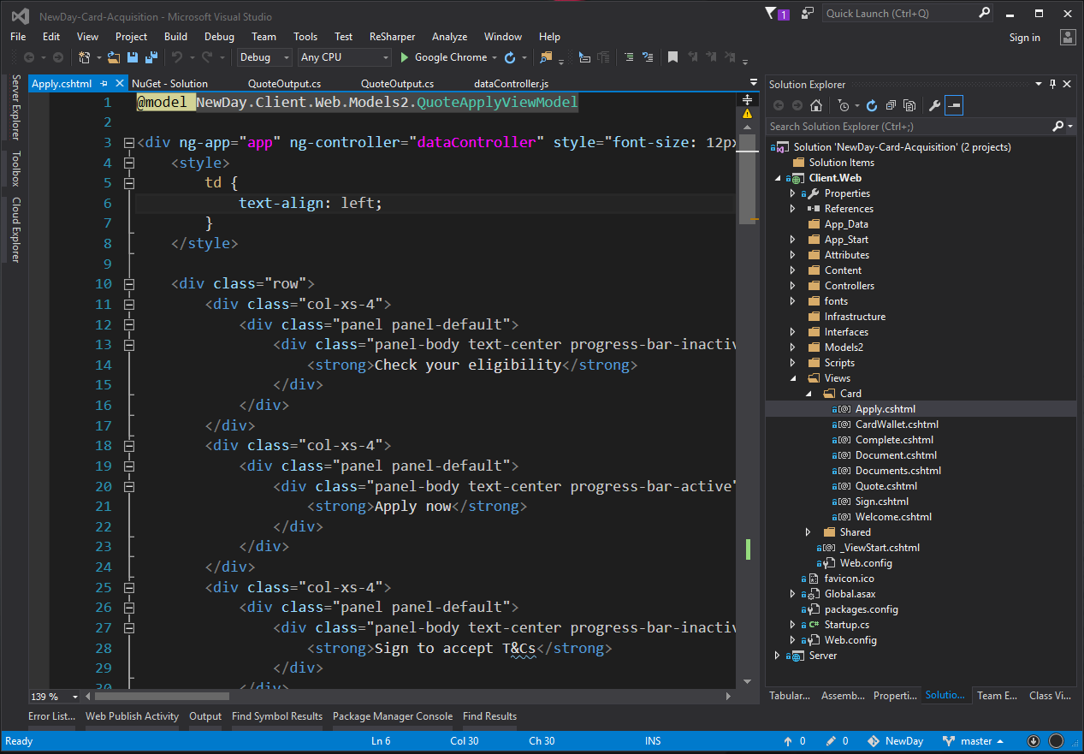
Azure APP Service – ASP.NET MVC
ASP.NET MVC Web App
ASP.NET MVC API App
Docker

Slide 14
Quiz – Azure App Services
What is an Azure App Plan?
What kinds of web apps/languages does Azure App Service support out of the box?
If web app auto-scales adding instances, how does it support a users shopping basket?
How does can Azure App Service support mobile technology?
What kind of Microsoft web application can I create that will run everywhere: Windows, Linux, Open-Shift, K8s?
I have 10 apps that each need a custom domain name, require HTTPS support, but no backup. What is the most cost-effective Azure tier/performance level?
I have 10 apps that can run on any domain name, require HTTPS support, but no backup. What is most cost-effective Azure tier/performance level?
How much does it cost to run a Web App in a VNET?
Name 2 ways to run a Google GO app in Azure App Services?

Slide 15
Quiz - Azure App Services - Answers
What is an Azure App Plan? A Web farm of one or more VMs offering a chosen pre-set tier and performance level - & corresponding features
What kinds of web apps/languages does Azure App service support? ASP.NET, Java, Python, PHP, Ruby
If web app auto-scales adding instances, how does it support a users shopping basket? Address Request Routing Affinity (sticky sessions by IP address)
How can Azure App Service support mobile technology? Can deploy a web API
What kind of Microsoft web application can I create that will run everywhere: Windows, Linux, OpenShift, K8s? ASP.NET Core
I have 10 apps that each need my custom domain and HTTPS support, but no backup. What is most cost-effective Azure tier/performance level? Single shared B1 App Plan
I have 10 apps that can run on any domain name and HTTPS support, but no backup. What is most cost-effective Azure tier/performance level? F1 - Free mode using azurewebsites.net wildcard certificate
How much does it cost to run a Web App in a private (non-public) VNET? A lot!!
Name 2 ways to run a Google GO web application in Azure App services? Install Go Runtime through KUDU, or deploy in a Docker container through Web Apps for Containers

Slide 16
Azure App Services
Presented By
Nigel Wardle
CSA CDW

