Slide 1


VMs, Containers, Registries, Micro-services
Presented By
Nigel Wardle
CSA CDW

Slide 2
Introduction – What is a VM?
Traditional Way of isolating applications on shared hardware
Each VM is a separate Guest Operating System (OS)
Guest OS is the fully bloated version with a Kernel (10GB)
Hypervisor supports each Guest OS
Host OS supports Hypervisor
Host OS is the fully bloated version
Inefficient use of resources
Very large attack surface area
Why not remove each Guest OS and share Host OS Kernel?

Slide 3
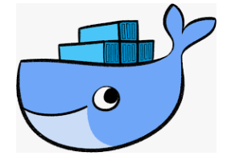
Introduction – What is Docker?
Docker is an Application Platform, that makes it easy to:
Encapsulate application files, runtime, cut down image OS, as a multi layered (cached) image
Deploy and run image layers as a Container on Linux distros or Windows 2016
Image OS is stripped of many dependencies, minus kernel <140MB
Many containers all sharing the same base OS Kernel
Isolate containers –Linux: Namespaces, Control groups, SELinux contexts
Run containers with non Root (admin) privileges
Start/stop containers in microseconds
Use a Micro-services, multi container, application model

Slide 4
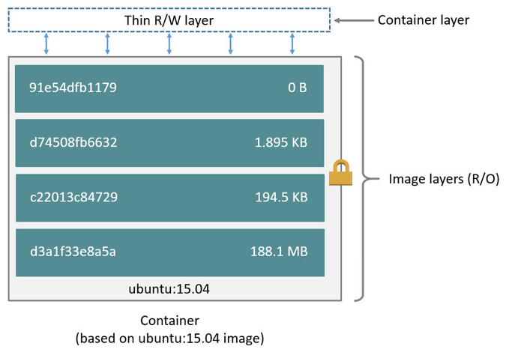
Introduction – What is a Docker Image?
Multiple stack of read-only file layers
First layer is the underlying OS
Add multiple file layers on top to replace lower layer files
Encapsulates all application dependencies
FROM ubuntu:15.04
COPY . /app
RUN make /app
CMD python /app/app.py

Slide 5
Introduction – What is a Container?
Thin writable layer overlaying Docker Image
Contains application code, runtimes and OS files
Uses shared Linux or Windows 2019 kernel
Much more efficient in CPU and memory than VM
5 x times -monolithic containers compared to VM
Apps 15 years old can be containerised
Mature production technology
Technical and commercial advantages over VMs
Share data using Volumes

Slide 6
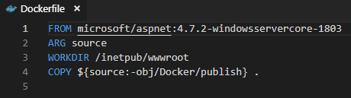
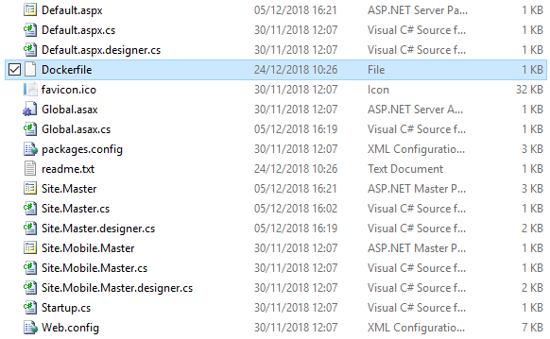
Container: ASP.NET 3.5, .NET 2.0, Webforms

Slide 7
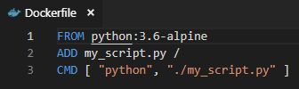
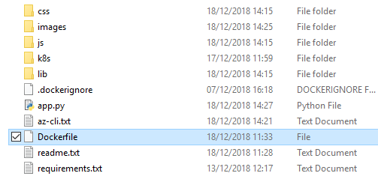
Container: Python Web App on Alpine Linux

Slide 8
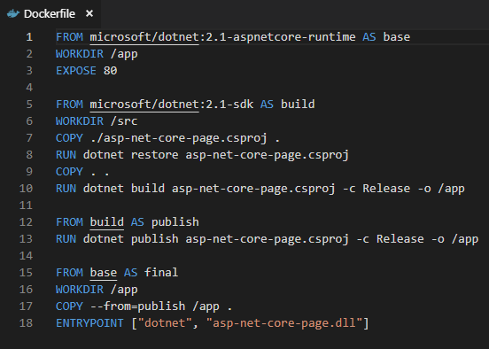
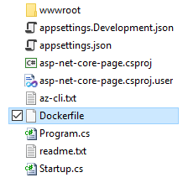
Container: ASP.NET Core on Linux or NanoServer

Slide 9
How to create Image – then Run a Container?

Slide 10
Container Security?
Regularly patch host OS
Always use an official Base Image (Docker Store?)
Regularly update FROM base image
Do not run container with root (admin) privileges
Scan image in registry for vulnerabilities
Use signed images
Do not allow configuration changes to occur at runtime
Monitor container for CPU and memory use
Add resource limits on CPU and memory

Slide 11
When not to Containerise?
Complex legacy apps with many external dependencies
Exotic Hardware
Very large multi server monolithic applications

Slide 12
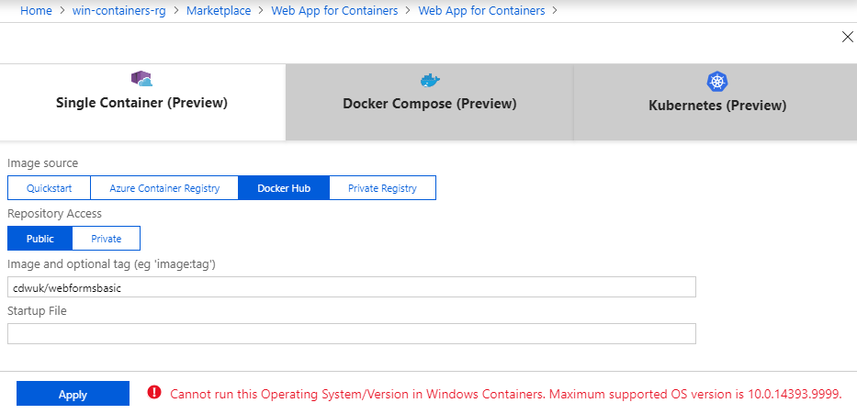
Windows Containers?
.NET Framework requires Windows – not work on Linux
Containerised .NET Framework based Apps only run in Windows Containers
Host (Node) must be Windows 2016+ with Docker
Azure Web Apps for Containers - Preview
Raw Kubernetes – imminen

Slide 13
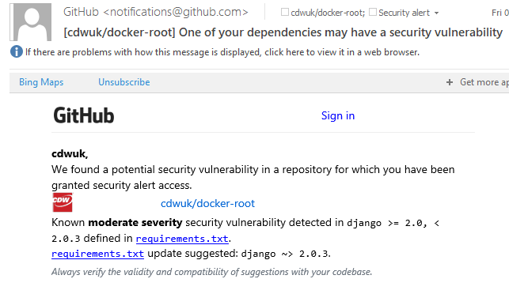
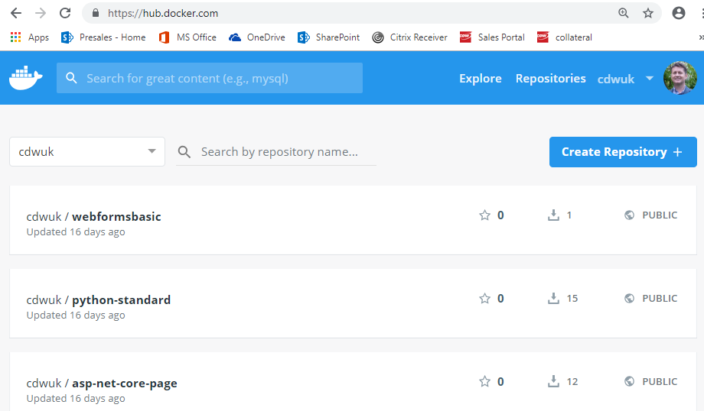
Overview – What is an Image Registry?
Server to store Docker Image layers
DockerHub is the most popular public Image Registry
{registry-domain}/{account-id}/{repository-name}:{tag}
docker.io/Cdwuk/MyWebApp:v1.0.0
Azure can host a private registry
Vulnerability Detection built in

Slide 14
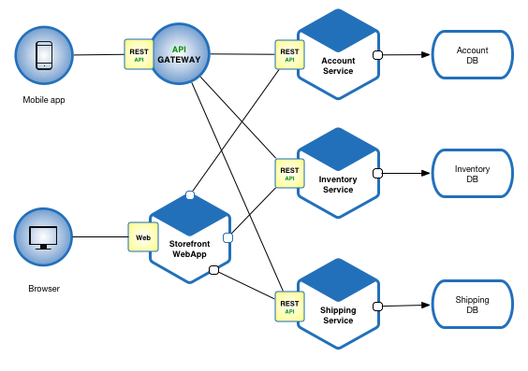
Overview – What are Micro-Services?
Small, discrete, standalone, isolated components of an application
Each independently developed, deployed and run as a single container
Application made up of many micro-services working together
Each container usually exposed as a web API and publishes events on data changes (ESB)
Deploy, update, delete independently
Unique non shared code and storage
API Gateway receives request and queries multiple Services
API Gateway to aggregate calls: Code, APIM, or NGINX solutions
Netflix, Amazon, eBay, Uber have evolved from a 3 tier monolithic architecture to a micro-service architecture.

Slide 15
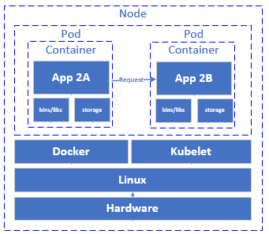
Overview – What is a Kubernetes (K8s) Cluster?
Container Orchestrator (schedules containers)
Runs across a cluster of Worker nodes – machines
Master runs on one or more master nodes -Linux
Each node hosts one or more pods
Pod typically host a single Container
K8s manages container deployment, rolling updates
Great for high availability micro-service based apps
Supported by all leading Cloud Providers – Azure, AWS, Google
Kubernetes 1.9 app nodes can run on Linux or Windows 2016 (Beta)
Requires knowledge of kubectl.exe and helm.exe command line utilities
Halfway between IaaS and PaaS

Slide 16
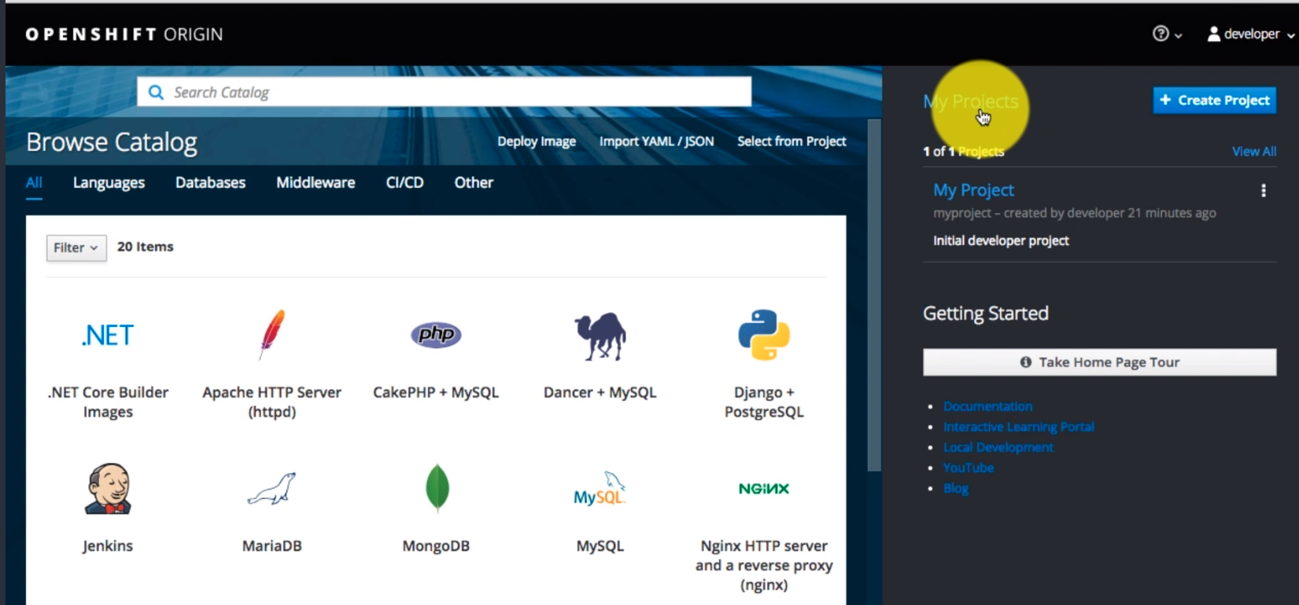
OpenShift – Kubernetes as PaaS or CaaS
Kubernetes as PaaS or CaaS
Create new app project
Choose base image from catalogue
Specify code in GitHub
Plumb in Azure technologies - OSBA
Initiate Jenkins CI/CD - build to image
Deploy to local container registry
Deploy images to local K8s
Perform rolling updates
Monitor ….

Slide 17
Quiz
If I have a Dell machine and 20 .NET apps running in isolated VMs how many licences of Windows server should I have purchased? How many if I convert to containers?
What are the pitfalls of traditional deployment of apps to a new production box?
How does a Docker deployment increase the chances of a successful rollout?
What kind of apps cannot usually be containerised?
What 3 features of Linux provide container isolation?
What security features does Docker Hub include?
I create 5 micro-services. They share common code for high efficiency. Is this good practice?
Name at least 3 technologies that can host an app running in a Docker container
Name as many commercial benefits as possible migrating to Docker in a PaaS environment
How can I migrate a 15-year-old unknown Linux based web app into Kubernetes without changing a line of code?
What are the 2 common communication mechanisms between microservices?

Slide 18
Quiz- Possible answers
If I have a Dell machine and 20 .NET apps running in isolated VMs how many licences of Windows server should I have purchased? How many if I convert to containers? 21 if purchased individually or Datacentre Versions, 1
What are the pitfalls of traditional deployment of apps to a new production box? – target has missing or wrong dependencies - wrong OS version, missing service pack, missing or wrong version of application runtime.
How does a Docker deployment increase the chances of a successful rollout? All dependencies included in image
What kind of apps cannot usually be containerised? Desktop Apps, Mainframe
What 3 features of Linux provide container isolation? Namespaces, CGroups, SELinux
What security features does Docker Hub include? Vulnerability detection
I create 5 micro-services. They share common code for high efficiency. Is this good practice? No bad practice. If common code is updated all micro-services must be retested and redeployed which is the opposite of what we want. Sharing storage should not occur for the same reasons.
Name at least 5 technologies that can host an app running in a Docker container: Azure ACI, Web apps for Containers, AKS. Google GKE, Amazon EKS, Pivotel Container Service, Red Hat Openshift
Name as many commercial benefits as possible migrating to Docker in a PaaS environment: 5 x packing ratio, smaller surface area of attack, easier to deploy, No capex, near instant scaling
How can I migrate a 15-year-old unknown Linux based web app into Kubernetes without changing a line of code? Convert to container, upload to Registry, deploy to K8s using KubeCtl.exe and deployment XAML file.
What are the 2 common communication mechanisms between microservices? Restfull API call and publishing of events.

Slide 19
VMs, Containers, Registries, Micro-services
Presented By
Nigel Wardle
CSA CDW

