Slide 1
Towards a Temporal World-wide Web:
A Transaction-time Server
Curtis Dyreson
Electrical Engineering and Computer Science
Washington State University, USA
(Information Technology - Bond University)

Slide 2
Outline
Motivation
  Additional functionality
Temporal database
  Transaction time
  Timeslice and rollback
Transaction-time web server
  Lazy transactions
  Queries
Future work

Slide 3
Motivation
Sep. 25, 2000 Cathy Freeman won the 400m
Sep. 26, 2000, article in The Australian
URL of the on-line newspaper (sports section)
  www.theaustralian.com.au/sports.html

Slide 4
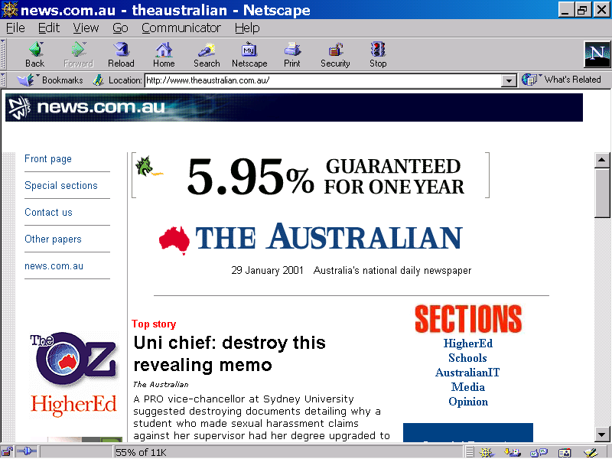

Slide 5
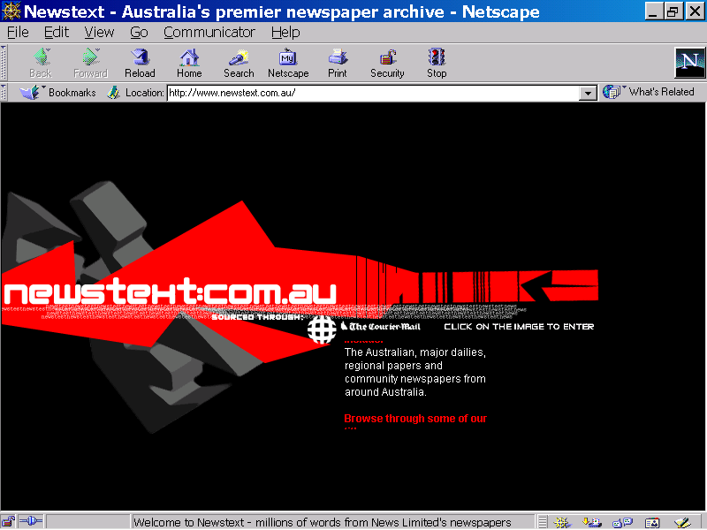

Slide 6
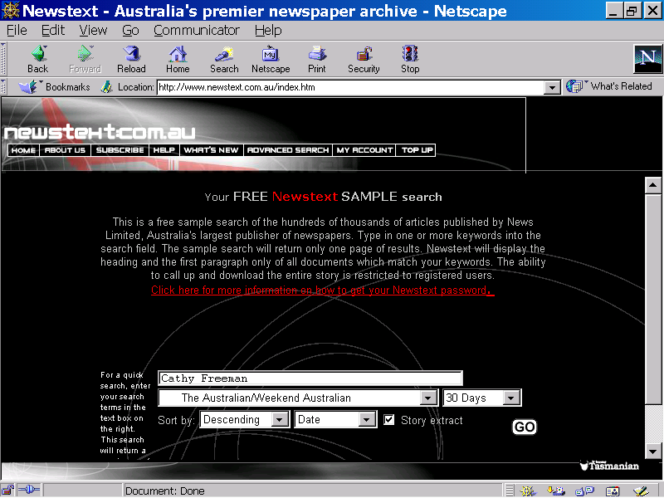

Slide 7
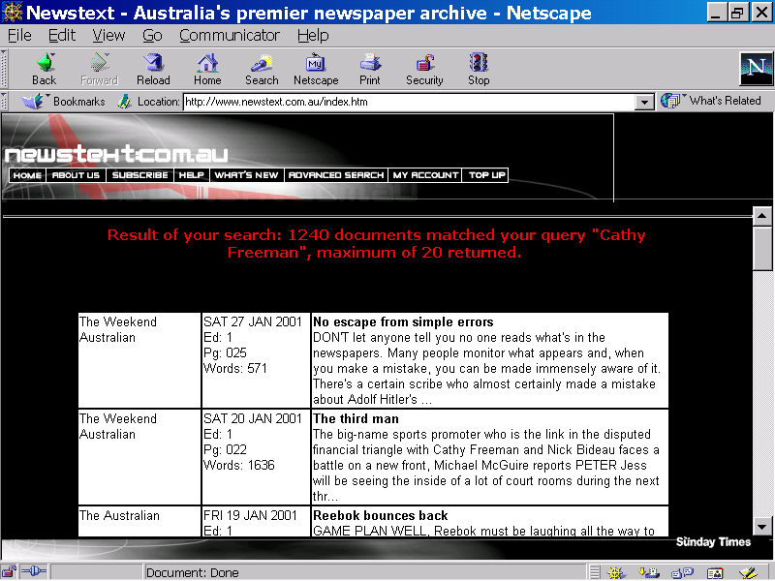

Slide 8
Capability of a Transaction-time Server
URL of the on-line newspaper (sports section)
  www.theaustralian.com.au/sports.html
Desired URL
  www.theaustralian.com.au/sports.html?26-Sep-2000
Avoid URL munging with XLink
  XML specification of link with additional elements for transaction time query

Slide 9
Motivation
Timeslice
  Entertainment, government, audit
  URI/XPath/XPointer
    Resource is “pinned”
  Pages within interval
Rollback - Restore a previous page
Fetch latest
  Broken links
    Hyperlinks point to independently evolving resources
    NEC 1998 - 8%-10% of links are broken
Show changes
  HTMLdiff, XMLdiff (AT&T Bell Labs)

Slide 10
Constraints on Design
Backwards compatible
  Minimal changes to HTML, HTTP, servers, browsers
  No changes to legacy pages
  No changes to page maintenance culture
Coexistence compatible
  Partial migration
Simplify problem
  Ignore active pages
    ASP
    CGI-bin
  Ignore processing changes
    Javascript bug fixes

Slide 11
Temporal Database - Time Dimensions
Valid time
  Time when “true” in real world
Transaction time
  Lifetime in database
  Interval
Degenerate relationship (Snodgrass and Jensen, Temporal Specialization and Generalization, TKDE, 1996)

Slide 12
Transaction Time
Interval representation - DBMS maintained
On Jul/2/2000
    DELETE FROM Movie WHERE Actor=‘Arnuld’;
    INSERT INTO Movie (‘True Lies’, ‘Arnold’);
Schema evolution (e.g., Roddick and Snodgrass, TSQL2, 1995)
Transaction Time
start end
Movie
Actor
Toy Story
Tom
Jan/4/1999
now
Lion King
Mustafa
Jan/4/1999
now
True Lies
True Lies
Arnuld
Arnuld
now
Jan/4/1999
Jul/1/2000
Jan/4/1999
True Lies
Arnold
Jul/2/2000
now

Slide 13
Web vs. Database
Must use DBMS to modify data
On the web, updates are independent of server
user
database server
data
pages
server
editor

Slide 14


Transaction Time without Transactions
Web resources are files
  File modification time
  Included/dependent files
Page versions
transaction time
April 1
May 2
May 5
June 2
now

Slide 15
Lazy Transactions
Perform transaction during HTTP get
archive
database
server
browser
resources
archived resources

Slide 16
Archive Database
Single relation
  URL, resource, transaction-time interval
(Almost) An append-only relation
  Insert on HTTP get
    For new versions only
  Resource forwarding
    Possibly insert historical records for new URL
  Resource expiration
    Transaction stop time is in the future
  Resource extinction (not append-only)
    Delete records for resource
  Resource vacuuming (not append-only)
    Delete some versions

Slide 17
Transaction-time Timeslice
server
request
as of time X
archive
database
archived resources

Slide 18
Broken Links
server
request
archive
database
?
pages
archived resources

Slide 19
History of Changes
server
request
archive
database
HTML diff
pages
archived resources

Slide 20
URL Munging Examples
Translate links to time of retrieval
Current version
  tabloid.au/sports.html?now,now
by default
  tabloid.au/sports.html?now,now
Version on Jan/6/2000 (links are to current state)
  tabloid.au/sports.html?6-Jan-2000,now
Version on Jan/6/2000 (links are as of that time)
  tabloid.au/sports.html?6-Jan-2000,6-Jan-2000
Sequence of predecessors
  tabloid.au/sports.html?pred,pred

Slide 21
Cost
Space - disks are cheap
  Store diffs
    RCS
  Append-only
    Without resource extinction
    CD’s are really cheap
  Vacuuming
  Offsite-storage
    Internet archive
Time
  Overhead on reading a file
    Database lookup, file read, file write
  Milliseconds are important

Slide 22
Implementation - Future Work
One server strategy
  Jigsaw - T. Dalling, JCU Honour’s Thesis 1998
  Apache - H. Lin, WSU Master’s Thesis
    Modify GET
    Translation module
    Experiment
Two server strategy
  One transaction-time server, one normal server
  GET request goes to both
    Asychronous
    TT server has low priority

Slide 23
Transaction-time Web Server Summary
Local server enhancement
  Non-TT servers ignore stuff after the ?
Compatible
  HTTP, HTML, URLs
  Page maintenance “culture”
Cost
  Modest overhead on normal fetches
  Some strategies for saving space

