Slide 1


CV5100: Modelling, Uncertainty and Data for Engineers MODULE 2: TIME SERIES ANALYSIS, lecture 3: Modeling and estimation

Slide 2
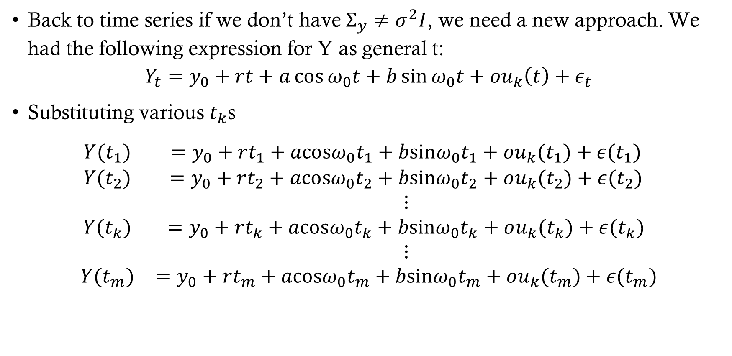
Blue of time series
Back to time series if we don’t have $Σ_{y}≠σ^{2}I$, we need a new approach. We had the following expression for Y as general t:
$$Y_{t}=y_{0}+rt+a\cos{ω_{0}t}+b\sin{ω_{0}t}+ou_{k}\left(t\right)+ε_{t}$$
Substituting various $t_{k}$s
$$\begin{aligned}\begin{matrix}Y(t_{1}) & =y_{0}+rt_{1}+acosω_{0}t_{1}+bsinω_{0}t_{1}+ou_{k}(t_{1})+ε(t_{1}) \\ Y(t_{2}) & =y_{0}+rt_{2}+acosω_{0}t_{2}+bsinω_{0}t_{2}+ou_{k}(t_{2})+ε(t_{2}) \\ & ⋮ \\ Y(t_{k}) & =y_{0}+rt_{k}+acosω_{0}t_{k}+bsinω_{0}t_{k}+ou_{k}(t_{k})+ε(t_{k}) \\ & ⋮ \\ Y(t_{m}) & =y_{0}+rt_{m}+acosω_{0}t_{m}+bsinω_{0}t_{m}+ou_{k}(t_{m})+ε(t_{m})\end{matrix}\end{aligned}$$

Slide 3
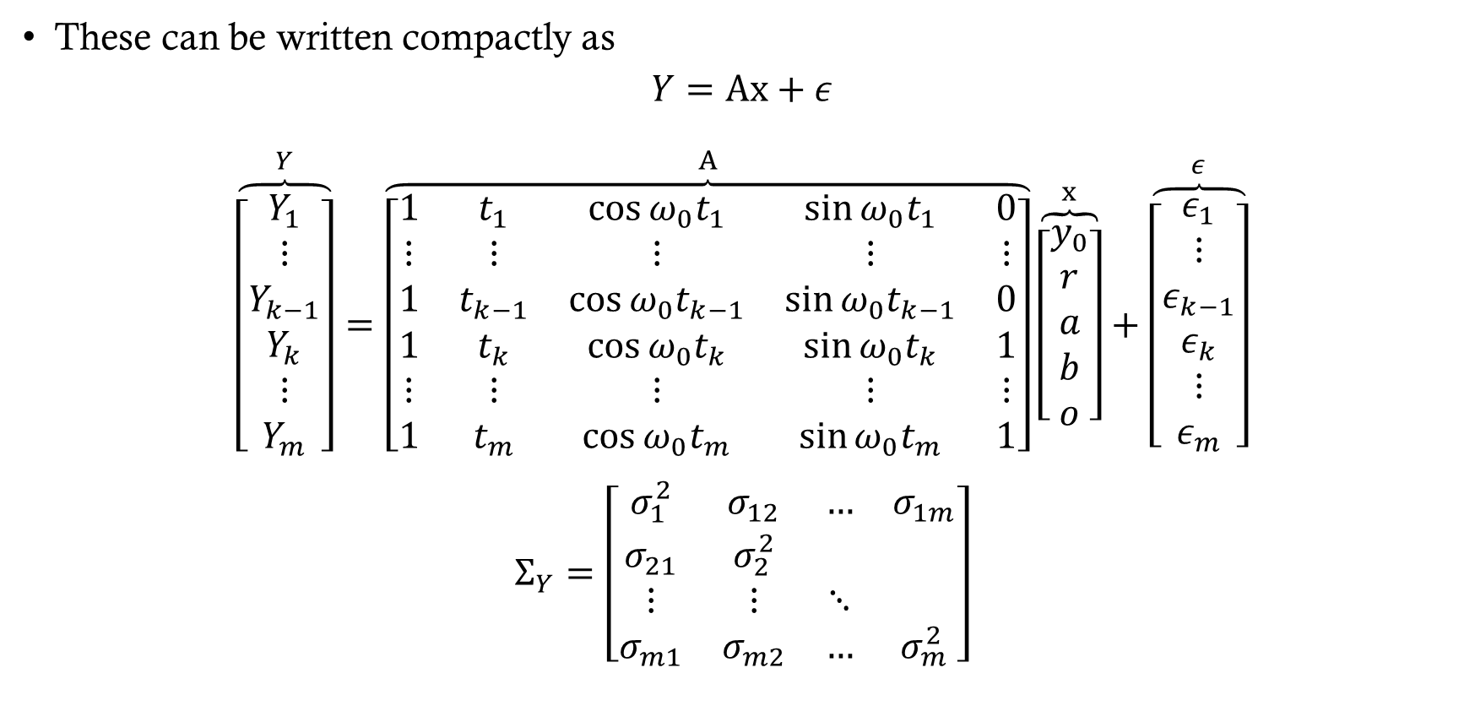
Blue of time series
These can be written compactly as
$$Y=Ax+ε$$
$$\begin{matrix}\overset{Y}{\overbrace{\left[\begin{matrix}Y_{1} \\ ⋮ \\ Y_{k−1} \\ Y_{k} \\ ⋮ \\ Y_{m}\end{matrix}\right]}}=\overset{A}{\overbrace{\left[\begin{matrix}1 & t_{1} & \cos{ω_{0}t_{1}} & \sin{ω_{0}t_{1}} & 0 \\ ⋮ & ⋮ & ⋮ & ⋮ & ⋮ \\ 1 & t_{k−1} & \cos{ω_{0}t_{k−1}} & \sin{ω_{0}t_{k−1}} & 0 \\ 1 & t_{k} & \cos{ω_{0}t_{k}} & \sin{ω_{0}t_{k}} & 1 \\ ⋮ & ⋮ & ⋮ & ⋮ & ⋮ \\ 1 & t_{m} & \cos{ω_{0}t_{m}} & \sin{ω_{0}t_{m}} & 1\end{matrix}\right]}}\overset{x}{\overbrace{\left[\begin{matrix}y_{0} \\ r \\ a \\ b \\ o\end{matrix}\right]}}+\overset{ε}{\overbrace{\left[\begin{matrix}ε_{1} \\ ⋮ \\ ε_{k−1} \\ ε_{k} \\ ⋮ \\ ε_{m}\end{matrix}\right]}}\end{matrix}$$
$$\begin{matrix}Σ_{Y}=\left[\begin{matrix}σ_{1}^{2} & σ_{12} & … & σ_{1m} \\ σ_{21} & σ_{2}^{2} & & \\ ⋮ & ⋮ & ⋱ & \\ σ_{m1} & σ_{m2} & … & σ_{m}^{2}\end{matrix}\right]\end{matrix}$$

Slide 4
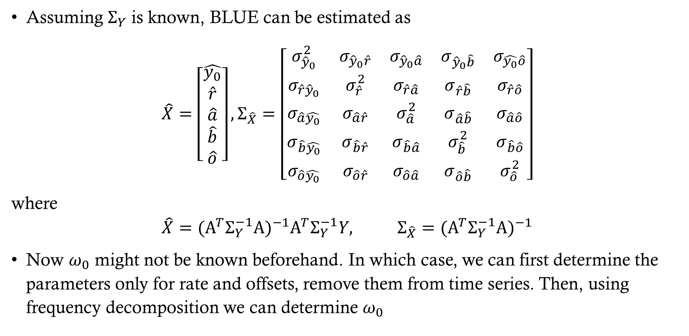
Blue of time series
Assuming $Σ_{Y}$ is known, BLUE can be estimated as
$$\begin{matrix}\hat{X}=\left[\begin{matrix}\hat{y_{0}} \\ \hat{r} \\ \hat{a} \\ \hat{b} \\ \hat{o}\end{matrix}\right], Σ_{\hat{X}}=\left[\begin{matrix}σ_{{\hat{y}}_{0}}^{2} & σ_{{\hat{y}}_{0}\hat{r}} & σ_{{\hat{y}}_{0}\hat{a}} & σ_{{\hat{y}}_{0}\hat{b}} & σ_{\hat{y_{0}}\hat{o}} \\ σ_{\hat{r}{\hat{y}}_{0}} & σ_{\hat{r}}^{2} & σ_{\hat{r}\hat{a}} & σ_{\hat{r}\hat{b}} & σ_{\hat{r}\hat{o}} \\ σ_{\hat{a}\hat{y_{0}}} & σ_{\hat{a}\hat{r}} & σ_{\hat{a}}^{2} & σ_{\hat{a}\hat{b}} & σ_{\hat{a}\hat{o}} \\ σ_{\hat{b}\hat{y_{0}}} & σ_{\hat{b}\hat{r}} & σ_{\hat{b}\hat{a}} & σ_{\hat{b}}^{2} & σ_{\hat{b}\hat{o}} \\ σ_{\hat{o}\hat{y_{0}}} & σ_{\hat{o}\hat{r}} & σ_{\hat{o}\hat{a}} & σ_{\hat{o}\hat{b}} & σ_{\hat{o}}^{2}\end{matrix}\right]\end{matrix}$$
where
$$\hat{X}=(A^{T}Σ_{Y}^{−1}A)^{−1}A^{T}Σ_{Y}^{−1}Y, Σ_{\hat{X}}=(A^{T}Σ_{Y}^{−1}A)^{−1}$$
Now $ω_{0}$ might not be known beforehand. In which case, we can first determine the parameters only for rate and offsets, remove them from time series. Then, using frequency decomposition we can determine $ω_{0}$

Slide 5
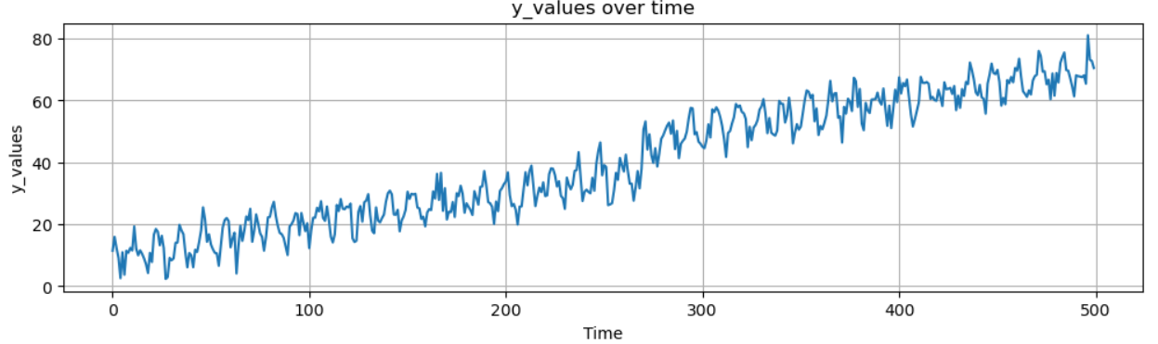
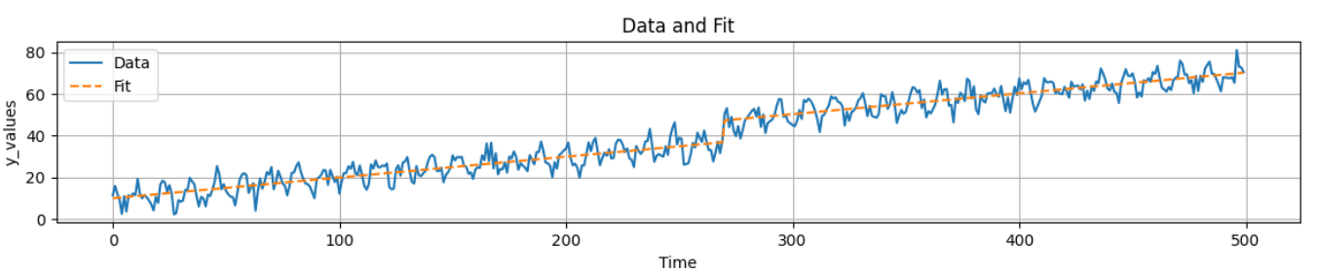
example

Slide 6
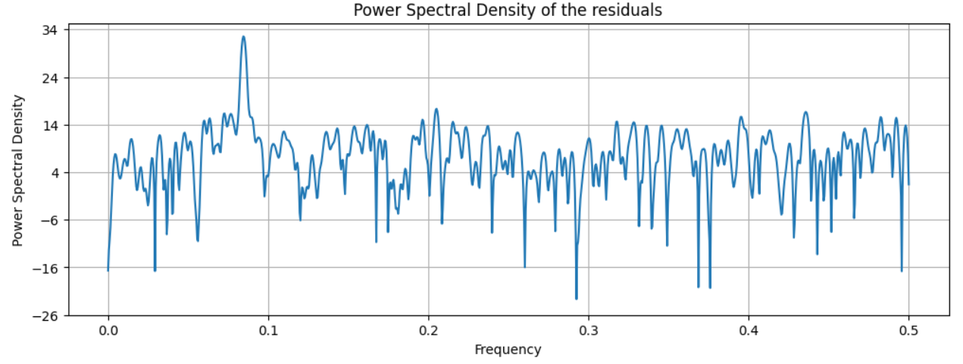
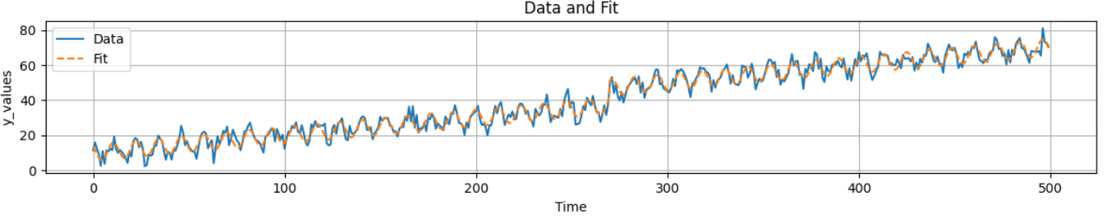
example

Slide 7
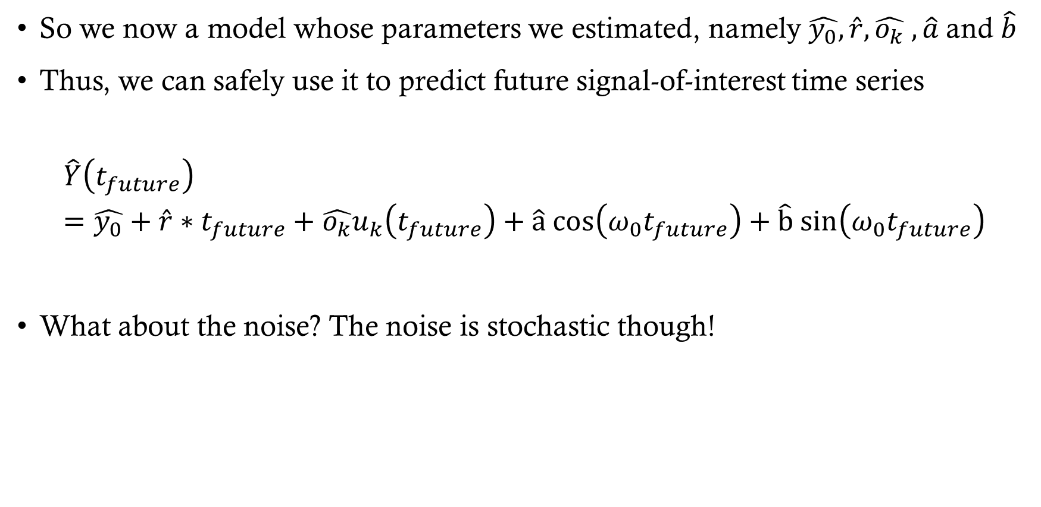
Forecasting
So we now a model whose parameters we estimated, namely $\hat{y_{0}}, \hat{r}, \hat{o_{k}} , \hat{a}$and $\hat{b}$
Thus, we can safely use it to predict future signal-of-interest time series
$$\hat{Y}\left(t_{future}\right)=\hat{y_{0}}+\hat{r}∗t_{future}+\hat{o_{k}}u_{k}\left(t_{future}\right)+\hat{a} cos\left(ω_{0}t_{future}\right)+\hat{b} sin\left(ω_{0}t_{future}\right)$$
What about the noise? The noise is stochastic though!

Slide 8
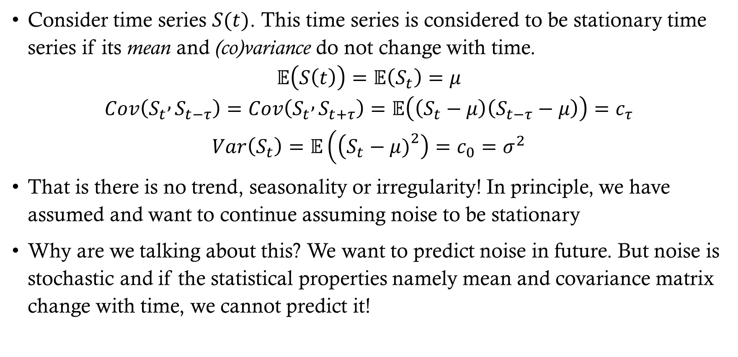
Time series stationarity
Consider time series $S(t)$. This time series is considered to be stationary time series if its mean and (co)variance do not change with time.
$$𝔼\left(S\left(t\right)\right)=𝔼\left(S_{t}\right)=μ$$
$$Cov\left(S_{t} , S_{t−τ}\right)=Cov\left(S_{t} , S_{t+τ}\right)=𝔼\left(\left(S_{t}−μ\right)\left(S_{t−τ}−μ\right)\right)=c_{τ}$$
$$Var\left(S_{t}\right)=𝔼\left(\left(S_{t}−μ{\left.)\right.}^{2}\right)=c_{0}=σ^{2}\right.$$
That is there is no trend, seasonality or irregularity! In principle, we have assumed and want to continue assuming noise to be stationary
Why are we talking about this? We want to predict noise in future. But noise is stochastic and if the statistical properties namely mean and covariance matrix change with time, we cannot predict it!

Slide 9
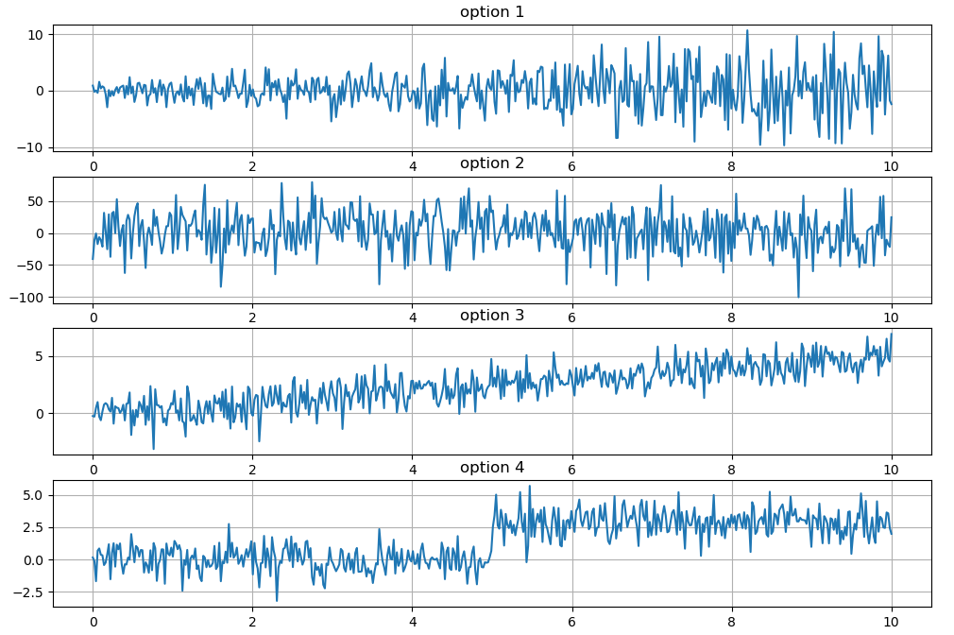
Time series stationarity
Which of the time series is stationary?

Slide 10
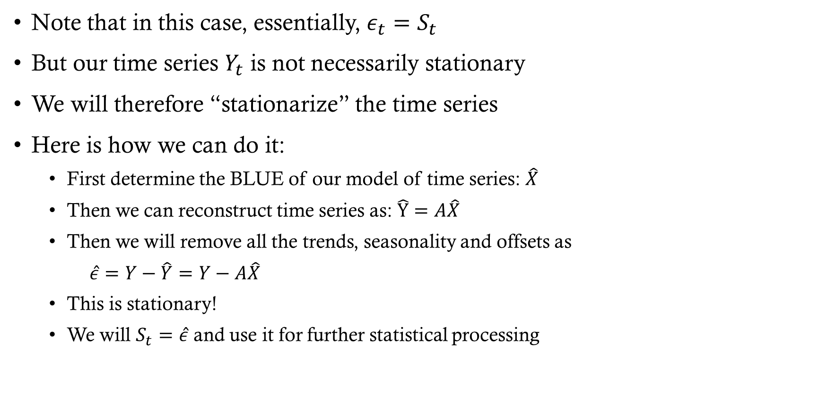
Time series stationarity
Note that in this case, essentially, $ε_{t}=S_{t}$
But our time series $Y_{t}$ is not necessarily stationary
We will therefore “stationarize” the time series
Here is how we can do it:
First determine the BLUE of our model of time series: $\hat{X}$
Then we can reconstruct time series as: $\hat{Y}=A\hat{X}$
Then we will remove all the trends, seasonality and offsets as
$\hat{ε}=Y−\hat{Y}=Y−A\hat{X}$
This is stationary!
We will $S_{t}=\hat{ε}$ and use it for further statistical processing

Slide 11
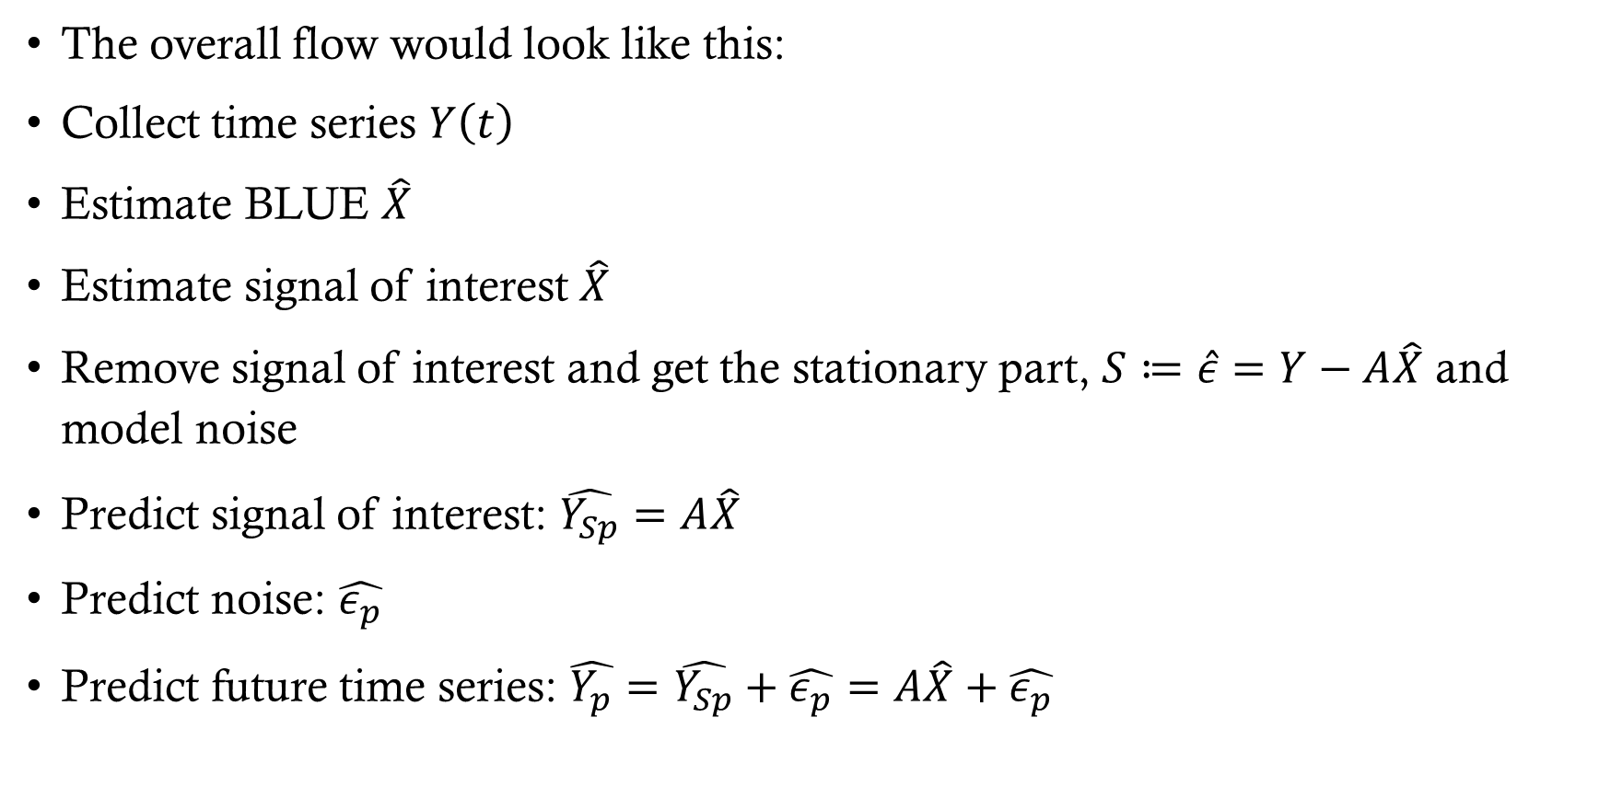
AND THEN WHAT?
The overall flow would look like this:
Collect time series $Y\left(t\right)$
Estimate BLUE $\hat{X}$
Estimate signal of interest $\hat{X}$
Remove signal of interest and get the stationary part, $S≔\hat{ε}=Y−A\hat{X}$ and model noise
Predict signal of interest: $\hat{Y_{Sp}}=A\hat{X}$
Predict noise: $\hat{ε_{p}}$
Predict future time series: $\hat{Y_{p}}=\hat{Y_{Sp}}+\hat{ε_{p}}=A\hat{X}+\hat{ε_{p}}$

Slide 12
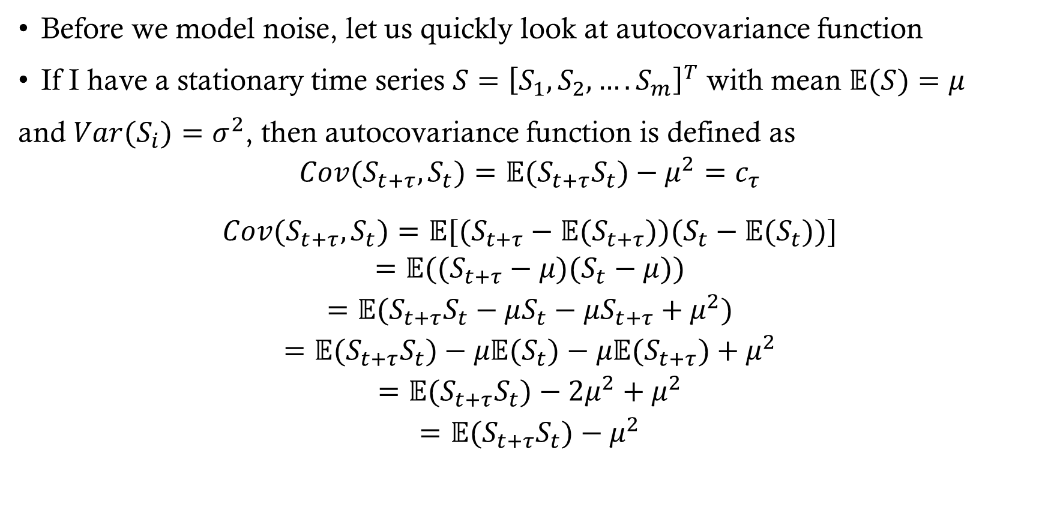
Autocovariance function
Before we model noise, let us quickly look at autocovariance function
If I have a stationary time series $S={\left[S_{1}, S_{2},….S_{m}\right]}^{T}$ with mean $𝔼(S)=μ$
and $Var(S_{i})=σ^{2}$, then autocovariance function is defined as
$$Cov(S_{t+τ},S_{t})=𝔼(S_{t+τ}S_{t})−μ^{2}=c_{τ}$$
$$\begin{aligned}Cov(S_{t+τ},S_{t})=𝔼[(S_{t+τ}−𝔼(S_{t+τ}))(S_{t}−𝔼(S_{t}))] \\ =𝔼((S_{t+τ}−μ)(S_{t}−μ)) \\ =𝔼(S_{t+τ}S_{t}−μS_{t}−μS_{t+τ}+μ^{2}) \\ =𝔼(S_{t+τ}S_{t})−μ𝔼(S_{t})−μ𝔼(S_{t+τ})+μ^{2} \\ =𝔼(S_{t+τ}S_{t})−2μ^{2}+μ^{2} \\ =𝔼(S_{t+τ}S_{t})−μ^{2}\end{aligned}$$

Slide 13
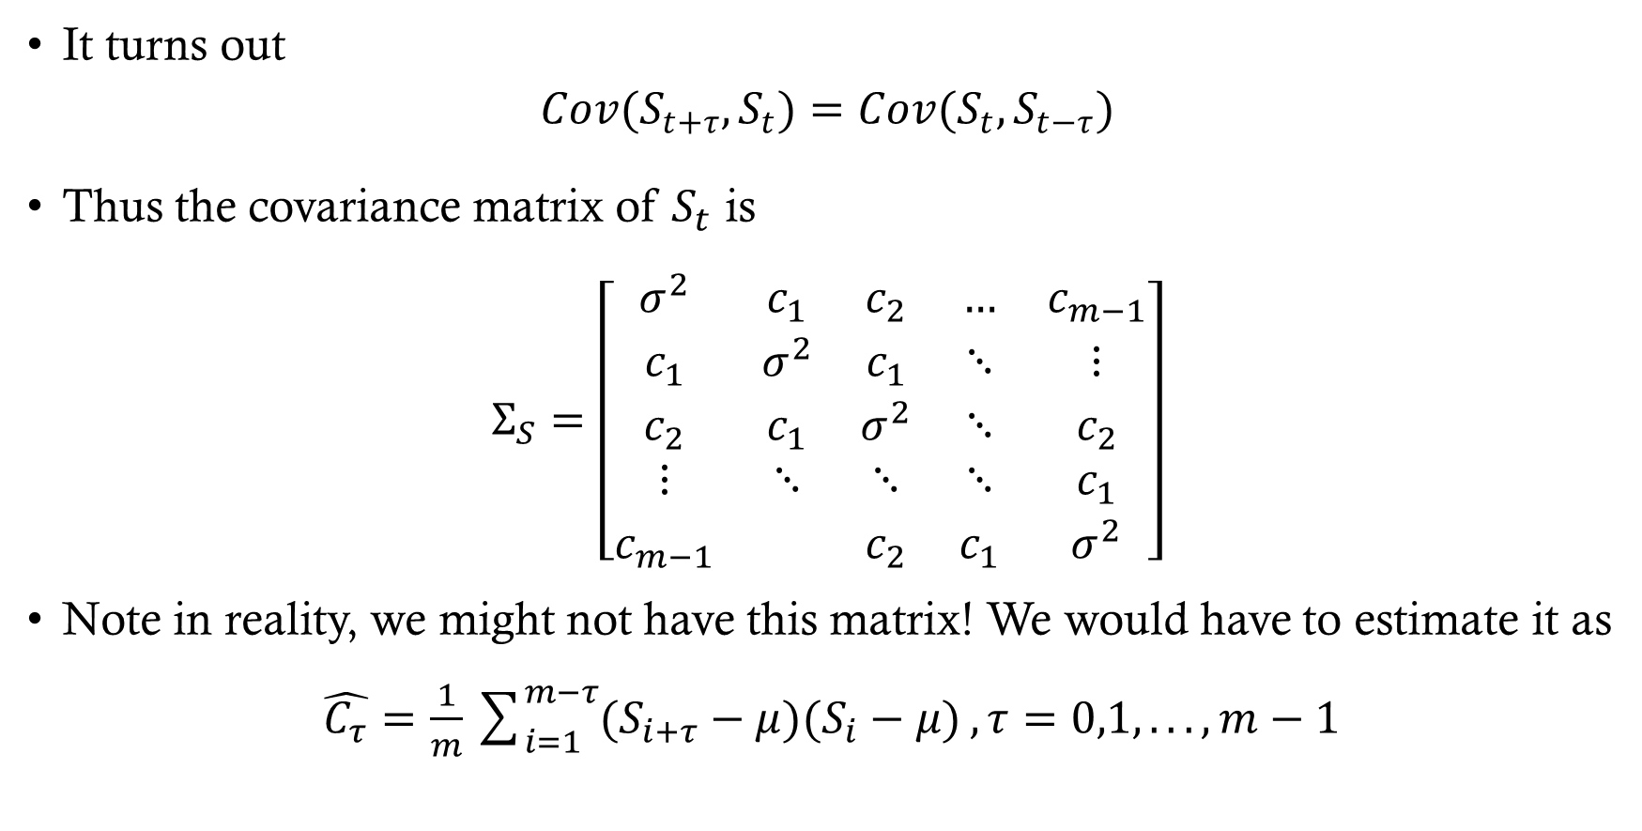
Autocovariance function
It turns out
$$Cov(S_{t+τ},S_{t})=Cov(S_{t},S_{t−τ})$$
Thus the covariance matrix of $S_{t}$ is
$$Σ_{S}=\left[\begin{matrix}σ^{2} & c_{1} & c_{2} & … & c_{m−1} \\ c_{1} & σ^{2} & c_{1} & ⋱ & ⋮ \\ c_{2} & c_{1} & σ^{2} & ⋱ & c_{2} \\ ⋮ & ⋱ & ⋱ & ⋱ & c_{1} \\ c_{m−1} & & c_{2} & c_{1} & σ^{2}\end{matrix}\right]$$
Note in reality, we might not have this matrix! We would have to estimate it as
$\hat{C_{τ}}=\frac{1}{m}\sum_{i=1}^{m−τ}{(S_{i+τ}−μ)(S_{i}−μ)},τ=0,1,...,m−1$

