Slide 1


CV5100: Modelling, Uncertainty and Data for Engineers MODULE 2: TIME SERIES ANALYSIS, lecture 2: Modeling and estimation

Slide 2
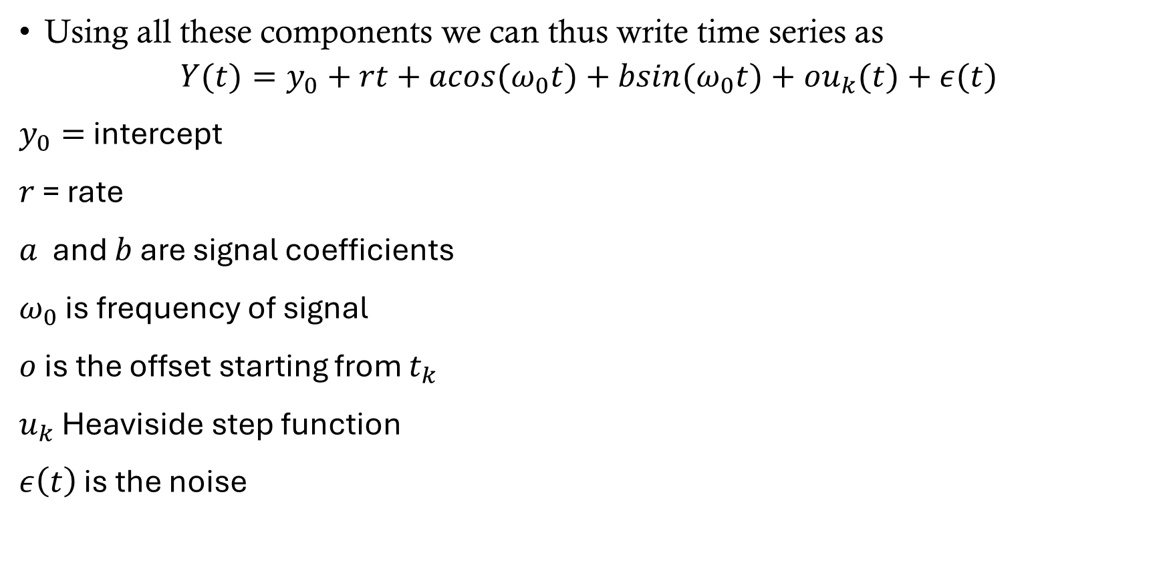
Time series expression
Using all these components we can thus write time series as
$$Y(t)=y_{0}+rt+acos(ω_{0}t)+bsin(ω_{0}t)+ou_{k}(t)+ε(t)$$
$y_{0}=$ intercept
$r$ = rate
$a$ and $b$ are signal coefficients
$ω_{0}$ is frequency of signal
$o$ is the offset starting from $t_{k}$
$u_{k}$ Heaviside step function
$ε\left(t\right)$ is the noise

Slide 3
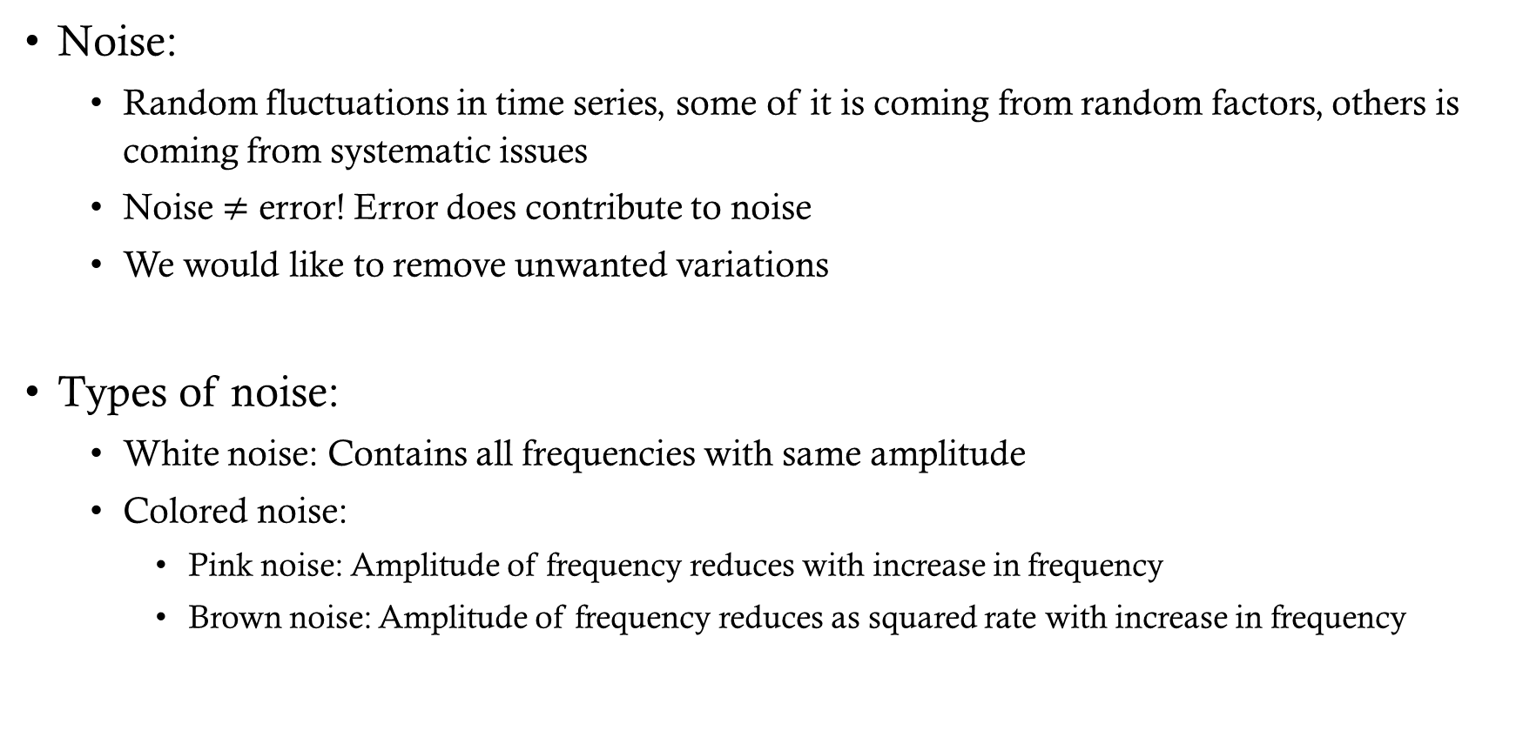
components
Noise:
Random fluctuations in time series, some of it is coming from random factors, others is coming from systematic issues
Noise $≠$ error! Error does contribute to noise
We would like to remove unwanted variations
Types of noise:
White noise: Contains all frequencies with same amplitude
Colored noise:
Pink noise: Amplitude of frequency reduces with increase in frequency
Brown noise: Amplitude of frequency reduces as squared rate with increase in frequency

Slide 4
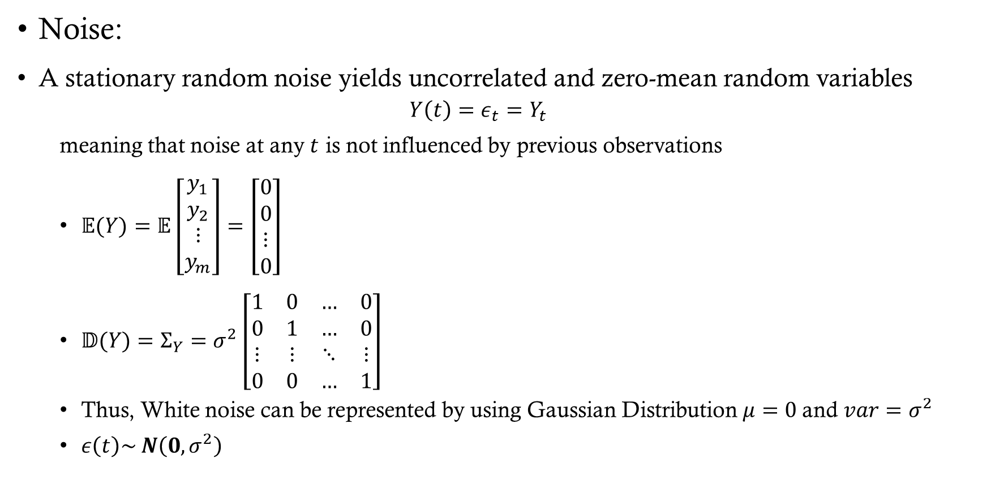
components model
Noise:
A stationary random noise yields uncorrelated and zero-mean random variables
$$Y\left(t\right)=ε_{t}=Y_{t}$$
meaning that noise at any $t$ is not influenced by previous observations
$\begin{aligned}𝔼(Y)=𝔼\left[\begin{aligned}y_{1} \\ y_{2} \\ ⋮ \\ y_{m}\end{aligned}\right]=\left[\begin{aligned}0 \\ 0 \\ ⋮ \\ 0\end{aligned}\right]\end{aligned}$
$\begin{aligned}𝔻(Y)=Σ_{Y}=σ^{2}\left[\begin{matrix}1 & 0 & … & 0 \\ 0 & 1 & … & 0 \\ ⋮ & ⋮ & ⋱ & ⋮ \\ 0 & 0 & … & 1\end{matrix}\right]\end{aligned}$
Thus, White noise can be represented by using Gaussian Distribution $μ=0$and $var=σ^{2}$
$ε\left(t\right)\sim N\left(0, σ^{2}\right)$

Slide 5
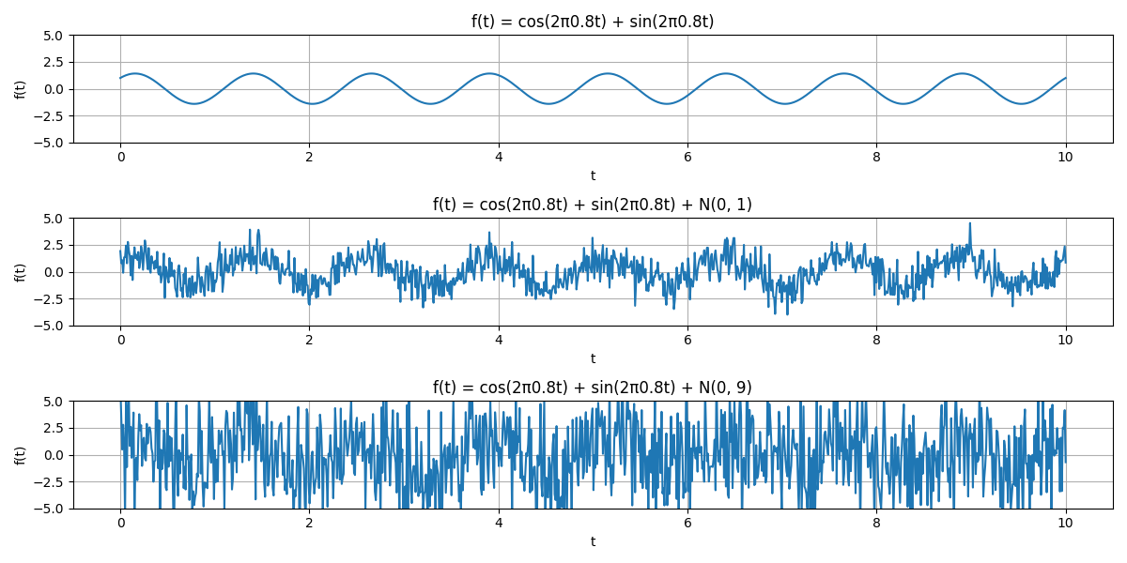
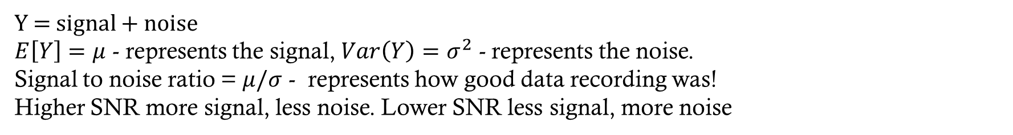
Signal and noise
Y = signal + noise
$E\left[Y\right]=μ$ - represents the signal, $Var\left(Y\right)=σ^{2}$ - represents the noise.
Signal to noise ratio = $μ/σ$ - represents how good data recording was!
Higher SNR more signal, less noise. Lower SNR less signal, more noise

Slide 6
Time series expression
Using all these components we can thus write time series as
$$Y(t)=y_{0}+rt+acos(ω_{0}t)+bsin(ω_{0}t)+ou_{k}(t)+ε(t)$$
$y_{0}=$ intercept
$r$ = rate
$a$ and $b$ are signal coefficients
$ω_{0}$ is frequency of signal
$o$ is the offset starting from $t_{k}$
$u_{k}$ Heaviside step function
$ε\left(t\right)$ is the noise

Slide 7
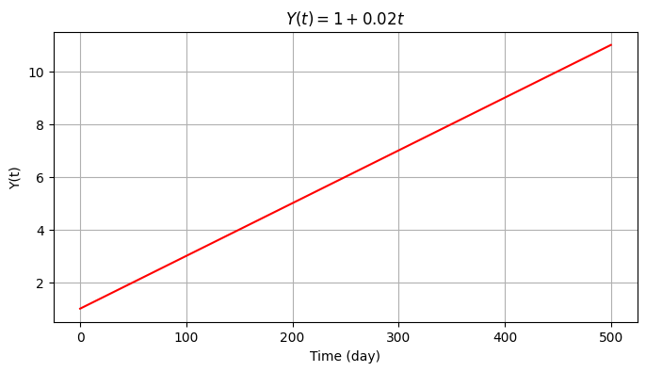
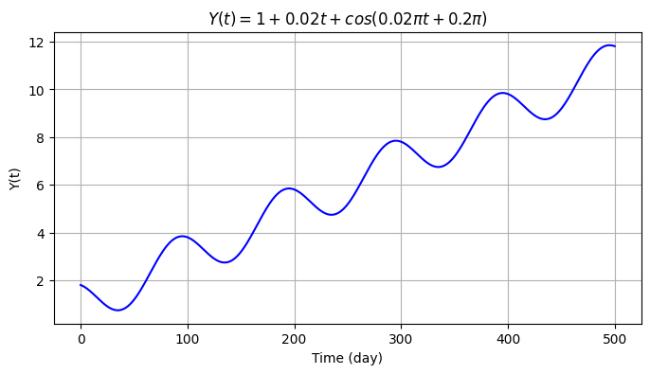
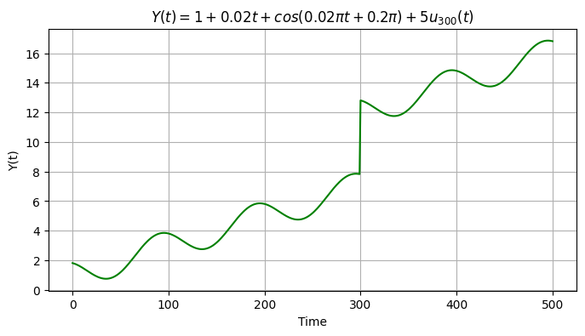
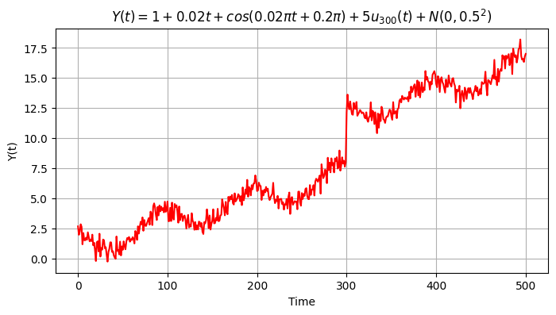
Example

Slide 8
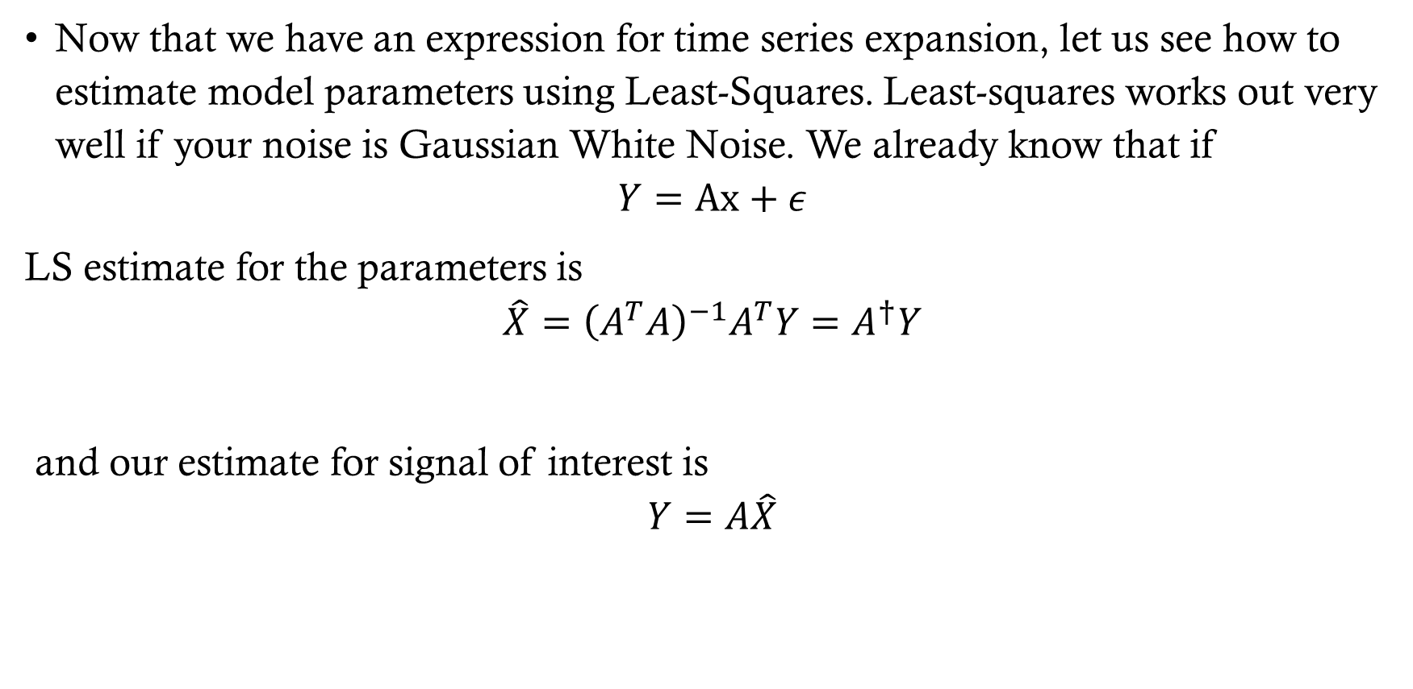
Model estimation
Now that we have an expression for time series expansion, let us see how to estimate model parameters using Least-Squares. Least-squares works out very well if your noise is Gaussian White Noise. We already know that if
$$Y=Ax+ε$$
LS estimate for the parameters is
$$\hat{X}={\left(A^{T}A\right)}^{−1}A^{T}Y=A^{†}Y$$
and our estimate for signal of interest is
$$Y=A\hat{X}$$

Slide 9
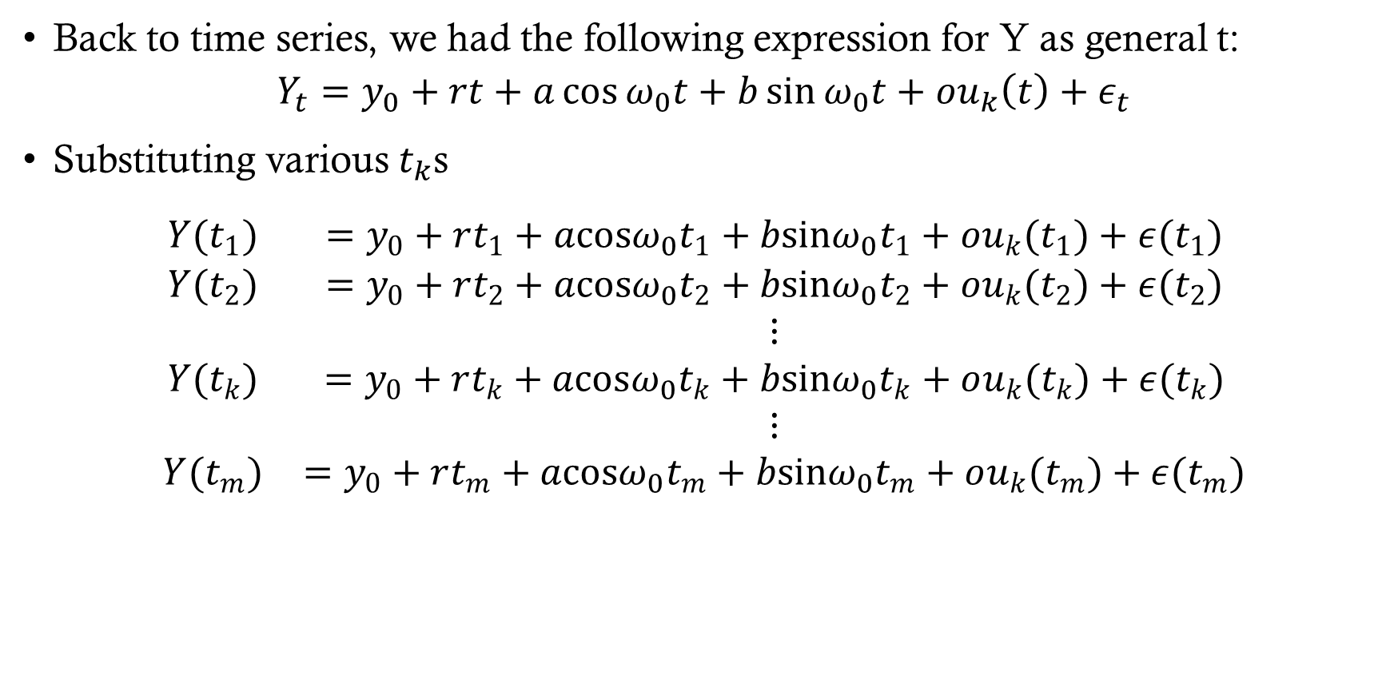
LS of time series
Back to time series, we had the following expression for Y as general t:
$$Y_{t}=y_{0}+rt+a\cos{ω_{0}t}+b\sin{ω_{0}t}+ou_{k}\left(t\right)+ε_{t}$$
Substituting various $t_{k}$s
$$\begin{aligned}\begin{matrix}Y(t_{1}) & =y_{0}+rt_{1}+acosω_{0}t_{1}+bsinω_{0}t_{1}+ou_{k}(t_{1})+ε(t_{1}) \\ Y(t_{2}) & =y_{0}+rt_{2}+acosω_{0}t_{2}+bsinω_{0}t_{2}+ou_{k}(t_{2})+ε(t_{2}) \\ & ⋮ \\ Y(t_{k}) & =y_{0}+rt_{k}+acosω_{0}t_{k}+bsinω_{0}t_{k}+ou_{k}(t_{k})+ε(t_{k}) \\ & ⋮ \\ Y(t_{m}) & =y_{0}+rt_{m}+acosω_{0}t_{m}+bsinω_{0}t_{m}+ou_{k}(t_{m})+ε(t_{m})\end{matrix}\end{aligned}$$

Slide 10
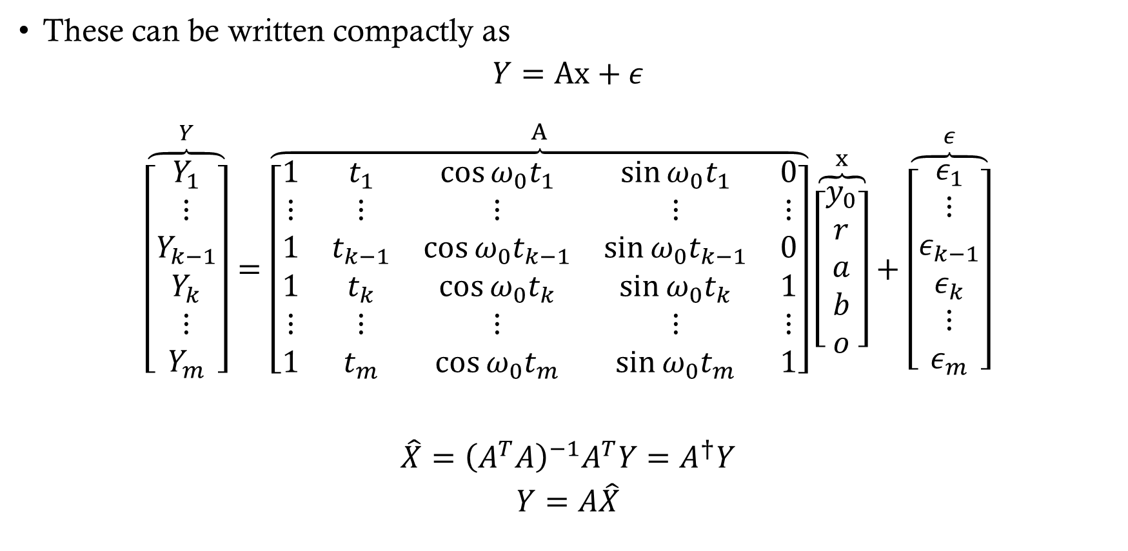
LS of time series
These can be written compactly as
$$Y=Ax+ε$$
$$\begin{matrix}\overset{Y}{\overbrace{\left[\begin{matrix}Y_{1} \\ ⋮ \\ Y_{k−1} \\ Y_{k} \\ ⋮ \\ Y_{m}\end{matrix}\right]}}=\overset{A}{\overbrace{\left[\begin{matrix}1 & t_{1} & \cos{ω_{0}t_{1}} & \sin{ω_{0}t_{1}} & 0 \\ ⋮ & ⋮ & ⋮ & ⋮ & ⋮ \\ 1 & t_{k−1} & \cos{ω_{0}t_{k−1}} & \sin{ω_{0}t_{k−1}} & 0 \\ 1 & t_{k} & \cos{ω_{0}t_{k}} & \sin{ω_{0}t_{k}} & 1 \\ ⋮ & ⋮ & ⋮ & ⋮ & ⋮ \\ 1 & t_{m} & \cos{ω_{0}t_{m}} & \sin{ω_{0}t_{m}} & 1\end{matrix}\right]}}\overset{x}{\overbrace{\left[\begin{matrix}y_{0} \\ r \\ a \\ b \\ o\end{matrix}\right]}}+\overset{ε}{\overbrace{\left[\begin{matrix}ε_{1} \\ ⋮ \\ ε_{k−1} \\ ε_{k} \\ ⋮ \\ ε_{m}\end{matrix}\right]}}\end{matrix}$$
$$\hat{X}={\left(A^{T}A\right)}^{−1}A^{T}Y=A^{†}Y$$
$$Y=A\hat{X}$$

Slide 11
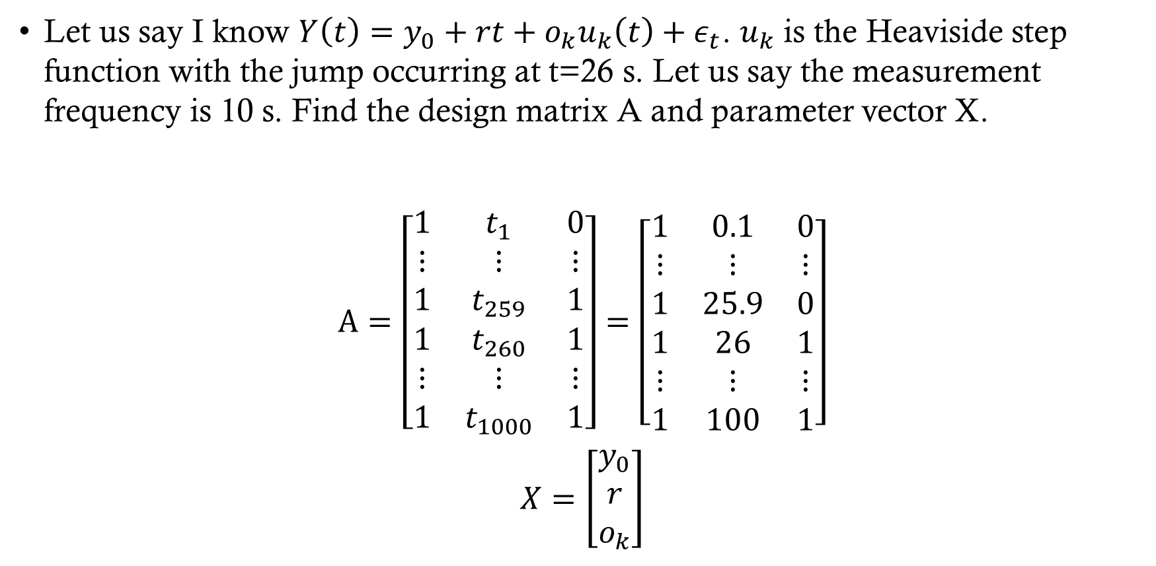
Example
Let us say I know $Y\left(t\right)=y_{0}+rt+o_{k}u_{k}\left(t\right)+ε_{t}$. $u_{k}$ is the Heaviside step function with the jump occurring at t=26 s. Let us say the measurement frequency is 10 s. Find the design matrix A and parameter vector X.
$$\begin{aligned}A=\left[\begin{matrix}1 & t_{1} & 0 \\ ⋮ & ⋮ & ⋮ \\ 1 & t_{259} & 1 \\ 1 & t_{260} & 1 \\ ⋮ & ⋮ & ⋮ \\ 1 & t_{1000} & 1\end{matrix}\right]=\left[\begin{matrix}1 & 0.1 & 0 \\ ⋮ & ⋮ & ⋮ \\ 1 & 25.9 & 0 \\ 1 & 26 & 1 \\ ⋮ & ⋮ & ⋮ \\ 1 & 100 & 1\end{matrix}\right]\end{aligned}$$
$$X=\left[\begin{aligned}y_{0} \\ r \\ o_{k}\end{aligned}\right]$$

